Slide 1

Stress Detection and Prediction using Artificial Neural Networks
This innovative project aims to leverage the power of Artificial Neural Networks (ANNs) to accurately detect and predict stress levels in individuals. By analyzing key physiological factors, the system will provide users with personalized insights and recommendations to manage stress effectively.

Slide 2

Introduction to the Project
1
Holistic Approach
2
Predictive Analytics
3
User-Friendly Interface
This project takes a comprehensive approach to stress management by considering multiple physiological and behavioral factors.
The ANN-based model will predict stress levels to help users proactively manage their well-being.
The web application will provide an intuitive and accessible platform for stress assessment and personalized recommendations.

Slide 3
The 8 Key Factors for Stress Prediction
Physiological
Behavioral
Stress Levels
Snoring Rate, Respiratory Rate, Body Temperature, Blood Oxygen
Limb Movement, Eye Movement, Sleep Hours, Heart Rate
The target variable, ranging from 0 (low stress) to 1 (high stress)

Slide 4
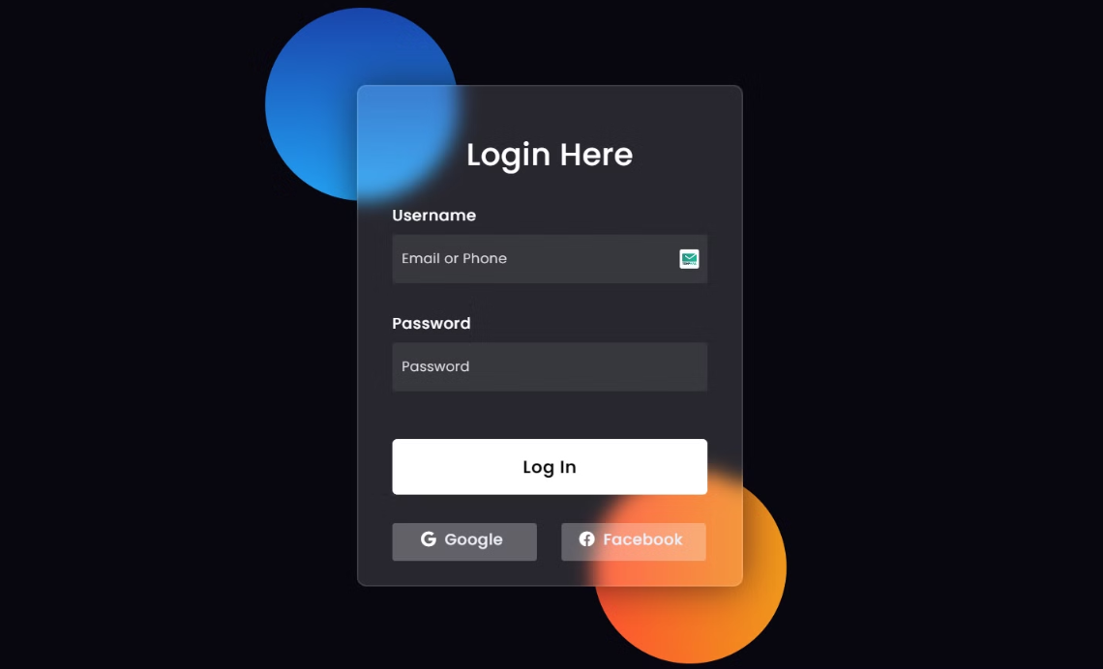
Login Page

Slide 5
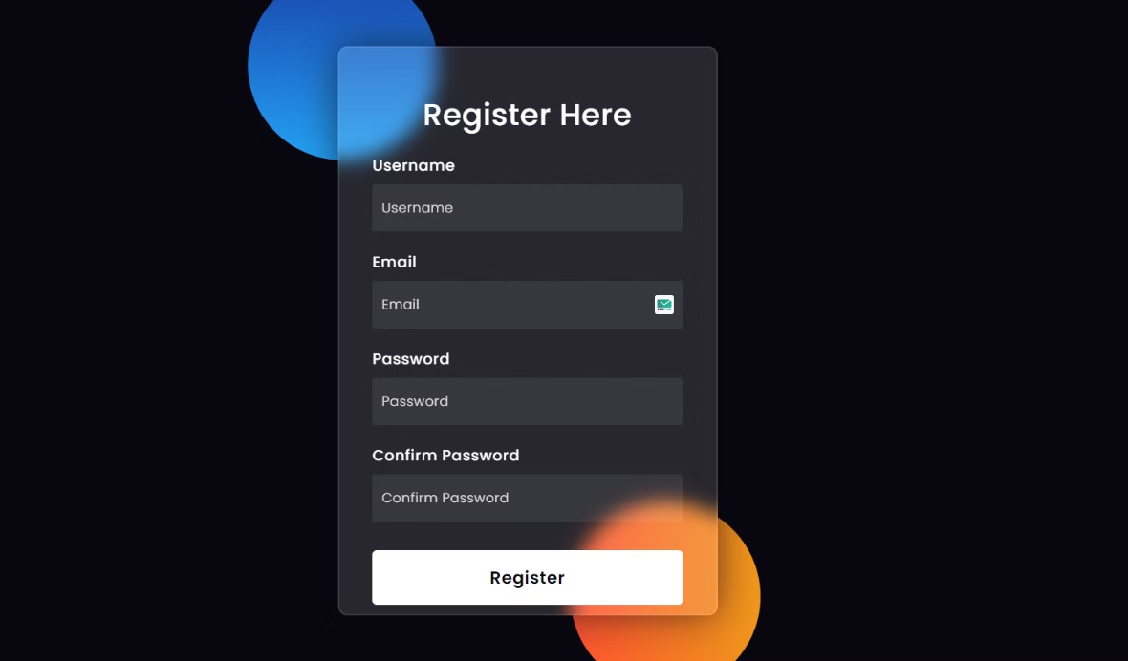
User Registration Page

Slide 6
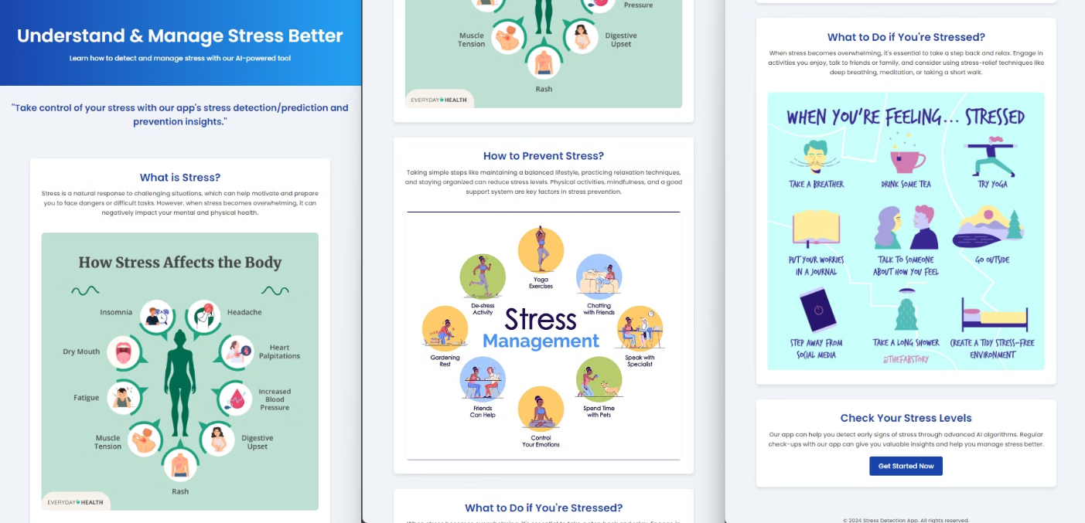
Home Page

Slide 7




"Am I Stressed?" Stress Assessment Tool
User Input
Provide the 8 key factors to assess your current stress levels.
Stress Prediction
The ANN model will analyze the data and generate a personalized stress score.
Personalized Recommendations
Receive tailored suggestions to manage stress and improve well-being.

Slide 8
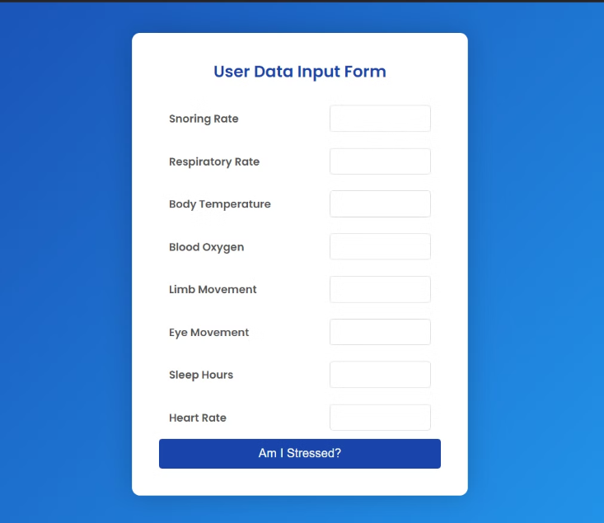
Inputting User Data
After inputting the 8 key factors, the user will receive a stress prediction score and personalized recommendations to manage their well-being.

Slide 9
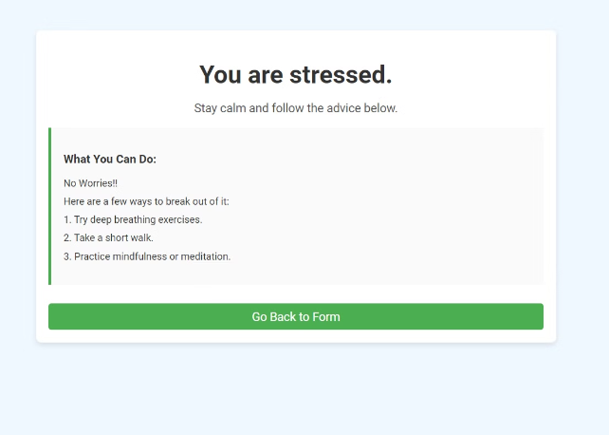
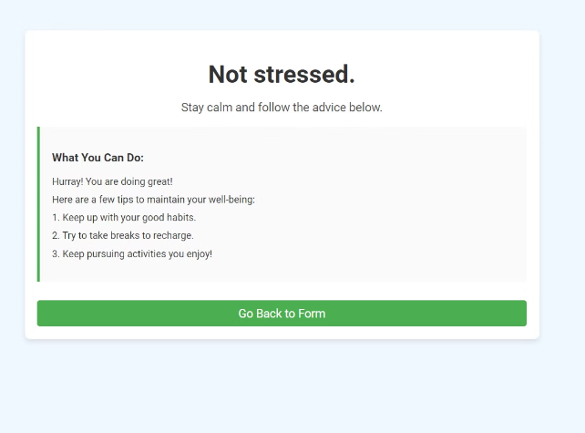
Stress Prediction and Recommendations
Once the ANN model analyzes the user's inputted data, it will generate a stress prediction score that reflects their current stress levels. In addition to the score, the user will also receive recommendations on how to manage stress and improve their overall well-being.

