Slide 1

Group 6
Paging

Slide 2
Reducing Minor Page Fault Overheads through Enhanced Page Walker
Amit Kumar(20CS30003)

Slide 3

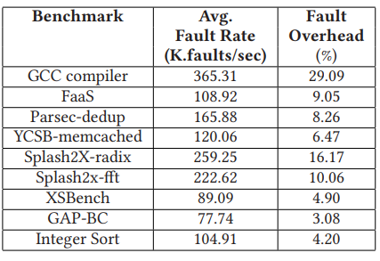
The Problem
slowdowns due to "minor page faults," (program accesses a page that is already in memory but is marked as not yet loaded)
resulting in slower programs and increased user costs.
affects real-world applications like Function-as-a-Service (FaaS).

Slide 4
Research Challenges
Optimizing Pre-Allocation Policies for NUMA Architectures:
The per-core allocation policy prefers local node pages, but further research is needed to optimize this policy for Non-Uniform Memory Access (NUMA) architectures. Ensuring efficient pre-allocation and fault handling across different memory nodes can be a challenging task.
Scalability and General Applicability:
The solution's scalability across diverse workloads and system configurations needs careful consideration. Ensuring that the proposed approach provides consistent benefits for various applications and under different conditions is a significant research challenge.
Integration with Existing Memory Management Mechanisms:
Integrating the MFOE approach with existing memory management mechanisms in the Linux kernel may pose challenges. Ensuring seamless cooperation and compatibility with other features, such as memory compaction and huge pages, is crucial for the practical adoption of MFOE.

Slide 5
Research Challenges
Handling Major Page Faults and Mixed Workloads:
The current focus is on minor page faults, but handling major page faults and scenarios with mixed workloads (involving both minor and major page faults) presents additional challenges. Research is needed to extend the MFOE approach to efficiently address major page faults without compromising performance.
User-Space Compatibility and Application Awareness:
Ensuring that MFOE is compatible with user-space applications and does not introduce compatibility issues or unexpected behaviors is essential. Research challenges may involve understanding the impact on applications with specific memory access patterns and ensuring widespread applicability.
Adaptability to Non-volatile Memory (NVM) Devices:
As the solution is designed for systems with NVM devices, further investigation is needed to optimize the MFOE approach specifically for these technologies. Handling memory access through file system APIs without incurring page faults introduces unique challenges that require careful consideration.

Slide 6
Core Solution Idea
implementation of a Minor Fault Offload Engine (MFOE)
optimized hardware page fault handling,
introducing system calls like MFOE_enable to activate pre-allocated physical frames per core.
Pre-allocation tables, adopting a lockless ring buffer architecture, facilitate efficient page fault handling, and a per-core allocation policy minimizes Non-Uniform Memory Access inefficiencies.
integrates post-page fault processing, enhancing system efficiency by periodically replenishing pre-allocated pages.
The solution targets a reduction in overall page fault-related latency, optimizing performance for real-world applications.

Slide 7
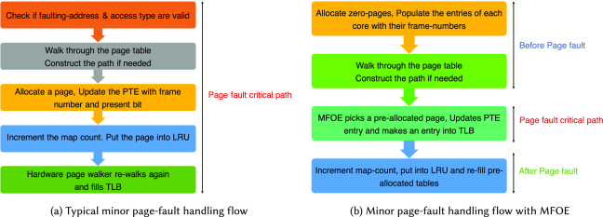
Design Overview

Slide 8
Design Overview
Page Fault Handling Breakdown: three parts:
pre-fault tasks, the critical path for fault handling, and post-fault tasks.
offloading pre- and post-fault tasks to reduce fault handling latency
optimising the critical path in hardware.
Pre-fault and post-fault functions are moved to a background thread, eliminating their impact on the fault handling process.
Page Pre-allocation:
involves obtaining a pointer to a struct page, (converted to the physical page frame number).
By saving these frame numbers in a specific format and making them accessible to hardware
Advantages: Avoids blocking user applications, Eliminates the need for zeroing entire pages in the critical path, enhancing efficiency.

Slide 9
Design Overview
Legal Virtual Address Space Indication:
focuses on page fault offloading mechanism on user space, specifically minor page faults caused by functions like malloc and mmap.
To inform hardware about the validity of faulting addresses, researchers introduced an "MFOEable" (Minor Fault Offload Enable) bit in the page table path, repurposing an unused PTE bit.
When applications use malloc or mmap, a background thread is created by the kernel before returning from the system call.
This thread constructs page table paths in the background for newly created virtual address regions, setting the MFOEable bit to indicate valid addresses.
If the hardware page walker doesn't find this bit in the PTE, it triggers a kernel fault handling exception.

Slide 10
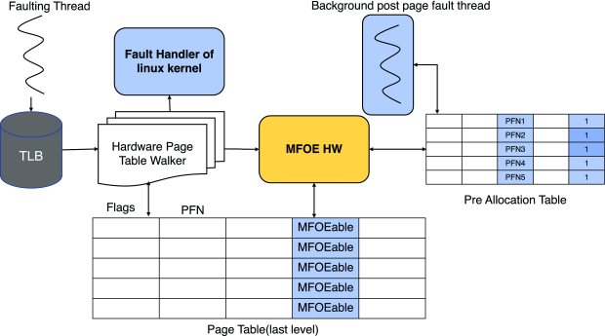
Design Overview

Slide 11
Design Overview
MFOE-Minor Fault Offload Engine:
incorporates a pre-allocation page table featuring entries with pre-allocated page frame numbers and MFOEable bits set at the leaf entries for legal addresses.
Working:
When a faulting address is accessed, causing a TLB miss,
the hardware page walker checks the MFOEable bit.
If it's set (indicating a legal address) and the present bit is not set (implying no allocated page), MFOE takes over.
It selects an entry from the pre-allocation page table, updates the PTE, sets necessary flag bits, creates a TLB entry, and proceeds with the faulting instruction, bypassing kernel software.
Otherwise, the hardware page table walker triggers the typical kernel page fault exception to handle the fault.

Slide 12
Design Overview
Post-Page Fault Handling:
These include :
incrementing the mm object's counter,
establishing a reverse map for the physical page,
adding the page to the LRU list for future swapping, and
managing cgroup-based memory usage.
can be deferred and executed in the background if the program is ongoing.

Slide 13
Implementation
MFOE Enable/Disable System Calls:
MFOE_enable activates optimized page fault handling and requires specifying pre-allocated frames per core.
Pre-allocation tables are created per core but populated later by a kernel thread for efficiency.
A "mfoe" flag in mm_struct indicates if MFOE is enabled for a process.
Hardware Page Fault Handling:
MFOE handles page faults as follows:
It's activated after a TLB miss and the last-level PTE. It checks PTE bits - if both the present and MFOEable bits are unset, it triggers a page fault. If the present bit is unset but the MFOEable bit is set, it proceeds.
MFOE retrieves the pre-allocation table's starting address, reads the entry, and checks its valid bit.
If valid, MFOE proceeds to handle the page fault; if not, it triggers a page fault.
MFOE updates the pre-allocation entry with TGID, VA fields, and PFN increments the tail index, and updates the PTE and TLB to avoid future page walks.

Slide 14
Evaluation
Microbenchmark
Software-only Version
Multi-threaded Microbenchmark
MFOE improved average fault handling latency by 33x and reduced tail latency by 51x compared to current systems.
The software-only version of MFOE improved average fault handling latency by 1.59x and reduced tail latency by 1.82x compared to the baseline.
MFOE reached a 90% hit rate even at a high fault rate of one fault every 21,000 cycles.
Average Performance Gain
Application-specific Results
MFOE achieved an average performance gain of 6.6% across all workloads.
Memcached achieved a high hit rate of 97%, resulting in a 6.2% runtime improvement, while gcc had a 68% hit rate and achieved a substantial 25% performance gain.

Slide 15
Summary
presents a promising solution to enhance the responsiveness and efficiency of modern operating systems.
The paper discusses problem which affect real-world applications, with a focus on a popular one called Function-as-a-Service (FaaS). This study examines how minor page faults affect FaaS applications, leading to slower response times and increased user costs.
Thank you

Slide 16
Memory-Efficient Hashed Page Tables
Nikhil Saraswat (20CS10039)

Slide 17
Background:
Current computer systems use radix-tree page tables. In radix tree page tables, during a TLB miss, hardware need to traverse multiple levels in tree.
If more memory is needed, then new levels are added which is not scalable.
As an alternative Hashed Page Tables (HPTs) are used which are faster, but yet data is in inconsistent order.
In HPTs hash collisions may occur and sometimes additional information is also required, which takes extra space.
HPTs also require contiguous memory requirements and Dynamic Resizing Overheads.
Memory Efficient Hashed Page Tables (ME-HPTs), has been designed to mitigate the issues associated with radix trees and conventional HPTs. ME-HPTs leverage efficient hashing techniques, introducing innovations like the L2P table, dynamically changing chunk sizes, and in-place resizing for more efficient and scalable memory management in contemporary computing environments

Slide 18
Logical to Physical (L2P) Table:
To overcome requirement for contiguous physical memory, proposed solution introduces the Logical to Physical (L2P) Table.
It is a hardware-assisted primitive that breaks down each HPT way into multiple fixed-sized Chunks, eliminating the need for contiguous allocation.
The L2P table, residing in the Memory Management Unit (MMU), acts as a small indirection table, redirecting accesses to these non-contiguous chunks.

Slide 19
Chunked Division: The HPT way is partitioned into non-contiguous Chunks of fixed chunksize (CS).
Logical to Physical (L2P) Table: The L2P table, residing in the MMU, facilitates access to Chunks. Each entry in the L2P table corresponds to a specific Chunk.
Access Redirection: On a TLB miss, the hash of the Virtual Page Number (VPN) is divided by CS, determining Chunk in the L2P table. The contents of that location provide a pointer to the base of the Chunk containing the desired (Physical Page Number (PPN).
Efficient Context Switching: During context switching, the OS saves and restores the L2P table, which incurs low overhead due to its size.
Hardware Localization: The L2P table size is based on 2’s powers, Hence Simple Division and modulo operations resulting minimal MMU access time overhead.

Slide 20
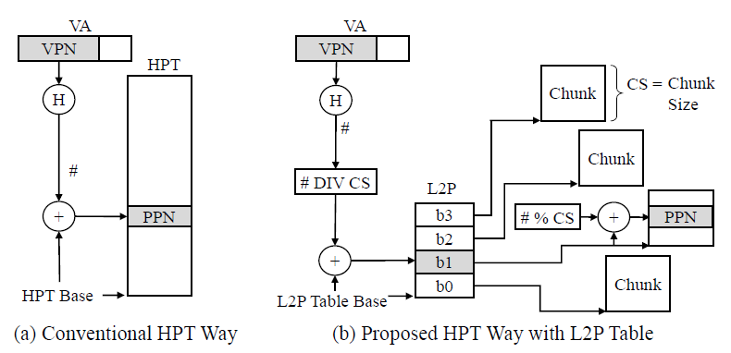
Reducing the HPT requirements for contiguous memory allocation using the L2P table.

Slide 21
Dynamically Changing Chunk Sizes:
Many applications exhibit widely varying behaviors in terms of memory allocation requirements. Dynamically-Changing chunk sizes are used in this case.
Dynamically Changing Chunk Sizes allows the system to adapt the size of the memory chunks based on the evolving behavior of the application over time.
The system maintains a range of chunk sizes, from small to large, and dynamically adjusts the chunk size assigned to an application as its HPT way requirements change.

Slide 22
Adaptive Chunk Selection: At the start of application smallest chunk size is allocated. As requirements grow, it has the flexibility to change its chunk size.
Efficient Memory Utilization: Large-memory applications can benefit from larger chunks, while small-memory applications avoid wasting substantial memory with unnecessarily large chunks.
Transition Mechanism: According to changes in chunk size of application, the system allocates a new chunk of the desired size, rehashes the entries from the old chunks into the new one, and subsequently frees up the old chunks.
Memory Management: The system uses some bits in the Memory Management Unit (MMU) to record the current chunk size being used by the HPT. This information is crucial for efficient upsizing, ensuring that the system can adapt to changes in HPT requirements without unnecessary overhead.

Slide 23
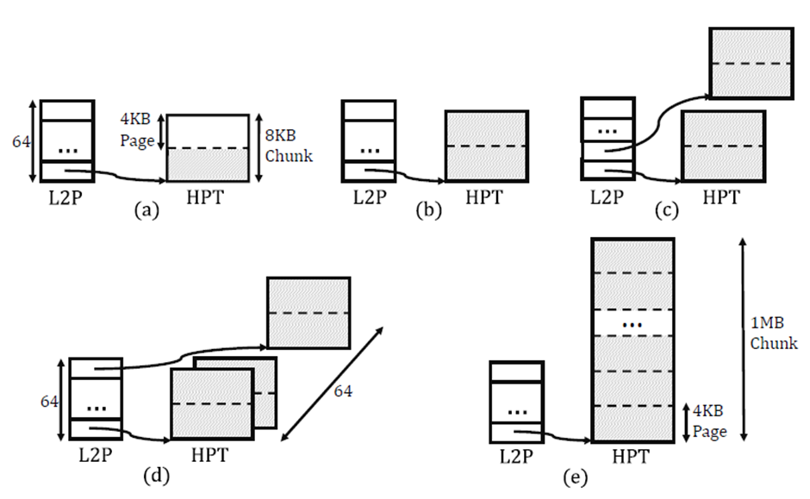
Dynamically changing chunk sizes for memory efficiency in non-contiguous HPTs. Shaded pages are in use.

Slide 24
In-place Page Table Resizing:
The conventional method, referred to as "out-of-place" resizing, has drawbacks. Firstly, during resizing, both the old and new HPTs coexist in memory, potentially consuming substantial memory.
In this resizing instead of having distinct memory spaces for the old and new HPTs during resizing, both HPTs share the same memory space. During an HPT resizing, a rehash operation moves an element from the old HPT to the new one.
This approach avoids the need for copying entire chunks, reducing the time and resources traditionally associated with resizing operations.

Slide 25
Evaluation of ME-HPT:
Memory Contiguity Savings: An average reduction of 92% in maximum size of contiguous memory allocation required. Useful in memory-intensive applications like GUPS and SysBench, contiguous memory requirements decreased from 64MB to 1 MB.
Application Performance: An average speedup of 8.9% for ME-HPTs compared to Elastic Cuckoo Page Tables (ECPTs). The lower memory allocation overhead and reduced data movement contribute to improved overall system performance.
Memory Savings: ME-HPTs exhibit substantial memory savings, averaging 43% without Transparent Huge Pages (THP) and 41% with THP compared to the ECPT baseline. In-place resizing contribute to these savings, emphasizing the efficiency of the proposed techniques.

Slide 26
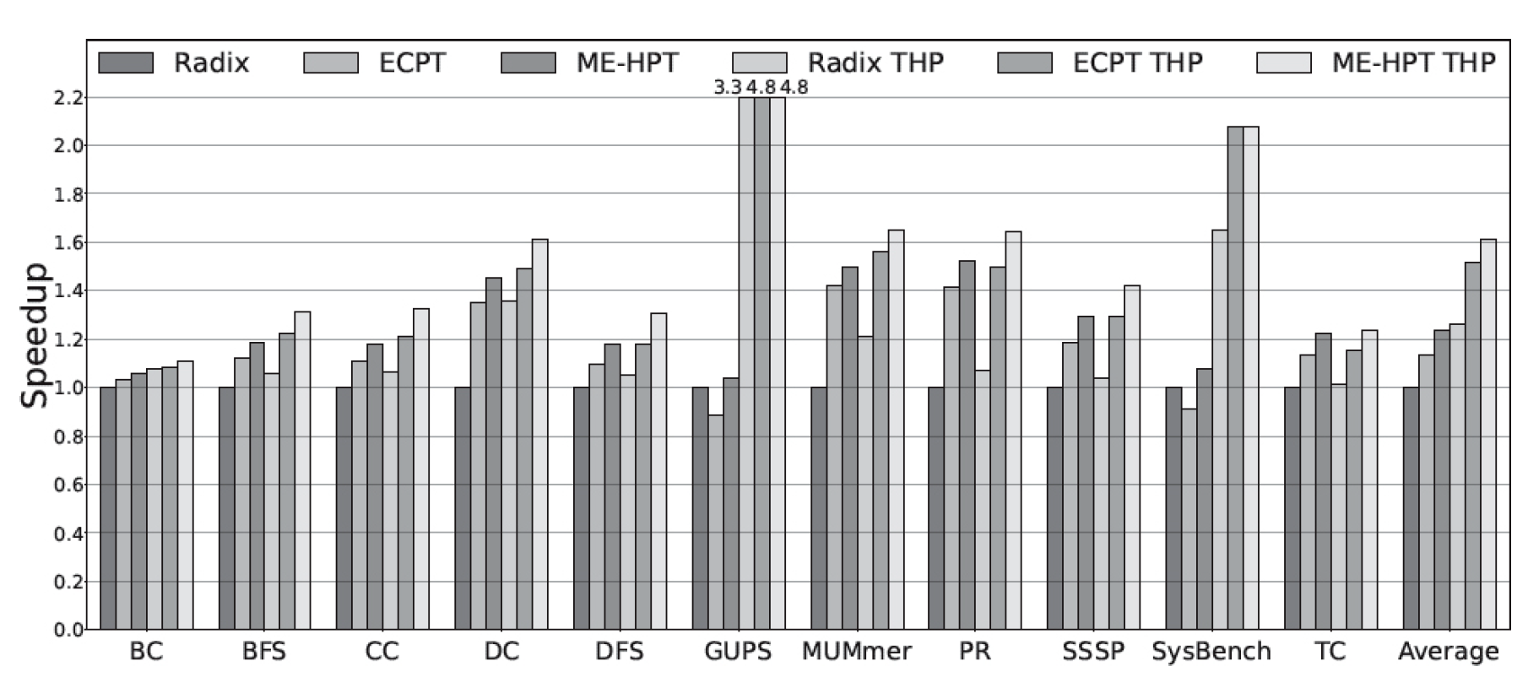
Speedup of ME-HPT, ECPT, and Radix, without and with THP

Slide 27
Application of ME-HPT Design in Other Problems:
Scalable Secure Directories: ME-HPT's in-place resizing technique are directly applicable to hash-based directory designs, such as SecDir, providing efficient solutions for scalable and secure hardware structures.
Memory Indexing: ME-HPT's support for in-place resizing makes it suitable for memory indexing in databases, file systems, and storage systems. It reduces contiguity requirements.
Key-Value Stores: The concepts developed in ME-HPTs find application in key-value stores, where dynamic resizing is crucial. ME-HPT designs can be integrated into hardware for key-value stores, enhancing their memory efficiency and contributing to accelerated performance in contemporary computing environments.

Slide 28
Broad Contributions and Significance:
Holistic Memory Management: ME-HPTs offer a solution to memory challenges by integrating the L2P table, dynamic chunk sizing, and innovative resizing techniques.
Relevance in Server Environments: Crucial for contemporary servers, ME-HPTs adapt to diverse workloads, ensuring efficient memory utilization.
Practical Solutions and Exploration: ME-HPTs provide practical solutions for memory management challenges and pave the way for future innovations.
Enhanced System Performance: ME-HPTs promise a substantial boost in overall system performance by addressing fundamental memory allocation issues.
Pivotal for OS Evolution: ME-HPTs are pivotal for the future of operating systems, offering adaptability and scalability in diverse computing environments.

Slide 29
EPK: Scalable and Efficient Memory Protection Keys
Divyansh Vijayvergia (20CS30016)

Slide 30
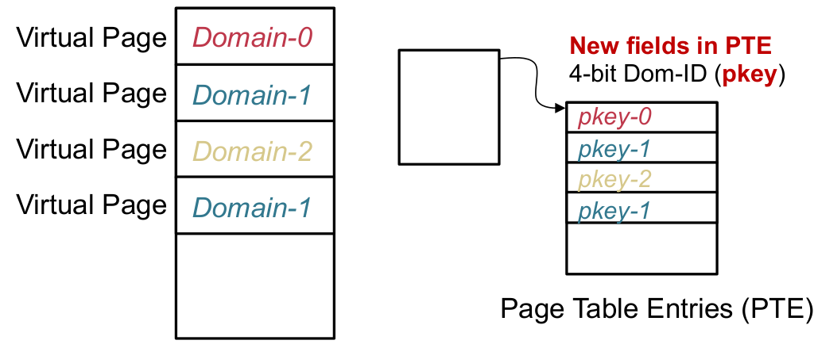
What are Memory Protection Keys (MPKs):
A hardware feature used for intra-process memory isolation
Partitions the virtual memory space into upto 16 different memory domains
Levereges previously unused 4 bits of page table as domain IDs

Slide 31
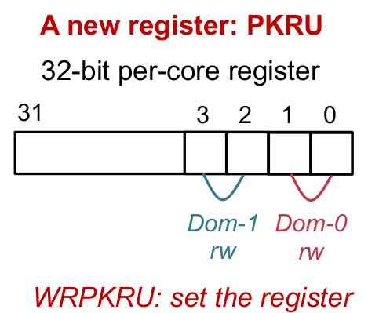
MPKs continued…
Access permissions for memory domains
controlled by a 32-bit register PKRU
Contains 2 access bits for each domain
Per core register, allowing different threads
to have different view of the memory
Can be updated by a non-priveleged
instruction, WRPKRU

Slide 32
Motivation
There have been several attempts for memory isolation and they have their limitations
Software fault isolation (SFI)
Have non-negligible performance overhead and is less flexible
Isolation through separate page tables
Provide fine grained control but have overhead of expensive context switches
Hardware based isolation
Requires non-trivial changes in hardware, often not feasible commercially
MPKs addresses the limitations of existing methods and surpasses their performance. Yet, MPK can only support upto 16 memory domains, limiting its usage in several practical scenerios

Slide 33
Proposal
A novel concept of Extended Protection Keys (EPKs) is proposed which combines two hardware features - MPKs and Extended Page Tables (EPTs)
Keys objectives include
Scalable number of memory domains
No hardware modification
Low performance overhead

Slide 34
Challenges
Unified Abstraction Challenge:
Complex Integration: Merging MPK and EPT features into a cohesive interface for applications.
Abstracting Complexity: Shielding applications from the complexities of EPT management.
Managing Domain Mappings: Handling mappings across multiple EPTs efficiently.
User-Friendly Libraries: Developing accessible APIs for smoother interactions.
Simultaneous Thread Access:
Cross-EPT Access: Allowing a single thread to access memory domains across different EPTs.
VE Hardware Feature: Leveraging virtualization exception for seamless EPT switching during domain violations.

Slide 35
Implementation
Introduction to some basic terms:
EPT (Extended Page Table):
used in virtualization
Maps guest physical addresses (GPA) to host physical addresses (HPA).
Managed by the hypervisor.
VMFUNC (Virtualization Hardware Extension):
Handles VM functions, specifically EPT switching within the virtual machine.
Loads one EPT from a set of 512 EPTs configured by the hypervisor.
Execution of VMFUNC doesn’t require TLB flushing.

Slide 36
Implementation
EPK optimizes by reusing MPK protection keys across different extended page tables (EPTs), enabling support for up to 7,680 domains with 512 EPTs.
The (extended) protection key for a domain now combines an EPT index (0-511) with an MPK value (1-15), expanding the range of assignable keys.
To leverage EPT functionality, EPK requires applications to run within a Virtual Machine (VM), making VM integration essential for utilizing its capabilities.
Memory pages belonging to one memory domain must be mapped to a single EPT
Domain 0 (pkey=0) is special as it mapped to all EPTs and it contains global code and data of the applications

Slide 37
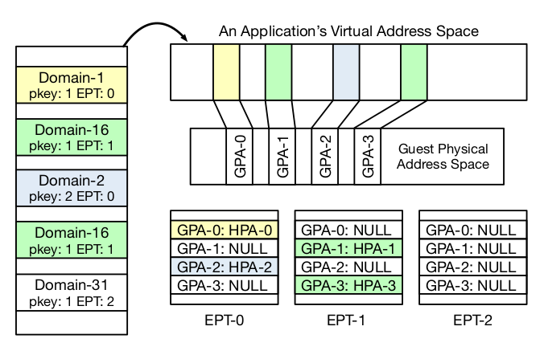
Implementation

Slide 38
Implementation
Switching domains within the same EPT requires a WRPKRU instruction (akin to MPK)
Switching between domains in different EPT requires an additional VMFUNC instruction for EPT switching along with WRPKRU instruction
EPK levereges Virtualization Exception (VE) to switch between EPTs when a domain access causes an EPT violation without causing expensive VM exits.
EPK provides intuitive API calls for applications, very similar to that of MPK
Interestingly, EPK optimizes domain allocation by favoring placement within the same EPT, anticipating that related domains might be accessed together, reducing the need for costly VMFUNC operations.

Slide 39
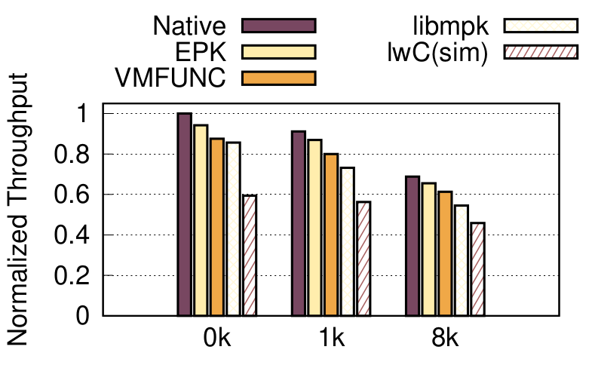
Observations
Macro-benchmark (using nginx):
300 clients keep sending request to server
Total 300 memory domain each with 5 pages
EPK outperform all existing solution
Boosting IPCs in microkernels:
Microkernel have most kernel functionalities as user space processes
Signifcant latency due to slow IPCs as compared to function calling in monolithic kernel
EPK based model proposes using Memory domains for isolation of user-level kernel functionalities rather than separate processes
Outperforms state-of-the-art MPK bases architecture

Slide 40
Elastic Cuckoo Page Tables: Rethinking Virtual Memory Translation for Parallelism
Anand Manojkumar Parikh (20CS10007)

Slide 41
The Problem:
Virtual Memory Translation is a bottleneck for applications with large memory requirements. The paper searches for a better virtual memory translation technique that maintains:
Process - Private page tables
Multiple sized pages supported
Page sharing
Dynamic Page Table resizing
Current techniques are not scalable.

Slide 42
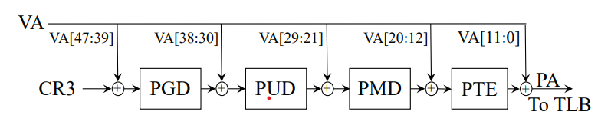
Multi-Level Radix Page Tables:
Assuming 4KB pages, 48-bit Virtual Address, 64-bit physical address, byte-addressable memory
Use a slice of the virtual address to get to the next level of translation.
At most 4+1 sequential memory accesses on a TLB miss. Too expensive.
20%-50% of total application runtime
20%-40% of main memory accesses

Slide 43
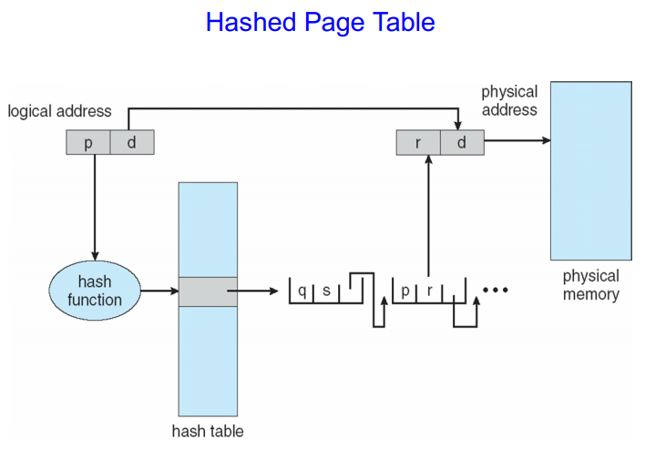
Hashed Page Tables:
Hash the virtual address and store the physical address against it.
Loss of spatial locality.
Overhead of storing the hash-tag (pre-image) with the physical address.
Problem of collisions remains unsolved - open addressing (probe till next empty slot) and chaining both expensive.
Global inverted page tables seem attractive, but cannot support multiple page sizes and page sharing easily

Slide 44
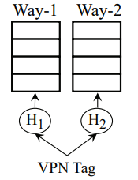
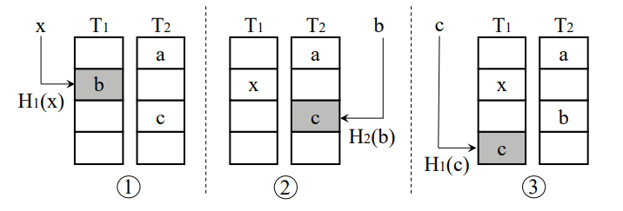
Cuckoo Hashing:
d-ary Cuckoo Hashing has d ways. Each way has a different
hash function.
An element can stay in at most 1 valid position at a time.
Lookups are now fully parallel: check all d ways at once.
Insertions require choosing a random way and placing
the element there. If already occupied, evict that element and
try to insert it in a different way. Repeat until empty spot found or threshold attempts crossed

Slide 45
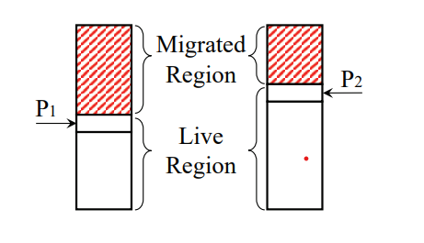
Resizing Cuckoo Hash Tables:
Cannot wait for the entire hash table to finish copying each time we resize.
So, we resize the table GRADUALLY.
Allocate a new hash table with d-ways, each is k times larger than the previous one.
Now, while inserting, only insert into the new table.
With each insert, perform a rehash operation, where one element from the old table is shifted to the new table. Deallocate old table when empty.
Look-ups now require 2 x d parallel operations. A bit expensive.
Also, almost half the entries fetched in lookups are useless, which pollute the cache.
Improve to Elastic Cuckoo Hash Tables
Each way of the OLD table is divided into
2 portions by a rehashing pointer.

Slide 46
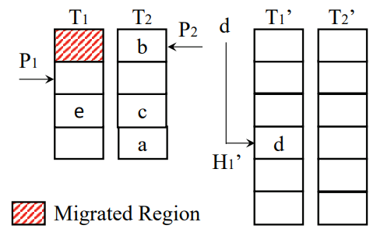
Elastic Cuckoo Hash Tables:
Lookup : Find location in OLD table first.
If index < pointer, search in NEW table.
Else in OLD. So, look-ups reduced to d
parallel operations. Also, no migrated entries
fetched, so cache pollution is minimized.
Insert: Choose a random way of the OLD table first. Find hashed location.
If index < pointer, insert in NEW table, since this is migrated region. Else in OLD table.
Also, continue the eviction-insertion process as earlier in case entry is already occupied.
With each insert, rehash one random element from the OLD table.
Rehash: Choose a random way from the old table. Pick element at the rehashing pointer. Remove from OLD way and insert in corresponding NEW way.

Slide 47
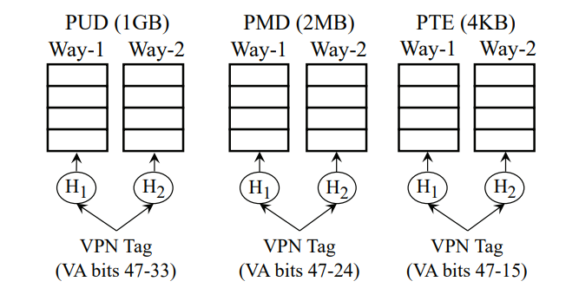
Elastic Cuckoo Page Tables:
Organize Page Tables as Elastic
Cuckoo Hash Tables. Support page
sizes: 4Kb, 2MB, 1GB.
1 ECPT for each possible page size.
Use VPN tags for indexing into the
page tables.
We do not know what size the target
page is. So, try out ALL translations
in parallel.
S x d parallel operations.

Slide 48
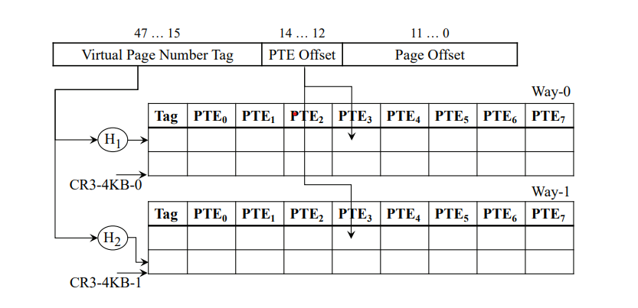
Example of Virtual->Physical Address Translation using ECPTs:
4KB Page Size ECPT example.
8 consecutive translation clustered together for spatial locality.
Organized to fit perfectly into a 64-byte cache line.

Slide 49
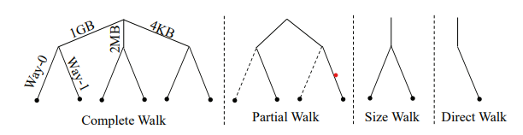
Cuckoo Walk Tables:
S x d degree of parallelism can be further reduced using Cuckoo Walk Tables.
Each ECPT has a corresponding CWT (also organized as Elastic Cuckoo Hash Tables), which store precise information about which directions of these S x d to explore for a particular range (section) of virtual address.
The Cuckoo Walk Tables can further be cached as Cuckoo Walk Caches (CWCs).

Slide 50
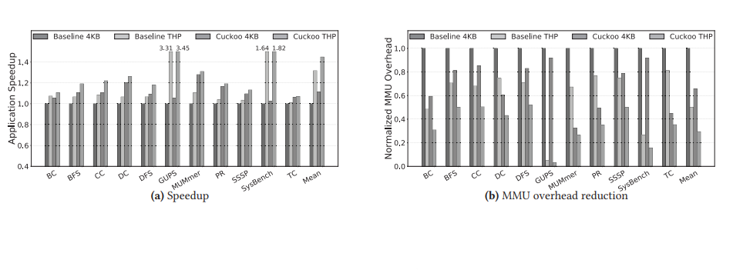
Contributions:
A purely software-level approach to replace the legacy radix page tables.
First to exploit the parallelism provided by modern memory hardware.
Scalable to very huge memory sizes.
Evaluation:
Achieved 3%-28% (mean 11%) improvement in application runtimes.
Reduced overall MMU overhead by 34%-41%.

