Slide 1
Modeling Synchronous
Logic Circuits
Debdeep Mukhopadhyay

Slide 2
Basic Sequential Circuits
A combinational circuit produces output solely depending on the current input.
But a sequential circuit “remembers” its previous state.
Its output depends on present inputs and previous state.
Examples:
  Latches
  Registers
  Memory
  parallel to serial / serial to parallel converters
  Counters

Slide 3
Latch vs Registers
Latch: Level sensitive device
  Positive Latches and Negative latches
  Can be realized using multiplexers
Register: edge triggered storage element
  Can be implemented using latches
  Cascade a negative latch with a positive latch to obtain a positive edge triggered register
Flip flop: bi-stable component formed by the cross coupling of gates.

Slide 4
Latches
Cycle stealing is possible leading to faster circuits
Problem of timing analysis.

Slide 5
Latch inference using if
A1
module ….
always@(...)
begin
if(En1)
Y1=A1;
if(En2)
begin
M2<=!(A2&B2);
Y2<=!(M2|C2);
end
if(En3)
begin
M3=!(A3&B3);
Y3=!(M3|C3);
end
D
Q
Y1
G
~Q
En1
C2
D
Q
A2
G
~Q
Y2
D
Q
B2
G
~Q
En2
C3
A3
Y3
D
Q
B3
G
~Q
En3

Slide 6
Modeling latches with present and clear inputs
begin
if(!Clear1)
Y1=0;
else if(En)
Y1=A1;
begin
if(Clear2)
Y2=0;
else if(En)
Y2=A2;

Slide 7
Modeling latches with present and clear inputs
if(!Preset3)
Y3=1;
else if(En3)
Y3=A3;
if(!Preset3)
Y3=1;
else if(En3)
Y3=A3;
D
Q
G
~Q
CLR

Slide 8
Modeling latches with present and clear inputs
A5
if(Clear5)
Y5=0;
else if(Preset5)
Y5=1;
else if(En5)
Y5=A5;
Y5
En5
D
Q
G
~Q
CLR
Preset5
Clear5
If there are no latches with a preset input In the library, equivalent functionality is produced by using latches with a clear input.

Slide 9
Multiple gated latch
always @(En1 or En2 or En3 …)
if(En1==1)
Y=A1;
else if(En2==1)
Y=A2;
else if(En3==1)
Y=A3;
Try to synthesize and check whether:
1. Is there a latch inferred?
2. Put an else statement. Is a latch inferred now?
3. Put a default output assignment before the if starts. Is a latch inferred now?
4. Use the posedge keyword in the trigger list, and repeat the above experiments.

Slide 10
Other places of latch inferences
Nested if: If all the possibilities are not mentioned in the code.
Case: In advertent. Not advisable to infer a latch from case statement.
  may lead to superfluous latches.
Nested case statements can also infer latches.

Slide 11
The D-Flip Flop
always @(posedge clk)
Y=D;
A-Synchronous reset:
always @(posedge clk or posedge reset)
if(reset)
Y=0
else Y=D;

Slide 12
Resets
Synchronous reset:
always @(posedge clk)
if(reset)
Y=0
else Y=D;

Slide 13
Combinational Block between two flops
always@(posedge clk)
begin
M <= !(A & B);
Y <= M|N;
end
assign N=C|D;
What will happen if a blocking assignment is used?
The first flip flop will become redundant…

Slide 14
Sequence Generators
Linear Feedback Shift Registers
Counters

Slide 15
LFSR Applications
Pattern Generators
Counters
Built-in Self-Test (BIST)
Encryption
Compression
Checksums
Pseudo-Random Bit Sequences (PRBS)

Slide 16
LFSR
Linear Feedback Shift Register (LFSR):
  For pseudo random number generation
  A shift register with feedback and exclusive-or gates in its feedback or shift path.
  The initial content of the register is referred to as seed.
  The position of XOR gates is determined by the polynomial (poly).

Slide 17
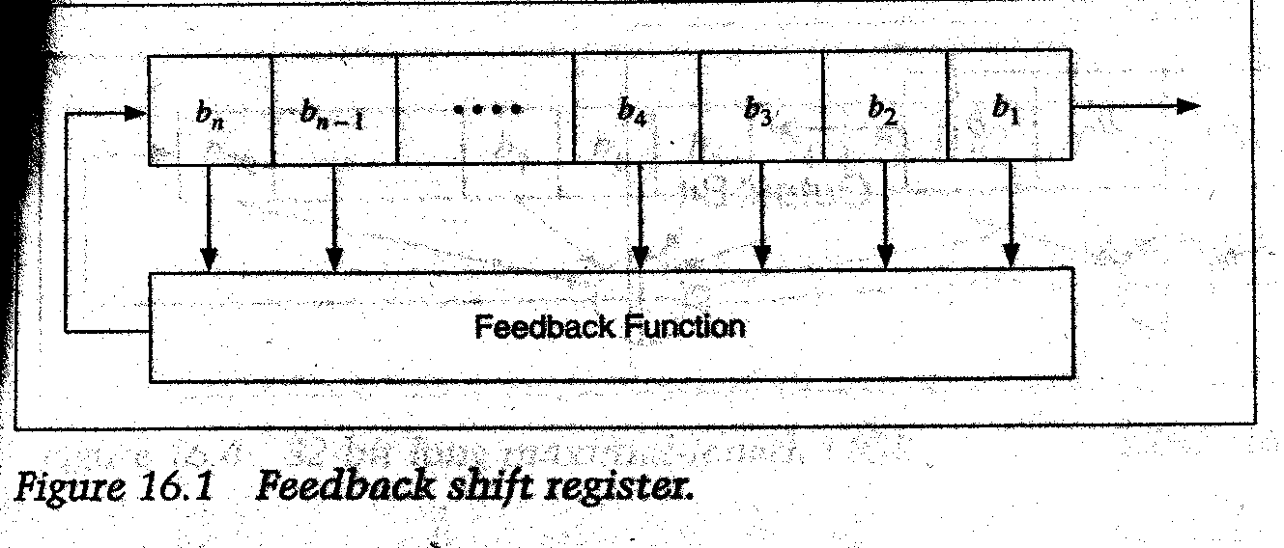
An LFSR outline
The feedback function (often called the taps) can be reprsesented
by a polynomial of degree n

Slide 18
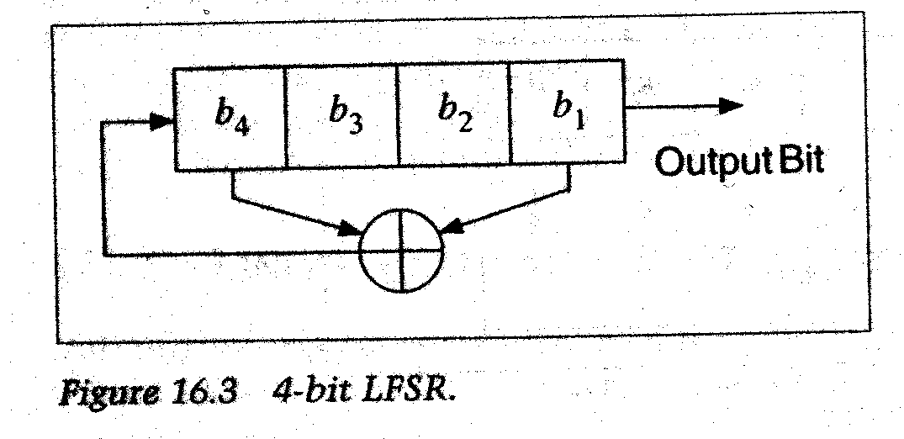
A 4 bit LFSR
The feedback polynomial is p(x)=x⁴+x+1

Slide 19
A 4 bit LFSR
1111
0111
1011
0101
1010
1101
0110
0011
1001
0100
0010
0010
1000
1100
1110
Output sequence:
111101011001000...
All the 2⁴-1 possible states are generated. This is called a maximal
length LFSR. So, the sequence depends on the feedbacks.

Slide 20
Types of feedbacks
Feedbacks can be comprising of XOR gates.
Feedbacks can be comprising of XNOR gates.
Given the same tap positions, both will generate the same number of values in a cycle. But the values will be same.
Permutation!

Slide 21
Number of Taps
For many registers of length n, only two taps are needed, and can be implemented with a single XOR (XNOR) gate.
For some register lengths, for example 8, 16, and 32, four taps are needed. For some hardware architectures, this can be in the critical timing path.
A table of taps for different register lengths is included in the back of this module.

Slide 22
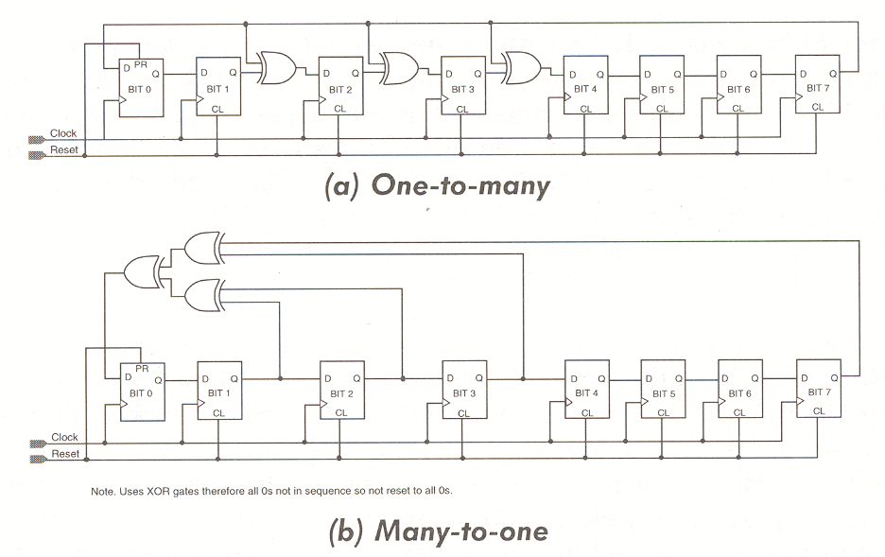
One-to-Many and Many-to-One
Implementation (a) has only a single gate delay between flip-flops.

Slide 23
Avoiding the Lockup State
Will Use XOR Form For Examples
We have an n-bit LFSR, shifting to the “right”
n
0

Slide 24
Avoiding the Lockup State
Will Use XOR Form For Examples
The all ‘0’s state can’t be entered during normal operation but we can get close. Here’s one of n examples:
0
0
0
0
0
1
n
0
We know this is a legal state since the only illegal state is all 0’s. If the first n-1 bits are ‘0’, then bit 0 must be a ‘1’.

Slide 25
Avoiding the Lockup State
Will Use XOR Form For Examples
Now, since the XOR inputs are a function of taps, including the bit 0 tap, we know what the output of the XOR tree will be: ‘1’.
It must be a ‘1’ since ‘1’ XOR ‘0’ XOR ‘0’ XOR ‘0’ = ‘1’.
0
0
0
0
0
1
n
0
So normally the next state will be:
1
0
0
0
0
0
n
0

Slide 26
Avoiding the Lockup State
Will Use XOR Form For Examples
But instead, let’s do this, go from this state:
0
0
0
0
0
1
n
0
To the all ‘0’s state:
1
0
0
0
0
0
n
0

Slide 27
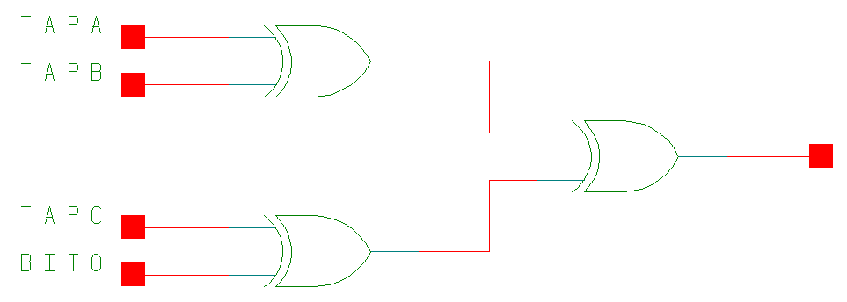
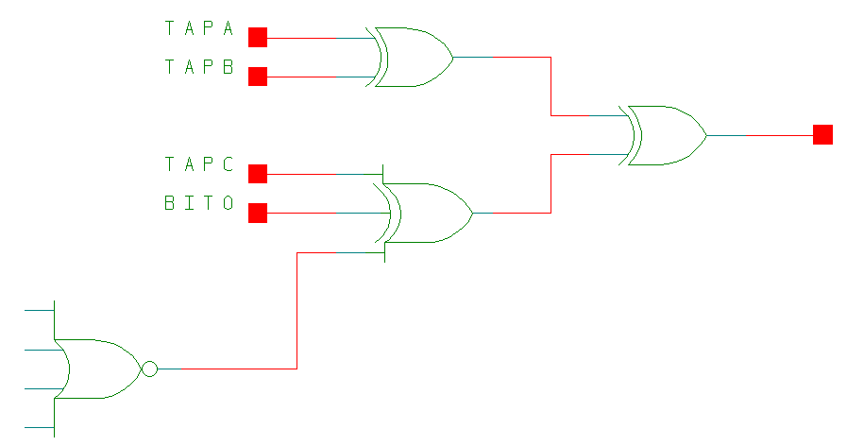
Avoiding the Lockup State
Modification to Circuit
2^{n-1} states
2^{n} states
NOR of all bits
except bit 0
Added this term
a) “000001” : 0 Xor 0 Xor 0 Xor 1 Xor 1 ⇒ 0
b) “000000” : 0 Xor 0 Xor 0 Xor 0 Xor 1 ⇒ 1
c) “100000” :

Slide 28
Verilog code
module …
always@(posedge clk or posedge rst)
begin
if(rst)
LFSR_reg=8’b0;
else
LFSR_reg=Next_LFSR_reg;
end

Slide 29
verilog
always @(LFSR_reg)
begin
Bits0_6_zero=~|LFSR_Reg[6:0];
Feedback=LFSR_Reg[7]^ Bits0_6_zero;
for(N=7;N>0;N=N-1)
if(Taps[N-1]==1)
Next_LFSR_Reg[N]=LFSR_Reg[N-1]^Feedback;
else
Next_LFSR_Reg[N]=LFSR_Reg[N-1];
Next_LFSR_Reg[0]=Feedback;
end
assign Y=LFSR_Reg;
endmodule

Slide 30
A Generic LFSR
module LFSR_Generic_MOD(Clk,rst,Y);
parameter wdth=8;
input clk,rst;
output [wdth-1:0] Y;
reg [31:0] Tapsarray [2:32];
wire [wdth-1:0] Taps;
integer N;
reg Bits0_Nminus1_zero, Feedback;
reg [wdth-1:0] LFSR_Reg, Next_LFSR_Reg;

Slide 31
always @(rst)
begin
TapsArray[2]=2’b11;
TapsArray[3]=3’b101;
…
TapsArray[32]=32’b10000000_00000000_00000000_01100010;
end
assign Taps[wdth-1:0]=TapsArray[wdth];
REST OF THE CODE IS SIMILAR TO THE PREVIOUS EXAMPLE

Slide 32
Counters
A register that goes through a pre-determined sequence of binary values (states), upon the application of input pulses in one or more than inputs is called a counter.
The input pulses can be random or periodic.
Counters are often used as clock dividers.

Slide 33
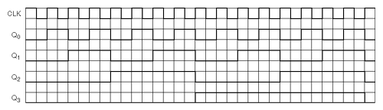
Timing Diagrams
The outputs (Q0 ⇒ Q3) of the counter can be used as frequency dividers with Q0 = Clock ÷ 2, Q1 = Clock ÷ 4, Q2 = Clock ÷ 8, and Q3 = Clock ÷ 16.

Slide 34
Types
Synchronous
  Using adders, subtractors
  Using LFSRs, better performance because of simple circuits. Most feedback polynomials are trinomials or pentanomials.
Asynchronous:
  Ripple through flip flops
  each single flip flop stage divides by 2
  so, we may obtain division by 2^{n}
  what if they are not powers of two? we require extra feedback logic
  significantly smaller

Slide 35
Divide by 13 :
A synchronous design
always@(posedge clk or posedge rst)
begin
if(!rst)
begin
cnt<=startcnt;
Y<=0;
end

Slide 36
Divide by 13 :
A synchronous design
else
if(Count==EndCount)
begin
Count<=StartCount;
Y<=1;
end

Slide 37
Divide by 13 :
A synchronous design
else
begin
for(N=1;N<=3;N=N-1)
if(Taps[N])
Count[N]<=Count[N-1]~^Count[3];
else
Count[N]<=Count[N-1];
Count[0]<=Count[3];
Y=0;
end
end

Slide 38
Asynchronous Design
Instantiate 4 DFFs.
Ripple the clock through them
Output is a divided by 16 clock.
Use the output states and check when 13 clock cycles have elapsed.
Use it to make the output bit high.
Reset the Flip Flops
Exercise: Write a verilog code!

Slide 39
Pros and Cons of
Synchronous and Asynchronous Resets

Slide 40
Problem of Choice
Quite a complex issue.
All of us know the importance of the reset button. When our PC does not work!
Less understood, less emphasized.
Require to a treatment to perform an informed design.

Slide 41
Some Points
Reset style depends on the ASIC design style, the application and where the flip flop is located.
If we design considering all the unused states (like the 2^{n}-2n states in a Johnson’s Counter), we should be able to do reset from any possible state.
A power on reset is required if the designer used the unused states as don’t cares to do optimization.
Often an explicit reset is not required if the flop is a part of shift register, just wait for some clock cycles. These are often called follower flops

Slide 42
Good Reset
Synchronous Reset:
        module goodFFstyle (
        output reg q2,
        input d, clk, rst_n);
        reg q1;
        always @(posedge clk)
        if (!rst_n) q1 <= 1'b0;
        else q1 <= d;
        always @(posedge clk)
        q2 <= q1;
        endmodule

Slide 43
Bad Reset
        module badFFstyle (
        output reg q2,
        input d, clk, rst_n);
        reg q1;
        always @(posedge clk)
        if (!rst_n) q1 <= 1'b0;
        else begin
        q1 <= d;
        q2 <= q1;
        end
        endmodule

Slide 44
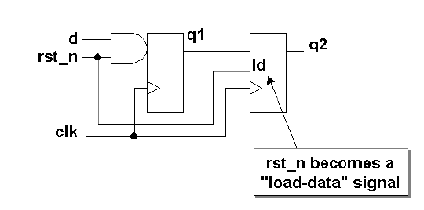
Bad Hardware
Unnecessary use of a loadable flip flop

Slide 45
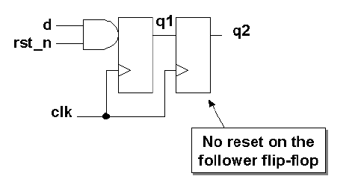
Good Hardware
This is one of the few cases where a multiple always block
is adviced.

Slide 46
Pros of Synchronous Resets
Flip flop size is less. Although the gate count increases.
Circuit is 100% synchronous.
Sometimes the reset may be an internally generated signal and may have glitches.
Work as a filter for such reset glitches.
However there can be a metastability if the glitches occur near the clock edges.

Slide 47
Cons
Not all ASIC libraries do have them
Need a pulse stretcher to ensure that reset stays when the clock goes high
Simulation issues can creep in, due to x-logic.
Its often an annoying fact that you can do reset only when there is a clock. What if the clock is disabled, say to save power?

Slide 48
Good Reset Again!
Asynchronous Reset:
    module good_async_resetFFstyle (
    output reg q,
    input d, clk, rst_n);
    always @(posedge clk or negedge rst_n)
    if (!rst_n) q <= 1'b0;
    else q <= d;
    endmodule

Slide 49
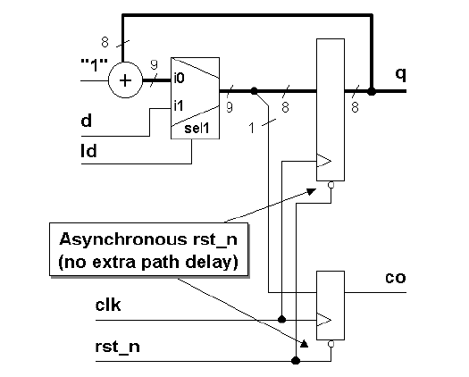
Pros
Data Path is clean. Less gates on the data path.
module ctr8ar (
output reg [7:0] q,
output reg co;
input [7:0] d;
input ld, rst_n, clk;
always @(posedge clk or negedge rst_n)
if (!rst_n) {co,q} <= 9'b0; // async
//reset
else if (ld) {co,q} <= d; // sync load
else {co,q} <= q + 1'b1; // sync increment
endmodule

Slide 50
Cons
Timing Analysis is hard.
If the reset net is not derived from the input, they have to disable for scan based test (DFT issues).
Glitches in the reset signal can be a problem.
De-assertion of the reset could be an issue. If it happens near the active clock edge meta-stability can occur.

Slide 51
Two main Cons…
Reset Recovery Time: Time between the de-assertion of reset and the next active clock edge. If this is not obeyed, meta-stability can occur.
Reset removal is asynchronous: Consider, the reset going to more than one flop. Due to the different propagation time in either or both the reset and the clock signal, some flops may be in reset state, while others may have gone passed the reset state.

Slide 52
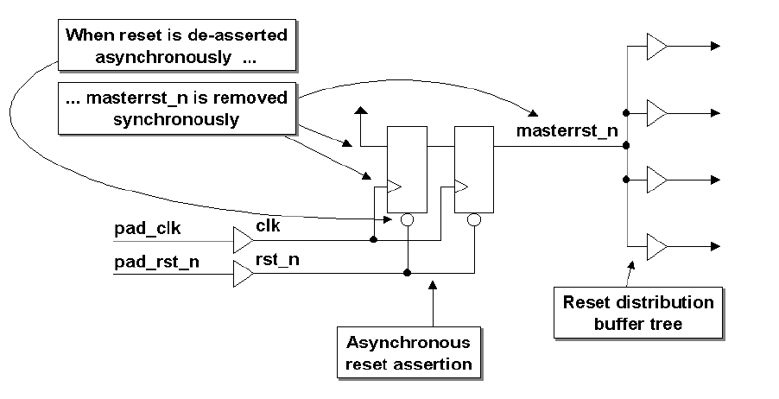
And Ugly Reset
Two flip-flops are required to synchronize the reset signal to the clock pulse
The second flip-flop is used to remove any metastability that might be caused by the reset signal being removed asynchronously and too close to the rising clock edge.
You also have the best of asynchronous reset.
Only reset becomes ugly!

Slide 53
Reset using the reset synchronizer
module async_resetFFstyle2 (
output reg rst_n,
input clk, asyncrst_n);
reg rff1;
always @(posedge clk or negedge asyncrst_n)
if (!asyncrst_n) {rst_n,rff1} <= 2'b0;
else {rst_n,rff1} <= {rff1,1'b1};
endmodule

Slide 54
Conclusion
We have seen various kinds of resets.
Resets that are good, bad and ugly.
One thing is clear reset is not simple. They should be carefully handled.

