Slide 1
Design of Control Path
Debdeep Mukhopadhyay

Slide 2
Hardwired Hardware

Slide 3
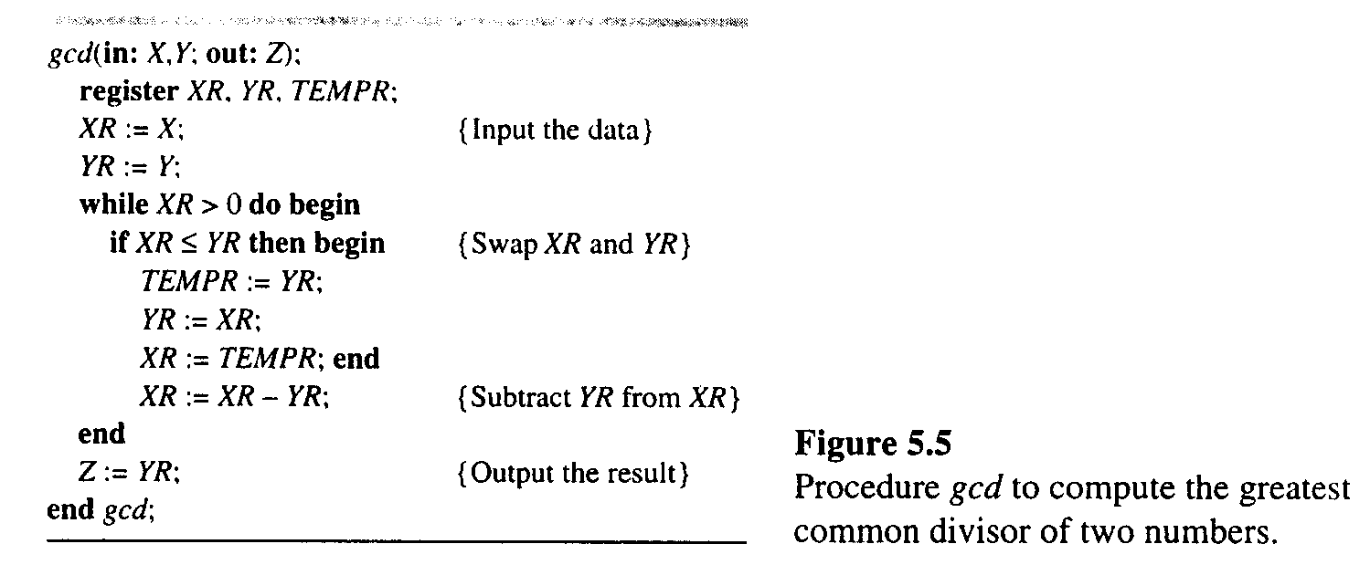
GCD Processor

Slide 4
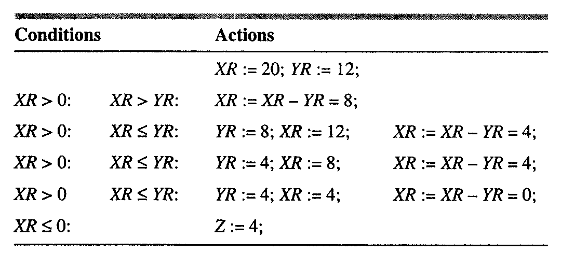
An Example

Slide 5
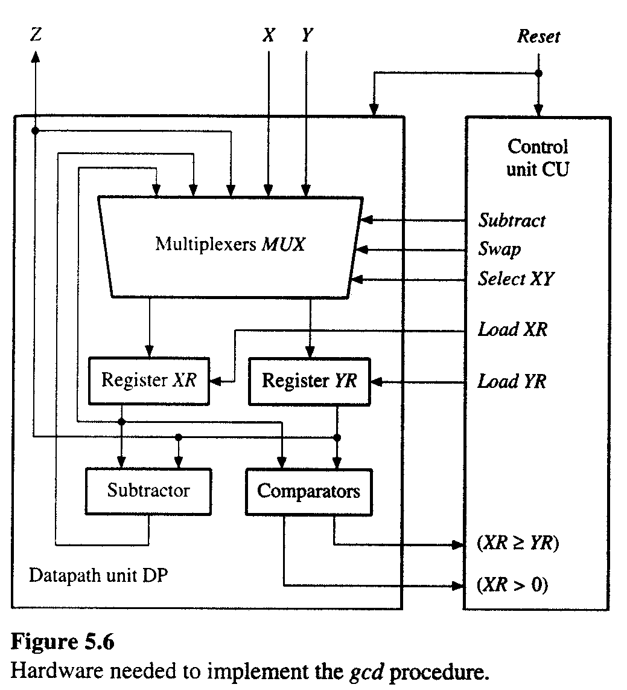
Hardware for the GCD processor

Slide 6
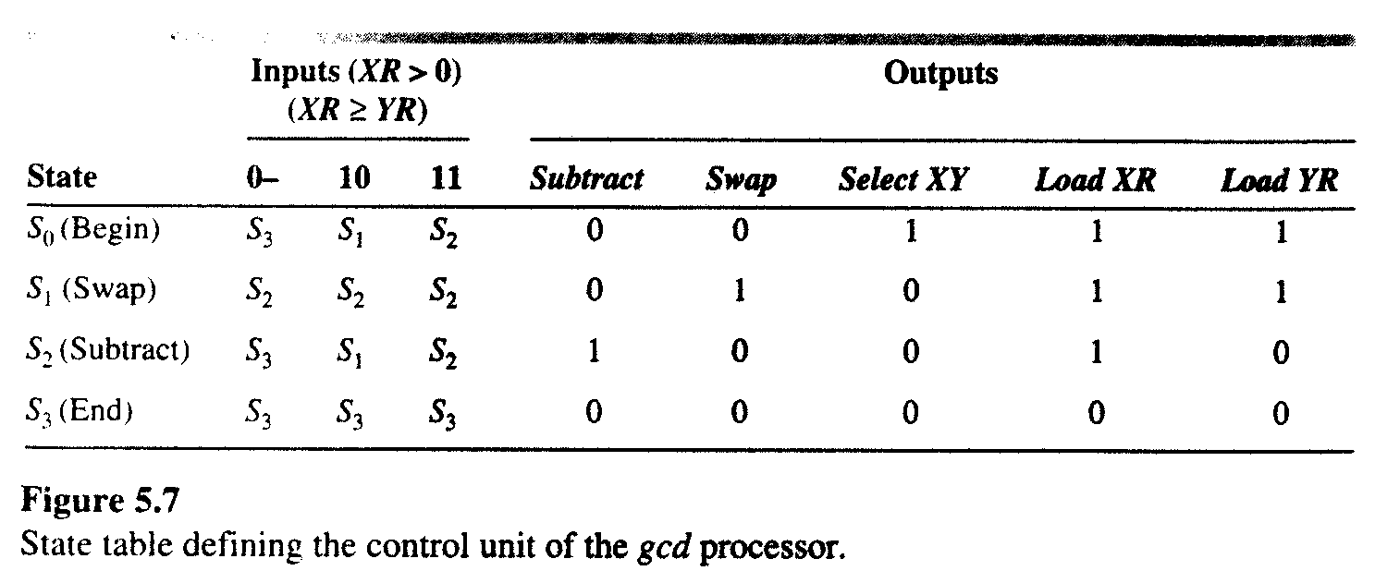
State Table for the Control Unit
What kind of state machine is this?

Slide 7
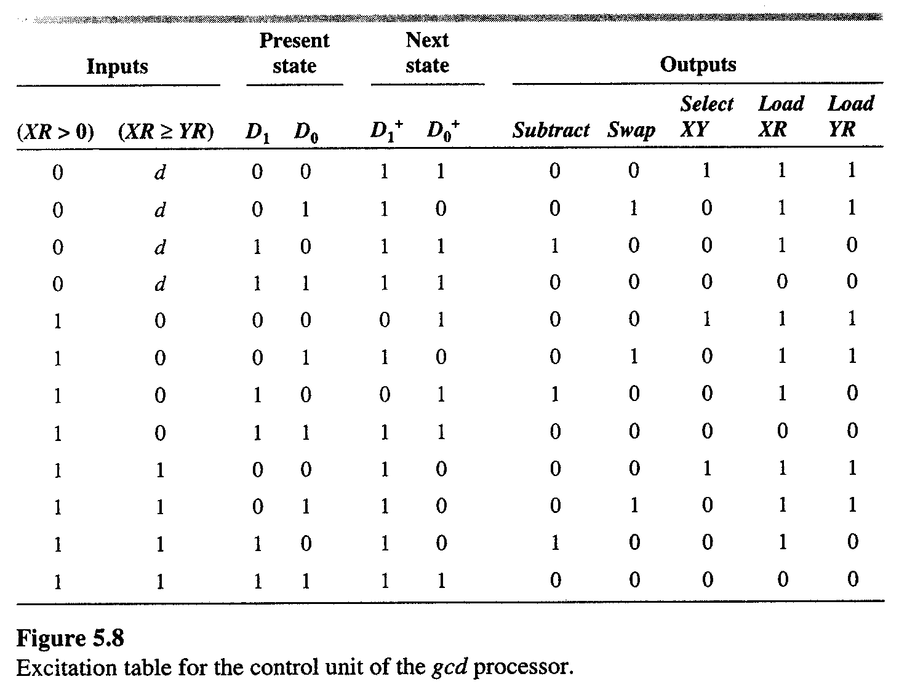
Classical method
S₀ = 00, S₁ = 01, S₂ = 10 and S₃ = 11
Excitation Table

Slide 8
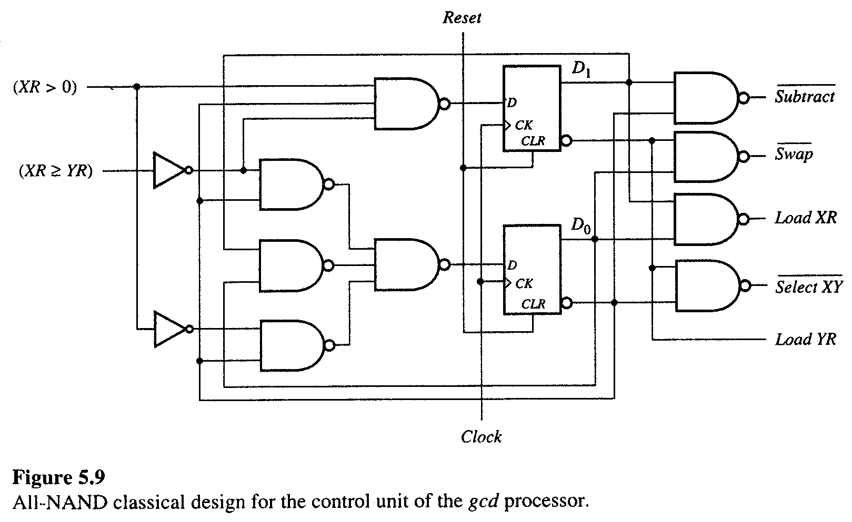
Is this a Moore or Mealy Machine?

Slide 9
Design based on Microprogram

Slide 10
Concept of Microprogram
High Level description of a double precision ADD:
  ADD AL, BL
  ADDC AH, BH
Low level description: Microprogram
Cycle | Function Select | Storage Control | Data Routing
1 2 | Add Add with carry | Read AL, Read BL, Write AL ReadAH, Read BH, Write AH | … …

Slide 11
What is a Microprogram?
Microprogram
- Program stored in memory that generates all the control signals required to execute the instruction set correctly
- Consists of microinstructions
Microinstruction
- Contains a control word and a sequencing word
Control Word - All the control information required for one clock cycle
Sequencing Word - Information needed to decide
the next microinstruction address
Control Memory(Control Storage: CS)
- Storage in the microprogrammed control unit to store the microprogram

Slide 12
What is a Microprogram?
Microprogramming is so named because it uses concepts from regular programming. The micro prefix should remind you, however, that the microprogram used by a processor is different from the program executed by the processor.
The main thing to remember is that we have a computer inside a computer, but that the inner computer is much simpler and more restricted

Slide 13
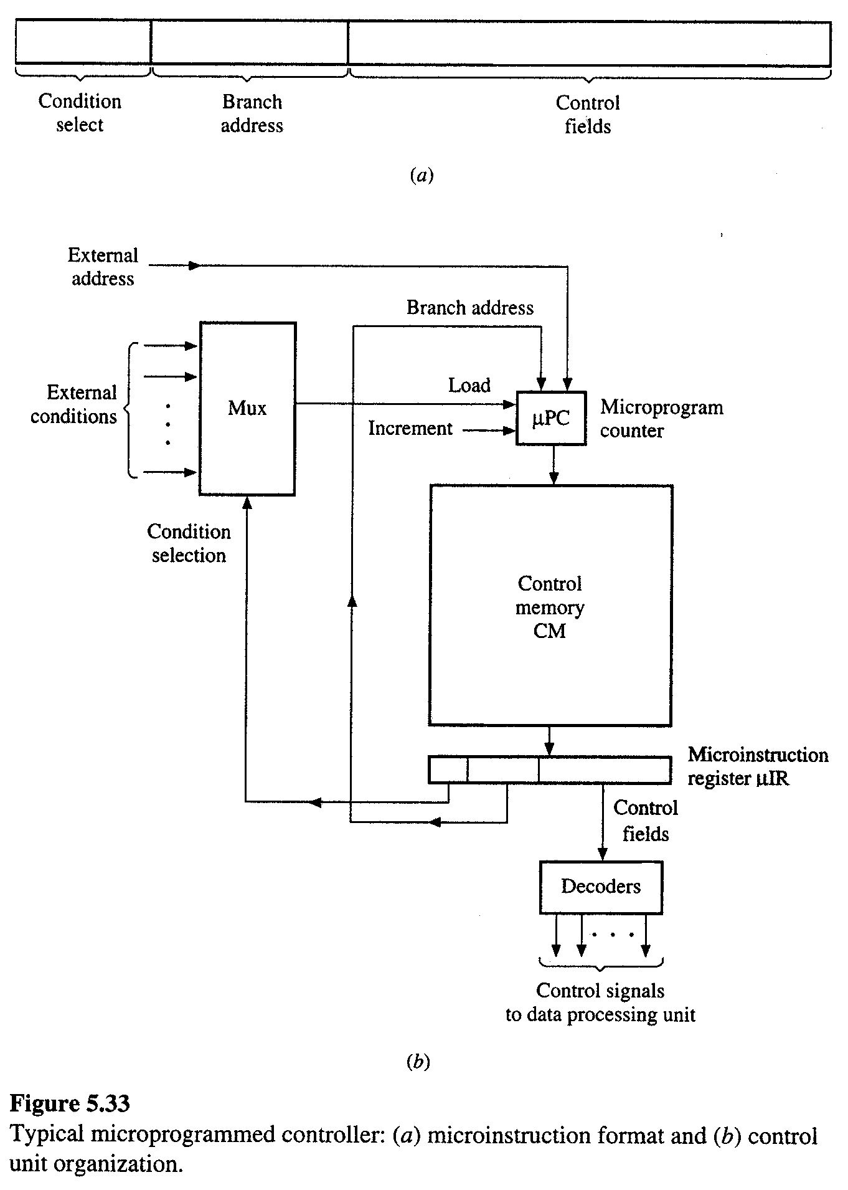
Micro-programmed Control Unit

Slide 14
Symbolic Micro-program
Begin: A=0, Count=0, F=0, M=InBus
Input: Q=Inbus
Test1: If Q[0]=0 then goto RSHIFT;
Add: A[7:0]=A[7:0]+M[7:0], F=(m[7] and Q[0])or F
Rshift: A[7]=F, A[6:0],Q=A,Q[7:1], Cnt=Cnt+1
if cnt≠7 then goto Test1
Test2: If Q[0]=0 then go to Output1
Subtract: A[7:0]=A[7:0]-M[7:0], Q[0]=0
Output1: Outbus=A
Output2: Outbus=B
End: Halt
c₉, c₁₀
c₈
c₂,c₃,c₄
c₀,c₁,c₁₁
c₂,c₃,c₄,c₅
c₆
c₇
END

Slide 15
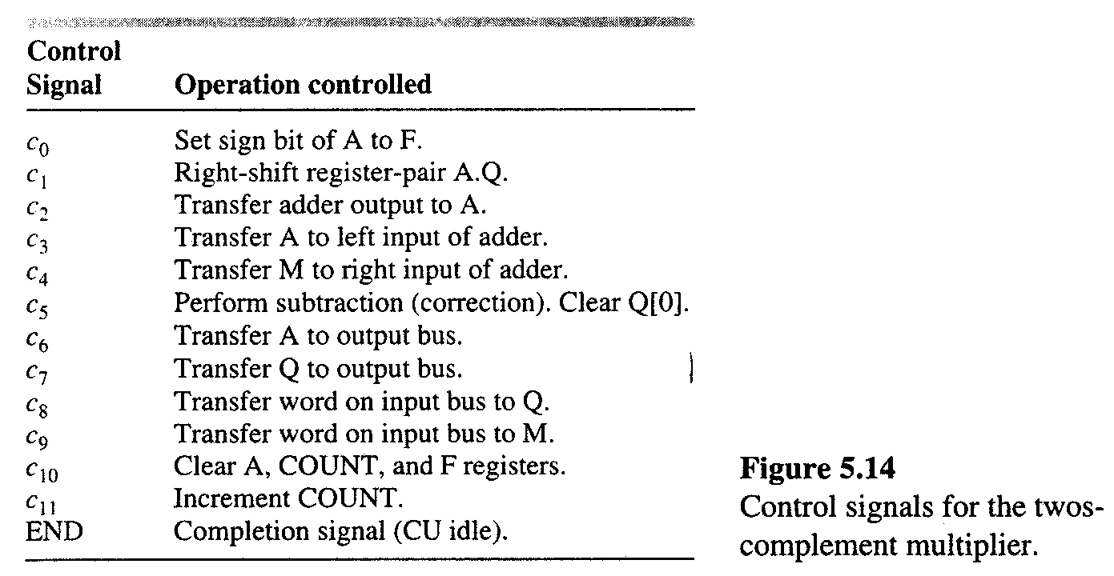
Control Signals

Slide 16
Branching
No Branching
Branch if Q[0]=0
Branch if Count≠7
Unconditional Branch
Hence a 2-bit conditional select field is needed.
There are 10 states, so 4 bits are enough to encode the states.

Slide 17
Binary Microprogram
Address in CM | Condition Selct | Branch Address | c₀ | c₁ | c₂ | c₃ | c₄ | c₅ | c₆ | c₇ | c₈ | c₉ | c₁₀ | c₁₁ | END
0000 | 00 | 0000 | 0 | 0 | 0 | 0 | 0 | 0 | 0 | 0 | 0 | 1 | 1 | 0 | 0
0001 | 00 | 0000 | 0 | 0 | 0 | 0 | 0 | 0 | 0 | 0 | 1 | 0 | 0 | 0 | 0
0010 | 01 | 0100 | 0 | 0 | 0 | 0 | 0 | 0 | 0 | 0 | 0 | 0 | 0 | 0 | 0
0011 | 00 | 0000 | 0 | 0 | 1 | 1 | 1 | 0 | 0 | 0 | 0 | 0 | 0 | 0 | 0
0100 | 10 | 0010 | 1 | 1 | 0 | 0 | 0 | 0 | 0 | 0 | 0 | 0 | 0 | 1 | 0
0101 | 01 | 0111 | 0 | 0 | 0 | 0 | 0 | 0 | 0 | 0 | 0 | 0 | 0 | 0 | 0
0110 | 00 | 0000 | 0 | 0 | 1 | 1 | 1 | 1 | 0 | 0 | 0 | 0 | 0 | 0 | 0
0111 | 00 | 0000 | 0 | 0 | 0 | 0 | 0 | 0 | 1 | 0 | 0 | 0 | 0 | 0 | 0
1000 | 00 | 0000 | 0 | 0 | 0 | 0 | 0 | 0 | 0 | 1 | 0 | 0 | 0 | 0 | 0
1001 | 11 | 1001 | 0 | 0 | 0 | 0 | 0 | 0 | 0 | 0 | 0 | 0 | 0 | 0 | 1

Slide 18
Control Path Design
0
MUX
Increment
~Q(0)
Load
~Count(7)
µPC
Reset
4 bits
1
Control
Memory
(10x19 bits)
4 bits
Branch
Address
19 bits
c₀,…,c₁₁,END

Slide 19
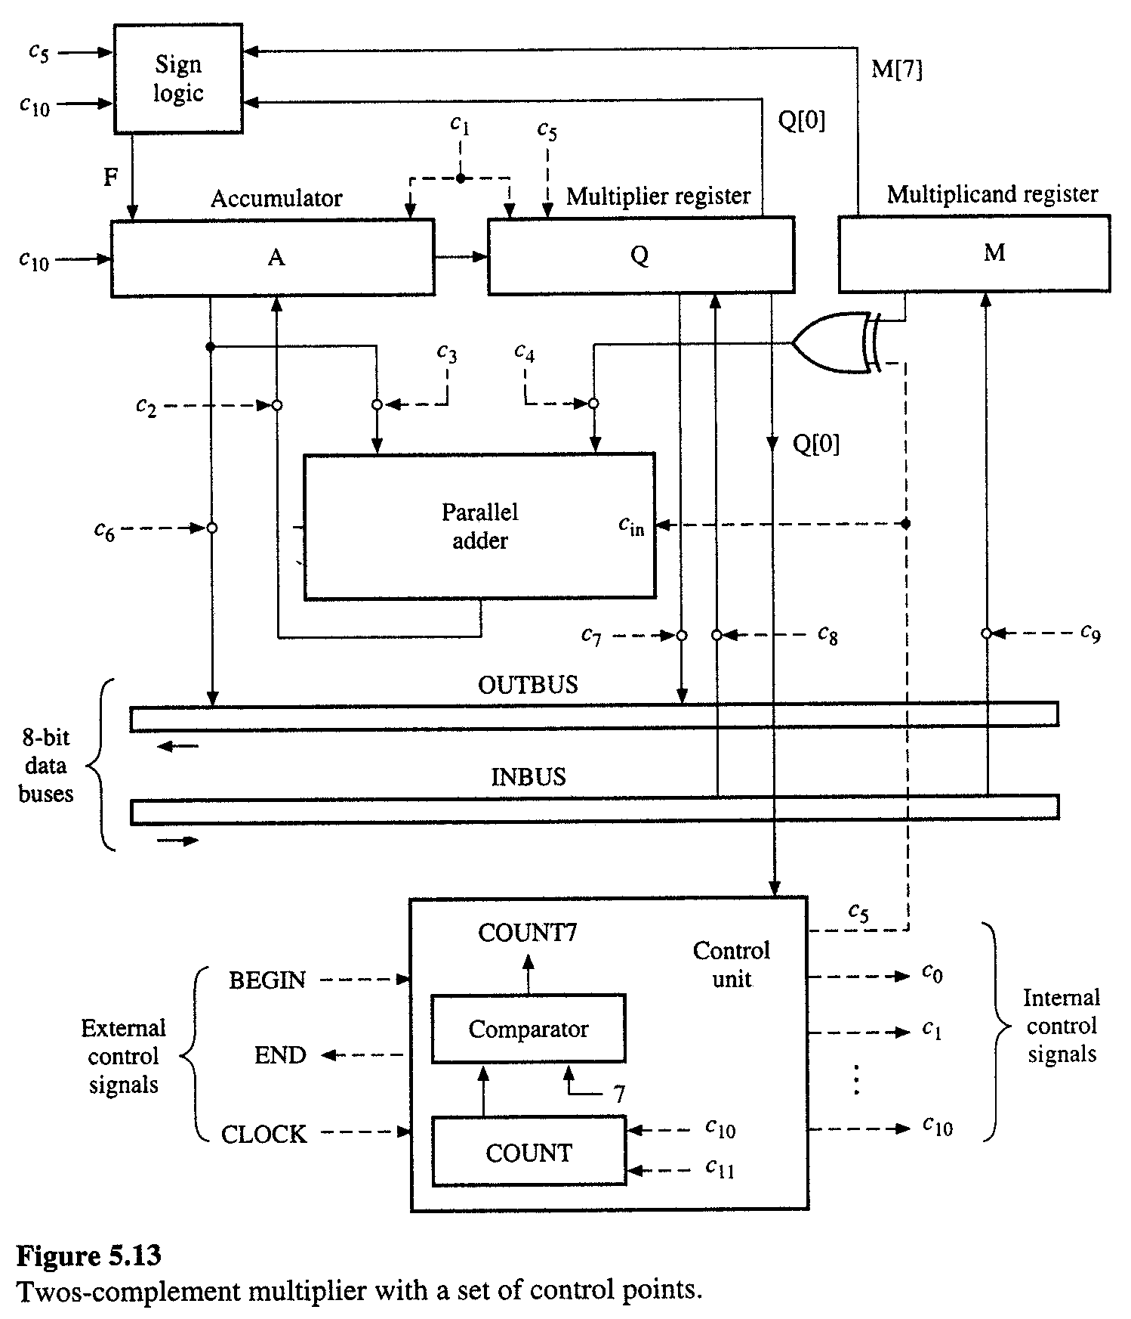
Data Path Design

Slide 20
Comments
Micro-programming helps in making Control Units which may be changed by changing the content of the memory.
But slow due to the fetch timing of the instruction from the memory.

Slide 21
Assignment 2
Write a verilog code to implement the control path for a gcd processor.
Write a verilog code to implement the micro-programmed control unit of a 2’s complement signed fraction multiplier.
Deadline: 21/3/08

