Slide 1
HACKFEST-IIIT-2025
Blockchain-Based Cybersecurity Solutions for Data Integrity
Problem Statement Title-
Theme- Blockchain
Team Name – Team ANARCHY
Team Leader- Abhishek Anand
Member 1 - Souvick Sarkar
Member 2 - Krish Singh Hura
Member 3 - Biswadaya Patra Samanta

Slide 2
Team ANARCHY
IDEA TITLE
PROPOSED SOLUTION:-
Leveraging blockchain technology to create an immutable and verifiable record of document hashes, ensuring data integrity and authenticity
HOW WE ADDRESS THE PROBLEM:-
Digital documents are vulnerable to tampering, fraud, and unauthorized modification, breaking trust and causing significant issues.
UNIQUENESS:-
Decentralized verification eliminates reliance on single points of failure.
Combines blockchain with digital signatures for better authenticity.
Focusing on a practical and easily understandable use case (document integrity).
Highlighting the use of off chain data storage for scalability.

Slide 3
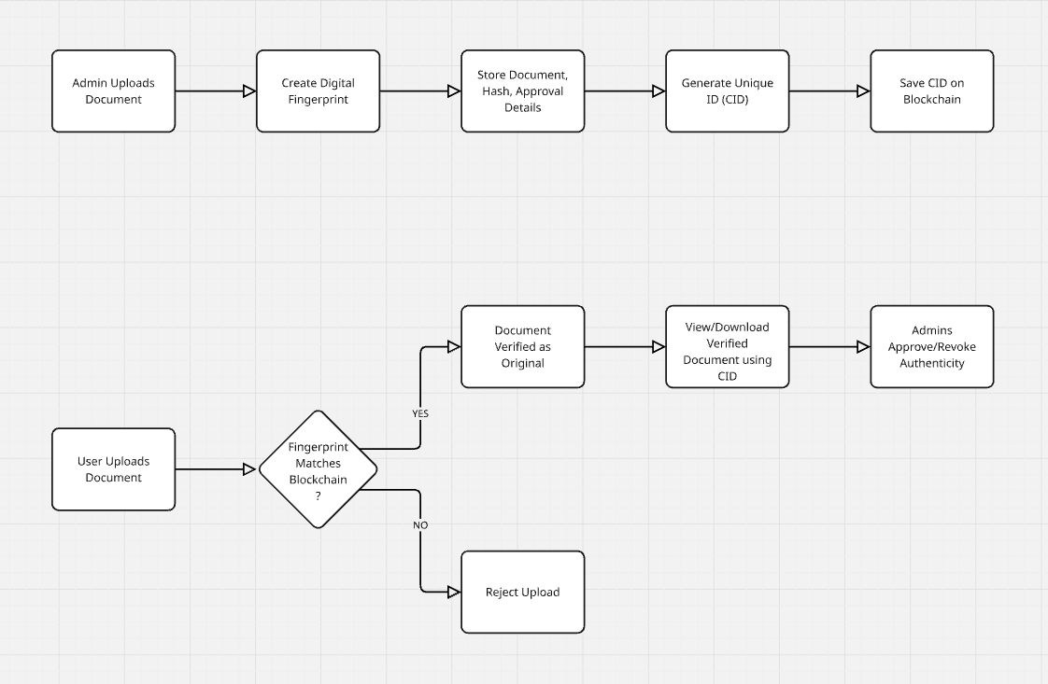
TECHNICAL APPROACH
Team ANARCHY
The TECH STACK we’re gonna be using are:- 1. BLOCKCHAIN- For Document Integrity and Proof of Authority.
2. DATA STORAGE- storing document hashes with metadata in blockchain and large documents on IPFS.
3. DIGITAL SIGNATURE- For verifying the documents and managing issuer public keys.
4. USER INTERFACE – React JS Library for Front end Components.

Slide 4
FEASIBILITY AND VIABILITY
Team ANARCHY
Challenges:
Limited time for complex blockchain implementation.
Integrating digital signature and PKI workflows.
Creating a user-friendly interface.
Overcoming Strategies:
Focus on a simplified blockchain structure and core functionality.
Use pre-built libraries for hashing and digital signatures.
Prioritize a clear and concise user interface over advanced features.

Slide 5
IMPACT AND BENEFITS
Team ANARCHY
Content: Enhanced Data Integrity: Ensures documents remain tamper-proof and verifiable.
Increased Transparency: Provides a clear audit trail of document history.
Reduced Fraud: Minimizes the risk of document forgery and manipulation.
Improved Trust: Fosters trust between document issuers and verifiers.

Slide 6
RESEARCH AND REFERENCES
Team ANARCHY
Blockchain for Document Verification: "Blockchain-based document verification system" - ResearchGate, various authors.
Digital Signatures and PKI: "Public Key Infrastructure (PKI) Overview" - National Institute of Standards and Technology (NIST).
IPFS for Decentralized Storage: "InterPlanetary File System (IPFS)" - ipfs.tech.
Python Cryptography Library Documentation - cryptography.io.

