Slide 1
IBM University Engagement
Project Submission
“Exploring the Power of Agentic AI with IBM Granite and Lang Flow”
Problem Statement No. 15 – Agentic Career Counseling Companion

Slide 2

Project Title – CareerMitra AI Assistant : Agentic Career Counseling Companion
Domain of Project – Education Career Guidance
Student Name | Recent Passport Photo | Email ID | Mobile number [WhatsApp]
Anand Kumar Prajapati |  | prajapatianand5732@gmail.com | 9792145636
Recommended font style and size:
Font Style: Arial
Font Size (Heading): 28
Font Size (Content): 20

Slide 3
Problem Statement – Agentic Career Counseling Companion
Problem Statement No. 15 – Agentic Career Counseling Companion
The Challenge
Students often struggle to make informed career decisions because career guidance is fragmented, awareness of personal strengths may be limited, and industry requirements change rapidly. Traditional counselling can be difficult to personalize and scale. As a result, students may miss opportunities or choose career paths that do not match their interests and abilities.
The Objective
Build an intelligent, autonomous career companion that continuously considers student performance, evolving interests, and labor-market trends to provide tailored career pathway suggestions.
The solution should:
• Student Profile – Understand education, skills, interests, and career goals.
• Career Assessment – Identify strengths, preferences, and development areas.
• Career Pathway Suggestions – Recommend suitable roles and explain the match.
• Skill Gap Analysis – Compare current skills with target-role requirements.
• Labor-Market Insights – Use current, traceable job and skills information when connected.
• Career Roadmap – Suggest learning steps, projects, and milestones.
• Progress Monitoring – Adapt guidance as student performance and interests change.

Slide 4
Proposed Solution – CareerMitra AI Assistant
Proposed Solution: CareerMitra AI Assistant – Agentic Career Counseling Companion
CareerMitra AI is designed as an AI-powered career guidance platform that helps students move from self-discovery to an actionable career plan. The student provides academic details, skills, interests, and goals through the CareerMitra dashboard. The application uses an AI counselling layer powered by IBM Granite through IBM watsonx.ai to interpret requests and generate personalized guidance.
The solution is organized into focused agent roles:
1. Student Profile Agent – Organizes education, skills, interests, and career goals.
2. Career Assessment Agent – Highlights strengths and areas for improvement.
3. Career Matching Agent – Suggests relevant career paths and explains why they may fit.
4. Skill Gap Agent – Identifies skills needed for selected roles.
5. Labor-Market Insight Agent – Uses connected job/skills sources to provide dated market context.
6. Roadmap & Progress Agent – Converts recommendations into learning milestones and updates them from feedback.
The Streamlet dashboard brings together student profile, AI career counselling, career recommendations, skill-gap analysis, career roadmap, and job-market insights. IBM Granite is the mandatory AI foundation; IBM Cloud Lite services can support eligible hosting and integrations.

Slide 5
Technology Used
IBM watsonx.ai – AI platform used to connect to foundation models and support model inference.
IBM Granite Model – Mandatory generative AI foundation for natural-language understanding, reasoning, summarization, and personalized career guidance. Configure the selected Granite model/API in the application.
IBM Cloud Lite – IBM cloud environment for eligible services, deployment, and integrations, subject to account quotas and service availability.
Python – Application logic, data handling, prompt orchestration, and integration code.
Streamlet – Web application framework used for the CareerMitra interactive dashboard and navigation.
GitHub – Source-code version control and public project repository.
Career / Skills Knowledge Sources – Curated role descriptions, skills frameworks, learning resources, and job-market sources for evidence-grounded recommendations.
RAG (planned enhancement) – Retrieve relevant career information from trusted sources before generating answers; show source and retrieval date.

Slide 6
CareerMitra AI Assistant – Application Components Used
Student Profile – Captures education, skills, interests, and career goals to personalize guidance.
AI Career Counselor – Conversational interface for career questions and tailored suggestions.
IBM Granite / watsonx.ai – AI model layer for understanding student requests and generating career guidance (configure valid API credentials).
Career Recommendations – Displays possible career paths with matching rationale.
Skill Gap Analysis – Highlights skills to develop for a selected target role.
Career Roadmap – Organizes learning steps, projects, and milestones.
Job Market Insights – Presents job and skill trends when a reliable data source is connected.
Streamlet UI – Provides navigation and a unified student-facing dashboard.
Note: Components are described according to the CareerMitra application structure. Live external job-market retrieval and automated monitoring require connected data sources and must be validated during testing.

Slide 7
CareerMitra AI Workflow – Agentic Career Guidance
Student Input
Profile Context
IBM Granite
Specialist Agents
Career Guidance
Education • interests
skills • goals
Student details
& progress
Understand request
and plan tasks
Assessment • matching
skills • roadmap
Suggestions • reasons
next steps
Feedback & Progress Loop
New grades • completed courses • projects • updated interests → refresh profile, skill gaps, and roadmap

Slide 8
CareerMitra AI – Architecture Blueprint
PRESENTATION LAYER
Streamlit dashboard • Student profile • AI chat • Career modules
APPLICATION / ORCHESTRATION
Request handling • Prompt construction • Agent task routing • Output validation
AI MODEL LAYER
IBM watsonx.ai • IBM Granite • Career counselling prompts
KNOWLEDGE & DATA LAYER
Student-approved profile • Career / skills knowledge • Job-market connectors • Progress history
CLOUD & SECURITY LAYER
IBM Cloud Lite (eligible services) • Secrets management • Authentication • Consent and access control
Student data should be collected with consent and protected. Market insights should display source and last-updated date.

Slide 9
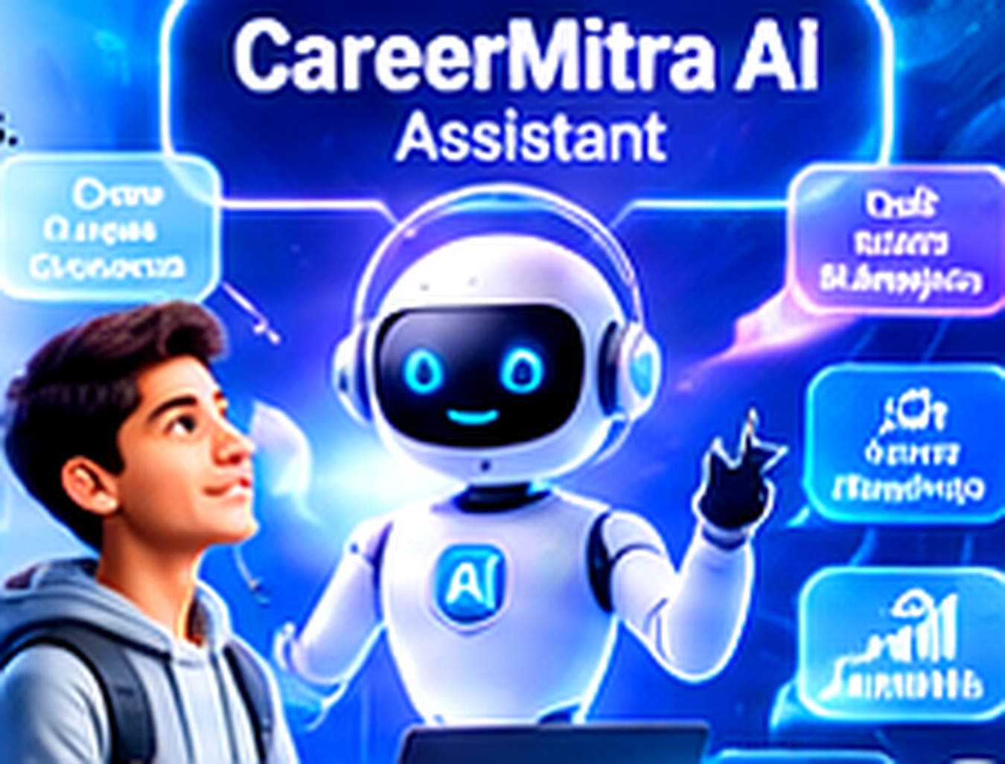
Role of Agentic AI in the Solution
Role of Agentic AI in CareerMitra AI Assistant
Agentic AI enables CareerMitra AI to work toward a student’s career goal through coordinated tasks rather than responding with generic one-time advice. IBM Granite, through watsonx.ai, can interpret a request, plan the steps, and support specialized career-guidance functions.
The system separates work into focused roles: profile understanding, career assessment, career matching, skill-gap analysis, labour-market insights, and roadmap planning. The outputs are combined into a single explanation with recommended next actions.
Context awareness helps the platform consider a learner’s education, skills, interests, and goals. A feedback loop can refresh the roadmap when the student reports new grades, completed courses, projects, or changing interests.
Agentic AI makes the experience more proactive and personalized. Important recommendations should remain explainable, evidence-aware, and subject to student review; the system should not promise a job or make decisions on the student’s behalf.
Career Guidance
Skill Gap Analysis
Personalized career direction
Skills to develop for target roles
Career Roadmap
Job Market Insights
Learning steps and milestones
Industry and role awareness

Slide 10
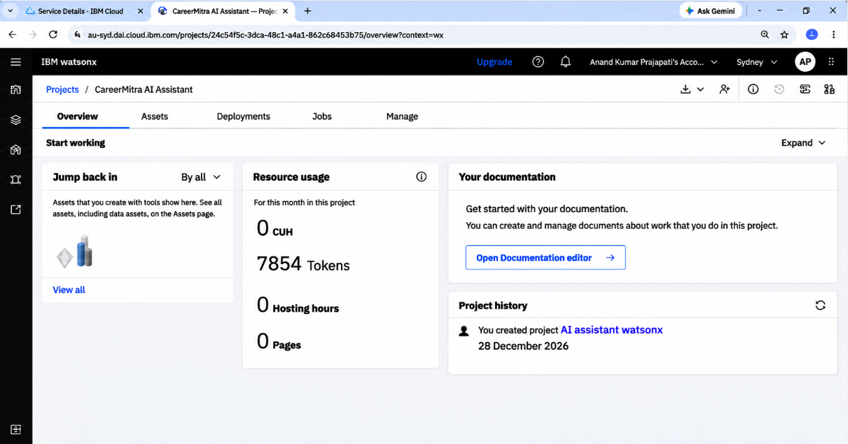
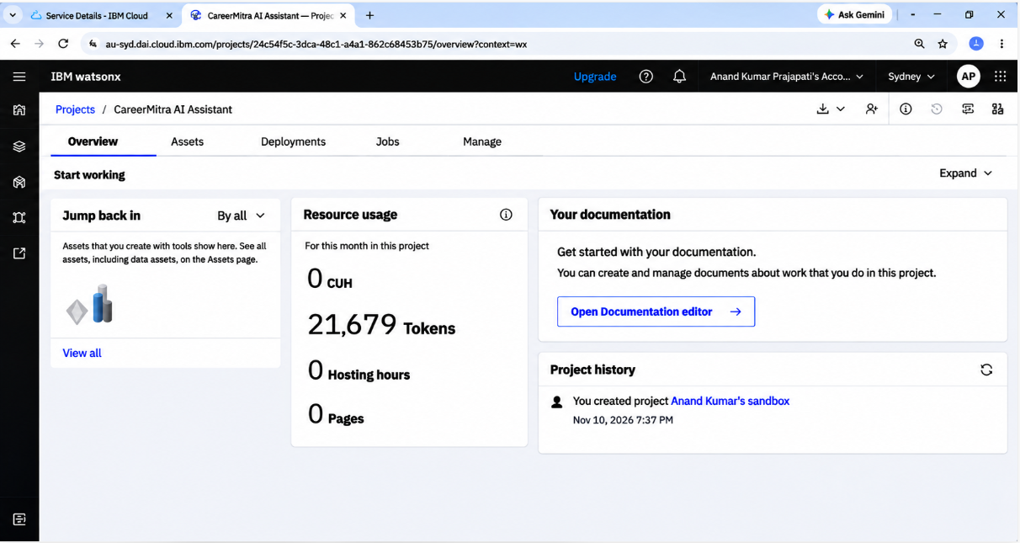
Token Usage
Before Prompt
After Prompt

Slide 11
Novelty and Uniqueness
CareerMitra AI Assistant combines agentic task planning, student context, and career-pathway guidance in one platform.
Personalized Career Guidance – Recommendations are linked to the learner’s education, skills, interests, and goals.
Multi-Agent Role Design – Focused functions for assessment, matching, skill-gap analysis, market insights, and roadmap creation.
Skill-to-Role Mapping – Connects target career roles with the capabilities a student should develop.
Progress-aware Roadmap -Turns recommendations into practical learning milestones and can adapt as the learner reports progress.
Labor-Market Awareness – Designed to use current, traceable job and skills information when reliable sources are connected.
Explainable Suggestions – Gives the learner reasons behind recommendations and encourages review and correction.
Accessible Dashboard – Brings profile, AI counselling, recommendations, skills, and roadmap tools together.
This makes CareerMitra AI a structured career-development companion rather than only a general-purpose chatbot.

Slide 12
GitHub Link & Live Application
Public GitHub Repository
https://github.com/anandprajapati-tech/CareerMitra-AI-Assistant
Live Streamlit Application
https://careermitra-ai-assistant-jfaat8yx2cf66j7rlhrks3.streamlit.app/
Repository submission checklist:
1) app.py – main Streamlit application.
2) requirements.txt – Python dependencies.
3) README.md – project overview and setup instructions.
4) Problem statement / project report PDF.
5) CareerMitra project presentation PPTX.
6) Supporting assets and configuration examples (without secrets).
Important: Never upload API keys, passwords, private student data, or .env files to a public repository. Use Streamlit Secrets or environment variables for credentials.

Slide 13
Future Scope
1. Live Labour-Market Integration –
Connect trusted job portals, skills frameworks, and labour-market datasets to refresh role demand and skill requirements. Show source and last-updated date.
2. Multilingual AI Voice Assistant –
Add Hindi, English, and Hinglish voice interaction to make career guidance easier to access.
3. Student Progress Monitoring –
With student consent, track completed learning activities, projects, and updated skills to refresh the roadmap.
4. Learning Resource Integration –
Connect recommended courses, certifications, and project resources to each identified skill gap.
5. Counsellor Collaboration –
Provide an authorized counsellor view for student-approved profiles and progress.
6. Notifications and Reminders –
Offer opt-in reminders for roadmap milestones, applications, and periodic career reviews.

Slide 14
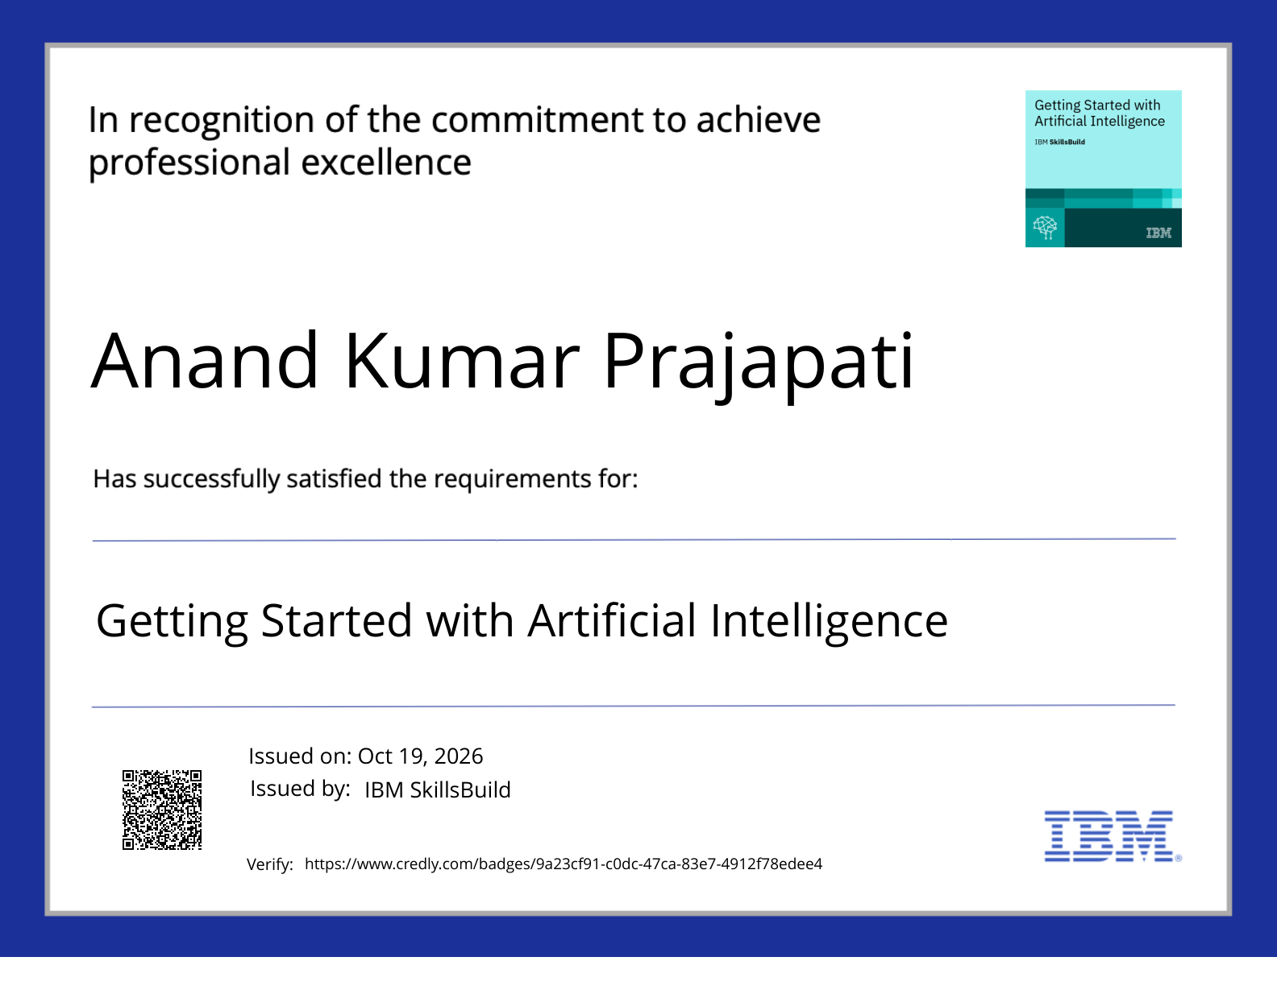
Certificates Earned:
IBM SkillsBuild – Getting Started with Artificial Intelligence

Slide 15
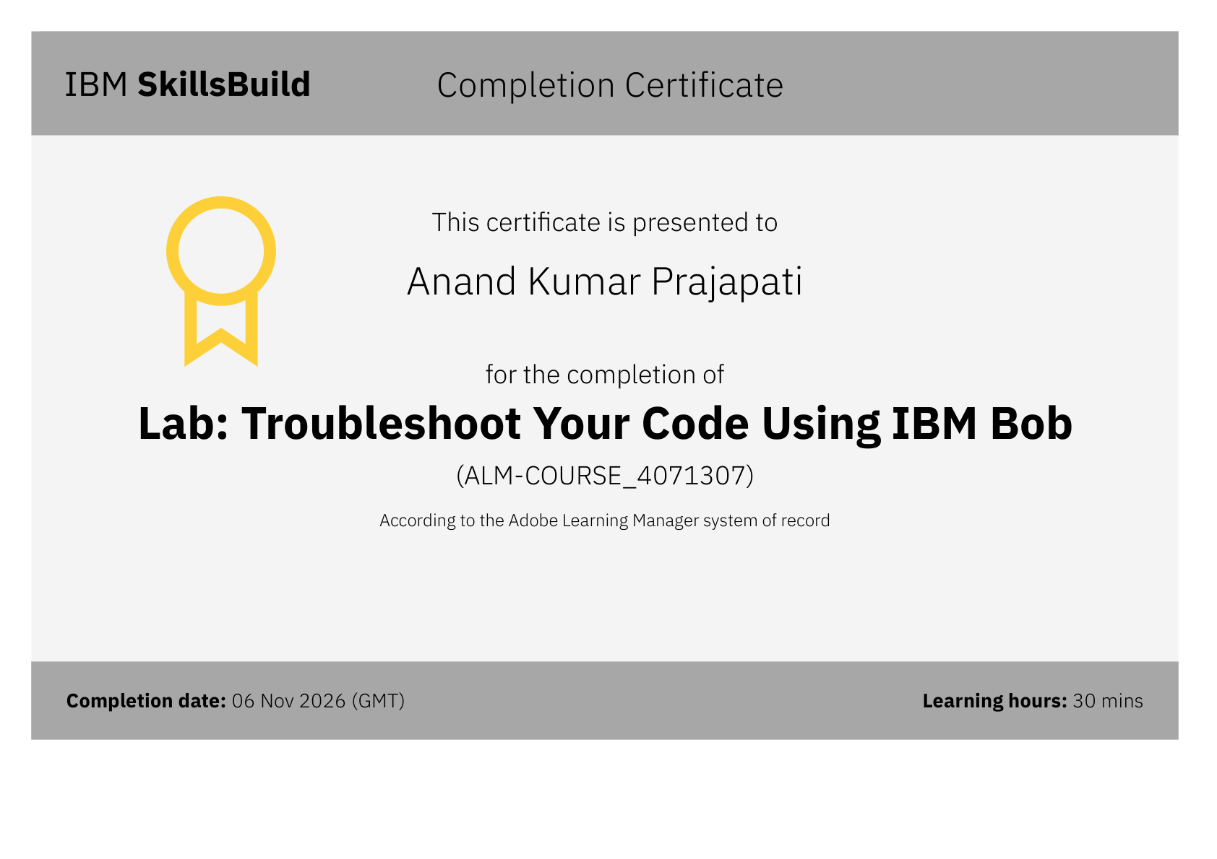
Certificates Earned:
IBM SkillsBuild – Lab: Troubleshoot Your Code Using IBM Bob

Slide 16

Anand Kumar Prajapati | prajapatianand5732@gmail.com

