Slide 1
Python - Function
Premanand S

Slide 2
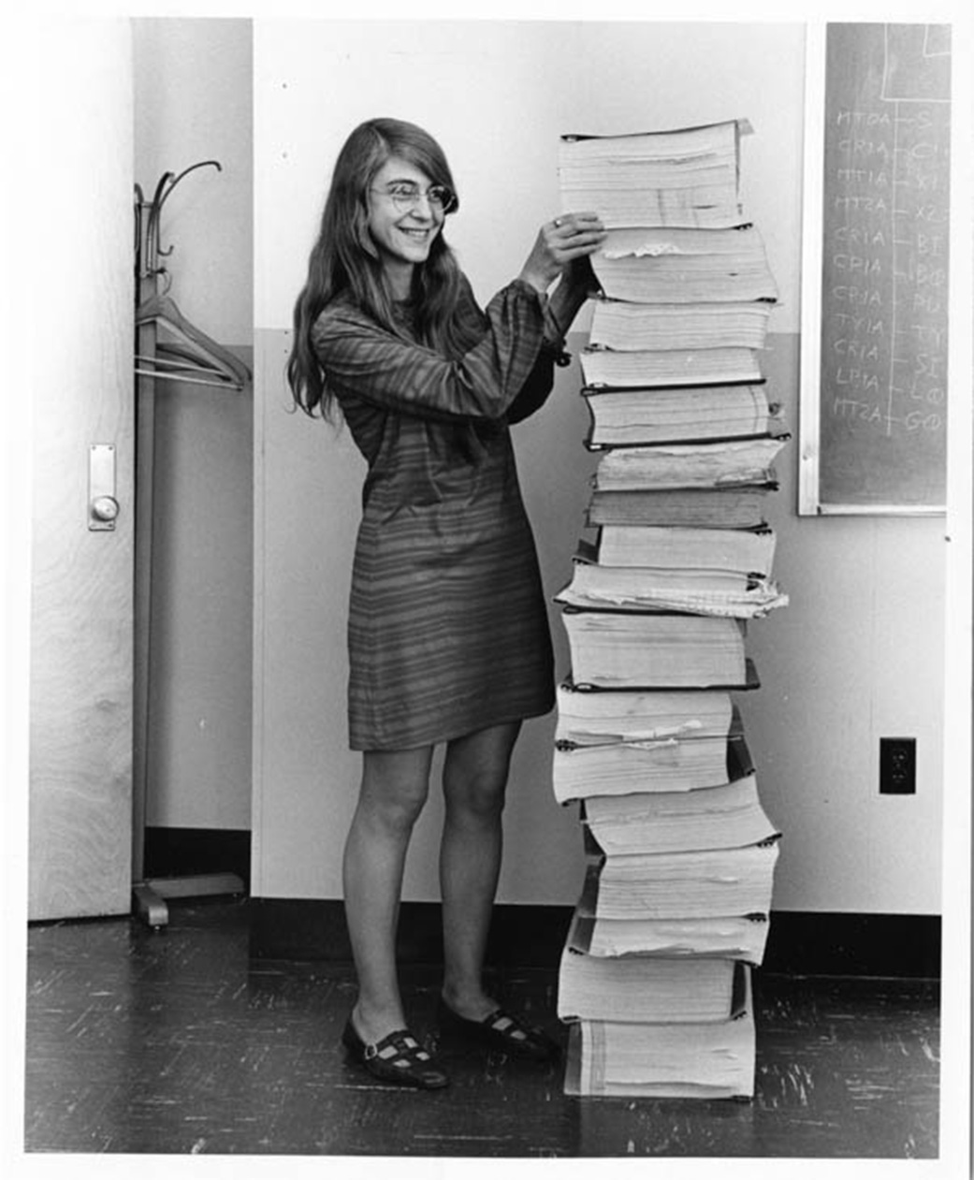
Need of function?

Slide 3
Function
Group of related statements that performs a specific task
Helps break our program into smaller
Bigger program, function makes it organized
Avoids repetition
def function_name(parameters):
"""docstring"""
statement(s)

Slide 4
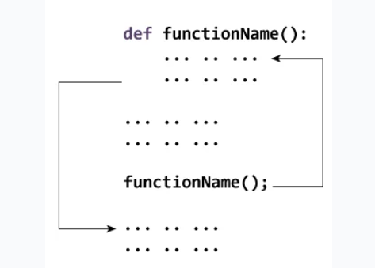
How function works?

Slide 5
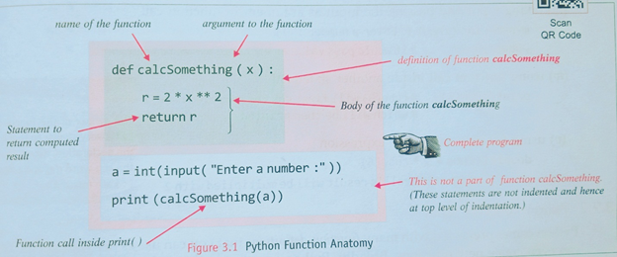
Function anatomy

Slide 6
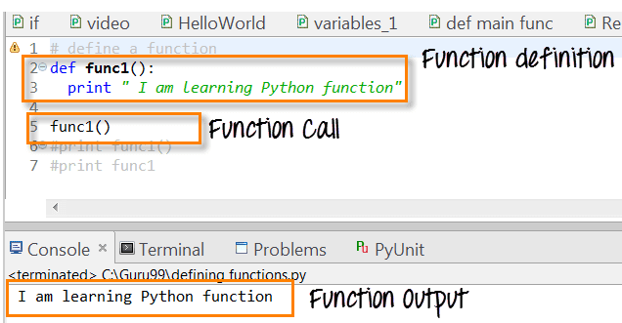
function

Slide 7
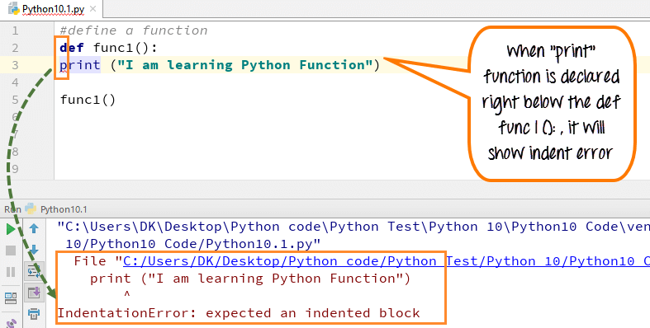
Function - indentation

Slide 8
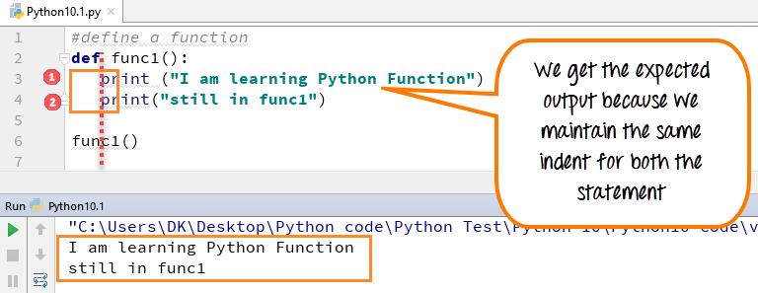
Function - indentation

Slide 9
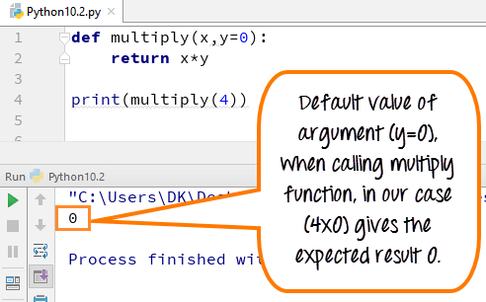
Function arguments

Slide 10
Docstrings in function
Description about the function within quotes
Its an optional but yet formal way of writing docstring within function for easy understanding
Triple quote helps in writing multiple line
__doc__ attribute – docstring
Apart from within function attribute, it can be used for all keywords too, to get attributes about that modeule

Slide 11
return
Exit the function and reach where the function is called
return [expression_list]

Slide 12
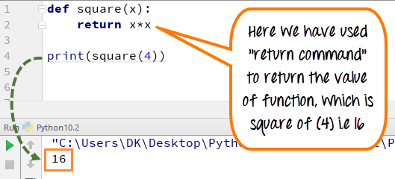
Return statement

Slide 13
Types of function
Built in function
User defined function

Slide 14
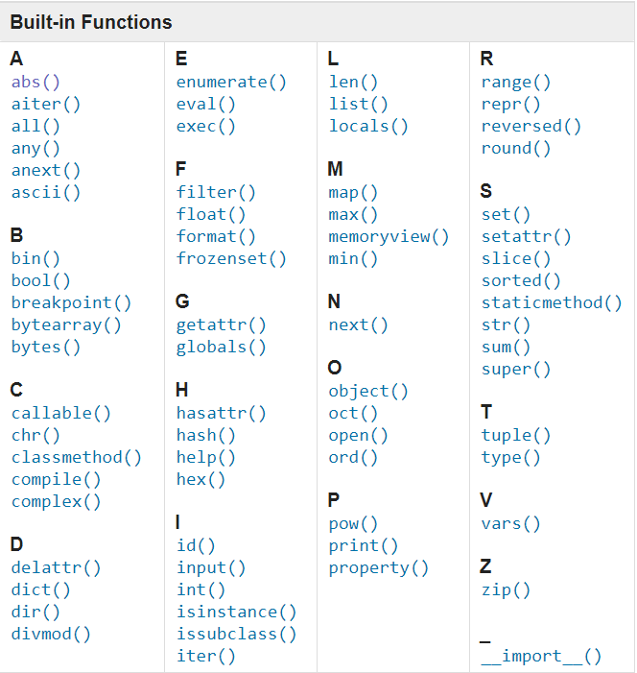
Built in functions

