Slide 1


26CSE1002J - Programming for Problem Solving
SRM INSTITUTE OF SCIENCE AND TECHNOLOGY
Kattankulathur
SCHOOL OF COMPUTING
Unit 1 : Decision-Making
Prepared by - Dr. Jeba Sonia J,Dr.R.Anita Jasmine, Dr. B.Yasodha DSBS

Slide 2
What Is a Computer Program?
A computer cannot think on its own — it only follows instructions.
A program is a set of step-by-step instructions that tells a computer exactly what to do.
These instructions must be written in a language the computer understands.
Just like a recipe tells a cook what to do step by step, a program tells a computer what to do step by step.
EVERYDAY ANALOGY
Recipe → Cook
(ingredients, steps, order)
Program → Computer
(data, instructions, order)

Slide 3
What Is a Programming Language? What Is C?
A programming language is a set of rules and words used to write instructions for a computer (e.g., C, Python, Java).
C is one of the oldest and most important programming languages — created by Dennis Ritchie in 1972 at Bell Labs.
Why C Is Taught First | What It Means for You
Close to how the computer actually works | You understand memory, variables, and logic deeply
Simple, small set of rules | Easier for beginners — including non-CS backgrounds
Foundation for C++, Java, Python, C# | Learning C makes every future language easier
Used in operating systems, embedded devices | Practical, real-world relevance

Slide 4
Structure of a C Program
Skeleton of a C Program
#include <stdio.h>
int main()
{
// declarations
// statements
return 0;
}
#include <stdio.h> — brings in ready-made input/output tools (like printf, scanf).
int main() — every C program starts execution from main(). It is compulsory.
{ } — curly braces mark the start and end of a block of code.
Statements inside main() run one after another, from top to bottom.
return 0; — tells the operating system the program finished successfully.

Slide 5
Your First C Program: Hello, World!
Example
#include <stdio.h>
int main()
{
printf("Hello, World!");
return 0;
}
OUTPUT
Hello, World!
printf() displays (prints) text on the screen.
Text inside double quotes " " is printed exactly as typed.
Every statement in C ends with a semicolon ( ; ).
This is usually the very first program every C programmer writes.

Slide 6
How a C Program Runs: Compiling & Executing
1. Write Source Code
2. Compile
3. Link
4. Run / Execute
You type .c file
using an editor/IDE
Compiler checks &
translates to machine code
Combines code with
library files
CPU executes the
program, shows output
A compiler (e.g., GCC, Turbo C, or an online tool like Replit) converts C code into machine code the computer can run.
If there are typing/logic mistakes, the compiler reports errors before the program can run.

Slide 7
Keywords in C
Keywords are reserved words that already have a fixed meaning in C. You cannot use them as variable names.
int
float
char
if
else
for
while
do
switch
case
return
void
break
continue
const
struct

Slide 8
Identifiers — Naming Things in a Program
An identifier is a name you give to a variable, function, or other item in your program (e.g., score, totalMarks).
Rule | Valid Example | Invalid Example
Can contain letters, digits, underscore | student_1 | student#1
Must start with a letter or underscore (not a digit) | _total, total1 | 1total
Cannot be a C keyword | sum, avg | int, float
Case-sensitive (Marks and marks are different) | Marks, marks | —
No spaces allowed | totalMarks | total Marks

Slide 9
Comments in C
Comments are notes for humans — the compiler ignores them completely.
They are used to explain what the code does, making it easier to read and maintain.
Two types in C:
  Single-line comment
  Multi-line comment
Example
#include <stdio.h>
int main()
{
// This prints a message
printf("Hi!");
/* This is a
multi-line comment */
return 0;
}

Slide 10
Recap:
A program is a set of instructions; C is a simple, foundational programming language.
Every C program starts from main() and is written inside { } blocks.
A source file is compiled, linked, and then run to produce output.
Keywords are reserved; identifiers are the names you choose for variables and functions.
Comments explain code to humans and are ignored by the compiler.

Slide 11
26CSE1002J - Programming for Problem Solving
Unit 1 : Decision-Making
Example Programs & Practice Questions: Introduction to C

Slide 12
Example Program 1 — Printing Details
Program
#include <stdio.h>
int main()
{
printf("Name: Arun Kumar\n");
printf("Department: CSE\n");
printf("College: SRMIST\n");
return 0;
}
OUTPUT
Name: Arun Kumar
Department: CSE
College: SRMIST
Each printf() prints one line and moves to the next using \n.
This is the simplest kind of C program — only output, no input.

Slide 13
Example Program 2 — Comments & Multiple Statements
Program
#include <stdio.h>
int main()
{
// Step 1: greet the user
printf("Hello, Student!\n");
// Step 2: show a motivational line
printf("Let's learn C together.\n");
return 0;
}
OUTPUT
Hello, Student!
Let's learn C together.
Comments (//) explain each step but do not appear in the output.
Statements execute strictly top to bottom.

Slide 14
Spot the Bug!
The program below has 3 mistakes. Can you find them before checking the answer?
Buggy Code
#include <stdio.h>
int main()
{
printf("Hello World"
return 0
}
Answer: 3 mistakes found.
Reason: 1) Missing closing ) after "Hello World". 2) Missing ; after printf(...). 3) Missing ; after return 0.

Slide 15
Practice Questions — Try These Yourself
1. Write a C program to print your name, roll number, and branch on three separate lines.
2. Write a C program that prints "Programming is Fun!" five times using five separate printf() statements.
3. Write a C program with at least two comments explaining what each printf() line does.
4. Write a C program that prints a small pattern using text, for example: * * * / ** ** ** / *** *** *** (one printf per line).
5. Rewrite Example Program 1 to also print your favorite subject, keeping the same style.

Slide 16
26CSE1002J - Programming for Problem Solving
Unit 1 : Decision-Making
Session 1 | SLO-1
SLO: Introduce simple data types (int, float, char) in C by understanding their size, range, and appropriate applications.

Slide 17
What Is a Variable?
A variable is a named location in the computer's memory used to store a value.
Think of it as a labelled box that can hold one piece of data at a time.
The value inside a variable can change while the program runs — that's why it is called a 'variable'.
In C, every variable must be declared with a data type before it is used.
age
21
A box labelled 'age' holding the value 21 in memory

Slide 18
What Is a Data Type? Why Do We Need It?
A data type tells the compiler what kind of value a variable will store, and how much memory to set aside for it.
Different kinds of information need different treatment — a whole number, a decimal number, and a single character are not stored the same way.
Real-World Data | C Data Type
Number of students in a class (25) | int
Height of a student (5.6 feet) | float
Grade of a student ('A') | char

Slide 19
Basic Data Types in C — Overview
Data Type | Used For | Example Value
int | Whole numbers (no decimal point) | 25, -10, 0
float | Decimal (real) numbers | 5.6, -3.14, 0.0
char | A single character | 'A', 'z', '5'
These are called basic (primitive) data types — the building blocks of every C program.
Choosing the correct data type keeps your program accurate and memory-efficient.

Slide 20
The int Data Type
Used to store whole numbers — numbers without a decimal point.
Can be positive, negative, or zero.
Typical size: 4 bytes (on most modern compilers).
Typical range: −2,147,483,648 to 2,147,483,647.
Examples: number of students, age, marks, count of items.
Example
int age = 20;
int totalStudents = 60;
int temperature = -5;
FORMAT SPECIFIER
%d is used with int
in printf() and scanf()

Slide 21
The float Data Type
Used to store decimal (real) numbers — numbers with a fractional part.
Can represent very small or very large decimal values.
Typical size: 4 bytes.
Typical range: about 1.2×10⁻³⁸ to 3.4×10³⁸ (approximate precision, about 6-7 digits).
Examples: height, weight, price, average, temperature in decimals.
Example
float height = 5.9;
float price = 199.50;
float pi = 3.14159;
FORMAT SPECIFIER
%f is used with float
in printf() and scanf()

Slide 22
The char Data Type
Used to store a single character — a letter, digit symbol, or special symbol.
Always written inside single quotes: 'A', 'z', '7', '$'.
Typical size: 1 byte.
Range: −128 to 127 (internally, C stores a character as a small integer using ASCII code).
Examples: grade ('A'), gender ('M'/'F'), a menu choice ('1').
Example
char grade = 'A';
char initial = 'S';
char symbol = '$';
FORMAT SPECIFIER
%c is used with char
in printf() and scanf()

Slide 23
Size and Range — Quick Reference
Data Type | Size (typical) | Approximate Range | Format Specifier
int | 4 bytes | -2,147,483,648 to 2,147,483,647 | %d
float | 4 bytes | ~1.2E-38 to ~3.4E38 (6-7 digit precision) | %f
char | 1 byte | -128 to 127 (stores ASCII code) | %c
Size decides how much memory (in bytes) a variable occupies. Range decides the smallest and largest value it can safely store.
Using sizeof(int), sizeof(float), sizeof(char) in a program shows you the exact size on your own compiler.

Slide 24
Declaring & Initializing Variables
Syntax
dataType variableName;
dataType variableName = value;
Example
int marks; // declaration
marks = 88; // assignment
float avg = 78.5; // declare + initialize
Declaration tells the compiler the variable's name and type (memory is reserved, value is undefined).
Initialization gives the variable its first value at the time of declaration.

Slide 25
Choosing the Right Data Type
Pick the data type that matches the real-world quantity you are storing:
Real-World Quantity | Best Data Type | Why
Number of students in a class | int | Always a whole number
Price of an item (₹149.50) | float | Has a decimal part
A student's grade ('A', 'B'...) | char | A single symbol, not a number
Attendance percentage (87.5%) | float | Has a decimal part
Roll number (101) | int | A whole number

Slide 26
Recap
A variable is a named box in memory; a data type tells the compiler what kind of value it holds.
int stores whole numbers, float stores decimal numbers, char stores a single character.
Each data type has a typical size (in bytes) and a range of values it can hold.
Use %d for int, %f for float, and %c for char in printf() / scanf().
Always choose the data type that matches the real quantity you are storing.

Slide 27
Example Program 1 — Declaring All Three Types
Program
#include <stdio.h>
int main()
{
int age = 19;
float height = 5.6;
char grade = 'A';
printf("Age: %d\n", age);
printf("Height: %.1f\n", height);
printf("Grade: %c\n", grade);
return 0;
}
OUTPUT
Age: 19
Height: 5.6
Grade: A
%.1f prints a float with 1 digit after the decimal point.
Each variable uses the format specifier that matches its data type.

Slide 28
Example Program 2 — Checking Size with sizeof()
Program
#include <stdio.h>
int main()
{
printf("Size of int: %lu bytes\n", sizeof(int));
printf("Size of float: %lu bytes\n", sizeof(float));
printf("Size of char: %lu bytes\n", sizeof(char));
return 0;
}
OUTPUT (typical)
Size of int: 4 bytes
Size of float: 4 bytes
Size of char: 1 byte
sizeof() tells you exactly how much memory a data type uses on your own compiler.

Slide 29
Example Program 3 — Taking Input from the User
Program
#include <stdio.h>
int main()
{
int rollNo;
float marks;
char section;
printf("Enter roll number, marks, section: ");
scanf("%d %f %c", &rollNo, &marks, &section);
printf("Roll No: %d, Marks: %.2f, Section: %c\n", rollNo, marks, section);
return 0;
}

Slide 30
Choose the Right Data Type
1. You need to store the number of pages in a book.
Answer: int
Reason: Number of pages is always a whole number.
2. You need to store the price of a notebook (₹45.75).
Answer: float
Reason: The price has a decimal (paise) part.
3. You need to store a student's blood group letter,
e.g., 'O'.
Answer: char
Reason: A single character/symbol, not a number.
4. You need to store the average rainfall in mm
(123.45 mm).
Answer: float
Reason: Rainfall is measured with decimal precision.

Slide 31
Practice Questions — Try These Yourself
1. Write a program that declares and prints your age (int), your height in feet (float), and the first letter of your name (char).
2. Write a program that uses sizeof() to print the size of a double along with int, float, and char.
3. Write a program that reads a student's marks (float) using scanf() and prints it using printf().
4. For each of the following, write only the variable declaration with the correct data type: number of chapters in a textbook, temperature in Celsius, first letter of a city name.
5. Write a program that stores three different subjects' marks (int) and prints all three using one printf() statement.

Slide 32
26CSE1002J - Programming for Problem Solving
Unit 1 : Decision-Making
Session 1 | SLO-2
SLO: Understand assignment usage and evaluate arithmetic expressions.

Slide 33
The Assignment Operator ( = )
In C, the = symbol is the assignment operator. It stores the value on its right side into the variable on its left side.
It does NOT mean 'equal to' like in mathematics — it means 'store into'.
Syntax
variable = value;
variable = expression;
READ IT AS
"marks is assigned the value 90"
not "marks equals 90"

Slide 34
Assignment — Examples
Example Program
int marks;
marks = 90; // store 90 in marks
int total = 250; // declare + assign
total = total + 10;
// take old total, add 10,
// store new result back in total
The right-hand side is calculated FIRST.
Then the result is stored in the variable on the left.
total = total + 10; is valid in C — it means 'compute total+10, then overwrite total with this new value'.
A variable can be assigned a new value as many times as needed while a program runs.

Slide 35
Arithmetic Operators in C
Operator | Meaning | Example | Result
+ | Addition | 5 + 2 | 7
- | Subtraction | 5 - 2 | 3
* | Multiplication | 5 * 2 | 10
/ | Division | 5.0 / 2.0 | 2.5
% | Remainder (Modulus) | 5 % 2 | 1
These operators work on numeric data types (int, float) to perform calculations.
% (modulus) only works with whole numbers (int) — it gives the remainder after division.

Slide 36
Evaluating Arithmetic Expressions
An expression is a combination of variables, constants, and operators that produces a value.
Example
int a = 10, b = 3;
int sum = a + b; // sum = 13
int difference = a - b; // difference = 7
int product = a * b; // product = 30
int quotient = a / b; // quotient = 3 (int division)
int remainder = a % b; // remainder = 1

Slide 37
Integer Division vs. Float Division
This is one of the most common beginner mistakes in C
Integer Division
int a = 7, b = 2;
int result = a / b;
// result = 3 (NOT 3.5)
// Both operands are int,
// so the decimal part
// is dropped (truncated).
Float Division
float a = 7.0, b = 2.0;
float result = a / b;
// result = 3.5
// At least one operand
// is a float, so the
// decimal part is kept.

Slide 38
The Modulus Operator ( % )
% gives the remainder left over after integer division.
Works only with integers — not with float or double.
Very useful for checking odd/even numbers, cyclic patterns, and divisibility.
Examples
10 % 3 // 1 (10 = 3*3 + 1)
20 % 5 // 0 (exactly divisible)
7 % 2 // 1 (7 is odd)
8 % 2 // 0 (8 is even)

Slide 39
Order of Operations — A First Look
When an expression has more than one operator, C follows a fixed order to decide what to calculate first.
This is called operator precedence — just like BODMAS/PEMDAS rules in mathematics.
Example
int result = 10 + 2 * 3;
// Multiplication happens BEFORE addition
// result = 10 + (2 * 3) = 10 + 6 = 16 (NOT 36)
We will study the full operator precedence table in detail in SLO-4.

Slide 40
Practice: Evaluate These Expressions
Expression | Your Answer
int x = 15 / 4; | ?
int y = 15 % 4; | ?
float z = 15.0 / 4.0; | ?
int p = 6 * 2 - 4; | ?
int q = (6 * 2) - (10 % 3); | ?

Slide 41
Recap — SLO-2
The = operator assigns (stores) a value into a variable; it is not mathematical equality.
C provides five basic arithmetic operators: +, -, *, /, and %.
An expression combines variables, constants, and operators to produce a value.
int / int gives integer (truncated) division; involving a float keeps the decimal part.
% (modulus) only works with integers and gives the remainder.

Slide 42
Example Program 1 — A Simple Calculator
Program
#include <stdio.h>
int main()
{
int a = 12, b = 5;
printf("Sum = %d\n", a + b);
printf("Difference = %d\n", a - b);
printf("Product = %d\n", a * b);
printf("Quotient = %d\n", a / b);
printf("Remainder = %d\n", a % b);
return 0;
}
OUTPUT
Sum = 17
Difference = 7
Product = 60
Quotient = 2
Remainder = 2

Slide 43
Example Program 2 — Average of Three Marks
Program
#include <stdio.h>
int main()
{
int m1 = 78, m2 = 85, m3 = 91;
float average;
average = (m1 + m2 + m3) / 3.0;
printf("Average = %.2f\n", average);
return 0;
}
OUTPUT
Average = 84.67
3.0 (a float) is used instead of 3 so the division keeps the decimal part.
If we had written / 3 instead of / 3.0, integer division rules would apply and precision would be lost.

Slide 44
Example Program 3 — Total Cost of Items
Program
#include <stdio.h>
int main()
{
int quantity = 4;
float pricePerItem = 25.50;
float totalCost;
totalCost = quantity * pricePerItem;
printf("Total Cost = %.2f\n", totalCost);
return 0;
}

Slide 45
Predict the Output
1. int a = 9, b = 4;
printf("%d", a / b);
Answer: 2
Reason: Both operands are int, so the result is truncated (9/4 = 2.25 -> 2).
2. float a = 9.0, b = 4.0;
printf("%.2f", a / b);
Answer: 2.25
Reason: At least one operand is float, so the decimal part is kept.
3. int x = 17;
printf("%d", x % 5);
Answer: 2
Reason: 17 = 5*3 + 2, so the remainder is 2.
4. int total = 100;
total = total - 30;
printf("%d", total);
Answer: 70
Reason: total is reassigned: 100 - 30 = 70 is stored back into total.

Slide 46
Practice Questions — Try These Yourself
1. Write a program to find the area of a rectangle given its length and breadth (both int).
2. Write a program that calculates the average of two integer marks and stores the result in a float variable.
3. Write a program that checks whether a number is exactly divisible by another using % (just print the remainder — no if statement needed yet).
4. Write a program to convert a given amount from rupees to paise (1 rupee = 100 paise).
5. Write a program to compute the perimeter of a rectangle: perimeter = 2 * (length + breadth).

Slide 47
26CSE1002J - Programming for Problem Solving
Unit 1 : Decision-Making
Session 2 | SLO-3 (Guided Practice)
SLO: Trace the execution of small programs involving variable declarations, assignments, and simple expressions to determine the final output.

Slide 48
What Does It Mean to "Trace" a Program?
Tracing means reading a program line by line, exactly as the computer would, and working out the value of every variable at each step.
It is done using pen and paper — no computer needed.
The goal is to predict the final output before you ever run the code.
Think of tracing like following a recipe with your finger,
checking what is in each bowl after every step —
instead of ingredients, we are tracking variable values.

Slide 49
Why Tracing Matters
It builds the core skill every programmer needs: reading code like the computer reads it.
It helps you find logic errors (bugs) before running the program.
It is exactly how you will be asked to answer 'predict the output' questions in exams.
It removes the fear of code — once you can trace it, you understand it completely.

Slide 50
How to Trace: The Variable Table Method
Draw a small table with one column for every variable in the program.
Line executed | a | b | sum
... | ... | ... | ...
Go through the code one statement at a time, top to bottom.
After each statement, update only the variable(s) that changed — leave the rest as they were.
Once you reach the last statement, the table shows you the final output.

Slide 51
Example 1 — Trace a Simple Program
Program
int a;
int b;
a = 5;
b = 10;
int sum = a + b;
printf("%d", sum);
Line executed | a | b | sum
int a; | ? | - | -
int b; | ? | ? | -
a = 5; | 5 | ? | -
b = 10; | 5 | 10 | -
sum = a + b; | 5 | 10 | 15
Output: 15

Slide 52
Example 2 — Trace with Arithmetic Expressions
Program
int x = 8;
int y = 3;
int diff = x - y;
int prod = x * y;
diff = diff + 2;
printf("%d %d", diff, prod);
Line executed | x | y | diff | prod
int x = 8; | 8 | - | - | -
int y = 3; | 8 | 3 | - | -
diff = x - y; | 8 | 3 | 5 | -
prod = x * y; | 8 | 3 | 5 | 24
diff = diff + 2; | 8 | 3 | 7 | 24
Output: 7 24

Slide 53
Example 3 — Multiple Variables Interacting
Program
int a = 4;
int b = a + 1;
a = a + b;
b = a - b;
printf("%d %d", a, b);
Line executed | a | b
int a = 4; | 4 | -
int b = a + 1; | 4 | 5
a = a + b; | 9 | 5
b = a - b; | 9 | 4
Output: 9 4
Notice: variables update in the ORDER the lines run

Slide 54
Common Mistakes When Tracing
Using the NEW value of a variable before it has actually been updated on that line.
Forgetting that a = a + b; uses the OLD value of a on the right side, then stores the new result.
Skipping a line because it looks 'unimportant' — every executed line can change a variable.
Mixing up int division: 7 / 2 gives 3, not 3.5, if both are int.
Not updating every affected variable in the table after each line.

Slide 55
Practice: You Trace It
Program
int p = 6;
int q = 2;
p = p * q;
q = p / q;
p = p - q;
printf("%d %d", p, q);
Line executed | p | q
int p = 6;
int q = 2;
p = p * q;
q = p / q;
p = p - q;

Slide 56
Recap — SLO-3
Tracing means executing a program mentally, line by line, to find the final output.
A variable table (one column per variable) keeps track of every value as it changes.
Only the variable(s) affected by the current line are updated in the table — others stay the same.
The right side of = is evaluated using OLD values, before the new value is stored.
Tracing builds the habit of reading code the way the computer executes it.

Slide 57
Worked Example — Trace This Program
Program
int m = 3;
int n = 7;
m = m + n;
n = m - n;
m = m - n;
printf("%d %d", m, n);
Line executed | m | n
int m = 3; | 3 | -
int n = 7; | 3 | 7
m = m + n; | 10 | 7
n = m - n; | 10 | 3
m = m - n; | 7 | 3
Output: 7 3

Slide 58
Practice Trace 1 — Fill In the Table
Program
int x = 2;
int y = 5;
x = x * y;
y = y + 1;
x = x - y;
printf("%d %d", x, y);
Line executed | x | y
int x = 2;
int y = 5;
x = x * y;
y = y + 1;
x = x - y;

Slide 59
Practice Trace 2 — Fill In the Table
Program
int p = 10;
int q = 4;
int r;
r = p % q;
p = p / q;
q = r + p;
printf("%d %d %d", p, q, r);
Line executed | p | q | r
int p = 10;
int q = 4;
int r;
r = p % q;
p = p / q;
q = r + p;

Slide 60
Practice Trace 3 — Fill In the Table
Program
int a = 5;
int b = a + 2;
int c = a * b;
a = b + c;
c = a - b - c;
printf("%d %d %d", a, b, c);
Line executed | a | b | c
int a = 5;
int b = a + 2;
int c = a * b;
a = b + c;
c = a - b - c;

Slide 61
Answer Key — Final Outputs
Practice Trace | Final Output
Practice Trace 1 | x = 4, y = 6 -> Output: 4 6
Practice Trace 2 | p = 2, q = 4, r = 2 -> Output: 2 4 2
Practice Trace 3 | a = 42, b = 7, c = 0 -> Output: 42 7 0
Try tracing each program yourself first — then use this table only to check your work.

Slide 62
More Practice Questions — Try These Yourself
1. Trace: int a=1,b=2,c=3; c=a+b; a=b+c; b=a-c; printf("%d %d %d",a,b,c);
2. Trace: int n=6; n=n*n; n=n-10; printf("%d", n);
3. Trace: int p=8,q=3; p=p/q; q=p*q; printf("%d %d", p, q);
4. Write your own 4-line program using int variables and arithmetic, then trace it using a variable table before running it on a compiler.

Slide 63
26CSE1002J - Programming for Problem Solving
Unit 1 : Decision-Making
Session 2 | SLO-4 (Practice)
SLO: Apply operator precedence rules and perform variable swapping (with and without a temporary variable).

Slide 64
What Is Operator Precedence?
When an expression has more than one operator, C must decide which operation to perform first.
Operator precedence is the fixed set of rules that decides this order — similar to BODMAS/PEMDAS in mathematics.
Without knowing precedence, this is confusing:
int result = 4 + 3 * 2;
// Is it (4 + 3) * 2 = 14 ? or 4 + (3 * 2) = 10 ?
// C follows a fixed rule: multiplication before addition -> result = 10

Slide 65
Operator Precedence Table (Basic)
Precedence | Operator(s) | Meaning | Associativity
Highest | ( ) | Parentheses | Left to Right
2 | * , / , % | Multiply, Divide, Modulus | Left to Right
3 | + , - | Add, Subtract | Left to Right
Lowest | = | Assignment | Right to Left
Rule of thumb: Parentheses first, then * / %, then + -, and assignment ( = ) happens last.

Slide 66
Associativity — What If Operators Have the Same Rank?
When two operators have the same precedence, associativity decides the order — usually left to right.
Example
int result = 20 / 5 * 2;
// / and * have the SAME precedence
// Evaluated left to right:
// Step 1: 20 / 5 = 4
// Step 2: 4 * 2 = 8
// result = 8

Slide 67
Worked Example: Evaluate Step by Step
Expression
int result;
result = 6 + 4 * 2 - 3;
Step | Operation | Expression Becomes
1 | 4 * 2 (multiply first) | 6 + 8 - 3
2 | 6 + 8 (left to right) | 14 - 3
3 | 14 - 3 | 11
Final | result = 11

Slide 68
Practice: Evaluate These Expressions
Expression | Your Answer
10 + 2 * 5 | ?
(10 + 2) * 5 | ?
20 - 4 / 2 + 1 | ?
3 * 4 % 5 | ?
2 + 3 * (4 - 1) | ?

Slide 69
What Is Variable Swapping?
Swapping means exchanging the values stored in two variables.
Example: if a = 5 and b = 9, after swapping a = 9 and b = 5.
a
5
b
9
A common beginner mistake: writing a = b; b = a; directly loses the original value of a. We solve this next.

Slide 70
Swapping WITH a Temporary Variable
Code
int a = 5, b = 9, temp;
temp = a; // save a's value
a = b; // put b's value into a
b = temp; // put saved value into b
Statement | a | b | temp
Start | 5 | 9 | ?
temp = a; | 5 | 9 | 5
a = b; | 9 | 9 | 5
b = temp; | 9 | 5 | 5

Slide 71
Swapping WITHOUT a Temporary Variable
Code (arithmetic method)
int a = 5, b = 9;
a = a + b; // a now holds 5+9 = 14
b = a - b; // b = 14 - 9 = 5 (old a)
a = a - b; // a = 14 - 5 = 9 (old b)
Statement | a | b
Start | 5 | 9
a = a + b; | 14 | 9
b = a - b; | 14 | 5
a = a - b; | 9 | 5
This method uses only + and - and needs no extra variable — but works only with numbers.

Slide 72
Recap — SLO-4
Operator precedence decides the order operators are evaluated: ( ) first, then * / %, then + -, then =.
Operators with the same precedence are evaluated using associativity, usually left to right.
Swapping exchanges the values of two variables.
With a temporary variable: save one value first, then overwrite safely, then restore from temp.
Without a temporary variable: use arithmetic (+ / -) to swap in place — no extra variable needed.

Slide 73
26CSE1002J - Programming for Problem Solving
Unit 1 : Decision-Making
| SLO-4
Example Programs & Practice Questions: Operator Precedence & Variable Swapping

Slide 74
Example Program 1 — Precedence in Action
Program
#include <stdio.h>
int main()
{
int result = 5 + 3 * 2 - 4 / 2;
printf("Result = %d\n", result);
return 0;
}
Step | Operation | Value So Far
1 | 3 * 2 | 5 + 6 - 4 / 2
2 | 4 / 2 | 5 + 6 - 2
3 | 5 + 6 | 11 - 2
4 | 11 - 2 | 9
Result = 9

Slide 75
Example Program 2 — Swap Two Numbers (Temp Variable)
Program
#include <stdio.h>
int main()
{
int a, b, temp;
printf("Enter two numbers: ");
scanf("%d %d", &a, &b);
temp = a;
a = b;
b = temp;
printf("After swap: a = %d, b = %d\n", a, b);
return 0;
}

Slide 76
Example Program 3 — Swap Two Numbers (No Temp Variable)
Program
#include <stdio.h>
int main()
{
int a, b;
printf("Enter two numbers: ");
scanf("%d %d", &a, &b);
a = a + b;
b = a - b;
a = a - b;
printf("After swap: a = %d, b = %d\n", a, b);
return 0;
}

Slide 77
Predict the Output
1. printf("%d", 2 + 3 * 4 - 1);
Answer: 13
Reason: Multiply first (3*4=12), then left to right: 2+12-1=13.
2. printf("%d", (2 + 3) * (4 - 1));
Answer: 15
Reason: Parentheses are evaluated first: 5 * 3 = 15.
3. int a=5,b=8;
a=a+b; b=a-b; a=a-b;
printf("%d %d", a, b);
Answer: 8 5
Reason: This is the no-temp swap — a and b exchange values.
4. printf("%d", 20 % 6 + 2 * 3);
Answer: 8
Reason: % and * rank above +, so they happen first: 20%6=2 and 2*3=6, then 2+6=8.

Slide 78
Practice Questions — Try These Yourself
1. Evaluate by hand, then verify on a compiler: 15 - 2 * 3 + 8 / 4
2. Evaluate by hand, then verify: (15 - 2) * (3 + 8) / 4
3. Write a program to swap two float values using a temporary variable.
4. Write a program to swap two integers without using a temporary variable, then test it with negative numbers too.
5. Write a program that reads three integers and prints them in reverse order using swapping logic.

Slide 79
26CSE1002J - Programming for Problem Solving
Unit 1
Session: 5
SLO :Implement decision-making using if…else statements in C.

Slide 80
Decision-making statements in C
Decision-making statements in C allow a program to evaluate specific conditions and alter its execution path dynamically based on whether those conditions are true or false.
In C, any non-zero value is treated as true, while zero is treated as false.
The decision-making structures in C include
  If statement
  if-else statement
  if-else if-else statement, and
  switch-case statement

Slide 81
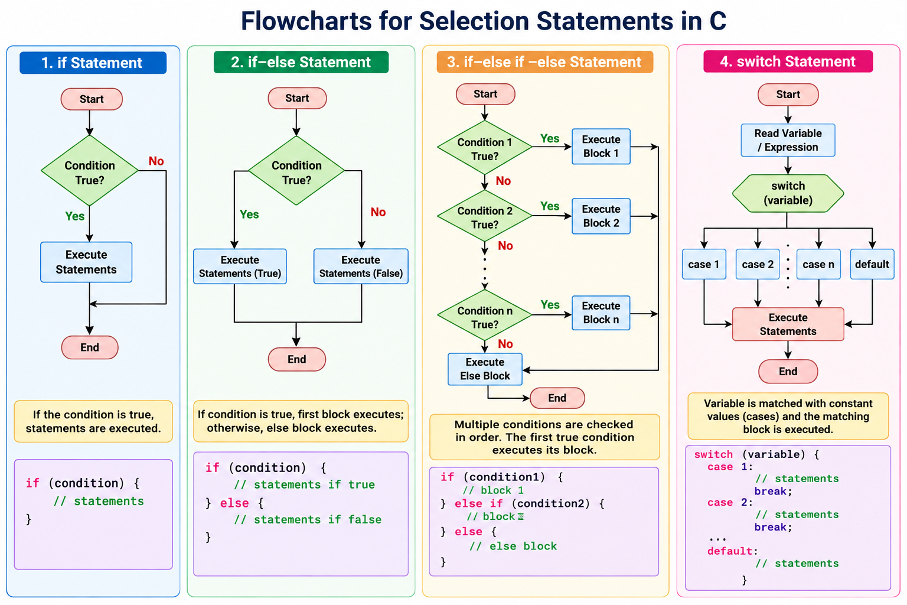

Slide 82
1. The if Statement
The simple if statement executes a block of code only if the specified condition evaluates to true. If the condition is false, the block is skipped entirely
Syntax
if(condition)
{ // Code to execute if condition is true }
Example
#include <stdio.h>
int main()
{ int score = 85;
if (score >= 50)
{ printf("You passed!\n"); }
return 0;
}

Slide 83
2.The if-else Statement
The if-else statement evaluates a condition, executing the if block if the condition is true, and the else block if the condition is false.
Example
#include <stdio.h>
int main()
{ int number = 13;
if (number % 2 == 0) { printf("Even number\n");}
else { printf("Odd number\n"); }
return 0;
}
Syntax
if (condition)
{ // Code if true }
else { // Code if false }

Slide 84
3. The if-else-if Ladder
When you need to test multiple conditions sequentially, the if-else-if ladder evaluates conditions from top to bottom. As soon as one condition evaluates to true, its corresponding block executes, and the rest of the ladder is skipped.
Syntax
if (condition1)
{ // Code if condition1 is true }
else if (condition2)
{ // Code if condition2 is true }
else
{ // Code if all conditions are false }
#include <stdio.h>
int main() {
int temperature = 25;
if (temperature > 30)
{ printf("It's hot.\n"); }
else if (temperature >= 15)
{ printf("It's pleasant.\n"); }
else
{ printf("It's cold.\n"); }
return 0;
}

Slide 85
4. Nested if-else Statements
A nested if statement is simply an if statement placed inside another if or else block. It is used when a subsequent decision depends entirely on the outcome of a previous decision.
#include <stdio.h>
int main() {
int marks;
printf("Enter your marks: "); scanf("%d", &marks);
  if (marks >= 40)
  { printf("You have passed.\n");
  if (marks >= 75)
  { printf("Grade: A"); }
  else { if (marks >= 60)
  { printf("Grade: B"); }
  else { printf("Grade: C"); }
  }
  } else { printf("You have failed."); } return 0;
}
Syntax
if (condition1)
{ // Code if condition1 is true }
else if (condition2)
{ // Code if condition2 is true }
else
{ // Code if all conditions are false }

Slide 86
5. The switch Statement
The switch statement provides a clean alternative to an if-else-if ladder when a single variable or expression needs to be compared against multiple constant integral values (like integers or characters)
Key Components:
  case: Matches the expression against a specific constant value.
  break: Exits the switch block immediately. If omitted, the program execution "falls through" into subsequent cases.
  default: Executes if none of the explicit cases match the expression's value.
Syntax
switch (expression)
{
  case value1: // Code block break; case value2: // Code block break; default: // Code block if no match
}

Slide 87
Example
switch (ch) {
      case 'a':
      case 'e':
      case 'i':
      case 'o':
      case 'u': printf("Vowel"); break; default: printf("Consonant");
}
return 0;
}
#include <stdio.h>
int main()
{
char ch;
printf("Enter a character between a and z: ");
scanf(" %c", &ch);

Slide 88
6. The Conditional (Ternary) Operator
The ternary operator (? :) serves as a shorthand alternative to a basic if-else statement. It evaluates an inline condition and returns one of two expressions.
syntax
variable = (condition) ? expression_if_true : expression_if_false;
Example
int a = 10, b = 20; int max = (a > b) ? a : b; // max will be assigned 20

Slide 89
summary
Statement | Best Used For | Condition Type Allowed | Efficiency
if | Evaluating a single Boolean condition | Logical expressions (x > 5) | High for simple conditions
if-else | Handling binary / true–false choices | Logical expressions | High
if-else if | Evaluating ranges or multiple complex conditions | Logical expressions | Evaluates conditions sequentially
switch | Testing a single variable against a specific set of constant values | Integral types such as integers and characters | Efficient for multiple fixed choices; may use jump tables

Slide 90
questions
1. A college wants to develop a program that checks whether a student has an attendance percentage of 75% or above. If yes, the student is eligible to write the examination. Which statement should be used?
Answer: if
Reason: There is only one condition to evaluate.
2. An online shopping application checks whether a customer is eligible for free shipping. If the order amount is ₹1,000 or more, shipping is free; otherwise, ₹100 shipping is charged. Which statement is most appropriate?
Answer: if-else
Reason: There are two possible outcomes.

Slide 91
questions
3. A university assigns grades as follows:
90–100 → A
80–89 → B
70–79 → C
60–69 → D
Below 60 → F
Which decision-making statement is most appropriate?
Answer: else-if ladder
Reason: Multiple ranges have to be evaluated.

Slide 92
questions
A food-ordering application asks the user to enter a choice:
1 → Pizza
2 → Burger
3 → Pasta
4 → Biryani
Which statement is best?
Answer: switch
Reason: A single variable is being compared with several fixed values.

Slide 93
26CSE1002J - Programming for Problem Solving
Unit 1
Session: 6
SLO :Evaluate and use Boolean expressions for decision-making for problem solving in C

Slide 94
What is an Expression in C?
An expression is a combination of constants, variables, function results, and operators that is evaluated to produce a value.
example:
      a + b
      x * 5
      total / count
      radius * radius
Expressions are commonly used on the right-hand side of an assignment statement.
Example:
kms = KMS_PER_MILE * miles;
kms is the variable receiving the result.
= is the assignment operator.
KMS_PER_MILE * miles is the expression.
variable = expression;

Slide 95
Arithmetic Expressions
Arithmetic expressions are used to perform mathematical calculations on numeric data.
Operator | Operation | Example | Result
+ | Addition | 5 + 2 | 7
- | Subtraction | 5 - 2 | 3
* | Multiplication | 5 * 2 | 10
/ | Division | 5.0 / 2.0 | 2.5
% | Remainder | 5 % 2 | 1

Slide 96
Example
int a = 10;
int b = 3;
int sum = a + b;
int difference = a - b;
int product = a * b;
int quotient = a / b;
int remainder = a % b;
Results:
sum = 13
difference = 7
product = 30
quotient = 3
remainder = 1

Slide 97
Integer Division
Consider the real number division
7.0 / 2.0
The above expression produces:
3.5
First: a / b is evaluated.
Since both are integers:
  7 / 2 = 3
Only afterward is 3 converted to 3.0 and stored in result.
The type of the receiving variable does not change how the expression on the right-hand side was evaluated
Cosider the statements,
int a = 7;int b = 2;double result;
result = a / b;
There is a difference between integer division and real-number division.
7 / 2
Both operands are integers. Therefore the result is:
3
not 3.5.

Slide 98
Operators / and % together
to show that integer division produces the quotient while % produces the remainder.
int total_paise = 375;
int total_rupees, remaining_paise;
total_rupees = total_paise / 100;
remaining_paise = total_paise % 100;
The calculation is:
375 / 100 = 3
375 % 100 = 75
Therefore:
Rupees = ₹3
Paise = 75

Slide 99
Data Type of an Expression
The data type of an arithmetic expression depends on the data types of its operands.
An expression containing operands of different numeric types is called a mixed-type expression.
Operand 1 | Operand 2 | Result type
int | int | int
int | double | double
double | int | double
double | double | double

Slide 100
Mixed-Type Assignment
Consider:
double x;
int n;
x = 9 * 0.5;
n = 9 * 0.5;
The expression:
9 * 0.5
evaluates to: 4.5
Therefore:
x = 4.5
But when 4.5 is assigned to the integer variable n, the fractional part cannot be stored, so:
n = 4
This warns about this loss of the fractional portion when a double expression is assigned to an int.

Slide 101
Type Casting
C allows the programmer to explicitly convert an expression from one type to another. This is called a type cast.
Syntax: (type) expression
Example:
(int)5.8
converts the value to an integer.
The following part shows casting as a way to avoid losing the fractional part when calculating averages.
int total_score = 425;
int num_students = 8;
double average;
average = (double)total_score / num_students;
Now one operand is double, so the division produces a real-number result.

Slide 102
Unary and Binary Operators
An operator may operate on one or two operands.
A unary operator acts on one operand:
-x
+y
For example:
x = -y;
A binary operator acts on two operands:
x + y
x - y
x * y
x / y
For example:
x = y + z;

Slide 103
Expressions with Multiple Operators
Precedence | Operators | Meaning | Associativity
Highest | () [] function call . | Parentheses, array subscripting, function calls, structure member selection | Left to right
 | ++ -- | Postfix increment and decrement | Left to right
 | ++ -- ! + - & * | Prefix increment/decrement, logical NOT, unary plus/minus, address-of, indirection | Right to left
 | (type) | Type cast | Right to left
 | * / % | Multiplication, division, remainder | Left to right
 | + - | Addition, subtraction | Left to right
 | < <= > >= | Relational operators | Left to right
 | == != | Equality and inequality | Left to right
 | && | Logical AND | Left to right
 | ` |  | `
Lowest | = += -= *= /= %= | Assignment and compound assignment | Right to left
C follows rules of operator precedence.

Slide 104
Associativity
When operators have the same precedence, associativity determines how they are grouped.
Most binary arithmetic operators are evaluated from left to right.
Example:
20 / 5 * 2
is evaluated as:
(20 / 5) * 2
so:
4 * 2 = 8
not:
20 / (5 * 2)

Slide 105
Compound Assignment Operators
Normal form | Compound form
x = x + y; | x += y;
x = x - y; | x -= y;
x = x * y; | x *= y;
x = x / y; | x /= y;
x = x % y; | x %= y;

Slide 106
Increment and Decrement Expressions
C provides: ++ to increment a variable by 1, and -- to decrement a variable by 1.
Instead of:
count = count + 1;
we can use:
++count;
or:
count++;
prefix and postfix forms have different meaning
Prefix
j = ++i;
means:
Increment i first, then use the new value.
If:
i = 2;
then afterward:
i = 3
j = 3
Postfix
j = i++;
means:
Use the current value of i first, then increment i.
If:
i = 2;
then afterward:
j = 2
i = 3

Slide 107
Relational Expressions
Expressions are also used to compare values.
age >= 18 This expression evaluates to true or false.
Operator | Meaning
< | Less than
> | Greater than
<= | Less than or equal to
>= | Greater than or equal to
== | Equal to
!= | Not equal to

Slide 108
Logical Expressions
Operator | Name | Syntax | Behavior | Example
&& | Logical AND | expr1 && expr2 | Returns 1 only if both operands are true. | (5 > 3) && (2 < 4) → 1
|| | Logical OR | expr1 || expr2 | Returns 1 if at least one operand is true. | (5 > 3) || (2 > 4) → 1
! | Logical NOT | !expr | Unary operator that inverts the truth value. | !(5 > 3) → 0

Slide 109
Short-Circuit Evaluation
For && (AND): If the first operand evaluates to 0 (false), the entire expression must be false. Therefore, the second operand is never evaluated.
For || (OR): If the first operand evaluates to non-zero (true), the entire expression must be true. Therefore, the second operand is skipped entirely

Slide 110
What is a Boolean Expression?
A Boolean expression is any expression that is evaluated as true or false
evaluate
TRUE
non-zero
Expression
FALSE
zero

Slide 111
Using Boolean Expressions in if Statements
if (boolean_expression) {
// runs when expression is true
} else {
// runs when expression is false
}
if (temperature > 38.0)
printf("High fever");
else
printf("Normal or mild");

Slide 112
Question:evaluate and use Boolean expressions for decision-making in C”
Write a C program that checks whether a student is eligible to write an exam
#include <stdio.h>
int main() {
int attendance;
int internalMark;
printf("Enter attendance percentage: ");
scanf("%d", &attendance);
printf("Enter internal mark: ");
scanf("%d", &internalMark);
if (attendance >= 75 && internalMark >= 40) {
printf("Student is eligible for the exam.\n");
} else {
printf("Student is not eligible for the exam.\n");
}
return 0;
}

Slide 113
26CSE1002J - Programming for Problem Solving
Unit 1
Session: 7
SLO :Guided Practice: Learn to form and combine conditions using relational operators and validate inputs through range checks and basic data constraints.

Slide 114
Range Checking
A range check determines whether a value lies between specified minimum and maximum values.
This is one of the most useful applications of logical expressions.
General form
value >= minimum && value <= maximum
For example:
marks >= 0 && marks <= 100
means:
0 ≤ marks ≤ 100

Slide 115
Range Check
Inclusive means the boundary values are accepted.
Example:
marks >= 0 && marks <= 100
Exclusive Range Check: Suppose the endpoints are not allowed.
in_range = (n > -10 && n < 10);
Checking Whether a Value is Outside a Range
marks are valid from 0 through 100, so check for invalid marks
if (marks < 0 || marks > 100){ printf("Invalid marks");}
Valid Range vs Invalid Range
Valid
marks >= 0 && marks <= 100
Invalid
marks < 0 || marks > 100

Slide 116
Example: Student Marks Validation
#include <stdio.h> // Standard input/output library
int main()
{
int marks; // Variable to store marks entered by the user
// Ask the user to enter marks
printf("Enter marks: ");
scanf("%d", &marks);
// Check whether marks are within the valid range
if (marks >= 0 && marks <= 100)
{
printf("Valid marks");
}
else
{
// Display message if marks are outside the range
printf("Invalid marks");
}
return 0; // End the program
}

Slide 117
Example: relational operators and validate inputs through range checks and basic data constraints.
#include <stdio.h> // Standard input/output library
int main()
{
int marks; // Variable to store student marks
// Ask the user to enter marks
printf("Enter marks (0 to 100): ");
// Check whether the user entered an integer
if (scanf("%d", &marks) != 1)
{ printf("Invalid input. Please enter an integer.");
return 0; }
// Check whether marks are outside the valid range
if (marks < 0 || marks > 100) {
printf("Invalid marks. Marks must be between 0 and 100."); }
// Check whether the student scored full marks
else if (marks == 100)
{
printf("Valid marks - Excellent! Full marks.");
}
// Check whether the student has passed
else if (marks >= 50)
{
printf("Valid marks - Pass.");
}
// Marks below 50 indicate failure
else
{
printf("Valid marks - Fail.");
}
return 0; // End of program
}

Slide 118
26CSE1002J - Programming for Problem Solving
Unit 1
Session: 8
SLO :Practice: Using boolean logic to categorize or classify: • Odd or Even : • Positive / Negative / Zero • Vowel / Consonant • Leap year checking • Checking if a character is alphabet, digit, or special symbol • Eligibility checks Ex: Loan eligibility, scholarship eligibility

Slide 119
1. Odd or Even
Algorithm
Start.
Read an integer.
Find the remainder when divided by 2.
If remainder is 0, the number is even.
Otherwise, the number is odd.
Stop.
#include <stdio.h> // Standard input/output library
int main()
{
int num; // Variable to store the number
// Get a number from the user
printf("Enter an integer: ");
scanf("%d", &num);
// Check whether the number is divisible by 2
if (num % 2 == 0)
{
printf("The number is Even");
}
else
{
printf("The number is Odd");
}
return 0; // End of program
}

Slide 120
2. Positive, Negative, or Zero
Algorithm
Start.
Read a number.
If the number is greater than 0, display Positive.
Else if it is less than 0, display Negative.
Otherwise, display Zero.
Stop.
#include <stdio.h> // Standard input/output library
int main()
{
int num; // Variable to store the number
// Get a number from the user
printf("Enter a number: ");
scanf("%d", &num);
// Check whether the number is positive
if (num > 0)
{
printf("Positive number");
}
// Check whether the number is negative
else if (num < 0)
{
printf("Negative number");
}
// If neither positive nor negative, it is zero
else
{
printf("Zero");
}
return 0; // End of program
}

Slide 121
3. Vowel or Consonant
Algorithm
Start.
Read a character.
Check whether it is an alphabet.
If it is a, e, i, o, u or their uppercase forms, display Vowel.
Otherwise, display Consonant.
If it is not an alphabet, display Invalid input.
Stop.

Slide 122
3. Vowel or Consonant
#include <stdio.h> // Standard input/output library
int main()
{
char ch; // Variable to store a character
// Get a character from the user
printf("Enter an alphabet: ");
scanf(" %c", &ch);
// Check whether the character is an alphabet
if ((ch >= 'A' && ch <= 'Z') ||
(ch >= 'a' && ch <= 'z'))
{
// Check whether the alphabet is a vowel
if (ch == 'A' || ch == 'E' || ch == 'I' ||
ch == 'O' || ch == 'U' ||
ch == 'a' || ch == 'e' || ch == 'i' ||
ch == 'o' || ch == 'u')
{ printf("Vowel"); }
else
{
printf("Consonant");
}
}
else
{
// Input is not an alphabet
printf("Invalid input");
}
return 0; // End of program
}

Slide 123
4. Leap Year Checking
Algorithm
Start.
Read the year.
If the year is divisible by 400, it is a leap year.
Otherwise, if it is divisible by 4 but not by 100, it is a leap year.
Otherwise, it is not a leap year.
Stop.
#include <stdio.h> // Standard input/output lib
int main()
{
int year; // Variable to store year
// Get the year from the user
printf("Enter a year: ");
scanf("%d", &year);
// Check the conditions for a leap year
if ((year % 400 == 0) ||
(year % 4 == 0 && year % 100 != 0))
{
printf("%d is a Leap Year", year);
}
else
{
printf("%d is not a Leap Year", year);
}
return 0; // End of program
}

Slide 124
5. Alphabet, Digit, or Special Symbol
Algorithm
Start.
Read a character.
Check whether it is between A-Z or a-z.
If yes, display Alphabet.
Otherwise, check whether it is between 0-9.
If yes, display Digit.
Otherwise, display Special Symbol.
Stop.
#include <stdio.h> // Standard input/output library
int main()
{
char ch; // Variable to store a character
// Get a character from the user
printf("Enter a character: ");
scanf(" %c", &ch);
// Check whet
if ((ch >= 'A' && ch <= 'Z') ||
(ch >= 'a' && ch <= 'z'))
{ printf("Alphabet"); }
// Check whether the character is a digit
else if (ch >= '0' && ch <= '9')
{ printf("Digit"); }
// Otherwise it is treated as a special symbol
else
{ printf("Special Symbol"); }
return 0; // End of program
}

Slide 125
6. Loan Eligibility Check
Algorithm
Start.
Read age and monthly salary.
Validate that age and salary are positive.
Check whether age is between 21 and 60.
Check whether salary is at least ₹25,000.
If both conditions are true, display Eligible for loan.
Otherwise, display Not eligible.
Stop.
#include <stdio.h> // Standard input/output library
int main()
{
int age;
float salary;
// Get age and salary from the user
printf("Enter age: ");
scanf("%d", &age);
printf("Enter monthly salary: ");
scanf("%f", &salary);
// Validate basic input constraints
if (age <= 0 || salary < 0)
{ printf("Invalid input"); }
// Check loan eligibility
else if ((age >= 21 && age <= 60) &&
salary >= 25000)
{
printf("Eligible for Loan");
}
else
{
printf("Not Eligible for Loan");
}
return 0; // End of program
}

Slide 126
7. Scholarship Eligibility Check
Algorithm
Start.
Read marks and annual family income.
Check whether marks are between 0 and 100.
Check whether income is non-negative.
If marks are at least 80 AND income is at most ₹3,00,000, display Eligible.
Otherwise, display Not eligible.
Stop.
#include <stdio.h> // Standard input/output library
int main()
{
int marks;
float income;
// Get marks from the student
printf("Enter marks (0 to 100): ");
scanf("%d", &marks);
// Get annual family income
printf("Enter annual family income: ");
scanf("%f", &income);
// Check basic input constraints
if (marks < 0 || marks > 100 || income < 0)
{ printf("Invalid input"); }
// Check scholarship eligibility
else if (marks >= 80 && income <= 300000)
{
printf("Eligible for Scholarship");
}
else
{
printf("Not Eligible for Scholarship");
}
return 0; // End of program
}

Slide 127
26CSE1002J - Programming for Problem Solving
Unit 1
Session: 9
SLO :At the end of this session the learners will be able to Read and display data using user-defined input and output in C

Slide 128
Input and Output statement
C language has standard libraries that allow input and output in a program. The stdio.h or standard input output library in C that has methods for input and output.
Scanf()
Printf()

Slide 129
scanf()
The scanf() method, in C, reads the value from the console as per the type specified and store it in the given address.
Syntax
Scanf (“%x”, &variableofxtype);
where %x is the format specifier in C. It is a way to tell the compiler what type of data is in a variable and & is the address operator in C, which tells the compiler to change the real value of variableOfXType, stored at this address in the memory

Slide 130
printf()
The printf() method, in C, prints the value passed as the parameter to it, on the console screen.
Syntax
printf(“%x”, variable Of x Type);
where %x is the format specifier in C. It is a way to tell the compiler what type of data is in a variable and variableOfXType is the variable to be printed.

Slide 131
Format Specifiers
The basic type in C includes types like int, float, char, etc. In order to input or output the specific type, the X in the above syntax is changed with the specific format specifier of that type.
The Syntax for input and output for these are:
Integer:
Input: scanf("%d", &intVariable);
Output: printf("%d", intVariable);
Float:
Input: scanf("%f", &floatVariable);
Output: printf("%f", floatVariable);

Slide 132
Format Specifiers
Character:
Input: scanf("%c", &charVariable);
Output: printf("%c", charVariable);
String:
Input: scanf("%s", stringVariable);
Output: printf("%s", stringVariable);
Code for reference:
https://tinyurl.com/y3zvn9zt

Slide 133
Format Specifier | Description
%c | For character type.
%d | For signed integer type.
%e or %E | For scientific notation of floats.
%f | For float type.
%g or %G | For float type with the current precision.
%i | signed integer
%ld or %li | Long
%lf | Double
%Lf | Long double
%lu | Unsigned int or unsigned long
%lli or %lld | Long long
%llu | Unsigned long long
%o | Octal representation
%p | Pointer
%s | String

Slide 134
26CSE1002J - Programming for Problem Solving
Unit 1
Session: 10
SLO :At the end of this session the learners will be able to handle Menu driven problems and fixed set of choices using switch statements
Compare and contrast switch and if..elseif..else statement

Slide 135
Switch Statements / Conditional Statements
The switch statement allows us to execute one code block among many alternatives.
You can do the same thing with the if...else..if ladder. However, the syntax of the switch statement is much easier to read and write.

Slide 136
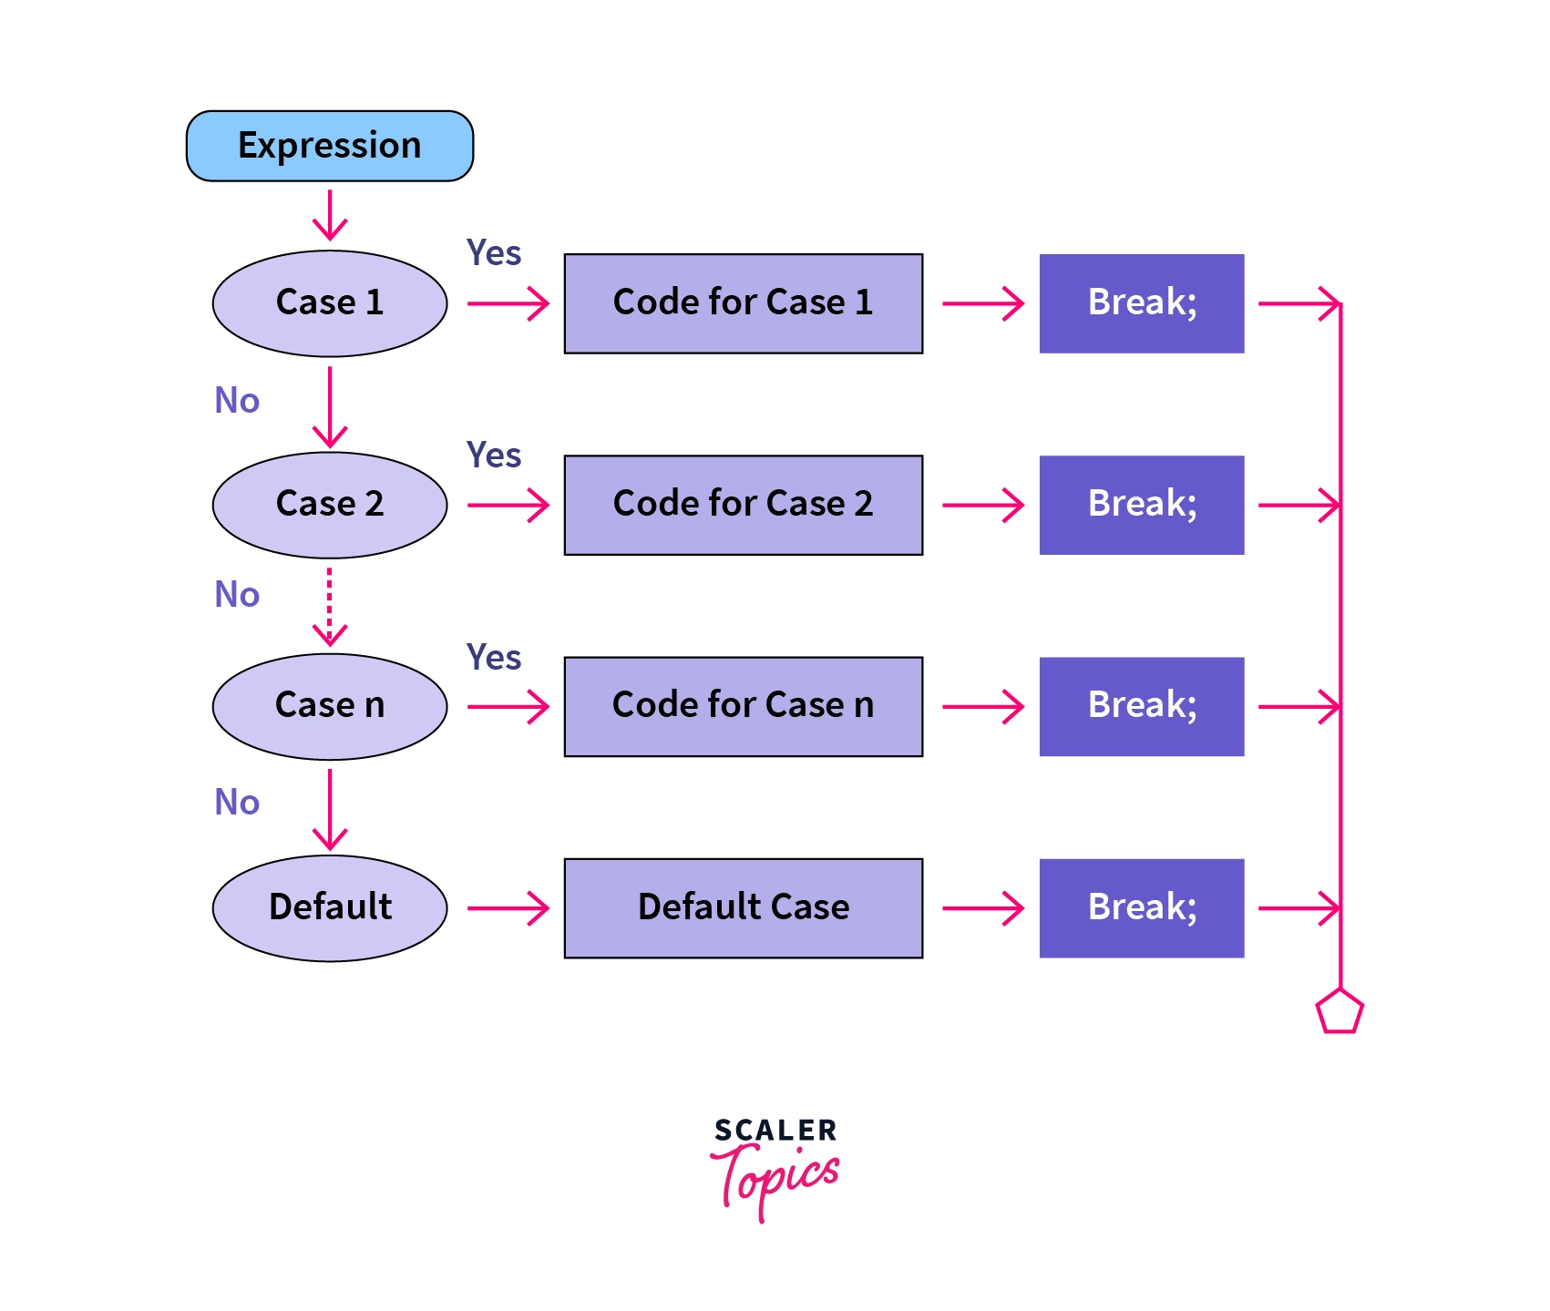
Switch Case
switch (expression) ​
{
case constant1:
// statements
break;
case constant2:
// statements
break;
. . .
default:
// default statements
}

Slide 137
menu-driven program
A menu-driven program provides choices to the user.
switch is useful for handling fixed choices.
Each case represents one choice.
break prevents execution of the next case.
default handles invalid choices.

Slide 138
Menu-Driven Calculator
#include <stdio.h>
int main()
{
int choice;
int a, b;
printf("1. Addition\n");
printf("2. Subtraction\n");
printf("3. Multiplication\n");
printf("Enter your choice: ");
scanf("%d", &choice);
printf("Enter two numbers: ");
scanf("%d%d", &a, &b);
switch(choice)
{
case 1:
printf("Sum = %d", a + b);
break;
case 2:
printf("Difference = %d", a - b);
break;
case 3:
printf("Product = %d", a * b);
break;
default:
printf("Invalid choice");
}
return 0;
}

Slide 139
Coding Assignments
1. Number to Word Conversion
Problem: Write a program that converts a digit (0-9) into its word form (e.g., 0 to "Zero", 1 to "One", etc.).
2. Traffic Light Simulation
Problem: Write a program that simulates a traffic light. It should take a character input (R, Y, G) and print the corresponding action (Stop for Red, Wait for Yellow, Go for Green).
3. Season Finder
Problem: Write a program that takes an integer input (1-12) representing a month and prints the corresponding season (e.g., 12, 1, 2 for Winter, 3, 4, 5 for Spring, etc.).

Slide 140
Compare and contrast switch and if..elseif..else statement
if...else if...else | switch
Checks conditions | Checks fixed values
Can use relational operators | Uses case values
Suitable for ranges | Suitable for fixed choices
Can check complex conditions | Best for simple equality checking
Uses if, else if, else | Uses switch, case, default
if...else if...else | switch
Checks conditions | Checks fixed values

Slide 141
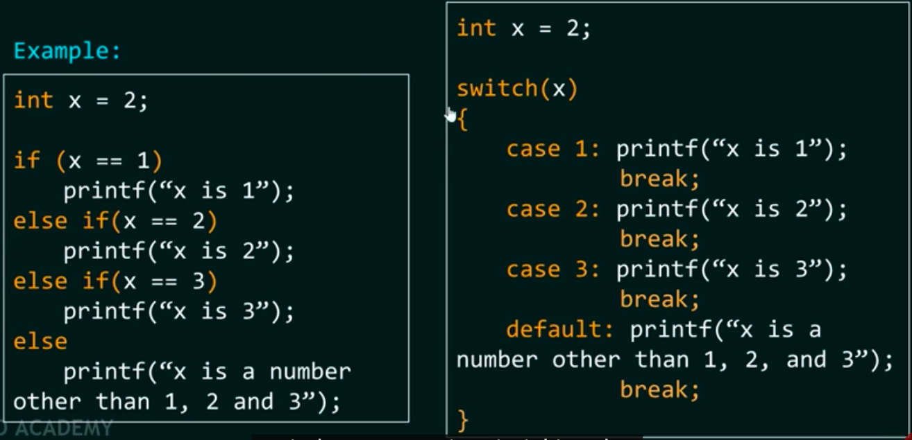
Example
If…else..if
Switch Case

Slide 142
REFERENCE
R. G. Dromey, How to Solve It by Computer, Pearson, 2020
Jeri R. Hanly, Elliot B. Koffman, Problem Solving and Program Design in C, Pearson, 2023
Greg Perry, Dean Miller, C Programming Absolute Beginner’s Guide, Pearson, 2023

