Slide 1
PYTHON - FUNCTION

Slide 2
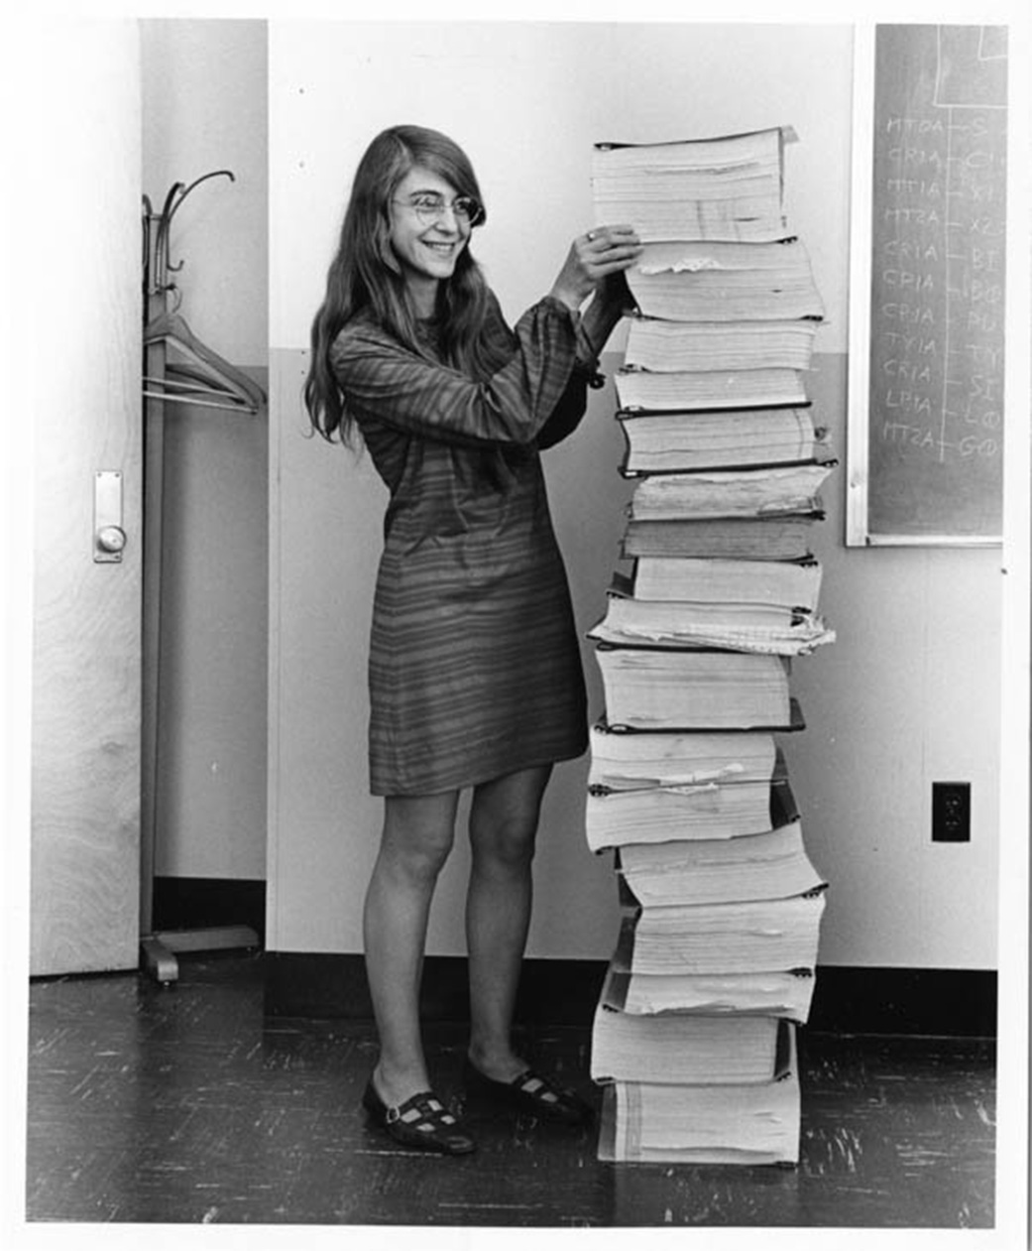
NEED OF FUNCTION?
Margaret Hamilton's Apollo Code
A computer scientist who led the Software Engineering Division of the MIT Instrumentation Laboratory
In 1961 contracted with NASA to develop the Apollo program's guidance system.

Slide 3
Stored (and reused) Steps
def
thing():
Program:
def thing():
print('Hello')
print('Fun')
thing()
print('Zip')
thing()
print('Hello')
print('Fun')
Output:
Hello
Fun
Zip
Hello
Fun
thing()
print('Zip')
thing()
We call these reusable pieces of code “functions”

Slide 4
Python Functions
There are two kinds of functions in Python.
  - Built-in functions that are provided as part of Python - print(), input(), type(), float(), int() ...
  - Functions that we define ourselves and then use
We treat function names as “new” reserved words
(i.e., we avoid them as variable names)

Slide 5
Function Definition
In Python a function is some reusable code that takes arguments(s) as input, does some computation, and then returns a result or results
We define a function using the def reserved word
We call/invoke the function by using the function name, parentheses, and arguments in an expression

Slide 6
Argument
big = max('Hello world')
Assignment
'w'
Result
>>> big = max('Hello world')
>>> print(big)
w
>>> tiny = min('Hello world')
>>> print(tiny)
>>>

Slide 7
Max Function
A function is some stored code that we use. A function takes some input and produces an output.
>>> big = max('Hello world')
>>> print(big)
w
max()
function
'Hello world'
(a string)
'w'
(a string)
Guido wrote this code

Slide 8
Max Function
A function is some stored code that we use. A function takes some input and produces an output.
>>> big = max('Hello world')
>>> print(big)
w
def max(inp):
blah
blah
for x in inp:
blah
blah
'Hello world'
(a string)
'w'
(a string)
Guido wrote this code

Slide 9
FUNCTIONS OF OUR OWN…

Slide 10
Building our Own Functions
We create a new function using the def keyword followed by optional parameters in parentheses
We indent the body of the function
This defines the function but does not execute the body of the function
def print_lyrics():
print("I'm a lumberjack, and I'm okay.")
print('I sleep all night and I work all day.')

Slide 11
print("I'm a lumberjack, and I'm okay.")
print('I sleep all night and I work all day.')
print_lyrics():
x = 5
print('Hello')
def print_lyrics():
print("I'm a lumberjack, and I'm okay.")
print('I sleep all night and I work all day.')
print('Yo')
x = x + 2
print(x)
Hello
Yo
7

Slide 12
Definitions and Uses
Once we have defined a function, we can call (or invoke) it
as many times as we like
This is the store and reuse pattern

Slide 13
x = 5
print('Hello')
def print_lyrics():
print("I'm a lumberjack, and I'm okay.")
print('I sleep all night and I work all day.')
print('Yo')
print_lyrics()
x = x + 2
print(x)
Hello
Yo
I'm a lumberjack, and I'm okay.
I sleep all night and I work all day.
7

Slide 14
Arguments
An argument is a value we pass into the function as its input when we call the function
We use arguments so we can direct the function to do different kinds of work when we call it at different times
We put the arguments in parentheses after the name of the function
big = max('Hello world')
Argument

Slide 15
Parameters
>>> def greet(lang):
... if lang == 'es':
... print('Hola')
... elif lang == 'fr':
... print('Bonjour')
... else:
... print('Hello')
...
>>> greet('en')
Hello
>>> greet('es')
Hola
>>> greet('fr')
Bonjour
>>>
A parameter is a variable which we use in the function definition. It is a “handle” that allows the code in the function to access the arguments for a particular function invocation.

Slide 16
Return Values
Often a function will take its arguments, do some computation, and return a value to be used as the value of the function call in the calling expression. The return keyword is used for this.
def greet():
return "Hello"
print(greet(), "Glenn")
print(greet(), "Sally")
Hello Glenn
Hello Sally

Slide 17
Return Value
>>> def greet(lang):
... if lang == 'es':
... return 'Hola'
... elif lang == 'fr':
... return 'Bonjour'
... else:
... return 'Hello'
...
>>> print(greet('en'),'Glenn')
Hello Glenn
>>> print(greet('es'),'Sally')
Hola Sally
>>> print(greet('fr'),'Michael')
Bonjour Michael
>>>
A “fruitful” function is one that produces a result (or return value)
The return statement ends the function execution and “sends back” the result of the function

Slide 18
Arguments, Parameters, and Results
>>> big = max('Hello world')
>>> print(big)
w
Parameter
def max(inp):
blah
blah
for x in inp:
blah
blah
return 'w'
'Hello world'
'w'
Argument
Result

Slide 19
Void (non-fruitful) Functions
When a function does not return a value, we call it a “void” function
Functions that return values are “fruitful” functions
Void functions are “not fruitful”

Slide 20
To function or not to function...
Organize your code into “paragraphs” - capture a complete thought and “name it”
Don’t repeat yourself - make it work once and then reuse it
If something gets too long or complex, break it up into logical chunks and put those chunks in functions
Make a library of common stuff that you do over and over - perhaps share this with your friends...

Slide 21
FUNCTION
Group of related statements that performs a specific task
Helps break our program into smaller
Bigger program, function makes it organized
Avoids repetition
def function_name(parameters):
"""docstring"""
statement(s)

Slide 22
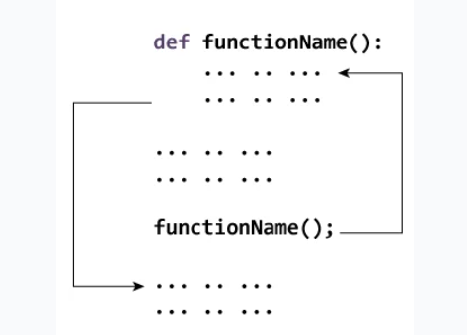
HOW FUNCTION WORKS?

Slide 23
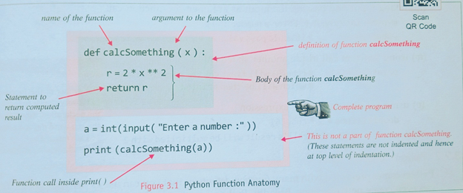
FUNCTION ANATOMY

Slide 24
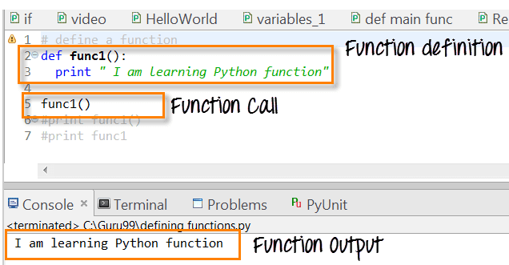
FUNCTION

Slide 25
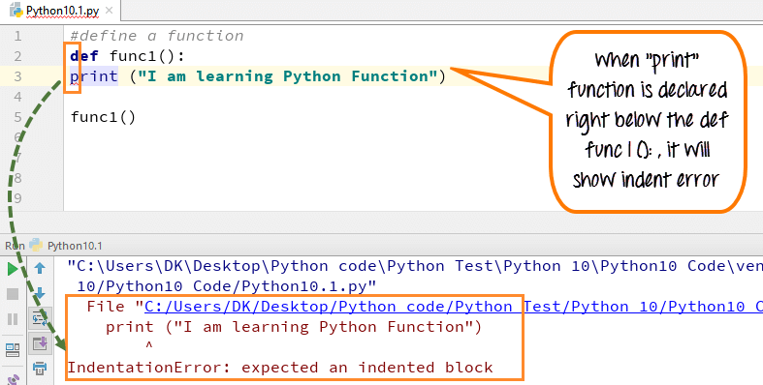
FUNCTION - INDENTATION

Slide 26
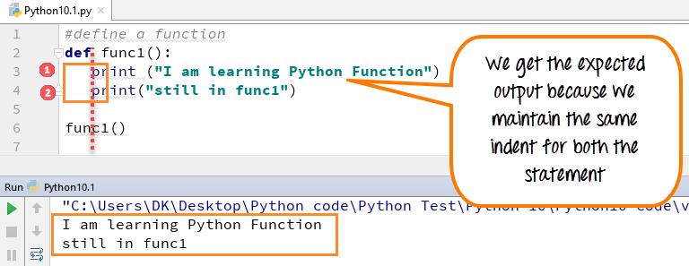
FUNCTION - INDENTATION

Slide 27
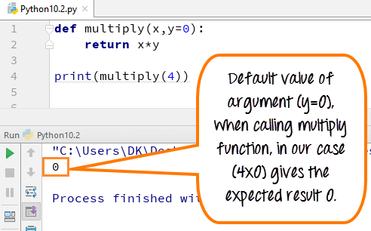
FUNCTION ARGUMENTS

Slide 28
DOCSTRINGS IN FUNCTION
Description about the function within quotes
Its an optional but yet formal way of writing docstring within function for easy understanding
Triple quote helps in writing multiple line
__doc__ attribute – docstring
Apart from within function attribute, it can be used for all keywords too, to get attributes about that modeule

Slide 29
RETURN
Exit the function and reach where the function is called
return [expression_list]

Slide 30
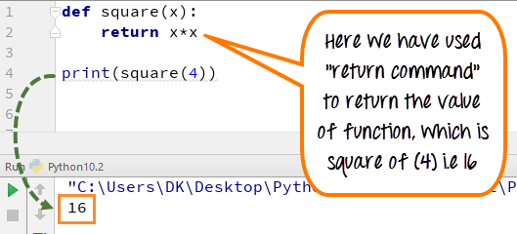
RETURN STATEMENT

Slide 31
TYPES OF FUNCTION
Built in function
User defined function

Slide 32
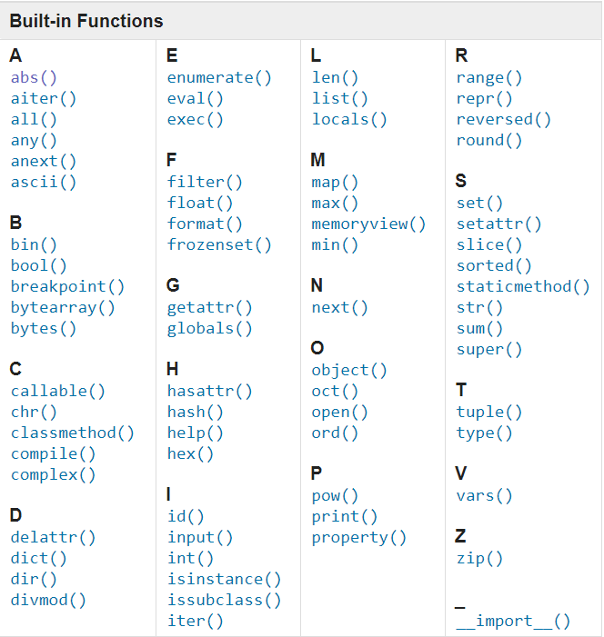
BUILT IN FUNCTIONS

Slide 33
PYTHON - RECURSION

Slide 34
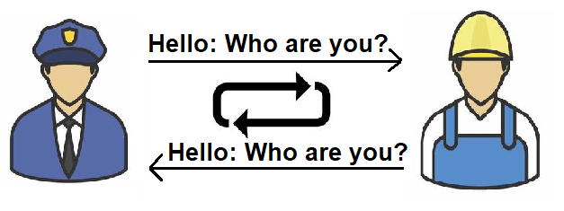
RECURSION? LAYMAN

Slide 35
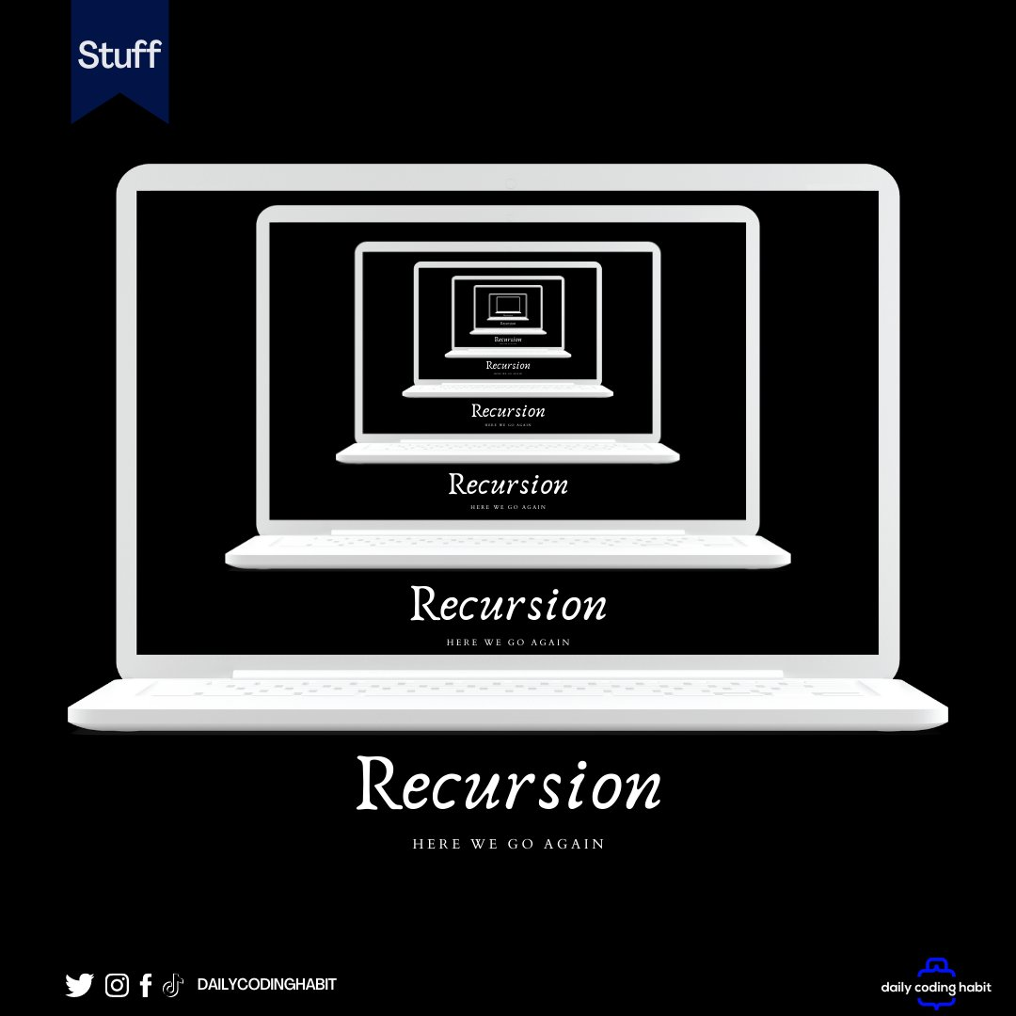
RECURSION

Slide 36
RECURSION
When a function call itself directly or indirectly
Why? - Sometime it is required to call same function on another set of data – Saves time
Understanding - place two parallel mirrors facing each other. Any object in between them would be reflected recursively

Slide 37
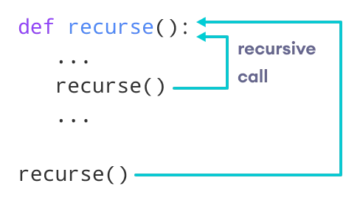
FLOW OF RECURSION

Slide 38
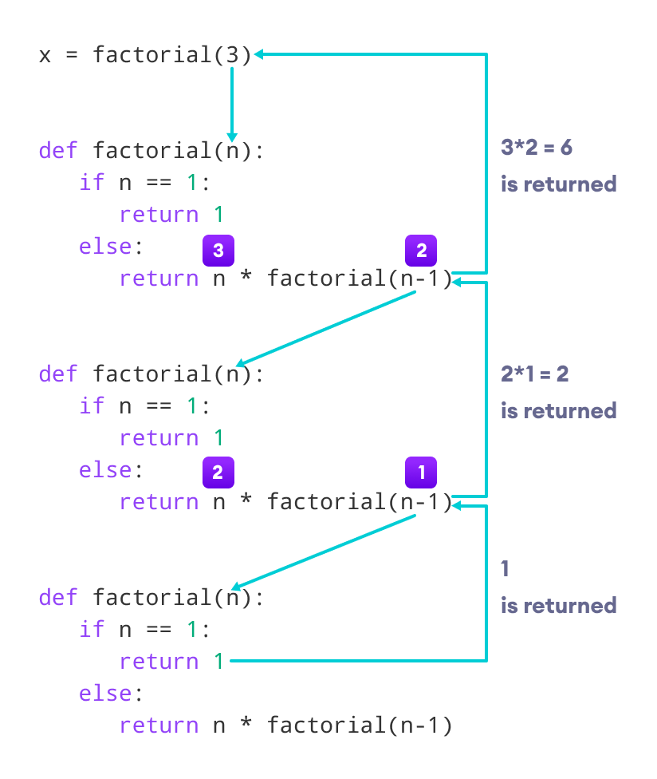
HOW IT WORKS? - FACTORIAL

Slide 39
PYTHON – EVAL FUNCTION

Slide 40
EVAL FUNCTION
Famous built in function
eval function evaluates the “String” like a python expression and returns the result as an integer.
String to any format
mostly used in situations or applications which need to evaluate mathematical expressions
if the user wants to evaluate the string into code then can use eval function

Slide 41
INPUT VS EVAL
input() takes the user input, but when the user enters an integer as an input the input function returns a string.
in the case of eval it will evaluate the returned value from a string to an integer

