Slide 1
PYTHON – IF..ELSE..ELIF STATEMENTS

Slide 2
DECISION MAKING
Decision making process
If statement
If…else statement
If… elif…else statement
Nested if statement

Slide 3
Conditional Steps
x = 5
x < 10 ?
Yes
Program:
x = 5
if x < 10:
print('Smaller')
if x > 20:
print('Bigger')
print('Finis')
No
print('Smaller')
Output:
Smaller
Finis
x > 20 ?
Yes
No
print('Bigger')
print('Finis')

Slide 4
Comparison Operators
Boolean expressions ask a question and produce a Yes or No result which we use to control program flow
Boolean expressions using comparison operators evaluate to True / False or Yes / No
Comparison operators look at variables but do not change the variables
Python | Meaning
< | Less than
<= | Less than or Equal to
== | Equal to
>= | Greater than or Equal to
> | Greater than
!= | Not equal
Remember: “=” is used for assignment.
http://en.wikipedia.org/wiki/George_Boole

Slide 5
Comparison Operators
x = 5
if x == 5 :
print('Equals 5')
if x > 4 :
print('Greater than 4')
if x >= 5 :
print('Greater than or Equals 5')
if x < 6 : print('Less than 6')
if x <= 5 :
print('Less than or Equals 5')
if x != 6 :
print('Not equal 6')
Equals 5
Greater than 4
Greater than or Equals 5
Less than 6
Less than or Equals 5
Not equal 6

Slide 6
One-Way Decisions
x = 5
print('Before 5')
if x == 5 :
print('Is 5')
print('Is Still 5')
print('Third 5')
print('Afterwards 5')
print('Before 6')
if x == 6 :
print('Is 6')
print('Is Still 6')
print('Third 6')
print('Afterwards 6')
Yes
x == 5 ?
Before 5
Is 5
Is Still 5
Third 5
Afterwards 5
Before 6
Afterwards 6
No
print('Is 5’)
print('Still 5')
print('Third 5')

Slide 7
increase / maintain after if or for
decrease to indicate end of block
x = 5
if x > 2 :
print('Bigger than 2')
print('Still bigger')
print('Done with 2')
for i in range(5) :
print(i)
if i > 2 :
print('Bigger than 2')
print('Done with i', i)
print('All Done')

Slide 8
Think About begin/end Blocks
x = 5
if x > 2 :
print('Bigger than 2')
print('Still bigger')
print('Done with 2')
for i in range(5) :
print(i)
if i > 2 :
print('Bigger than 2')
print('Done with i', i)
print('All Done')

Slide 9
Nested Decisions
x > 1
yes
no
print('More than one’)
x = 42
if x > 1 :
print('More than one')
if x < 100 :
print('Less than 100')
print('All done')
x < 100
yes
no
print('Less than 100')
print('All Done')

Slide 10
Two-Way Decisions
x = 4
Sometimes we want to do one thing if a logical expression is true and something else if the expression is false
It is like a fork in the road - we must choose one or the other path but not both
no
x > 2
yes
print('Not bigger')
print('Bigger')
print('All Done')

Slide 11
Two-Way Decisions with else:
x = 4
no
x > 2
yes
x = 4
if x > 2 :
print('Bigger')
else :
print('Smaller')
print('All done')
print('Not bigger')
print('Bigger')
print('All Done')

Slide 12
Visualize Blocks
x = 4
no
x > 2
yes
x = 4
if x > 2 :
print('Bigger')
else :
print('Smaller')
print('All done')
print('Not bigger')
print('Bigger')
print('All Done')

Slide 13
Multi-way
yes
x < 2
print('small')
if x < 2 :
print('small')
elif x < 10 :
print('Medium')
else :
print('LARGE')
print('All done')
no
yes
x < 10
print('Medium')
no
print('LARGE')
print('All Done')

Slide 14
Multi-way
x = 0
yes
x < 2
print('small')
x = 0
if x < 2 :
print('small')
elif x < 10 :
print('Medium')
else :
print('LARGE')
print('All done')
no
yes
x < 10
print('Medium')
no
print('LARGE')
print('All Done')

Slide 15
Multi-way
x = 5
yes
x < 2
print('small')
x = 5
if x < 2 :
print('small')
elif x < 10 :
print('Medium')
else :
print('LARGE')
print('All done')
no
yes
x < 10
print('Medium')
no
print('LARGE')
print('All Done')

Slide 16
Multi-way
x = 20
yes
x < 2
print('small')
x = 20
if x < 2 :
print('small')
elif x < 10 :
print('Medium')
else :
print('LARGE')
print('All done')
no
yes
x < 10
print('Medium')
no
print('LARGE')
print('All Done')

Slide 17
IF STATEMENT
If expression:
statement (s)
Expression true – statement will proceed
Expression false – statement will not proceed

Slide 18
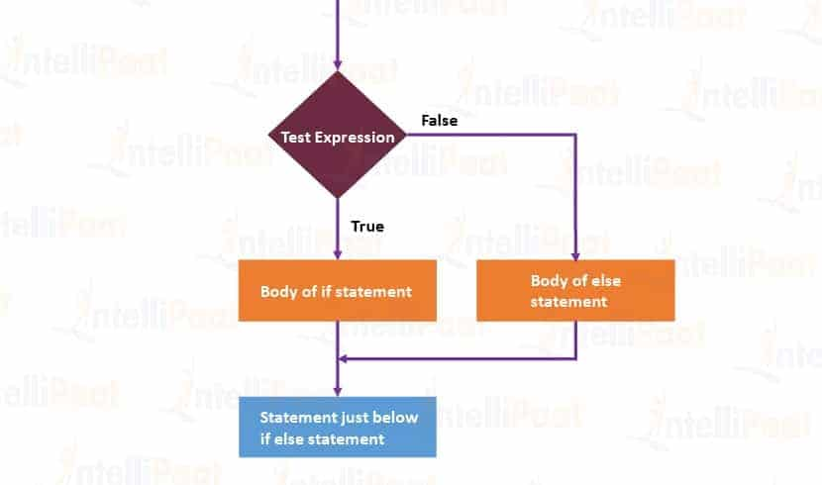
FLOW CHART –
IF STATEMENT

Slide 19
IF ELSE STATEMENT
if test expression:
Body of if
else:
Body of else
Expression true – body of if
Expression false – body of else

Slide 20
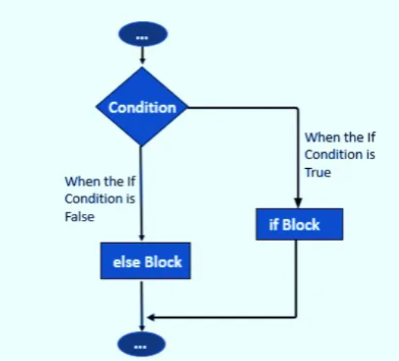
IF ELSE – FLOW CHART

Slide 21
IF … ELIF … ELSE STATEMENT
if test expression:
Body of if
elif test expression:
Body of elif
else:
Body of else
Elif – else if condition
If – false – will check elif
All condition is false – body else will execute
If .. Elif … else (any one will execute)
The if block can have only one else block. But it can have multiple elif blocks

Slide 22
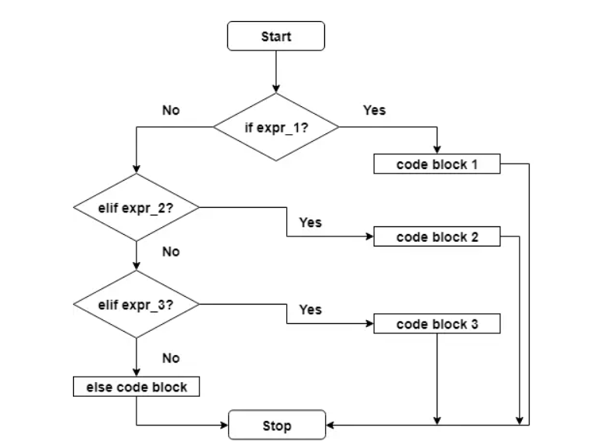
IF… ELSE… ELIF – FLOW CHART

Slide 23
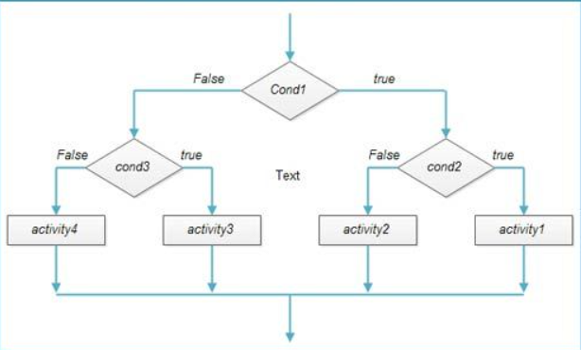
NESTED IF STATEMENT
We can have a if...elif...else statement inside another if...elif...else statement
Indentation is the only way to figure out the level of nesting.

Slide 24
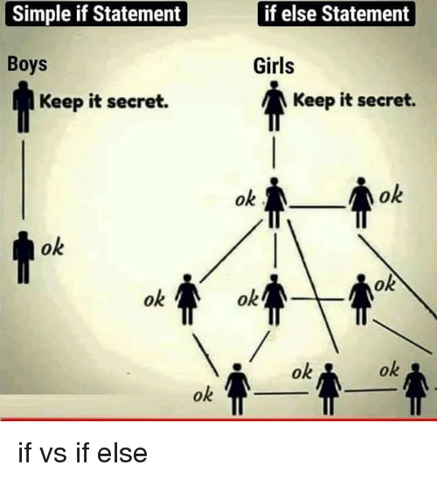
IF STATEMENT – MEME EXPLANATION

Slide 25
The try / except Structure
You surround a dangerous section of code with try and except
If the code in the try works - the except is skipped
If the code in the try fails - it jumps to the except section

Slide 26
$ python3 notry.py
Traceback (most recent call last): File "notry.py", line 2, in <module> istr = int(astr)ValueError: invalid literal for int() with base 10: 'Hello Bob'
$ cat notry.py
astr = 'Hello Bob'
istr = int(astr)
print('First', istr)
astr = '123'
istr = int(astr)
print('Second', istr)
All
Done

Slide 27
$ python3 notry.py
Traceback (most recent call last): File "notry.py", line 2, in <module> istr = int(astr)ValueError: invalid literal for int() with base 10: 'Hello Bob'
The program stops here
$ cat notry.py
astr = 'Hello Bob'
istr = int(astr)
print('First', istr)
astr = '123'
istr = int(astr)
print('Second', istr)
All
Done

Slide 28
astr = 'Hello Bob'
try:
istr = int(astr)
except:
istr = -1
print('First', istr)
astr = '123'
try:
istr = int(astr)
except:
istr = -1
print('Second', istr)
When the first conversion fails - it just drops into the except: clause and the program continues.
$ python tryexcept.py
First -1
Second 123
When the second conversion succeeds - it just skips the except: clause and the program continues.

Slide 29
try / except
astr = 'Bob'
print('Hello')
astr = 'Bob'
try:
print('Hello')
istr = int(astr)
print('There')
except:
istr = -1
print('Done', istr)
istr = int(astr)
print('There')
istr = -1
print('Done', istr)
Safety net

Slide 30
Sample try / except
rawstr = input('Enter a number:')
try:
ival = int(rawstr)
except:
ival = -1
if ival > 0 :
print('Nice work')
else:
print('Not a number')
$ python3 trynum.py
Enter a number:42
Nice work
$ python3 trynum.py
Enter a number:forty-two
Not a number
$

Slide 31
PYTHON – WHILE LOOP

Slide 32
Repeated Steps
n = 5
Program:
n = 5
while n > 0 :
print(n)
n = n – 1
print('Blastoff!')
print(n)
Output:
5
4
3
2
1
Blastoff!
0
No
n > 0 ?
Yes
print(n)
n = n -1
Loops (repeated steps) have iteration variables that change each time through a loop. Often these iteration variables go through a sequence of numbers.
print('Blastoff')

Slide 33
An Infinite Loop
n = 5
No
n > 0 ?
Yes
n = 5
while n > 0 :
print('Lather')
print('Rinse')
print('Dry off!')
print('Lather')
print('Rinse')
print('Dry off!')
What is wrong with this loop?

Slide 34
Another Loop
n = 0
No
n > 0 ?
Yes
n = 0
while n > 0 :
print('Lather')
print('Rinse')
print('Dry off!')
print('Lather')
print('Rinse')
print('Dry off!')
What is this loop doing?

Slide 35
Breaking Out of a Loop
The break statement ends the current loop and jumps to the statement immediately following the loop
It is like a loop test that can happen anywhere in the body of the loop
while True:
line = input('> ')
if line == 'done' :
break
print(line)
print('Done!')
> hello there
hello there
> finished
finished
> done
Done!

Slide 36
Breaking Out of a Loop
The break statement ends the current loop and jumps to the statement immediately following the loop
It is like a loop test that can happen anywhere in the body of the loop
while True:
line = input('> ')
if line == 'done' :
break
print(line)
print('Done!')
> hello there
hello there
> finished
finished
> done
Done!

Slide 37

No
True ?
Yes
while True:
line = input('> ')
if line == 'done' :
break
print(line)
print('Done!')
....
break
...
http://en.wikipedia.org/wiki/Transporter_(Star_Trek)
print('Done')

Slide 38
Finishing an Iteration with continue
The continue statement ends the current iteration and jumps to the top of the loop and starts the next iteration
while True:
line = input('> ')
if line[0] == '#' :
continue
if line == 'done' :
break
print(line)
print('Done!')
> hello there
hello there
> # don't print this
> print this!
print this!
> done
Done!

Slide 39
Finishing an Iteration with continue
The continue statement ends the current iteration and jumps to the top of the loop and starts the next iteration
while True:
line = input('> ')
if line[0] == '#' :
continue
if line == 'done' :
break
print(line)
print('Done!')
> hello there
hello there
> # don't print this
> print this!
print this!
> done
Done!

Slide 40
No
True ?
Yes
while True:
line = raw_input('> ')
if line[0] == '#' :
continue
if line == 'done' :
break
print(line)
print('Done!')
....
continue
...
print('Done')

Slide 41
Indefinite Loops
While loops are called “indefinite loops” because they keep going until a logical condition becomes False
The loops we have seen so far are pretty easy to examine to see if they will terminate or if they will be “infinite loops”
Sometimes it is a little harder to be sure if a loop will terminate

Slide 42
WHILE LOOP
Repeat a specific block of code
Used to iterate over a block of code as long as the test expression (condition) is true
While loop when we don't know the number of times to iterate beforehand
while test_expression:
Body of while

Slide 43
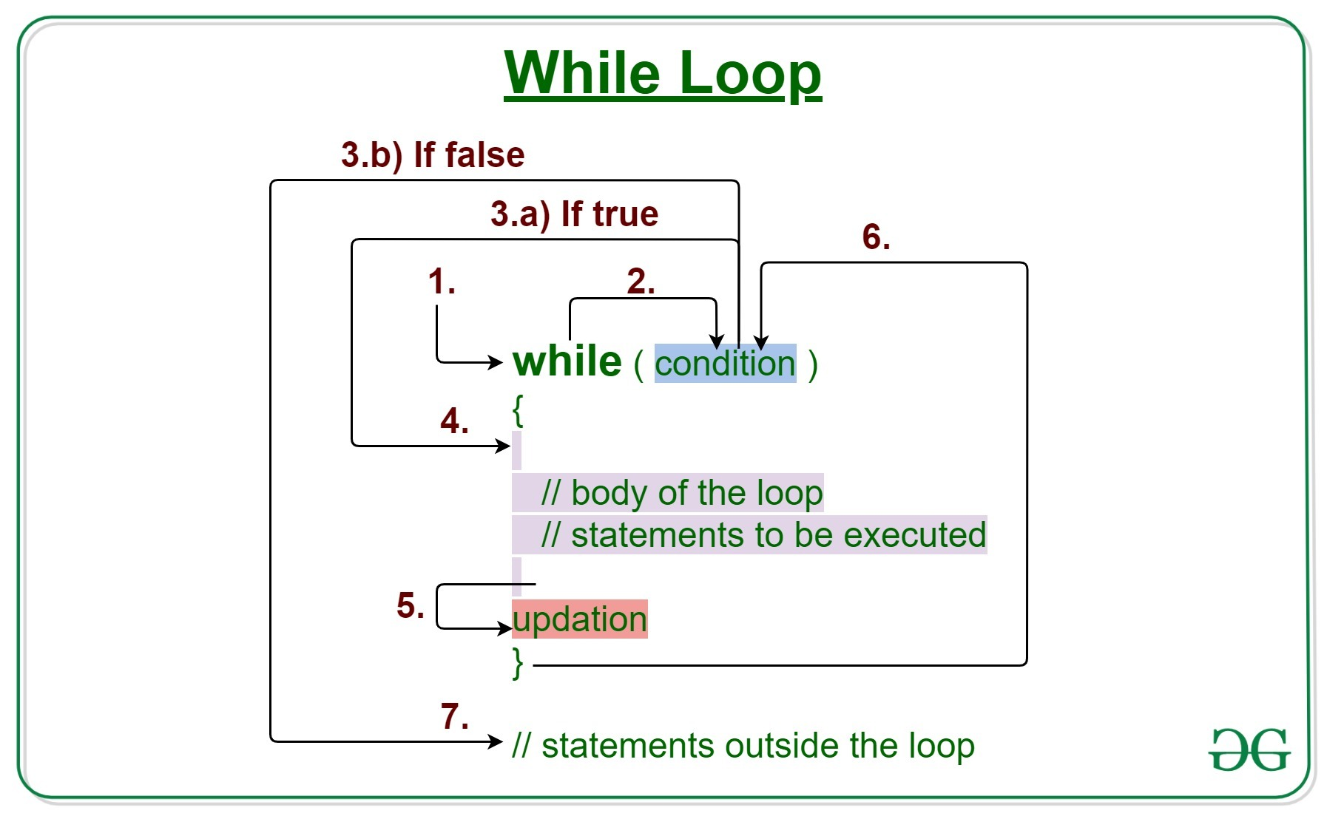
WHILE LOOP

Slide 44
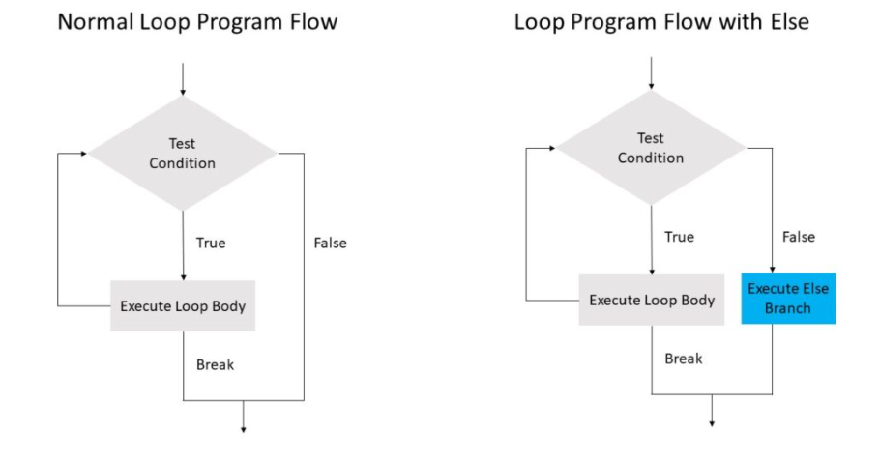
WHILE – ELSE

Slide 45
PYTHON – BREAK AND CONTINUE

Slide 46
BREAK & CONTINUE
To alter the flow of a loop
Loops iterate over a block of code until the test expression is false, but sometimes we wish to terminate the current iteration or even the whole loop without checking test expression
Break and continue

Slide 47
BREAK
terminates the loop containing it
Control of the program flows to the statement immediately after the body of the loop
If the break statement is inside a nested loop (loop inside another loop), the break statement will terminate the innermost loop
break

Slide 48
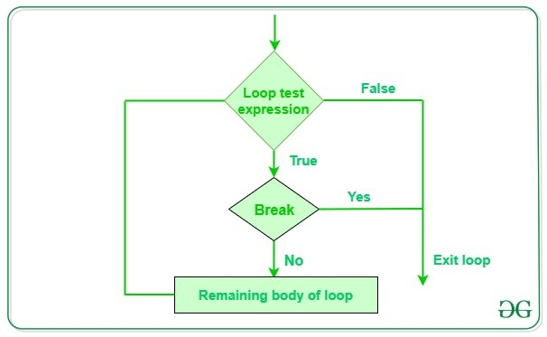
BREAK – WORK FLOW

Slide 49
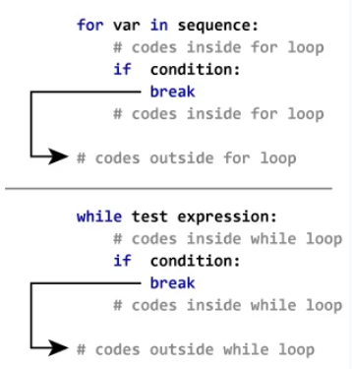
BREAK – FOR AND WHILE LOOPS

Slide 50
CONTINUE STATEMENT
The continue statement is used to skip the rest of the code inside a loop for the current iteration only.
Loop does not terminate but continues on with the next iteration
continue

Slide 51
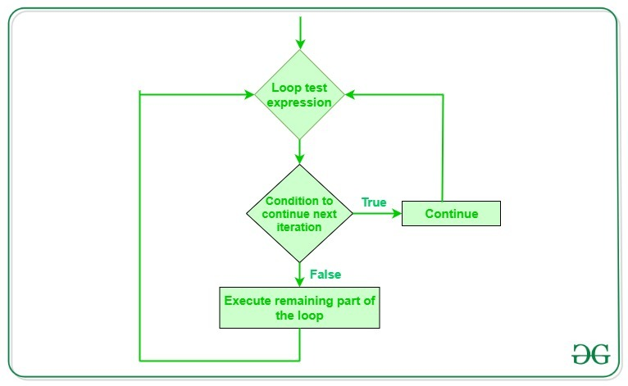
CONTINUE – WORK FLOW

Slide 52
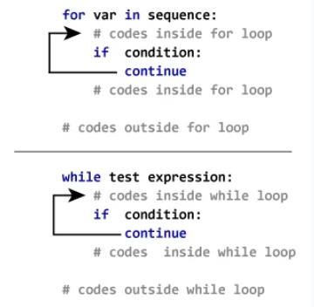
CONTINUE STATEMENT FOR FOR AND WHILE LOOP

Slide 53
PYTHON – PASS STATEMENT

Slide 54
PASS STATEMENT
Null statement
Difference with comment – not ignored and it’s no operation
Placeholder – future presprective
pass

Slide 55
PYTHON – FOR LOOP

Slide 56
Definite Loops
Quite often we have a list of items of the lines in a file - effectively a finite set of things
We can write a loop to run the loop once for each of the items in a set using the Python for construct
These loops are called “definite loops” because they execute an exact number of times
We say that “definite loops iterate through the members of a set”

Slide 57
A Simple Definite Loop
5
4
3
2
1
Blastoff!
for i in [5, 4, 3, 2, 1] :
print(i)
print('Blastoff!')

Slide 58
A Definite Loop with Strings
Happy New Year: Joseph
Happy New Year: Glenn
Happy New Year: Sally
Done!
friends = ['Joseph', 'Glenn', 'Sally']
for friend in friends :
print('Happy New Year:', friend)
print('Done!')

Slide 59
A Simple Definite Loop
Yes
Done?
No
Move i ahead
5
4
3
2
1
Blastoff!
for i in [5, 4, 3, 2, 1] :
print(i)
print('Blastoff!')
print(i)
Definite loops (for loops) have explicit iteration variables that change each time through a loop. These iteration variables move through the sequence or set.
print('Blast off!')

Slide 60
Looking at in...
The iteration variable “iterates” through the sequence (ordered set)
The block (body) of code is executed once for each value in the sequence
The iteration variable moves through all of the values in the sequence
Five-element sequence
Iteration variable
for i in [5, 4, 3, 2, 1] :
print(i)

Slide 61
No
Yes
Done?
The iteration variable “iterates” through the sequence (ordered set)
The block (body) of code is executed once for each value in the sequence
The iteration variable moves through all of the values in the sequence
Move i ahead
print(i)
for i in [5, 4, 3, 2, 1] :
print(i)

Slide 62
i = 5
No
Yes
Done?
print(i)
Move i ahead
i = 4
print(i)
print(i)
i = 3
print(i)
i = 2
for i in [5, 4, 3, 2, 1] :
print(i)
print(i)
i = 1
print(i)

Slide 63
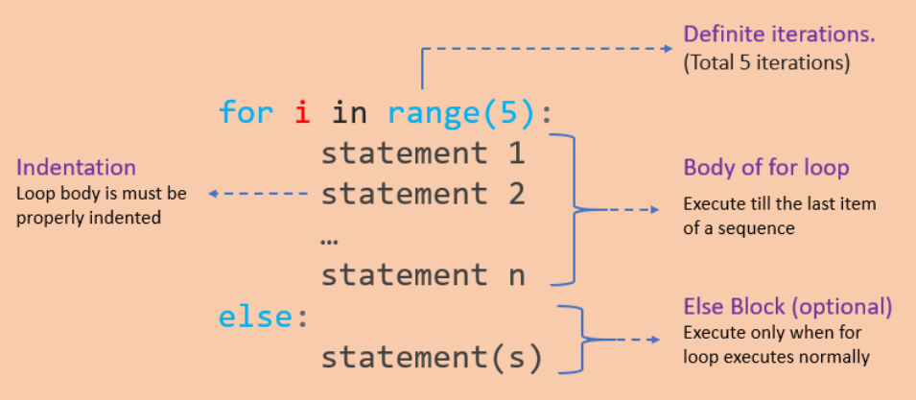
FOR LOOP
Used to iterate over a sequence like list, tuple, string or other
Loop continues until we reach the last item in the sequence
Identation

Slide 64
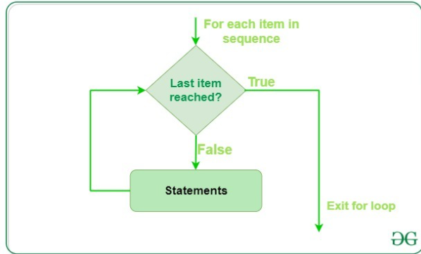
FOR LOOP – FLOW CONTROL

Slide 65
RANGE()
Generate a sequence of numbers using range() function
range(start, stop,step_size)
Not an iterator since it supports in, len and __getitem__ operations

Slide 66
FOR…ELSE STATEMENT
for...else statement can be used with the break keyword to run the else block only when the break keyword was not executed

Slide 67
Making “smart” loops
The trick is “knowing” something about the whole loop when you are stuck writing code that only sees one entry at a time
Set some variables to initial values
for thing in data:
Look for something or do something to each entry separately, updating a variable
Look at the variables

Slide 68
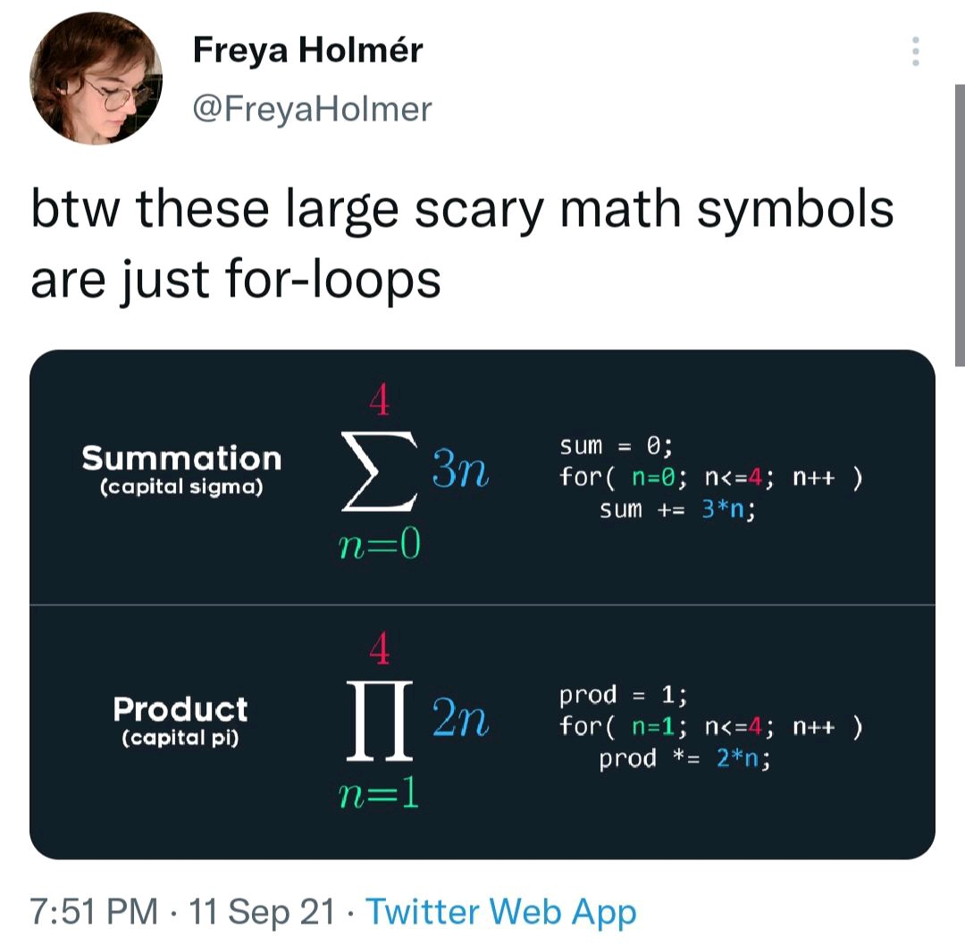
HOW EFFECTIVE OF USING FOR LOOP – MEME EXPLANATION

Slide 69
Counting in a Loop
$ python countloop.py
Before 0
1 9
2 41
3 12
4 3
5 74
6 15
After 6
zork = 0
print('Before', zork)
for thing in [9, 41, 12, 3, 74, 15] :
zork = zork + 1
print(zork, thing)
print('After', zork)
To count how many times we execute a loop, we introduce a counter variable that starts at 0 and we add one to it each time through the loop.

Slide 70
Summing in a Loop
$ python countloop.py
Before 0
9 9
50 41
62 12
65 3
139 74
154 15
After 154
zork = 0
print('Before', zork)
for thing in [9, 41, 12, 3, 74, 15] :
zork = zork + thing
print(zork, thing)
print('After', zork)
To add up a value we encounter in a loop, we introduce a sum variable that starts at 0 and we add the value to the sum each time through the loop.

Slide 71
Finding the Average in a Loop
$ python averageloop.py
Before 0 0
1 9 9
2 50 41
3 62 12
4 65 3
5 139 74
6 154 15
After 6 154 25.666
count = 0
sum = 0
print('Before', count, sum)
for value in [9, 41, 12, 3, 74, 15] :
count = count + 1
sum = sum + value
print(count, sum, value)
print('After', count, sum, sum / count)
An average just combines the counting and sum patterns and divides when the loop is done.

Slide 72
Filtering in a Loop
print('Before')
for value in [9, 41, 12, 3, 74, 15] :
if value > 20:
print('Large number',value)
print('After')
$ python search1.py
Before
Large number 41
Large number 74
After
We use an if statement in the loop to catch / filter the values we are looking for.

Slide 73
Search Using a Boolean Variable
$ python search1.py
Before False
False 9
False 41
False 12
True 3
True 74
True 15
After True
found = False
print('Before', found)
for value in [9, 41, 12, 3, 74, 15] :
if value == 3 :
found = True
print(found, value)
print('After', found)
If we just want to search and know if a value was found, we use a variable that starts at False and is set to True as soon as we find what we are looking for.

Slide 74
HOW TO FIND THE SMALLEST VALUE
$ python largest.py
Before -1
9 9
41 41
41 12
41 3
74 74
74 15
After 74
largest_so_far = -1
print('Before', largest_so_far)
for the_num in [9, 41, 12, 3, 74, 15] :
if the_num > largest_so_far :
largest_so_far = the_num
print(largest_so_far, the_num)
print('After', largest_so_far)
How would we change this to make it find the smallest value in the list?

Slide 75
FINDING THE SMALLEST VALUE
smallest_so_far = -1
print('Before', smallest_so_far)
for the_num in [9, 41, 12, 3, 74, 15] :
if the_num < smallest_so_far :
smallest_so_far = the_num
print(smallest_so_far, the_num)
print('After', smallest_so_far)
We switched the variable name to smallest_so_far and switched the > to <

Slide 76
FINDING THE SMALLEST VALUE
$ python smallbad.py
Before -1
-1 9
-1 41
-1 12
-1 3
-1 74
-1 15
After -1
smallest_so_far = -1
print('Before', smallest_so_far)
for the_num in [9, 41, 12, 3, 74, 15] :
if the_num < smallest_so_far :
smallest_so_far = the_num
print(smallest_so_far, the_num)
print('After', smallest_so_far)
We switched the variable name to smallest_so_far and switched the > to <

Slide 77
FINDING THE SMALLEST VALUE
smallest = None
print('Before')
for value in [9, 41, 12, 3, 74, 15] :
if smallest is None :
smallest = value
elif value < smallest :
smallest = value
print(smallest, value)
print('After', smallest)
$ python smallest.py
Before
9 9
9 41
9 12
3 3
3 74
3 15
After 3
We still have a variable that is the smallest so far. The first time through the loop smallest is None, so we take the first value to be the smallest.

Slide 78
The is and is not Operators
Python has an is operator that can be used in logical expressions
Implies “is the same as”
Similar to, but stronger than ==
is not also is a logical operator
smallest = None
print('Before')
for value in [3, 41, 12, 9, 74, 15] :
if smallest is None :
smallest = value
elif value < smallest :
smallest = value
print(smallest, value)
print('After', smallest)

Slide 79
HAPPY LEARNING & HAPPY CODING!
WhatsApp +91 7358679961
Official: premanand.s@vit.ac.in
Personal: er.anandprem@gmail.com
Weblink: www.anandsdata.com
Github: https://github.com/anandprems
Linkedin: https://www.linkedin.com/in/premsanand/
Author @ Analytics Vidya: https://www.analyticsvidhya.com/blog/author/premanand17/

