Slide 1
Using a large metagenomic data to infer dependency network among microbes by different methods and their applications in next gen. probiotics based therapeutics.

Slide 2

Microbial Abundance data is taken from the below mentioned research article. The data contains 7009 samples and 2904 microbial species.
Sample metadata is also downloaded.
Total Sum scaling (TSS) normalization has been done.

Slide 3
Introduction
Human Microbiome is very personalized so it’s likely to be happened that the presence of two microbial clusters are different in two individuals but performing same/similar functionalities.
It’s very important to find out the modules of microbes those are clustered on the basis of their presence on the gut atmosphere.
If we want to study the inter-relations among the species, then we have to analyse the network of the microbial communities.
Machine Learning based approaches are already available but there is a gap in application of holistic approach where we will consider inter-cluster as well as intra-cluster relationships.

Slide 4
Project Objectives
To find out the highly interactive microbial pairs based on the eigenvalues in a dimensionally reduced space.
To relate the phenotypic changes with different module microbes.
To investigate the hub microbial species from the modules
Prediction of the eigenvalues between two species to make the network formation more handy.

Slide 5
Approaches
1. Application of Random Matrix Theory with Bootstrapping
2. WGCNA based network analysis to find hub microbial species.
3. Substantial model (Deep learning based model) to predict eigenvalues for network formation.

Slide 6
Random Matrix Theory with Bootstrapping
Workflow :
2904 Microbial species
Correlation matrix
(2904*2904 )
Bootstrapping
Calculate eigenvalues and eigenvectors (SVD)
Network formation

Slide 7
Random Matrix Theory with bootstrapping
Workflow:
Construct a count matrix
Normalize the matrix
Calculate eigenvalues and eigenvectors (Singular Value Decomposition)
Interpret results:
Construct a correlation matrix
Compare to a random matrix and construct network
The eigenvalues represent the strength of the correlations between the different taxa
This can provide insights into the structure and dynamics of the microbial community.
Correct for differences in library size between samples
several correlation methods that can be used like Distance-based correlation: Jaccard Distance, spearman correlation
Any eigenvalues that deviate significantly from the expected distribution are considered to be significant correlations
The matrix should represent the relative abundance of each taxa or functional group in each sample.
1
2
3
4
5
6

Slide 8
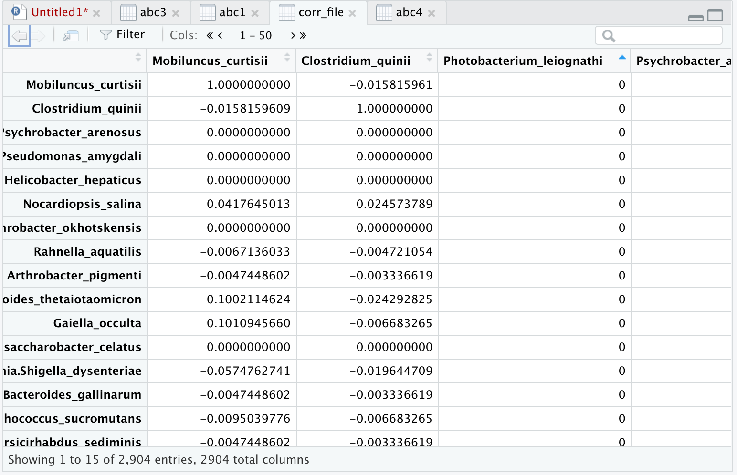
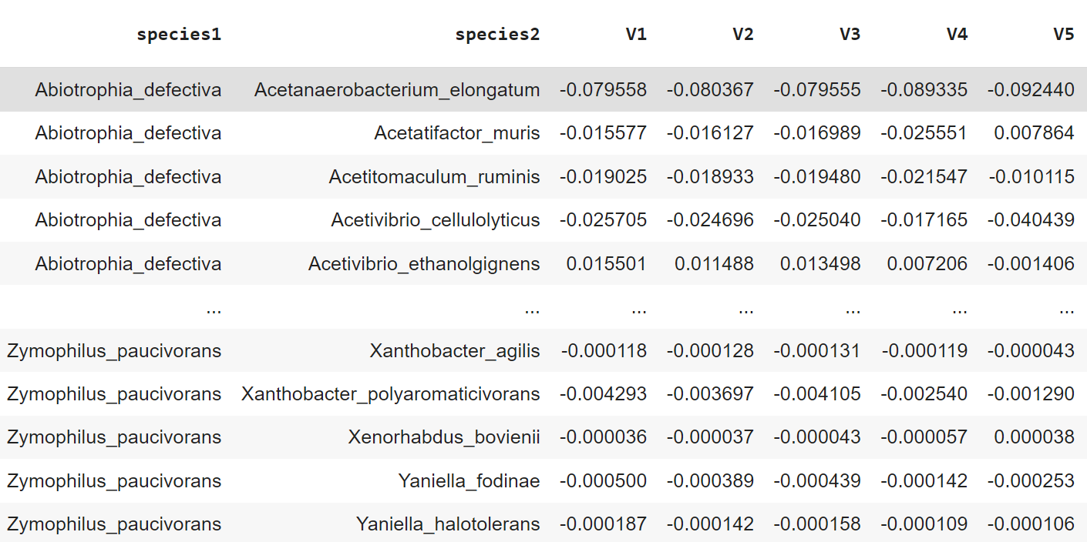
Correlation matrix
Matrix top 5 eigenvectors

Slide 9
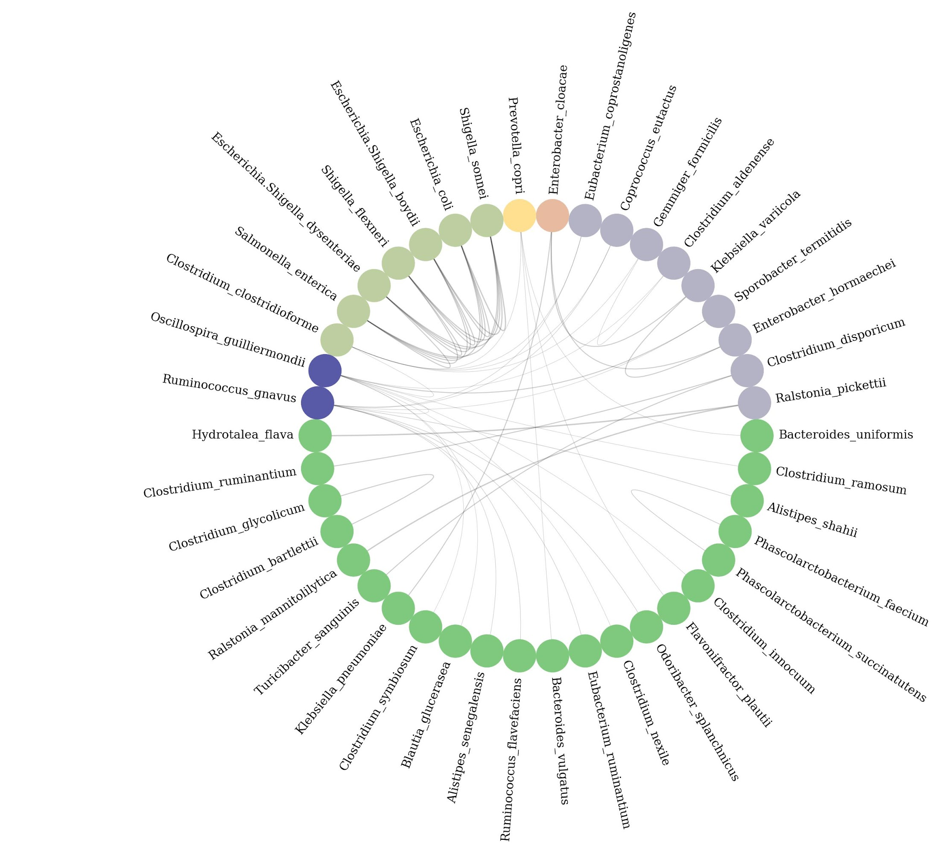
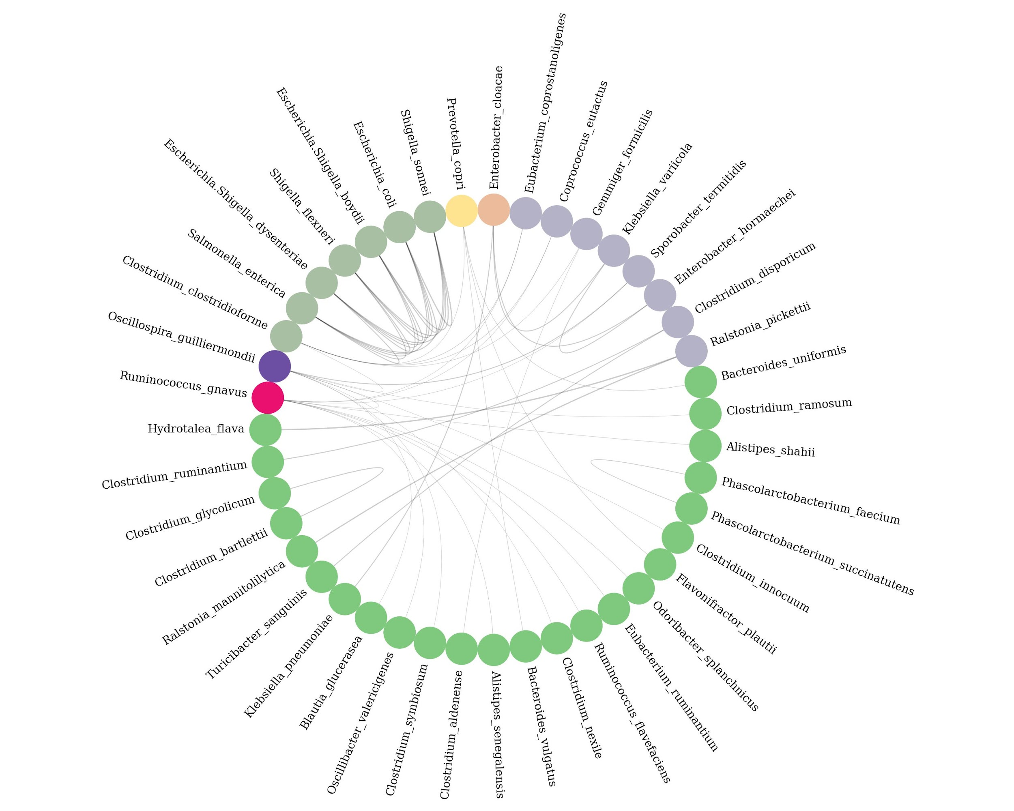
Network on the basis of eigenvalue
Network on the base of pc 1
Network on the base of pc 2
Notes:
Multiple studies associate Ruminococcus gnavus, a prevalent gut microbe, with Crohn’s disease, a major type of inflammatory bowel disease.

Slide 10
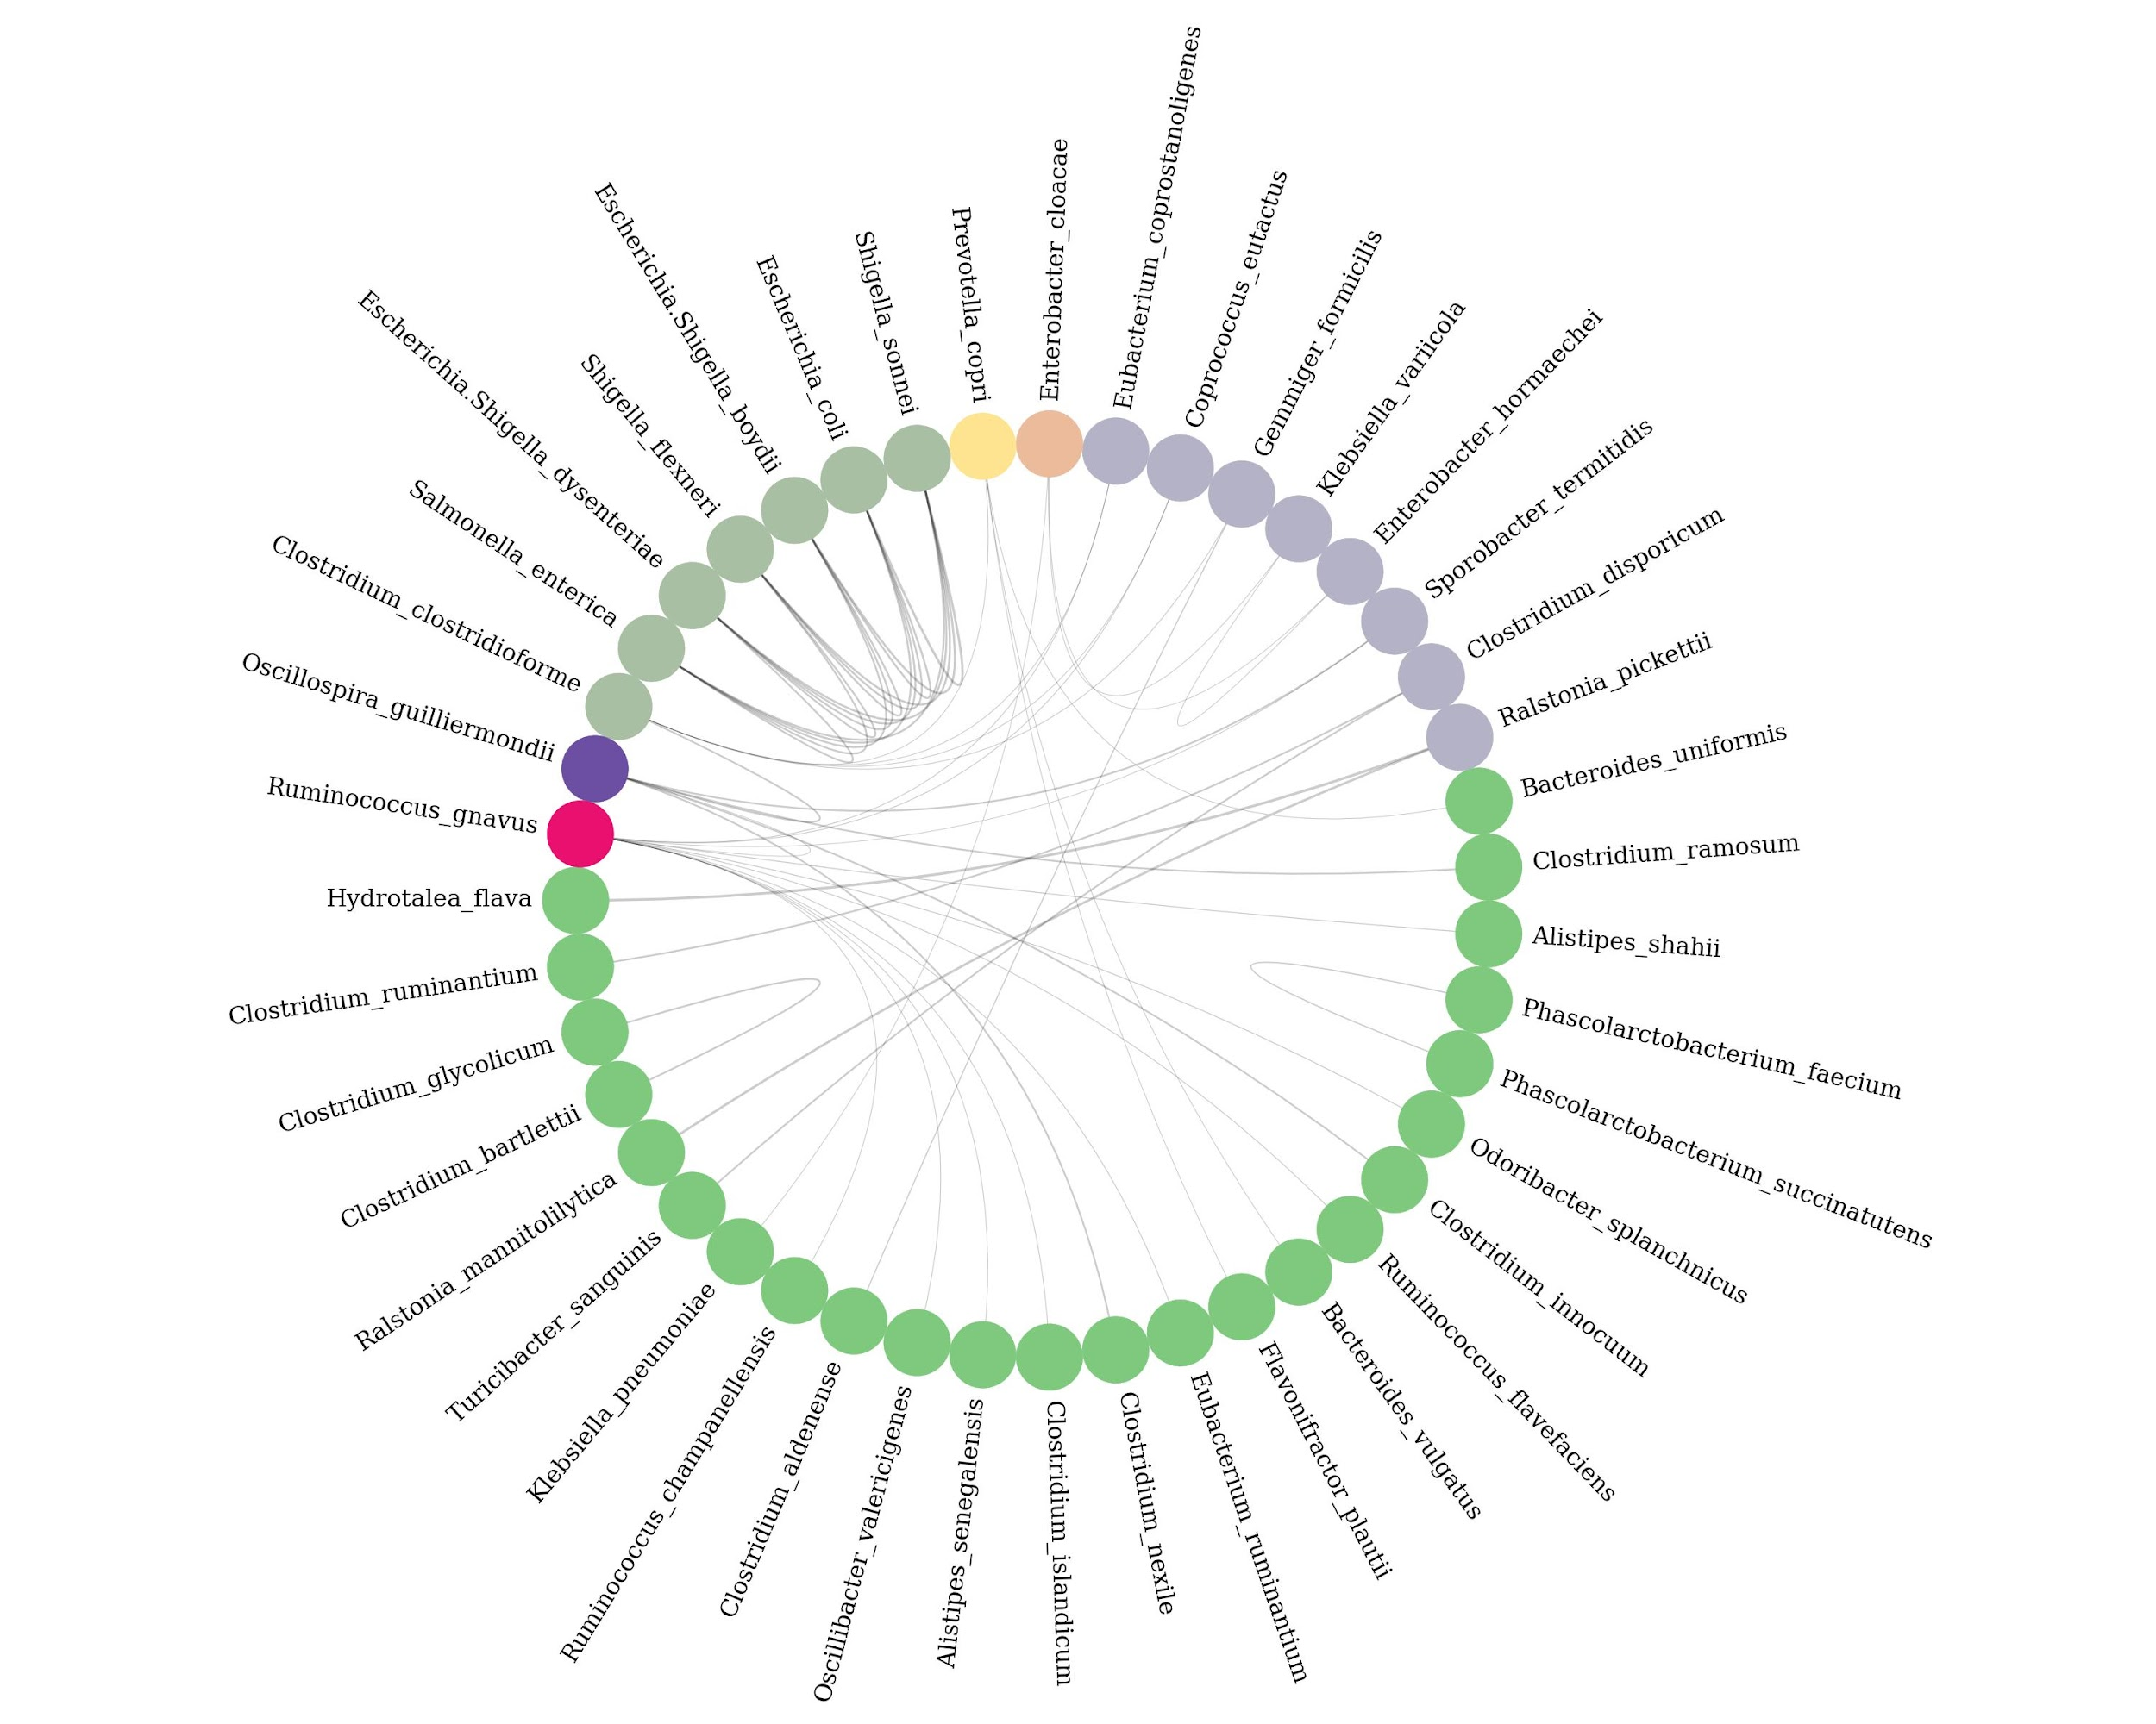
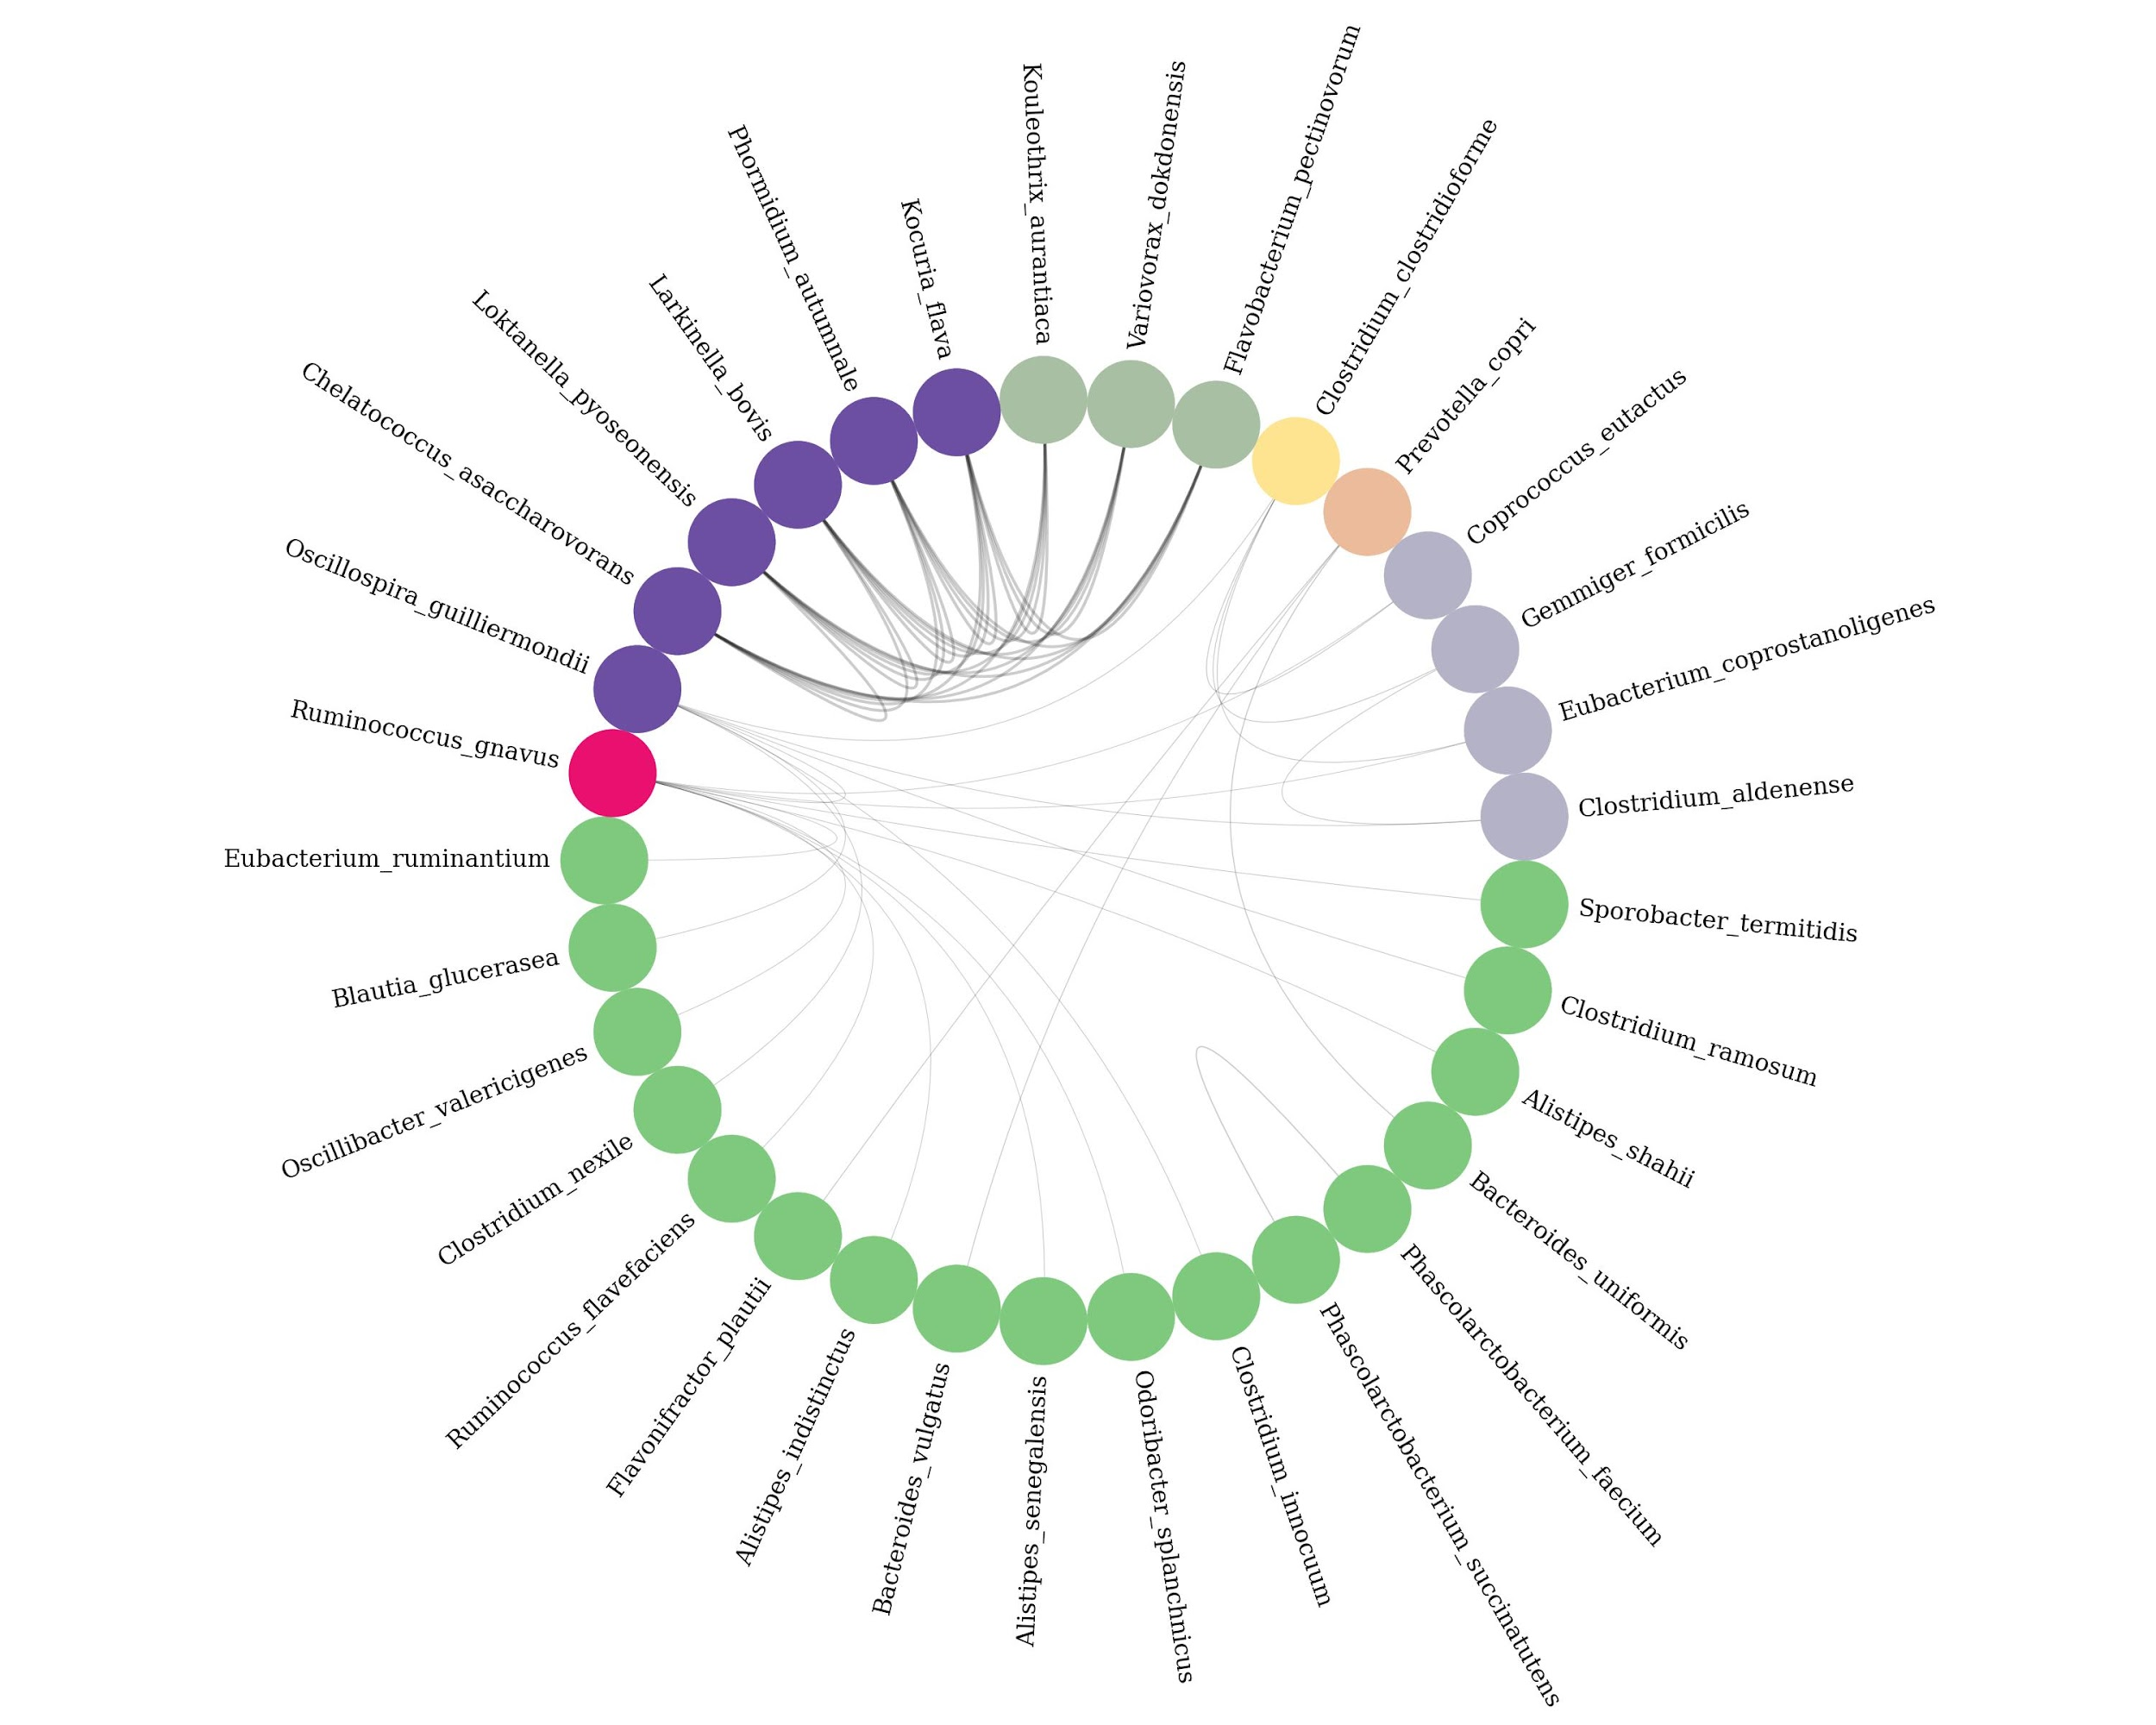
Network on the base of eigenvalue
Network on the base of pc 4
Network on the base of pc 5

Slide 11
Random matrix theory (RMT) is a statistical method that has been widely used in network analysis to identify significant correlations between variables.
The approach is based on the idea that a large matrix of random variables (such as gene expression data or microbial abundance data) will exhibit certain statistical properties that can be used to identify meaningful correlations.
In RMT, a random matrix is constructed from the data, and the eigenvalues and eigenvectors of the matrix are analyzed. The eigenvalues represent the strength of the correlations between the different variables, while the eigenvectors represent the pattern of the correlations. The distribution of the eigenvalues is compared to the expected distribution for a random matrix, and any eigenvalues that deviate significantly from the expected distribution are considered to be significant correlations.
One advantage of RMT is that it can be used to identify both positive and negative correlations between variables, and it is particularly useful for identifying correlations between many variables in large datasets. RMT has been applied to a variety of network analysis problems, including co-expression networks, microbial interaction networks, and gene regulatory networks.

