Slide 1

Modern c++
Visitor Design Pattern

Slide 2

“The best way to learn is often through simple, clear examples. Shape classes in C++ might seem mundane, but they effectively illustrate the power of object-oriented programming.” ~Bjarne Stroustrup
“Using Shape classes in C++ might appear boring, but it’s the perfect way to demonstrate inheritance and polymorphism without unnecessary complexity.”
~Scott Meyers

Slide 3
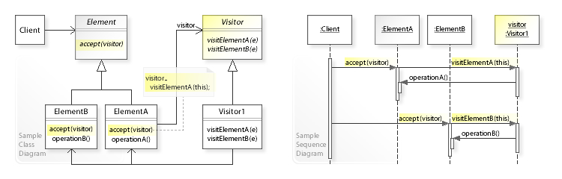

Slide 4
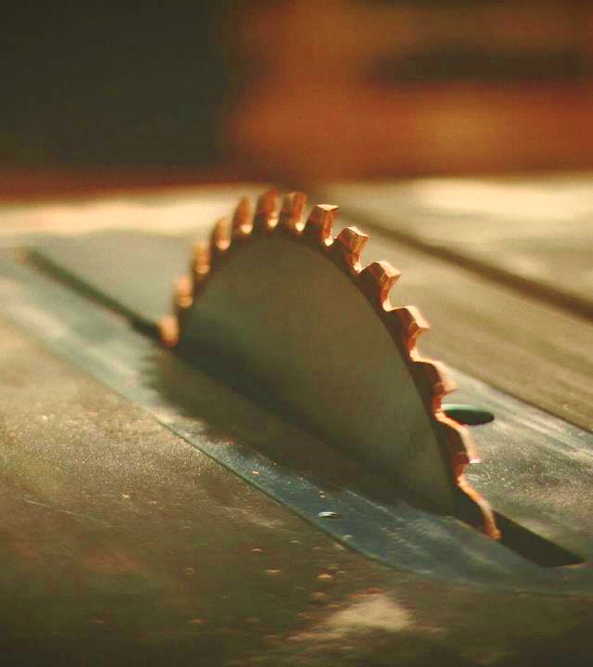
What next?

Slide 5

Q & A
Thank YOU

