Slide 1
Classification of Pneumonia Utilizing Convolution Neural Networks
SAT 5114 Project Presentation
Members: Anand Addepalli Djinaud Prophete

Slide 2
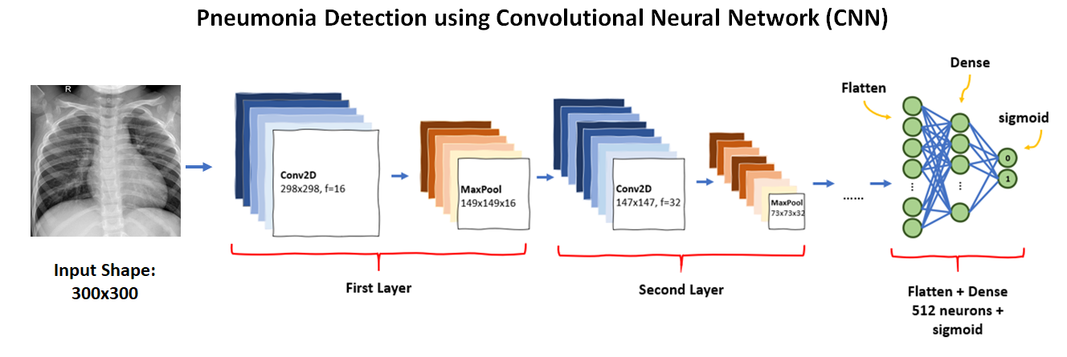
Long-term goal and major application of your project
Efficiently detect and classification lung images into normal and pneumonia affected images.
Explore various deep learning techniques to analyze the models performance.
Utilize the training results to deploy on the real-time datasets.

Slide 3
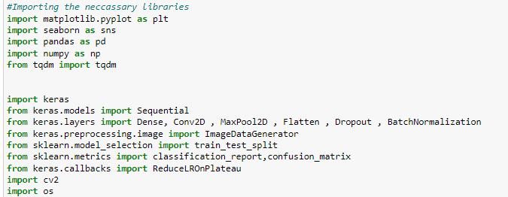
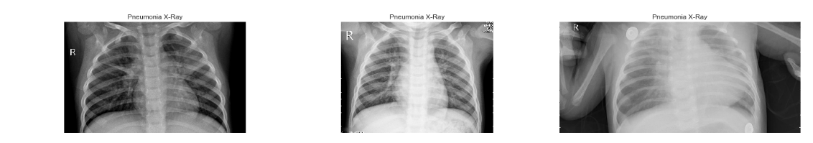
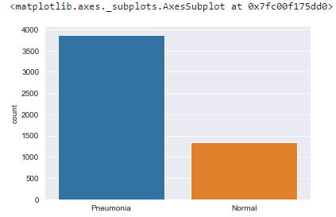
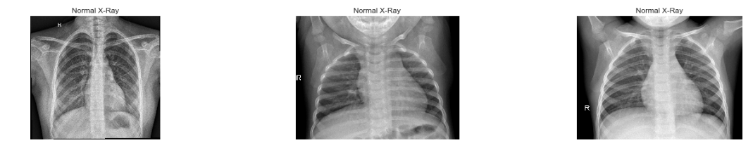
Headline optional
Exploring the dataset

Slide 4
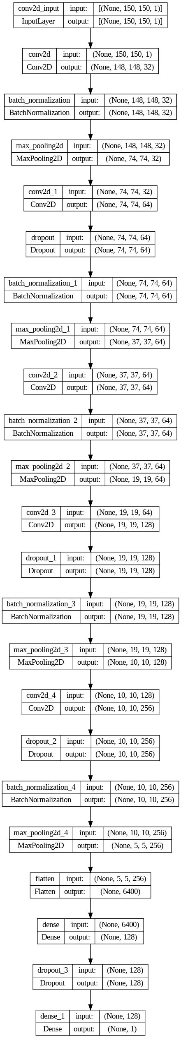
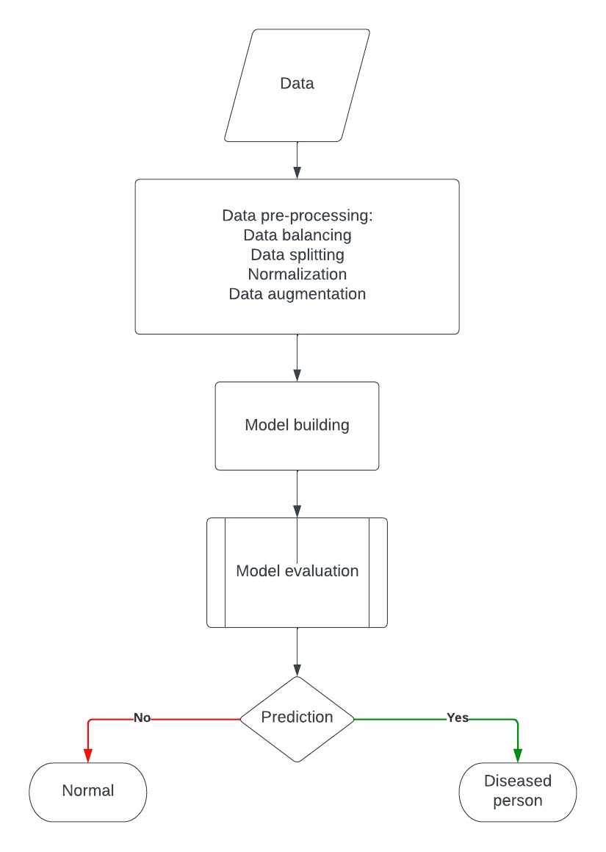
Workflow of the CNN
Architecture of the model

Slide 5
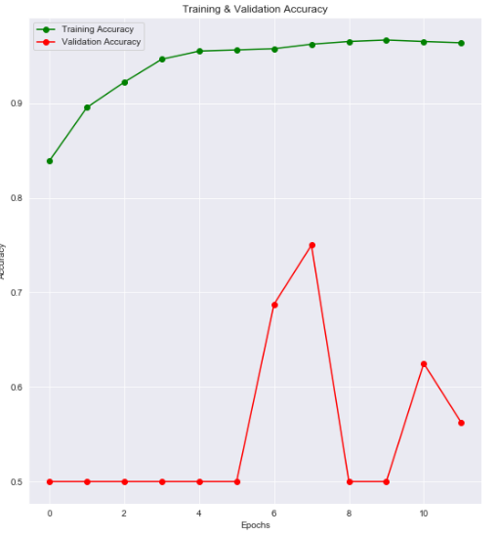
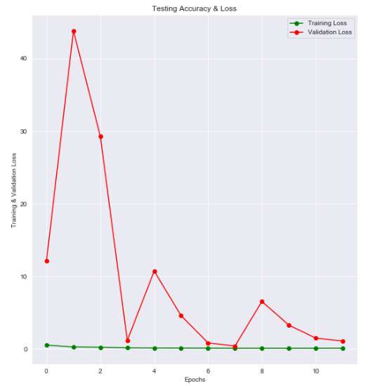
Results and Future work
Training accuracy that has been achieved is 91.98%
Working on the concept of fastai using the Resnet18 model to deploy the current dataset.
Will be working on the transfer learning algorithms like U-Net, SAM(yet to explore).
Finally we will be deploying on the real time dataset to predict the disease.

Slide 6
References
[1] Lamia A, Fawaz A. Detection of Pneumonia Infection by Using Deep Learning on a Mobile Platform. Comput Intell Neurosci. 2022 Jul 30;2022:7925668. doi: 10.1155/2022/7925668. PMID: 35942467; PMCID: PMC9356824.
[2 ] Patrik Szepesi, László Szilágyi, Detection of pneumonia using convolutional neural networks and deep learning, Biocybernetics and Biomedical Engineering, Volume 42, Issue 3, 2022, Pages 1012-1022, ISSN 0208-5216, https://doi.org/10.1016/j.bbe.2022.08.001.
[3] https://segment-anything.com/
[4] arXiv:2002.04688
4/17/2023

