Slide 1
Predicting the Typing Time of a Sentence
Capstone Project by Anand Ramakrishnan

Slide 2
Background
Professional typing tests, which assess words per minute, are a common part of job interviews.
Does any aspect of the sentence cause variation in typing speed?
The dataset was taken from a study by Nahuel Gonzalez of the University of Buenos Aires, in which the content of a sentence was predicted based on the timing of each keystroke. Since there were no time units listed in the data, I decided that total typing time would be the dependent variable.
There are 32,716 sentences in total, split between those about gay rights, those about gun rights, and restaurant reviews.
I cleaned the data to remove and account for function keys.

Slide 3
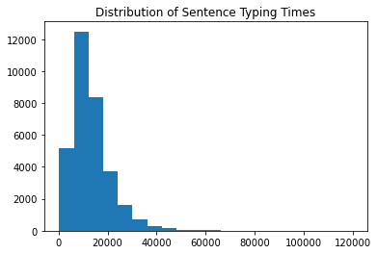
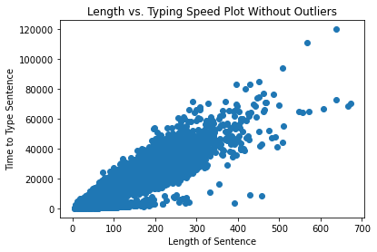
Plots

Slide 4
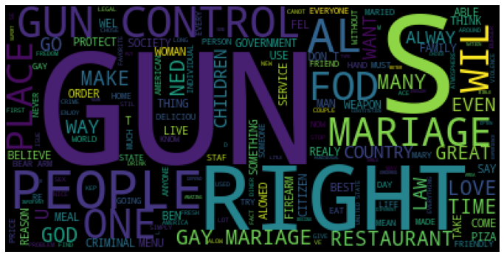
Word Cloud

Slide 5
Word Analysis
Four models were fit at each step of the analysis process: linear regression, decision tree regression, bagged regression, and random forest regression. The main statistic for success was accuracy.
After splitting the dataset into training and test sets, I used a CountVectorizer to tally the counts of each word that appeared at least 33 times, or roughly 1% of the total number of sentences, in the training set.
Using the word counts as predictors of typing time, the model that fit the best was linear regression, though it only had above-average accuracy for both the training and test sets. The other three models were very overfit.
Choosing only words which are not real US English words, the models performed even worse.

Slide 6
Attribute Analysis
For my next group of models, I used these attributes as predictors: the length of the sentence, the topic of the sentence, the number of function keys (such as shift or backspace) used, and the sentiment of the sentence.
The sentiment was calculated using the VADER tool, on a scale of -1 (most negative) to +1 (most positive).
The random forest regressor performed the best, though its parameters needed to be fine-tuned afterwards in order to limit overfitting.
The length was easily the most important attribute in the model, but both sentiment and the number of function keys also had a significant effect.

Slide 7
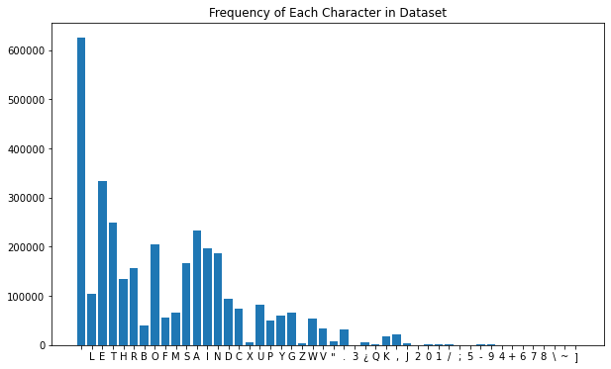
Character Analysis
Using the Counter function in Python’s Collections library, I found out the characters contained in the sentences as well as how much each character appeared in the sentences.
The random forest regressor performed the best again.
The features with the highest coefficients were space and nine of the ten most common letters.

Slide 8
Multicollinearity
The frequencies of the 10 most important characters had high correlation with the length of the sentence. In addition, the frequencies of the 9 letters had high correlation with the number of occurrences of the space. However, the frequencies of the letters did not have high correlation with each other.
Since multicollinearity (high correlation between predictors) can lead to a wider confidence interval, it is best that we remove highly-correlated predictors. Thus, the length and number of spaces will no longer be included.

Slide 9
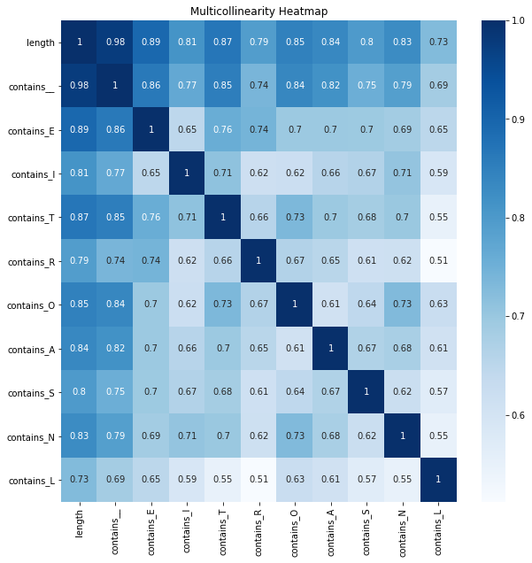

Slide 10
Final Model
The final models had 21 predictors:
The 10 words with the highest coefficients for linear regression: 'thethe', 'tha', 'health', 'consenting', 'sandy', 'wouldn', 'hte', 'fof’, 'considering’, and 'walked’
The 9 letters with the highest feature importances in the character random forest regression model: 'E', 'I', 'T', 'R', 'O', 'A', 'S', 'N’, and ‘L’
The number of function keys used while typing each sentence
The sentiment of each sentence
The eventual model chosen was a random forest regressor.
The model had higher variance if the 10 words were not included, indicating that the words helped to prevent overfitting.

Slide 11
Table of Accuracy Scores
Model (set) | Words as predictors | Attributes as predictors | Characters as predictors | Final choice of predictors
Linear (training) | 0.719 | 0.854 | 0.82 | 0.85
Linear (test) | 0.672 | 0.858 | 0.827 | 0.854
Decision tree (training) | 0.998 | 0.987 | 0.999 | 0.999
Decision tree (test) | 0.384 | 0.722 | 0.689 | 0.714
Bagged (training) | 0.925 | 0.959 | 0.965 | 0.97
Bagged (test) | 0.597 | 0.827 | 0.822 | 0.849
Random forest (training) | 0.946 | 0.967/0.883 | 0.976 | 0.979
Random forest (test) | 0.624 | 0.836/0.851 | 0.838 | 0.862

Slide 12
Conclusions & Limitations
The letter E had a much higher impurity-based feature importance than any other predictor in my final model, with a value of 0.569. The only other predictor with an importance higher than 0.1 was the number of function keys, which had a value of 0.123.
Possible reasons for the dominance of the letter E are that E is such a common letter in the English language and that it is not in the center row of the QWERTY keyboard, so typists must do a little reaching to press the key.
There are a few limitations to this project:
Since the data never had consecutive [BACK] instances, it is impossible to tell how many letters were deleted upon using backspaces, so my cleaned data might not be accurate.
The sentiment analyzer could not assign a score to misspelled words.

