Slide 1
Market Basket Analysis
Popular basket of Items

Slide 2
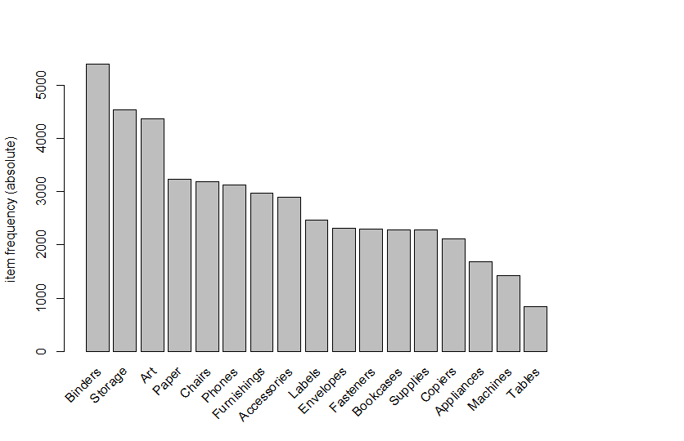
Most selling Items

Slide 3
Most selling Items [top 50%]
Binders
Storage
Art
Paper
Chair
Phone
Furniture
Labels

Slide 4
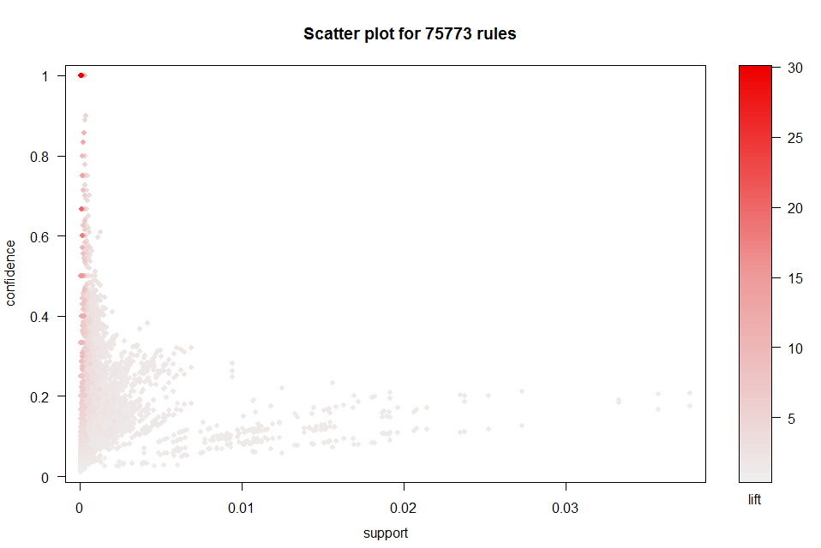
Association Rules [Minmum 2 Items]

Slide 5
Seleting Rules
Support-Count-Confidence-Rules | Support-Count-Confidence-Rules
0.90% 461.61-28-1 0.90% 461.61-27-1 0.90% 461.61-26-2 0.90% 461.61-25-2 0.80% 410.32-28-1 0.80% 410.32-27-1 0.80% 410.32-26-2 0.80% 410.32-25-2 0.70% 359.03-28-1 0.70% 359.03-27-1 0.70% 359.03-26-2 0.70% 359.03-25-2 0.60% 307.74-32-1 0.60% 307.74-31-2 0.60% 307.74-30-3 0.60% 307.74-29-3 | 0.60% 307.74-28-4 0.60% 307.74-27-5 0.60% 307.74-26-7 0.60% 307.74-25-8 0.5%256.45-32-2 0.5%256.45-31-3 0.5%256.45-30-5 0.5%256.45-29-7 <<<<=== SELECT THIS 0.5%256.45-28-8 0.5%256.45-27-14 0.5%256.45-26-19 0.5%256.45-25-22

Slide 6
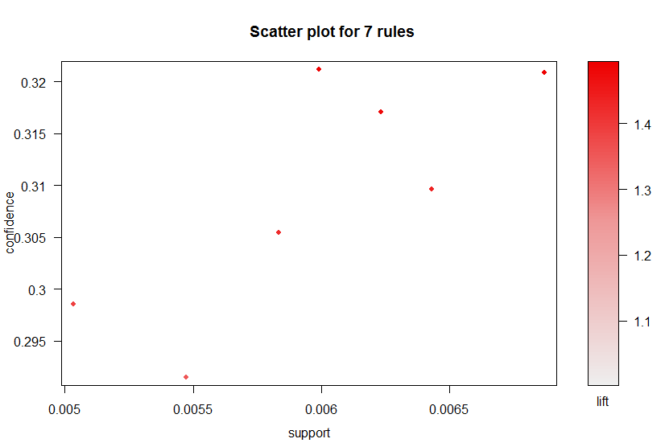

Slide 7
Popular Baskets/Items
lhs rhs support confidence lift
{Labels,Storage} => {Binders} 0.005032954 0.2985782 1.386295
{Accessories,Art} => {Binders} 0.005472339 0.2914894 1.353382
{Accessories,Storage} => {Binders} 0.006231276 0.3170732 1.472167
{Art,Furnishings} => {Binders} 0.005991612 0.3211991 1.491324
{Furnishings,Storage} => {Binders} 0.005831835 0.3054393 1.418152
{Art,Phones} => {Binders} 0.006430997 0.3096154 1.437541
{Phones,Storage} => {Binders} 0.006870381 0.3208955 1.489915

Slide 8
Conclusion
Keep Binder , Storage , Art , Paper Near will help more sales for these items

