Slide 1
Heart Disease Prediction Model
SUBMITTED BY:
ANAND RAVIDAS
181210010
SHASHI RAJ
181210050

Slide 2
Introduction
Heart disease, one of the major causes of mortality worldwide.
Importance of heart disease diagnosis in the life.
Past data related to heart disease can help in predicting the presence of heart disease.
Using past data and applying ML technique helps in diagnosis of heart disease.

Slide 3
Objective
Creating an efficient Heart disease prediction model using a sequence of ML technique and standard dataset.
Compare our model with other existing model.

Slide 4
Datasets
1.Statlog
Dataset consists of 270 subjects, 13 attributes and one output class (120 and 150 subjects are labelled with the presence (positive class) and absence (negative class) of heart disease, respectively).
2.Cleveland
Dataset consists of 303 subjects with 138 and 165 subjects being labelled with the presence (positive class) and absence (negative class) of heart disease, respectively.

Slide 5
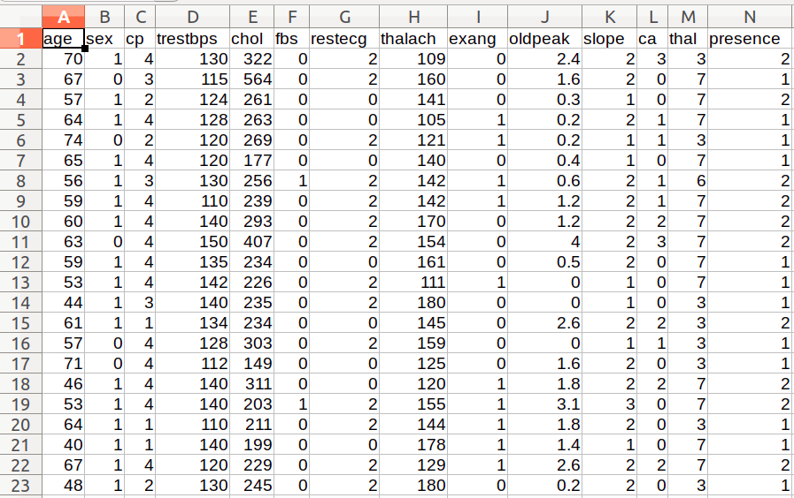

Slide 6
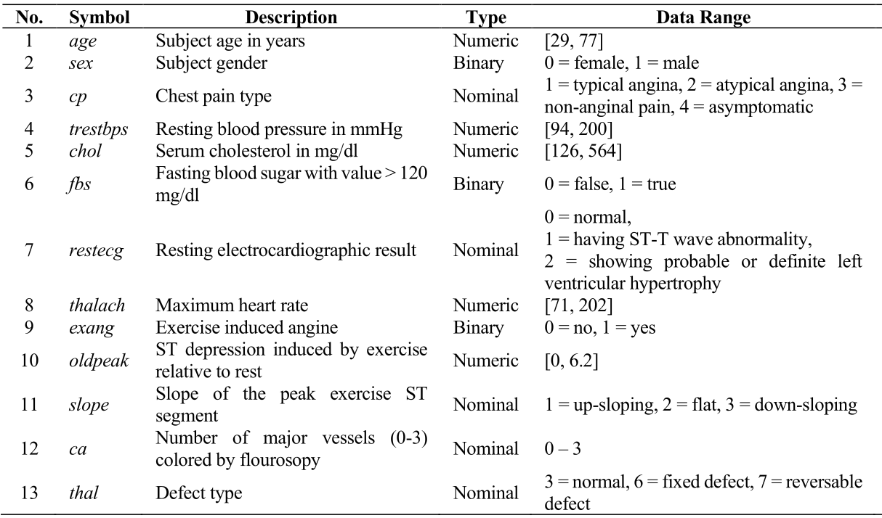
Attribute description

Slide 7
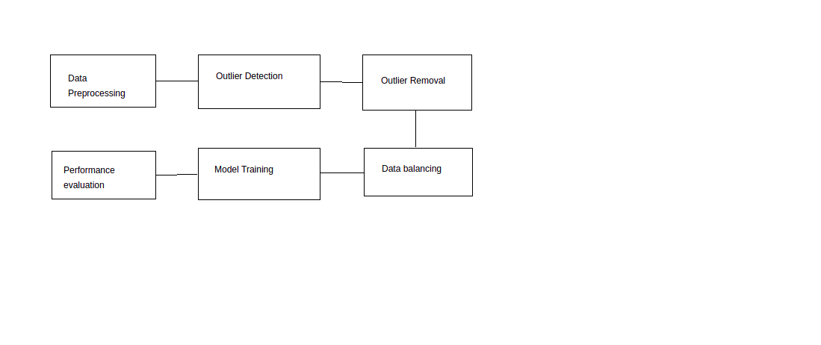
Methodology
Data Preprocessing
Outlier Detection and removal
Data balancing
Data training
Performance evaluation

Slide 8
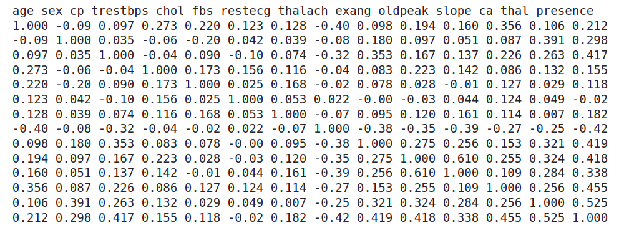
Pearson Correlation coefficient

Slide 9
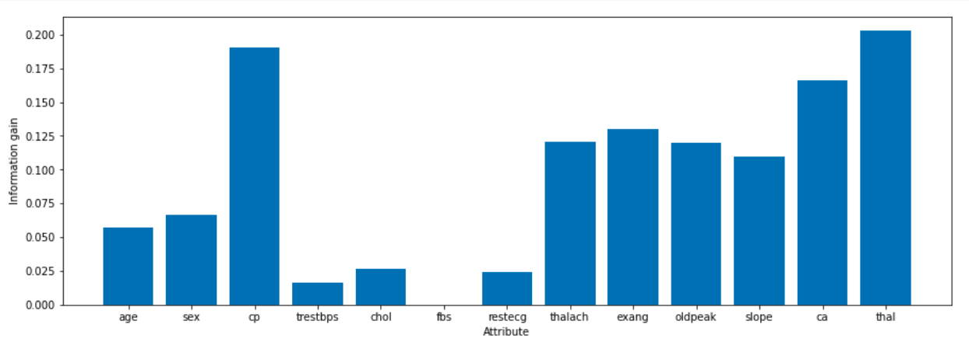
Information gain

Slide 10
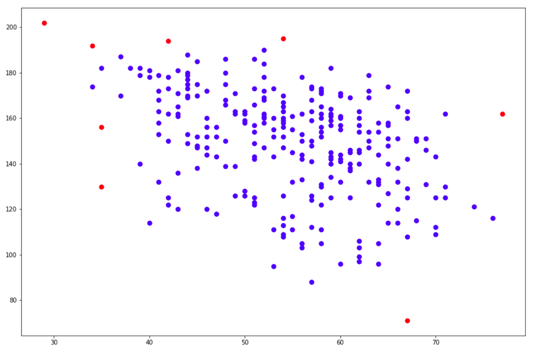
Outlier detection

Slide 11
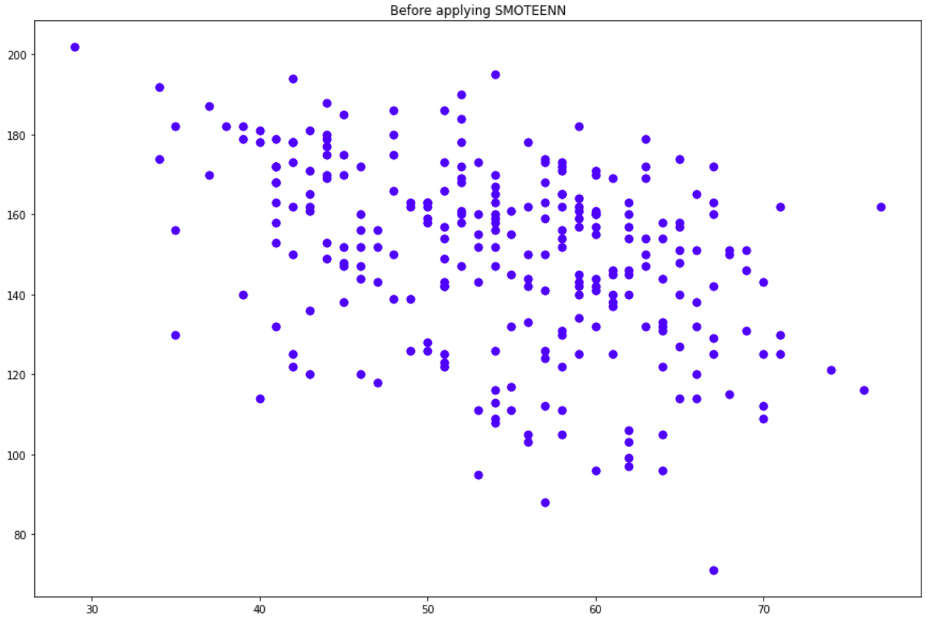
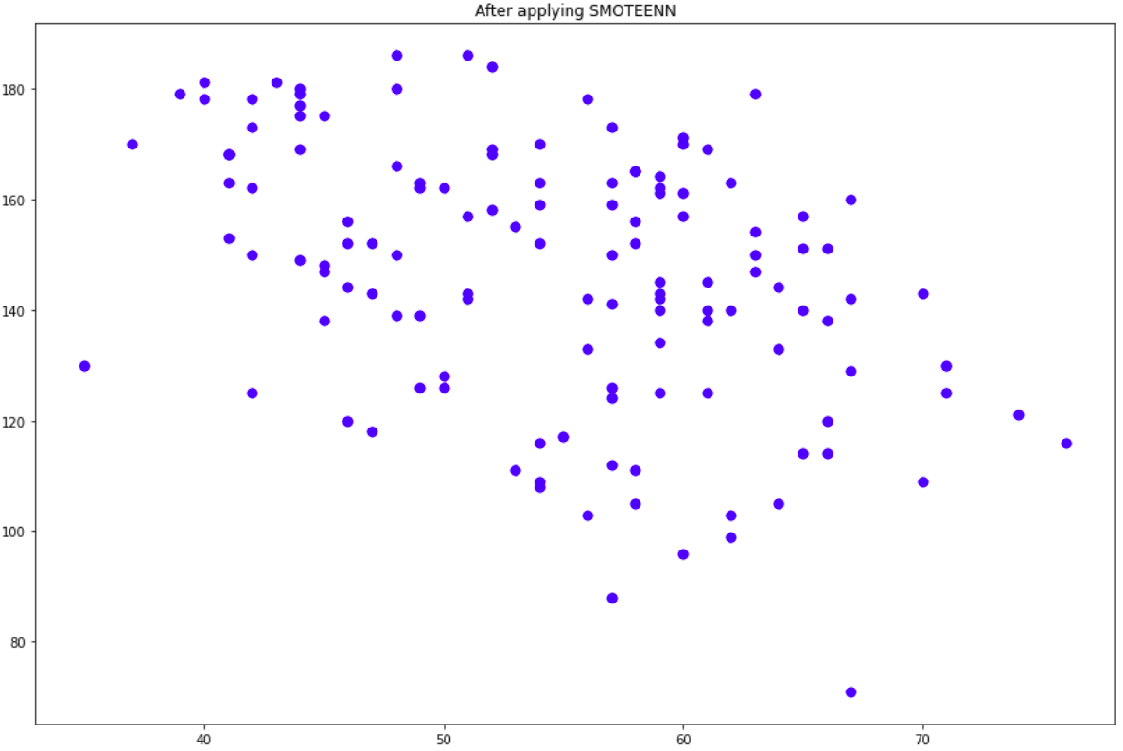
Data balancing

Slide 12
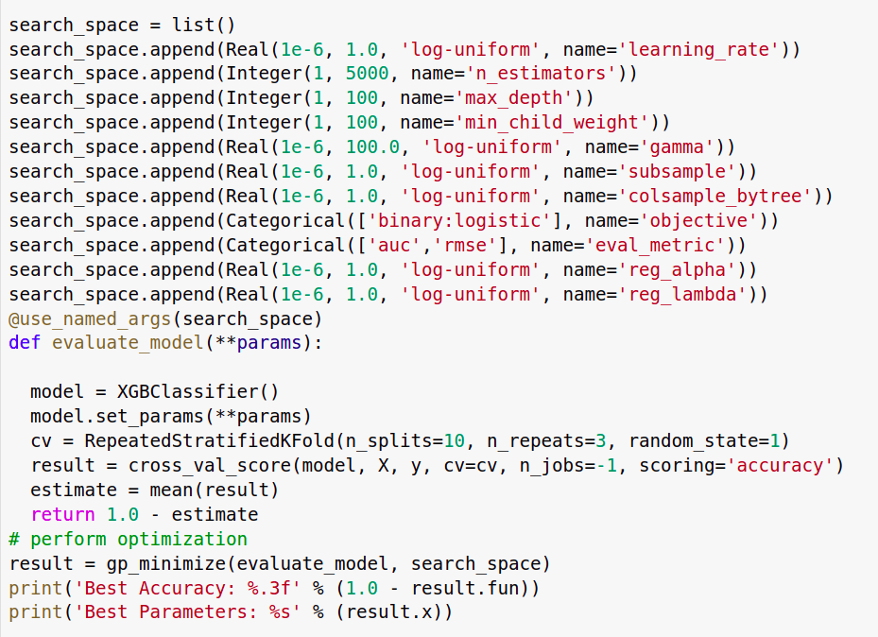
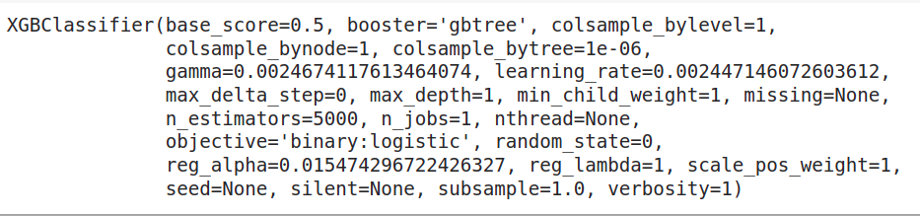
Genetic Algorithm

Slide 13
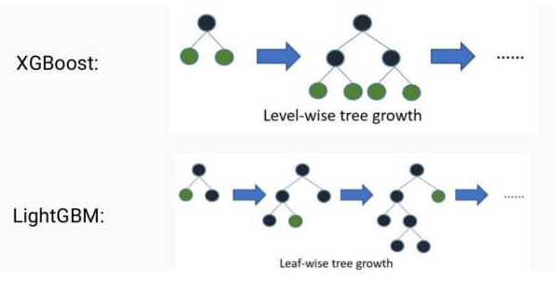
Training of Model

Slide 14
Performance evaluation
Metrics used:
1.Accuracy
2.F1 Score
3.Recall Score
4.Precision Score
5.MCC(Matthews correlation coefficient)
6.TPR(true positive rate)
7.TNR(true negative rate)
8.FPR(false positive rate)
9.FNR(false negative rate)

Slide 15
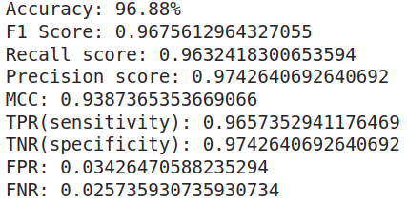
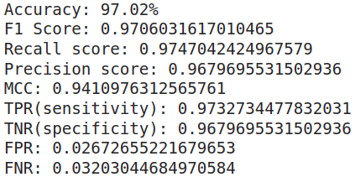
Results

Slide 16
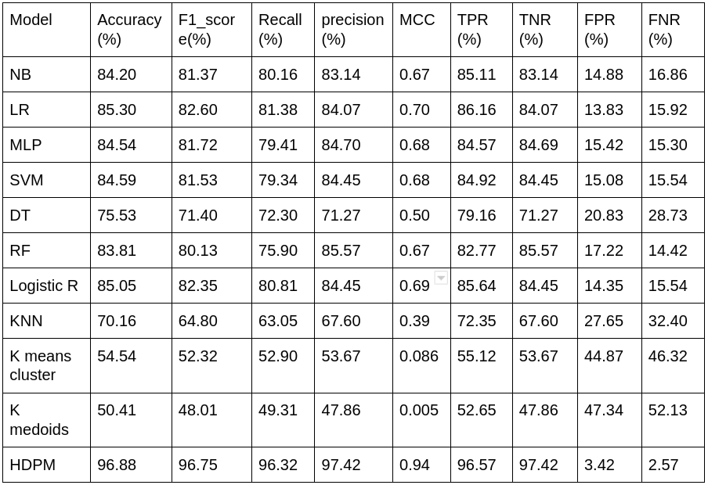

Slide 17
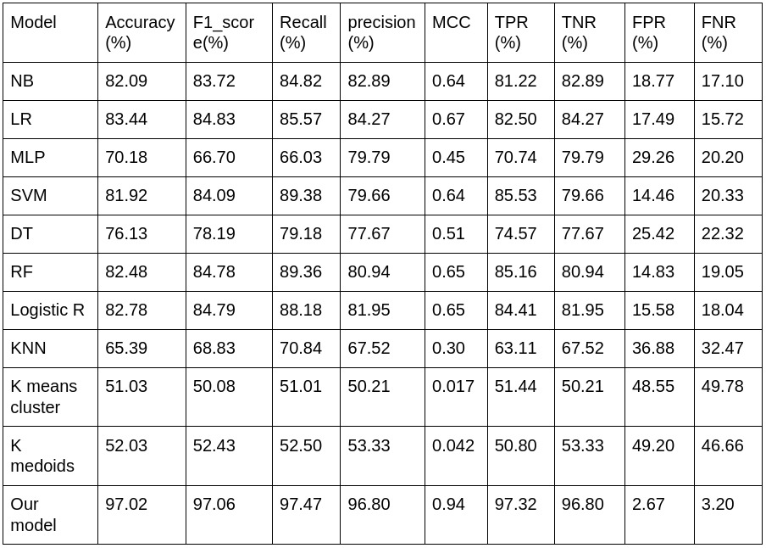

Slide 18
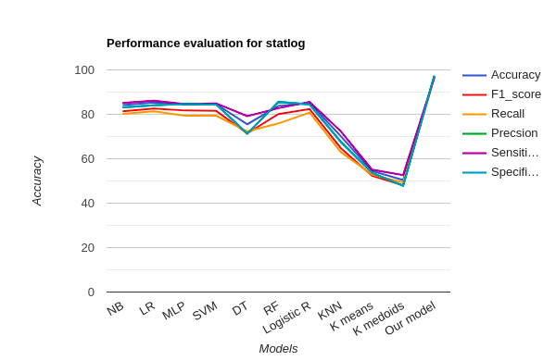
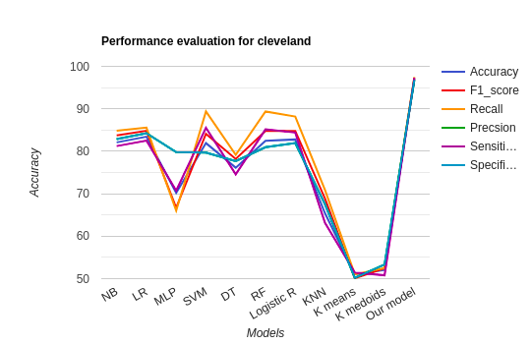
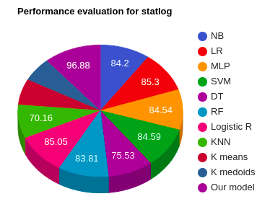


Slide 19
Conclusion
The Heart Disease Prediction System using Machine learning algorithm,viz. XGboost provides its users with a prediction result that gives the state of a user leading to CAD. Due to recent advancements in technology, machine learning algorithms have evolved a lot and hence we use a hybrid model combination of DBSCAN, SMOTEENN, GA, XGboost in the proposed system because of its efficiency and accuracy. Also, the algorithm gives the nearby reliable output based on the input provided by the users. If the number of people using the system increases, then the awareness about their current heart status will be known and the rate of people dying due to heart diseases will reduce eventually.

Slide 20
THANKS

