Slide 1
Adaptive Soft Associative Memory
ECE 560 Project Report
Anand Ramachandran

Slide 2
Sparse Distributed Memory
n-bit vector space – sparsely populated with random hard addresses
Circle of X’ ~ X
.
.
.
Address X
.
.
.
.
.
.
.
.
.
.
.
.
.
.
.
.
.
.
.
.
.
.
.
.
.
.
.
.
.
.
.
.
.
.
.
.
Programming or Reading at X:
Select all addresses within a distance d_{th} of X.
Write X into all locations.
Read and average across all locations.
.
.
.
.
.
.
Can respond to patterns similar to those stored in memory
Memory should not be too sparse. Properties depend on hyper-dimensional vector distribution around a given vector.

Slide 3
Too Much Memory Required: One possible solution
.
.
.
.
.
.
.
.
.
.
.
.
.
.
.
.
.
.
.
.
.
.
.
.
.
.
.
.
.
.
.
.
.
.
.
.
.
.
.
Initially Empty Storage
.
.
.
.
.
.
Assumption: The data is very sparse and noisy data is clustered very close to signal.
Thus circles of two different data and associated noise will be disjoint.
If there is no hard-location near X, create hard-locations in the circle of X mirroring the probability density of SDM

Slide 4
Why not always dynamically allocate?
Memory consists of empty address and data locations in the beginning.
User initializes both address and data.
Address
Data
100101101, 110101001
Initially empty (address, data) pairs. Incoming address and data are both programmed into memory.
Issue – what if the data is noisy? And the initially programmed address is the noisy?
Other noisy data may not be detected.

Slide 5
Example
Actual address is 0000
Noisy incoming address is 0001. 0001 stored
Assume memory parameter is d_{th} = 1
Assume address 0010 comes in next
d(0001, 0010) = 2 => 0010 goes undetected
Solution: Adaptively change 0001 to 0000 based on input statistics

Slide 6
Auto-associative modification
Stored data = Address
Data represented as counters per bit-position
Increment counter at respective bit-position if address has a ‘1’ at that position
Decrement otherwise
soft address
0
1
1
1
0 1 0 1
Incoming address
Data-fields
-
+
-
+

Slide 7
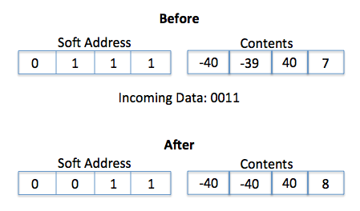
Adapt the address to data
When a data-field saturates, modify the address bit accordingly
Thus if the first address lodged is noisy, the address will later change to the “signal”

Slide 8
Automate Dynamic Allocation of memory
Maintain a state of each cell.
Allocate a location if no cell is activated by incoming address based on static priority.
Address
Data
0
+
-
+
-
1
2
X
X
3
1010
4
X
X
5
‘X’ indicates occupied location
6
X
X
7
Dynamic Allocation picks the least unoccupied index to program
8
9
X
X
10

Slide 9
Strength and Unlearning
Define a strength threshold, H
A bit position is strong if the counter at that position has magnitude higher than ‘H’
Memory location is strong if all bit positions are strong
Memory Contents
If H = 8, the bit-positions in bold are strong.
-40
-39
40
7
Invalidate weak locations when their activation coincides with the activation of another location.
Weak location will be invalidated, or “unlearned.” Strong location’s contents will be updated and later adapted.
0011 : Strong location 0110 : Weak location
Incoming: 0010
Activates both locations

Slide 10
Overall Memory-Cell Architecture
setAddress (dynamic allocation)
address
Hamming Distance Unit
Soft Address
hit
rddata
otherHit
Data
Data Management
update
adapt
strength
“Learn, Adapt, Unlearn”

Slide 11
Implementation and Experiments
Implemented in Verilog, parameterized fully
Structural coding can be synthesized.
Not synthesized.
Memory built to correct erroneous hamming codes
Symbols: 11111111, 11110000, 11001100, 10101010
Hamming distance of four between any two codes
Code can correct 1 bit error per symbol

Slide 12
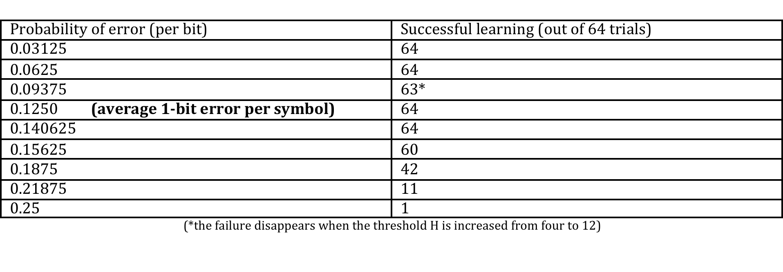
Experimental Results
The associative memory can make a successful estimation of the correct symbols from erroneous symbols. After this initial training, it can start correcting 1-bit errors in the code.
Errors are uniform random per bit
Most incoming symbols are erroneous in some experiments

Slide 13
Thank You! Questions?

Slide 14
Initial Application studied
Genomic Error Correction.
Ambiguities in portions of a genome due to erroneous duplicates.
Initial project objective: use SDM to filter out statistically more significant genome portions compared to similar statistically less significant genome portions.

