Slide 1
Image Based Food Classification
-Team
Kamal Awasthi(MT19091)
Anand Sharma(MT19059)
Vishal Srivastava(MT19102)
Group - 4

Slide 2
Dataset:
Sample of Food101 Dataset
Total 10 classes.
150 training samples for each class, ence training set size=10*150
50 testing images for each class. Hence testing set size=10*50
Classes:
['edamame', 'ramen', 'sushi', 'bibimbap', 'apple_pie', 'falafel', 'ice_cream', 'french_toast', 'tiramisu', 'cannoli'

Slide 3
Methodology:
We have performed Data Augmentation(random transformation and resizing) on training and testing images and then normalized the images.
Machine Learning Models- Random Forest ,Decision Tree,KNN , Naive Bayes and applied feature extraction using HOG.
Deep Learning:
Artificial Neural Network(from Scratch)
Alex-net
Densenet
Resenet
Squeezenet
Vgg

Slide 4
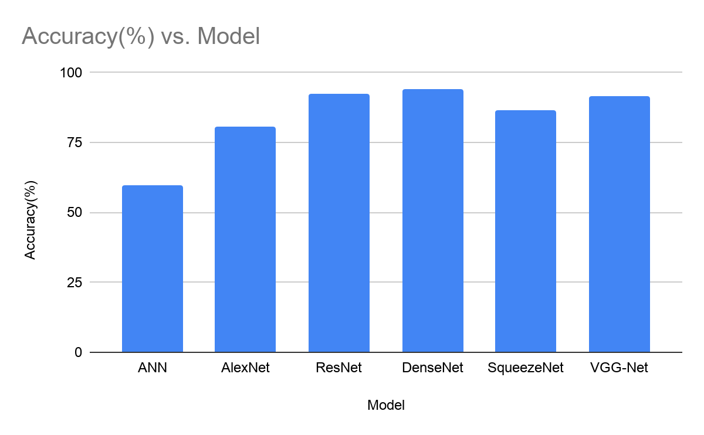
Results

Slide 5
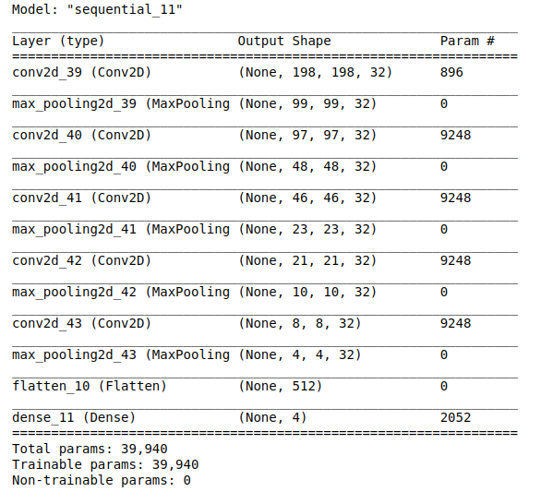
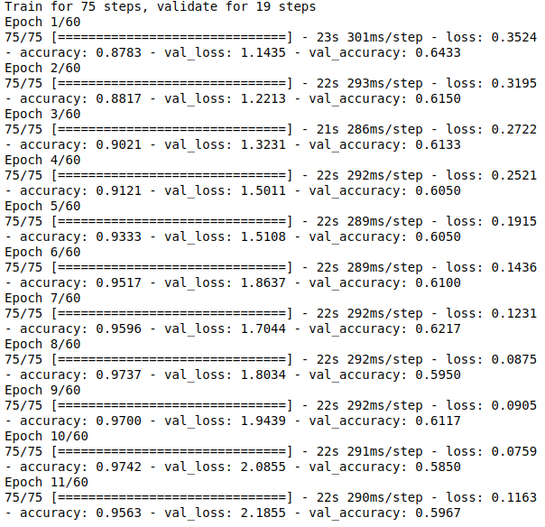
Artificial Neural Network
Model-Architecture
Accuracy: 59.67%

Slide 6
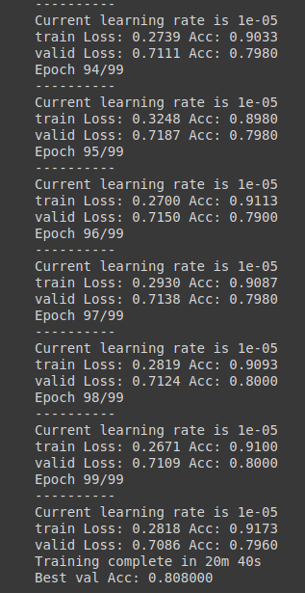
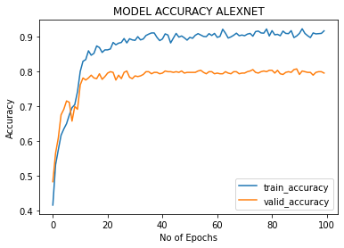
Alex-net
Accuracy: 80.8%

Slide 7
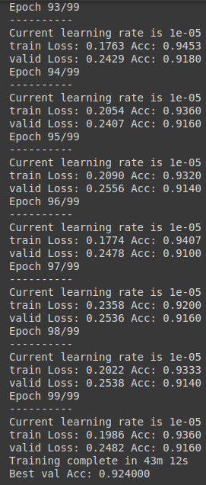
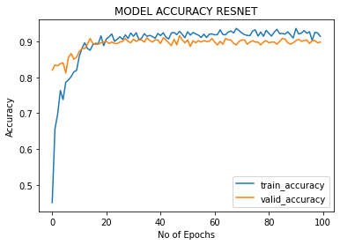
Resnet
Accuracy: 92.40%

Slide 8
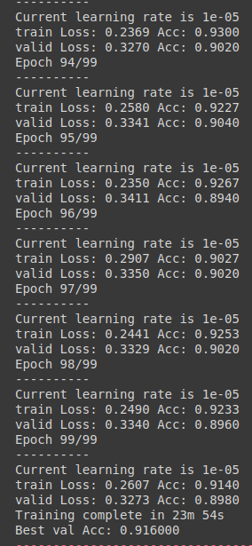
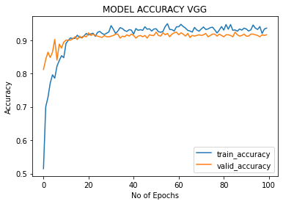
Vgg-net
Accuracy: 91.60%

Slide 9
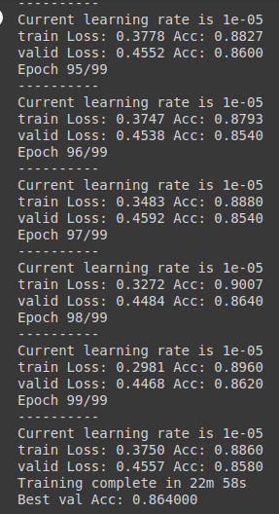
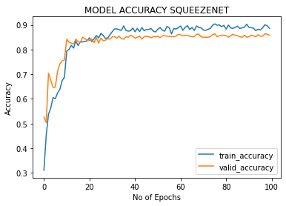
SqueezeNet
Accuracy: 86.40%

Slide 10
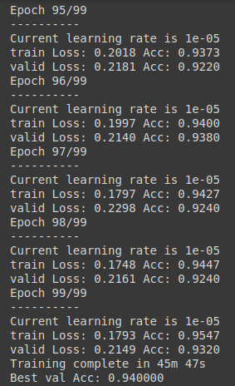
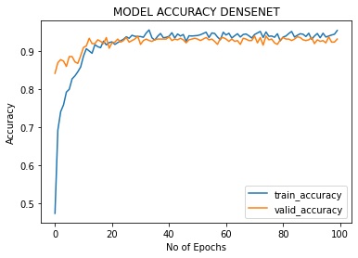
Densenet
Accuracy: 94.0%

Slide 11
READ ME FILES:-
Colab LINK for Deep Learning :-https://colab.research.google.com/drive/1byMuagYD03kxSIVNsiu3jD42LOy4DD67?usp=sharing
Colab Link for ML techniques:- https://colab.research.google.com/drive/1yylvWvfUSgDTsriCnM6ndHuLrhgVCsf-?usp=sharing
Used Data is food 101 dataset which is sampled for 10 classes and 150 training and 50 testing images.
Various Experiments were performed for results generation they are performed by modifying code that are commented or changed in between.
DenseNet model and ResNet model has given best accuracy approx 94-95% for valiadtion among all models.
Some Machine Learning models were also tried but their results was not good to show .
One Manual self-designed CNN architecture is also applied that gives 65% accuracy.

