Slide 1
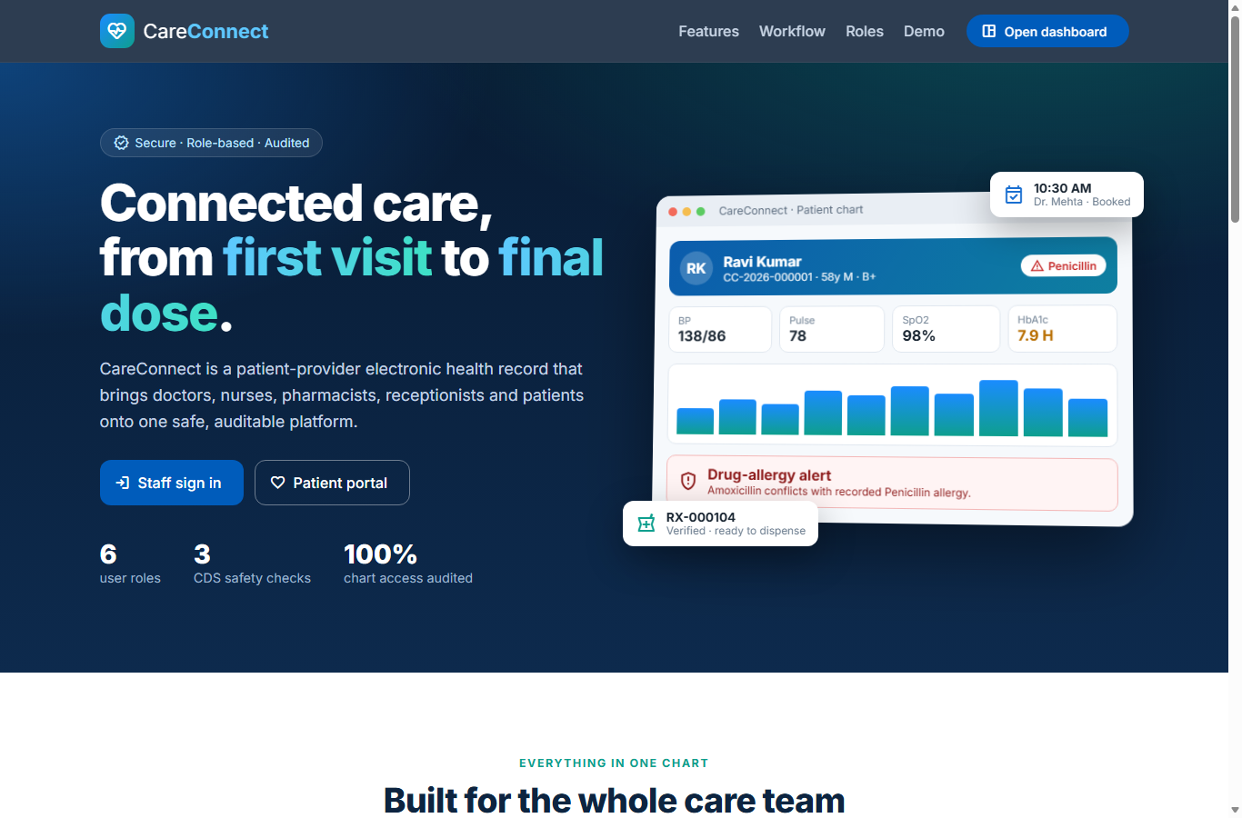
MAJOR PROJECT PRESENTATION
CareConnect
Patient-Provider EHR System
A web application that keeps every patient's health record in digital form and connects doctors, nurses, pharmacists, reception staff and patients on one system.
Spring Boot
Angular
Oracle
Presented by: ______________________
Guided by: ______________________
Notes:
Good morning. Our project is CareConnect, a Patient-Provider Electronic Health Record system. It is a web application built with Spring Boot, Angular and Oracle that stores patient records digitally and connects everyone involved in a patient's care.

Slide 2
Introduction & Problem Statement
What is an EHR? An Electronic Health Record is the digital form of a patient's medical file. It keeps the patient's history, allergies, visit notes, test results and medicines in one place, so every authorised doctor, nurse or pharmacist sees the same up-to-date information.
Problems in the existing system
Proposed system: CareConnect
Paper files. Records are hard to find, get lost, and cannot be shared between departments.
Digital chart. Each patient gets a unique MRN and one complete online record.
Prescription errors. Nobody checks the patient's allergies or other medicines before a drug is written.
Automatic safety check. Every prescription is checked for allergies, drug interactions and duplicates.
Manual pharmacy. Medicine stock is counted by hand, so shortages are noticed too late.
Smart pharmacy. Pharmacist verifies each prescription; stock updates itself on dispensing.
Patients kept outside. Reports and appointments need a visit or a phone call to the clinic.
Patient portal. Patients see results, download PDFs and book appointments online.
Notes:
First explain what an EHR is. Then read the four problems on the left and show how each point on the right solves the problem next to it.

Slide 3
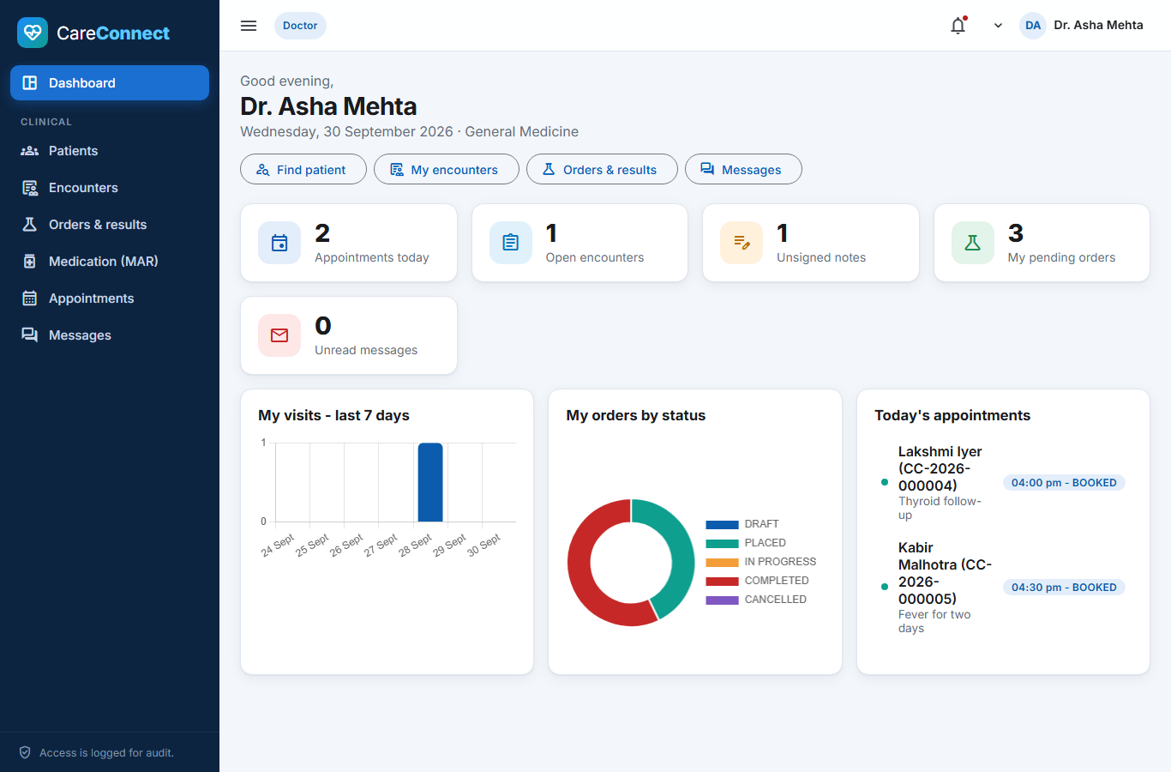
System Modules
The system has six types of users. Each user logs in and sees only the screens needed for their work.
D
Doctor
N
Nurse
Examines the patient, writes the visit note, adds the diagnosis, orders tests and prescribes medicines.
Records vitals such as BP and pulse, enters lab results and records every dose given to the patient.
P
Pharmacist
R
Receptionist
Checks and approves prescriptions, gives out medicines and manages medicine stock.
Registers new patients and books, checks in or cancels appointments.
A
Admin
P
Patient
Doctor's dashboard after login: today's appointments, pending orders and unsigned notes at a glance.
Creates user accounts, manages departments and medical codes, and reviews the activity log.
Views own medicines and reports, downloads PDFs, books appointments and messages the doctor.
Notes:
Explain each role in one line. Point out that the screens change with the role: for example the receptionist can register a patient but cannot read the doctor's notes, and a patient can only see their own record.

Slide 4
System Architecture
Three-tier architecture: what the user sees, where the rules run, and where the data is stored
FRONTEND
BACKEND
DATABASE
Angular
Spring Boot
Oracle
The screens the user works on in the browser: forms, tables, charts and alerts.
Checks who the user is, applies the hospital rules and safety checks, and talks to the database.
Stores all data safely in 29 related tables with keys, constraints and indexes.
How one request works
1
Login
2
Request
3
Check & process
4
Save & reply
User enters username and password. The password is checked and a secure token (JWT) is given.
When the user opens a screen, Angular sends the request to the backend with the token.
Spring Boot checks the user's role, validates the data and applies the rules.
Data is saved in Oracle, the access is recorded in the audit log, and the result is shown.
Notes:
Explain the three layers from left to right, then walk through the four steps of a request. Mention that passwords are never stored in plain text and every access to patient data is logged.

Slide 5
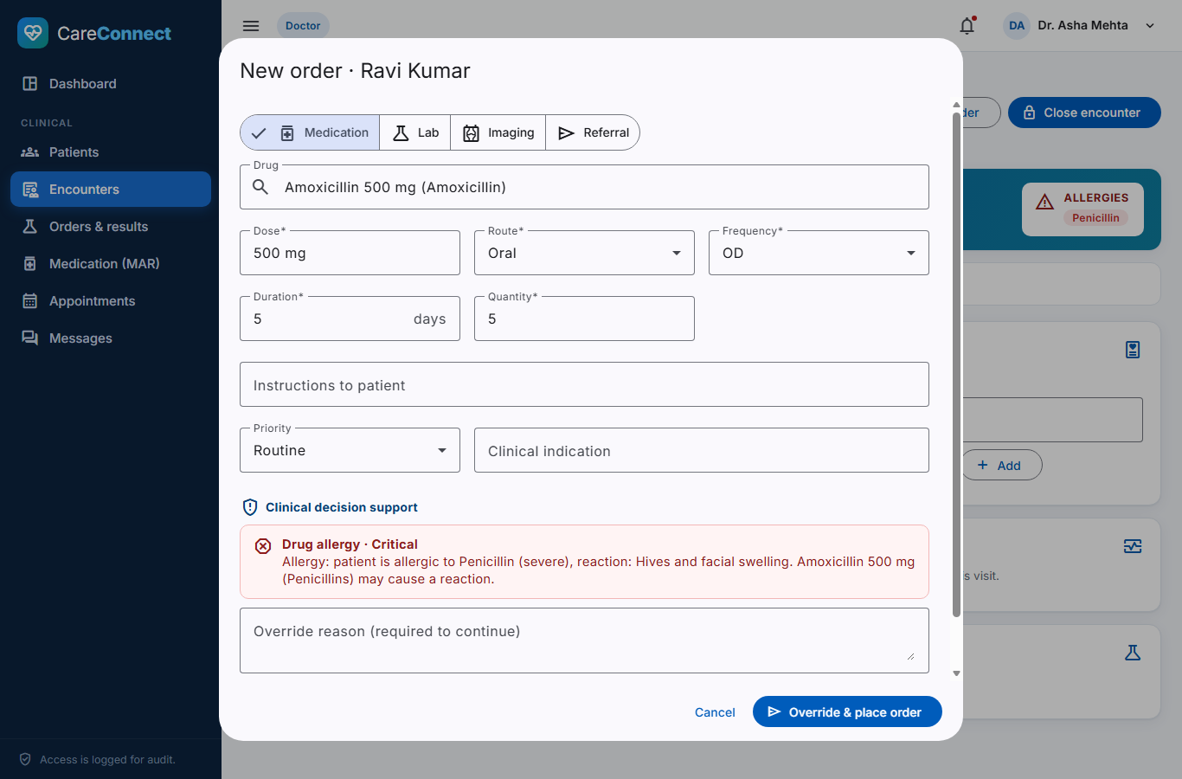
Working Example: Safe Prescription
What happens when a doctor prescribes a medicine the patient is allergic to
1
Doctor selects the medicine
The doctor opens the patient's visit and orders Amoxicillin 500 mg.
2
System checks automatically
The patient is allergic to Penicillin and Amoxicillin belongs to that group, so a red Critical alert is shown.
3
Doctor decides
The doctor cancels the order, or writes a reason to continue. Dangerous drug pairs are blocked completely.
4
Pharmacist verifies
The pharmacist sees the alert and the doctor's reason before approving the prescription.
Screenshot from the system: the red alert appears as soon as Amoxicillin is selected for Ravi Kumar.
5
Medicine is dispensed
Stock reduces automatically. If it falls below the minimum level, the pharmacist is alerted.
Notes:
This is the most important feature. The same check also works for drug-drug interactions, for example Aspirin with Warfarin, and for duplicate orders. You can show it live by logging in as dr.mehta and then as pharm.arjun.

Slide 6
Testing, Conclusion & Future Scope
39 / 39
76
6 / 6
automated tests passed
API checks passed on Oracle
user roles tested on screen
Conclusion
Future scope
All patient information is now in one digital, secure record.
The automatic safety check stops wrong or dangerous prescriptions before they reach the patient.
Doctors, nurses, pharmacists and reception work on the same up-to-date data.
Patients can see their reports and book appointments from home.
Connect with outside labs and pharmacies (HL7 / FHIR).
Video consultation for telehealth appointments.
SMS and e-mail reminders for appointments and medicines.
Billing, insurance and hospital bed management.
Notes:
Summarise the testing results, read the conclusion and future scope, and then thank the panel and invite questions.

