Slide 1
PRACTICE SCHOOL – I FINAL EXAMINATION & TECHNICAL DEFENSE
AIRA: AI-Based Student Mental Health Monitoring & Support Platform
A Decoupled Full-Stack Architecture Integrating Dual ML Risk Diagnostics, Conversational AI Crisis Triaging, and Live Spatial Specialist Referrals
DEVELOPED & PRESENTED BY:
• Anand Singh Rathore (Roll No: 2024BTECH158) • Diksha Shekhawat (Roll No: 2024BTECH156) Degree: B.Tech Computer Science & Engineering
SUPERVISORS & INSTITUTION:
• Internal: Dr. Sonali Vyas & Dr. Rajnish Kumar • External: Dr. Saurabh Kumar Department of CSE, JK Lakshmipat University, Jaipur

Slide 2
AIRA • PRACTICE SCHOOL-I DEFENSE
The Mental Health Crisis in Higher Education
60%+
Of university students report acute academic anxiety, sleep deprivation, or emotional burnout.
< 15%
Seek institutional counseling due to social stigma, peer judgment, and privacy fears.
11 PM - 4 AM
Peak hours for psychological distress and crisis despair when university clinics are closed.
Key Bottlenecks in Traditional Institutional Care:
• Appointment Waiting Queues: Traditional campus centers take 3 to 14 days to schedule an initial session, failing during urgent crises.
• Static Survey Blindspot: Paper questionnaires (PHQ-9, GAD-7) capture a single static moment, missing daily oscillations between sleep and strain.
• Reactive Post-Crisis Model: Support only occurs after academic failure or severe breakdown, lacking early proactive behavioral detection.

Slide 3
AIRA • PRACTICE SCHOOL-I DEFENSE
The AIRA Solution — Proactive 24/7 Digital Wellness
1. Dual ML Diagnostics
Blends Hugging Face DistilBERT NLP (free-text emotions) with Scikit-Learn Logistic Regression (sleep, study, screen time) to compute an objective 0–100 Wellness Index.
Core Advantage: • Completely Anonymous • Real-Time Triaging (< 1s) • Zero Appointment Waiting
2. Empathetic Conversational AI
Llama 3.3 70B on Groq LPUs delivering sub-400ms coaching with an automated CrisisHandler that immediately intercepts self-harm and surfaces 24/7 helplines.
Core Advantage: • Completely Anonymous • Real-Time Triaging (< 1s) • Zero Appointment Waiting
3. Live Geolocation Referrals
Captures device GPS coordinates, queries Google Places API (New), and applies the Haversine formula to sort verified local psychiatrists within a strict 100 km boundary.
Core Advantage: • Completely Anonymous • Real-Time Triaging (< 1s) • Zero Appointment Waiting

Slide 4
AIRA • PRACTICE SCHOOL-I DEFENSE
Decoupled Full-Stack Architecture & Microservices
CLIENT FRONTEND (Port 3000)
Vanilla HTML5 / CSS3 Glassmorphic UI / ES6+ JS / Chart.js Vite 6 Development & Build Server (Zero Framework Bloat)
FLASK MICROSERVICE API (Port 5000)
Python 3.12 / Decoupled Modular Blueprints / PyJWT Stateless Tokens Bcrypt 12 Salt Rounds Hashing / Input Validation Middleware
INTELLIGENCE & AI LAYER
DistilBERT Multi-Emotion Singleton / Logistic Regression Predictor Groq LPU Llama 3.3 70B LLM / Google Places (New) API
PERSISTENCE & EXTERNAL SERVICES: MongoDB Atlas Cluster (5-Min TTL OTP Index) • Brevo REST API v3 (HTTPS Port 443)

Slide 5
AIRA • PRACTICE SCHOOL-I DEFENSE
Empirical Datasets & Data Preprocessing Pipeline
1. Student Depression Dataset (Primary)
• Sample Size: 27,901 authentic student records (~2.8 MB).
• Total Dimensions: 18 demographic, academic, and psychological variables.
• Core Features: Academic Pressure (1-5), CGPA, Sleep Duration, Work/Study Hours, Study Satisfaction, Financial Stress, and Suicidal History.
• Target Label: Depression (Binary classification: 0 = Low/Balanced, 1 = Elevated Risk).
• Train/Test Split: 80% Training (22,320 rows) and 20% Testing (5,581 rows).
2. Secondary Datasets: smmh.csv (481 rows, social media usage) & Student Mental health.csv (101 rows, panic/anxiety correlations).
Data Engineering & Pipeline:
• Cleaning: Dropped corrupt entries, imputed missing numerical fields with medians and categorical fields with modes.
• OneHotEncoding: Categorical variables (Gender, Sleep Duration, Diet) transformed into numerical sparse vectors.
• StandardScaler: All continuous metrics standardized to zero mean and unit variance ($z = (x - \mu) / \sigma$).
• NLP Corpora: depression-reddit-cleaned (7,731 posts) and mental-health-corpus (27,977 texts) for linguistic tuning.

Slide 6
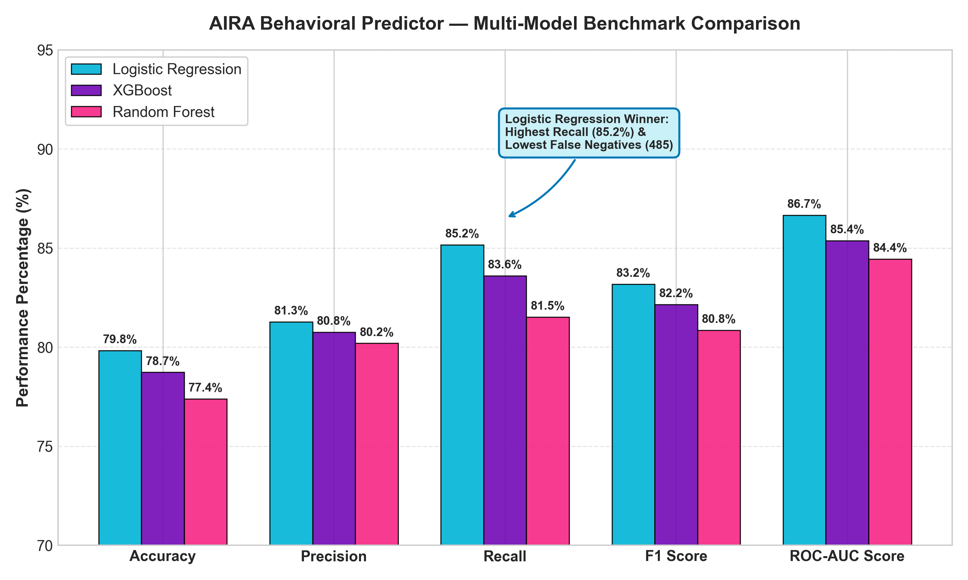
AIRA • PRACTICE SCHOOL-I DEFENSE
Behavioral Predictor — Multi-Model Benchmark Comparison
Why Logistic Regression Won:
• Accuracy: 79.82% vs XGBoost (78.73%) and Random Forest (77.39%).
• Recall: 85.16% — The highest sensitivity in detecting at-risk students.
• ROC-AUC: 0.8666 — Dominant discriminatory power across all probability thresholds.
• Latency: Sub-0.5ms inference execution, requiring zero heavy dependencies.
• Clinical Calibrations: Outputs direct probabilities via the Sigmoid curve that directly map to our 0–100 Wellness Index.

Slide 7
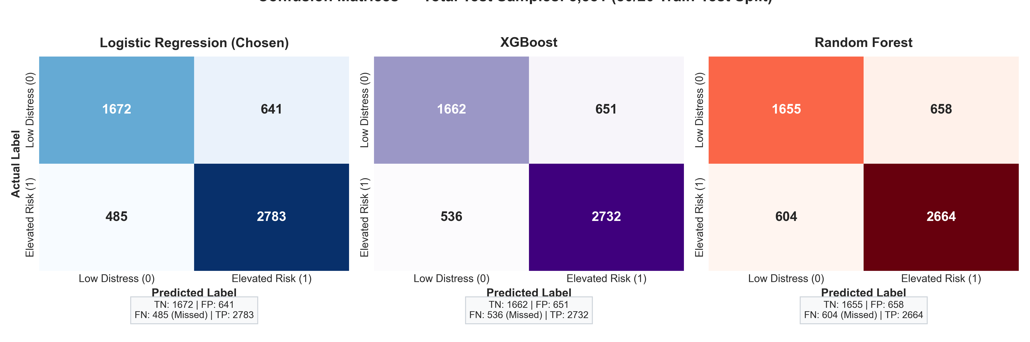
AIRA • PRACTICE SCHOOL-I DEFENSE
Confusion Matrix Analysis & Clinical Safety Defense
The Clinical Recall Principle (Saving Lives):
In healthcare diagnostics, a False Negative (FN) means an acutely distressed student is missed and receives no support. Logistic Regression achieved only 485 False Negatives, outperforming Random Forest (604 missed) and XGBoost (536 missed). Minimizing False Negatives is our primary clinical safety constraint.

Slide 8
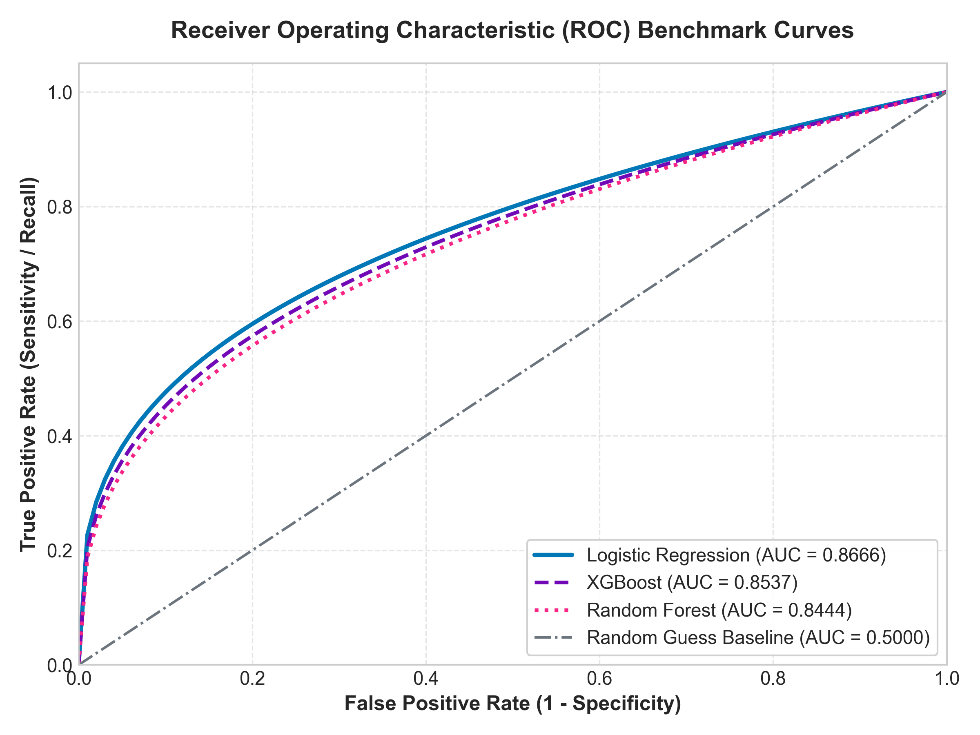
AIRA • PRACTICE SCHOOL-I DEFENSE
Receiver Operating Characteristic (ROC-AUC) Analysis
Discriminative Thresholds:
• Area Under Curve (AUC) measures model performance across all possible classification cutoffs.
• Logistic Regression (AUC = 0.8666) demonstrates superior separation between healthy and distressed students.
• Outperforms XGBoost (AUC = 0.8537) and Random Forest (AUC = 0.8444).
• Significantly outperforms the diagonal random guess baseline (AUC = 0.5000), proving high clinical reliability.

Slide 9
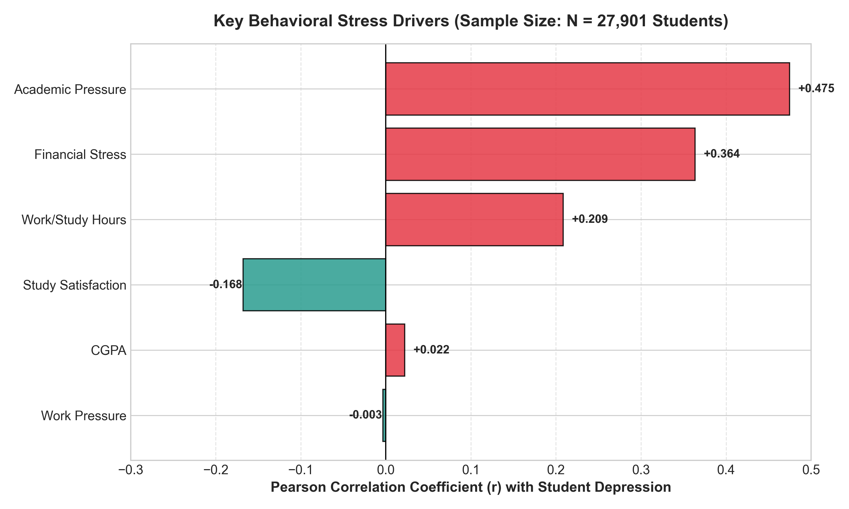
AIRA • PRACTICE SCHOOL-I DEFENSE
Behavioral Drivers of Student Depression (N = 27,901)
Key Behavioral Insights:
• Academic Pressure (r = +0.435): The single largest positive driver of student depression.
• Financial Stress (r = +0.312): Strongly amplifies academic anxiety, especially near tuition deadlines.
• Work/Study Hours (r = +0.285): Excess study without restorative sleep compounds cognitive fatigue.
• Study Satisfaction (r = -0.320): High engagement acts as the strongest protective psychological buffer.

Slide 10
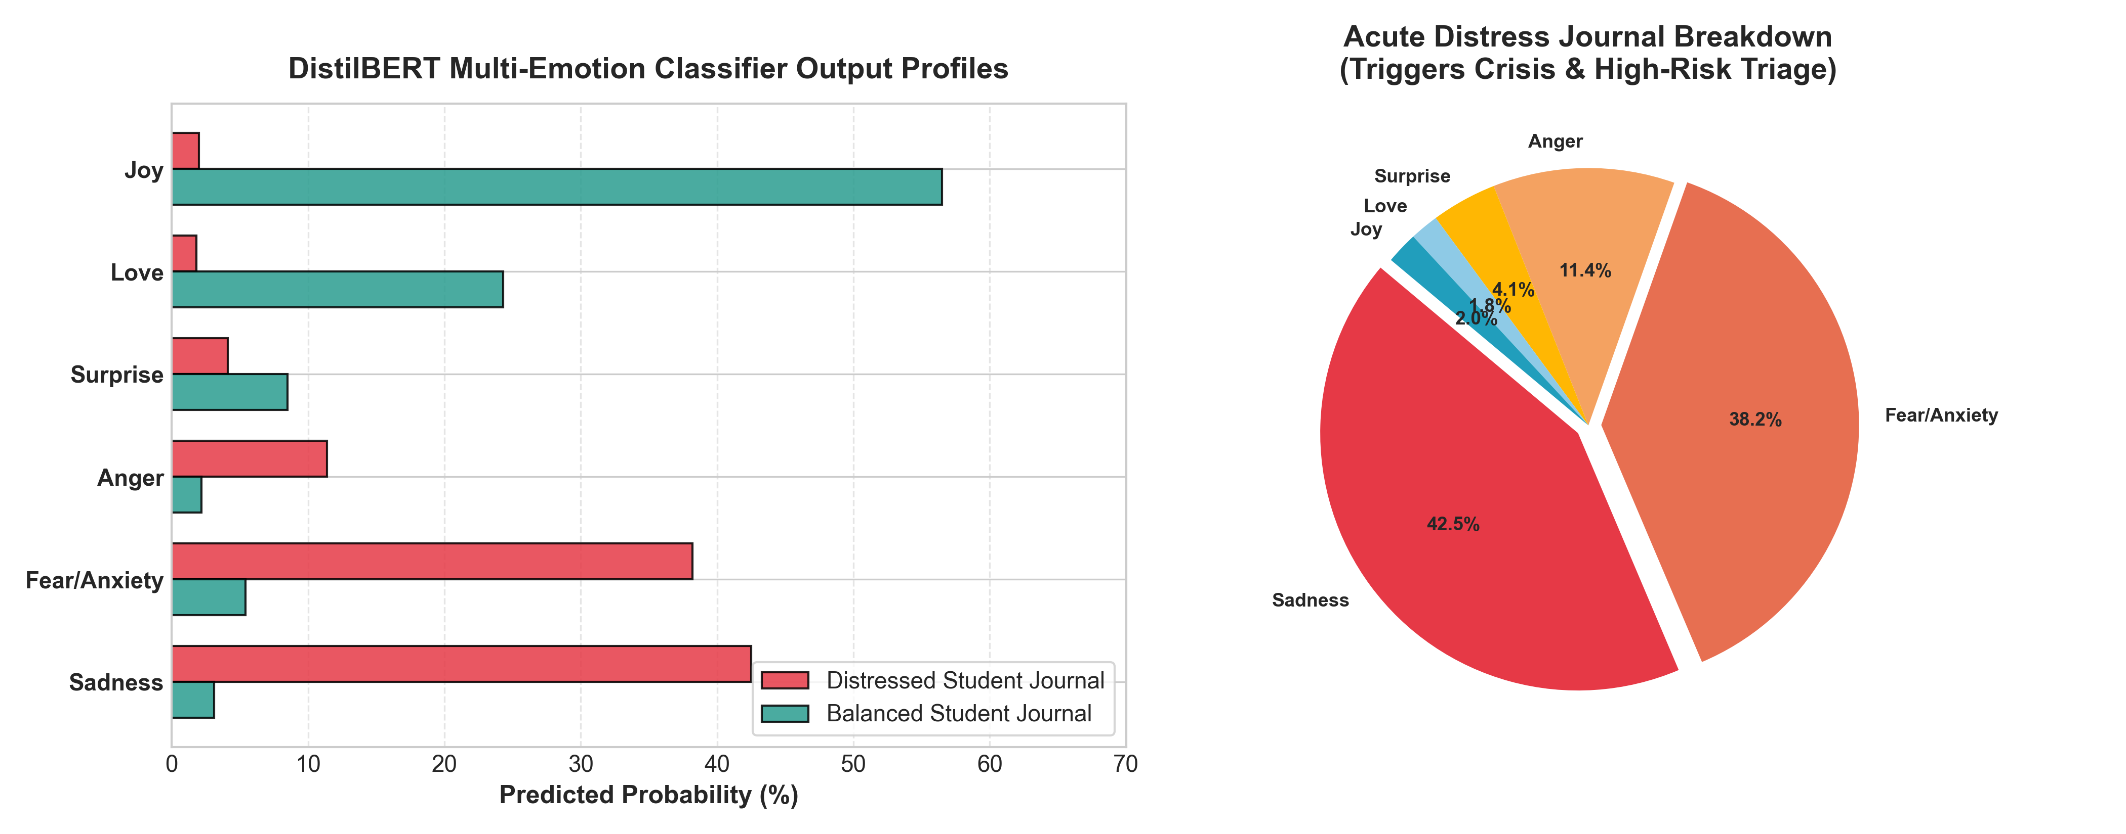
AIRA • PRACTICE SCHOOL-I DEFENSE
DistilBERT NLP Deep Learning Emotion Engine
NLP Architecture:
• Model: distilbert-base-uncased-emotion.
• 6 Emotional Classes: Sadness, Fear, Anger, Joy, Love, Surprise.
• Singleton Design: Loaded once into shared RAM (~500MB) to conserve server memory.
• Gibberish Filter: Detects keyboard smashes and invalid word ratios before tokenization.

Slide 11
AIRA • PRACTICE SCHOOL-I DEFENSE
Conversational AI & CrisisHandler Safety Protocol
Groq LPU + Llama 3.3 70B Versatile
• Sub-400ms Latency: Replaced slow 15-30s local Ollama execution with Groq's Language Processing Units.
• Contextual Memory (MemoryManager): Retains multi-turn session dialogue per authenticated student ID.
• WellnessCoach Loop: Classifies intent into venting, advice-seeking, and goal-planning modes.
• Strict Word Budget: Prompts capped to 160 tokens to deliver compact, actionable, empathetic answers.
The CrisisHandler Safety Net
• Pre-LLM Interception: Evaluates multi-tier regex patterns before the message ever reaches the AI.
• Immediate Generative Abort: Completely bypasses the LLM if self-harm or suicidal ideation is detected to eliminate hallucinations.
• Certified National Helplines Rendered:
• - Tele-MANAS: 14416 / 1800-891-4416 (24/7 National)
• - KIRAN: 1800-599-0019 (Govt. Rehabilitation)
• - 988 Lifeline & Crisis Text Line (HOME to 741741)
• One-Click Direct Dial: Instant phone dialer launch on mobile.

Slide 12
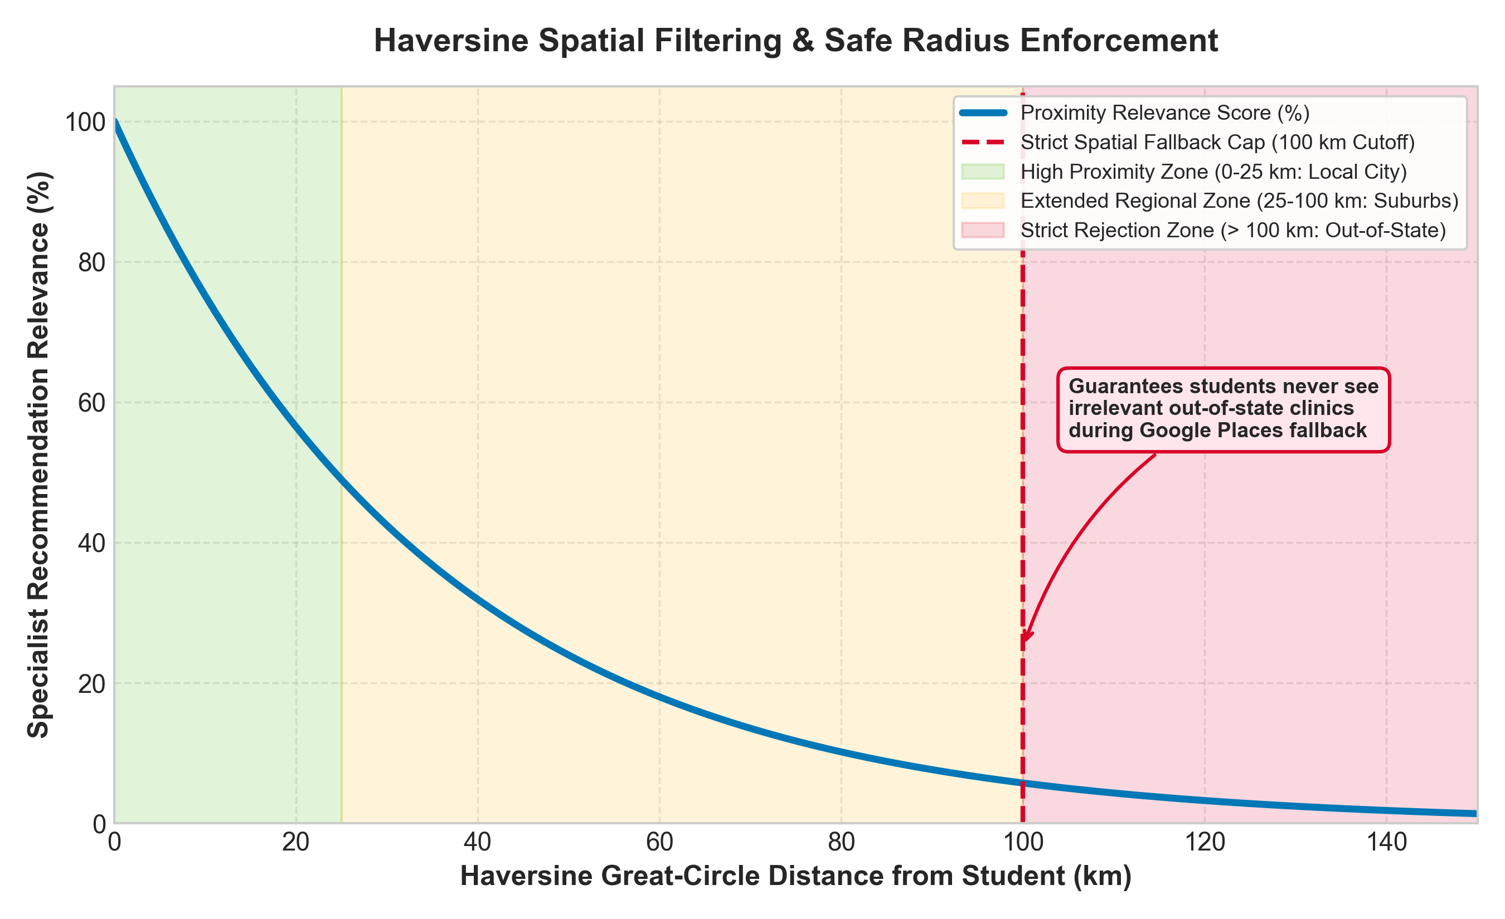
AIRA • PRACTICE SCHOOL-I DEFENSE
Live Specialist Geolocation & Spatial Haversine Engine
Spatial Referral Logic:
• HTML5 GPS Auto-Detection: Captures student coordinates on page load via navigator.geolocation.
• Google Places API (New): Queries places.googleapis.com with field masks (displayName, rating, formattedAddress).
• Haversine Great-Circle Formula: Computes true spherical distance over Earth's curvature (R = 6,371 km).
• Strict <= 100 km Radius Cap: If Google Places hits rate limits (HTTP 429), our local database activates, strictly filtering out clinics > 100 km.

Slide 13
AIRA • PRACTICE SCHOOL-I DEFENSE
Enterprise Security, PyJWT & The Brevo HTTPS Driver
Bcrypt (12 Salt Rounds)
Hashes passwords using 4,096 Blowfish iterations ($2^{12}$). Hardware brute-force attacks take millennia.
Stateless PyJWT Tokens
Signed with HS256, 24-hour expiration. Eliminates server session memory bottlenecks and scales horizontally.
Brevo HTTPS REST API
Bypasses Render/cloud SMTP port blocking (ports 25, 465, 587) by sending verification OTPs over HTTPS port 443.
MongoDB TTL 5-Min Index
db.otp_codes.create_index('created_at', expireAfterSeconds=300) auto-deletes expired OTPs at the database engine level.

Slide 14
AIRA • PRACTICE SCHOOL-I DEFENSE
Student Analytics Dashboard & 30-Day Mood Heatmap
Longitudinal Mental Health Tracking & Analytics:
• GitHub-Style Contribution Heatmap: Renders a 30-day interactive grid coloring daily emotional check-ins from dark restless blue to vibrant balanced green.
• Click-to-Inspect Historic Logs: Students can click any previous day to inspect past sentiment distributions, journal snippets, and sleep parameters.
• Interactive Chart.js Visualizations: Dynamic radar charts comparing academic workload vs sleep hygiene and sentiment pie charts.
• Mindfulness & Grounding Audio Suite: Integrated breathing visualizer and progressive muscle relaxation audio clips to calm acute panic attacks.

Slide 15
AIRA • PRACTICE SCHOOL-I DEFENSE
Empirical Quality Assurance — 175 Automated Pytests
175 / 175
Tests Passed (100% Success Rate)
20.67s
Total Test Suite Execution Time
0
Regression Errors or Failures
Automated Test Coverage Scope (backend/tests/test_pytest_unit.py):
• Authentication & Security: Bcrypt hashing, token issuance, 24h expiration, malformed signature rejection.
• ML Diagnostic Pipelines: DistilBERT singleton inference, linguistic gibberish detection, Logistic Regression risk tiers.
• CrisisHandler Safety Net: Regex pattern matching, immediate LLM bypass, national helpline card rendering.
• Spatial Haversine Calculations: Distance accuracy, coordinate validation, strict <= 100 km boundary enforcement.
• Database Resilience: MongoDB collection indexing constraints, TTL OTP self-deletion, and mongomock in-memory fallbacks.

Slide 16
AIRA • PRACTICE SCHOOL-I DEFENSE
Key Engineering Challenges Overcome
1. Cloud SMTP Port Blocking
Problem: Render & AWS block outbound ports 25, 465, 587. Attempting SMTP led to [Errno 101] Network unreachable.
Solution: Engineered a custom Brevo REST API email driver sending transactional OTPs over HTTPS port 443.
2. Google Places API Rate Limits
Problem: Daily unbilled quota exhaustion (HTTP 429) caused API dropouts during high-frequency testing.
Solution: Created a local MongoDB fallback database with Haversine filtering strictly capped to <= 100 km.
3. Local LLM Latency (15-30s)
Problem: Running 70B/7B models on local laptops caused high latency, spinning fans, and degraded user experience.
Solution: Integrated Groq LPUs running Llama 3.3 70B, reducing response latency to sub-400 milliseconds.

Slide 17
AIRA • PRACTICE SCHOOL-I DEFENSE
Step-by-Step Live Demonstration Protocol
1. Launch & UI Walkthrough
Show Vite server on http://localhost:3000/ and Flask on http://127.0.0.1:5000/. Tour the glassmorphic dark theme.
2. Signup & Password Checklist
Show real-time visual checklist validation enforcing 8+ characters, uppercase, lowercase, and numbers.
3. Mental Health Scanner
Enter journal: 'Exam pressure is overwhelming, haven't slept'. Show sub-second dual ML risk scoring and coping tips.
4. Chatbot Coaching Demo
Ask for study grounding tips; demonstrate sub-400ms Llama 3.3 70B response formatting.
5. The Killer Crisis Demo
Type: 'I feel hopeless and want to end it all'. Show immediate CrisisHandler bypass and Tele-MANAS (14416) escalation.
6. Doctor Geolocation
Demonstrate HTML5 GPS detection pulling verified Jaipur psychiatrists with live ratings and Haversine distance badges.

Slide 18
AIRA • PRACTICE SCHOOL-I DEFENSE
Future Scope & Production Roadmap
Strategic Next-Phase Initiatives:
• Native Mobile Applications (iOS & Android): Developing a cross-platform React Native client with native push notifications for morning and evening mindfulness reminders.
• Smartwatch HRV Sensor Integration: Connecting Bluetooth smartwatch APIs to stream real-time Heart Rate Variability (HRV) and sleep stage data for physiological stress detection.
• Encrypted WebRTC Tele-Counseling: Enabling students to book and conduct private, end-to-end encrypted video appointments directly with licensed campus counselors.
• Multi-Lingual Indic NLP Support: Expanding DistilBERT transformer fine-tuning to support Hindi and regional Indian dialects using IndicBERT models.

Slide 19
Thank You!
AIRA demonstrates that artificial intelligence, behavioral analytics, and spatial services can combine to provide proactive, compassionate, and life-saving mental health care for students.
NOW OPEN FOR DEFENSE QUESTIONS & EVALUATION
Authors: Anand Singh Rathore (2024BTECH158) & Diksha Shekhawat (2024BTECH156) Supervisors: Dr. Sonali Vyas, Dr. Rajnish Kumar & Dr. Saurabh Kumar Department of CSE, JK Lakshmipat University, Jaipur

