Slide 1



AS-IS
CM
SIT
Manual Deployment of WAR files
OneView.WAR
Orion.WAR
SVN Update
Check in UNIT TESTED Code
Manual Deployment of EAR files
Tibco Services
( EAR + Global variables)
Manual Deployment of SQL scripts
SQL Packages, Scripts
Thindra
OneWarriors
Kohinoor
HawkEye

Slide 2

Continuous Deployment and Continuous Integration
TO-BE
Automated Deployment
OneView, Orion will be built and deployed 4 times a day.
New TIBCO EARs will be deployed 4 times a day. (If any)
10:00 CET
13:00 CET
16:00 CET
18:00 CET
SIT
OneView.WAR
Orion.WAR
Check in UNIT TESTED Code
Tibco Services
( EAR + Global variables)
CM
Manual Deployment
SQL Packages, Scripts
Thindra
OneWarriors
Kohinoor
HawkEye

Slide 3
Continuous Deployment and Continuous Integration
With deployment automation in place, we will have the deployment done seamlessly without any scope for manual errors.
This will be rolled out for the SIT environment from the 18th July.
The deployment will begin at the specified slot every day and look for any changes in the SVN.
Upon finding new changes that need to be deployed, the content is copied to the respective servers and deployed into SIT. All Affected services will be restarted.
There is no need for special request to deploy from the developers with the exception of SQL scripts.
(Due to nature of DDL and DML scripts and its impact)
Expectations & Assumptions
We are assuming all the code that is checked into SVN is UNIT TESTED and hence is ready for deployment in to the SIT.
While specifying any changes in the global variable for TIBCO service. Request the teams to follow the below
Create a filename <ServiceName.props> and specify the name value pairs as show below
bash-4.1$ more TIPTV_Prov.props
Common/MailHost=C2mail.bredband.local
Common/OrionURL=jdbc:tibcosoftwareinc:oracle://10.56.17.153:1533;SID=EXOST2
bash-4.1$

Slide 4
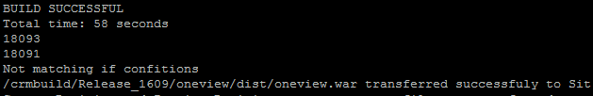
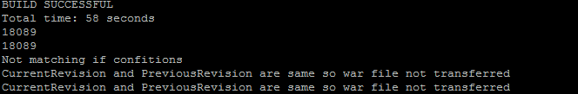
Continuous Deployment and Continuous Integration for Oneview/Orion Portal
Build Machine/crmbuild.bredband.local
Server Machine /DeployWar(exdevfe04.bredband.local-SIT)

Slide 5

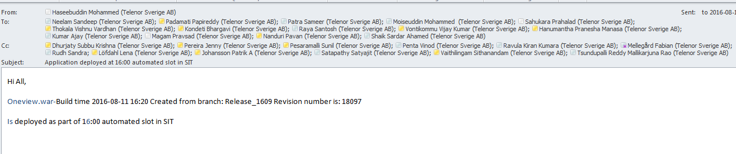
Continuous Deployment and Continuous Integration for Oneview/Orion portal
Server Machine /DeployWar(exdevfe04.bredband.local-SIT)

Slide 6

Continuous Deployment and Continuous Integration Tibco BW apps
Build Machine/crmbuild.bredband.local
NNo ear files to transfer
Server Machine /DeployEar(one-sit-app01.hgd.bredband.local/exdevapp07.bredband.locall-SIT)

Slide 7
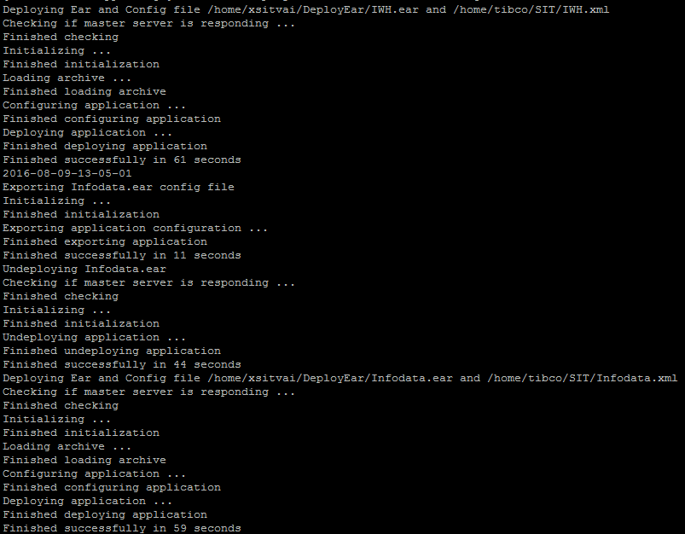
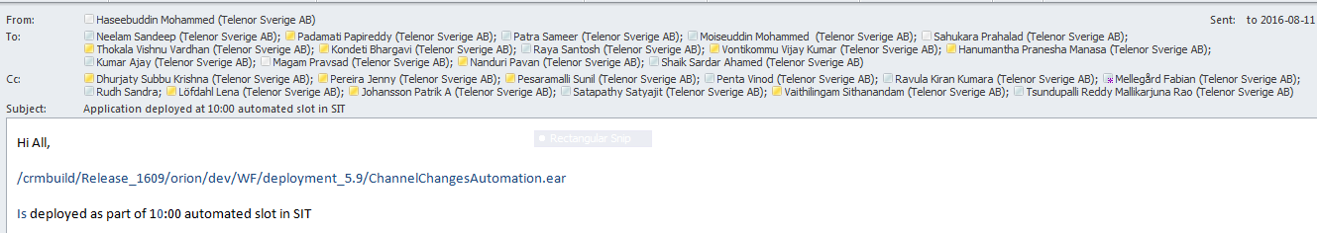
Continuous Deployment and Continuous Integration Tibco BW apps
Server Machine /DeployEar(exdevfe04.bredband.local-SIT)

Slide 8
Future Activities
We are aiming to automate the complete deployment process.
Automated deployment of SQL scripts
Automated build of TIBCO Services ( Today its done locally by the developers and checked into SVN).
Mail communication before and after deployments with details of the deployment.
Automated Sanity tests to be performed after every deployment.

