Slide 1
Employee Engagement Survey Analysis
Anand Suresh Krishnan

Slide 2
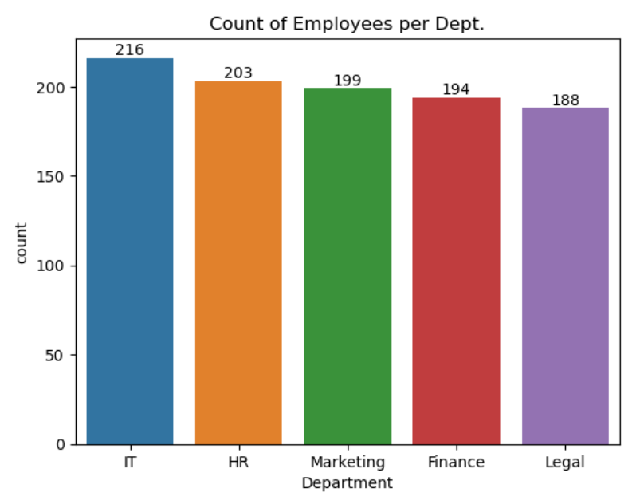
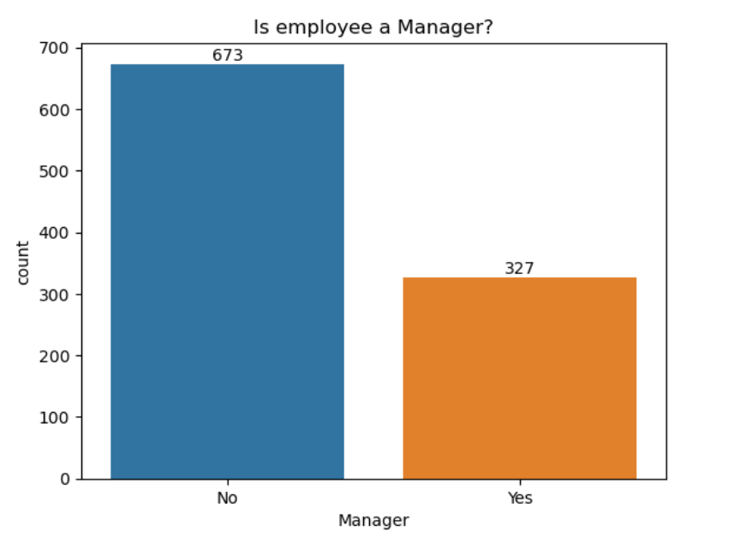
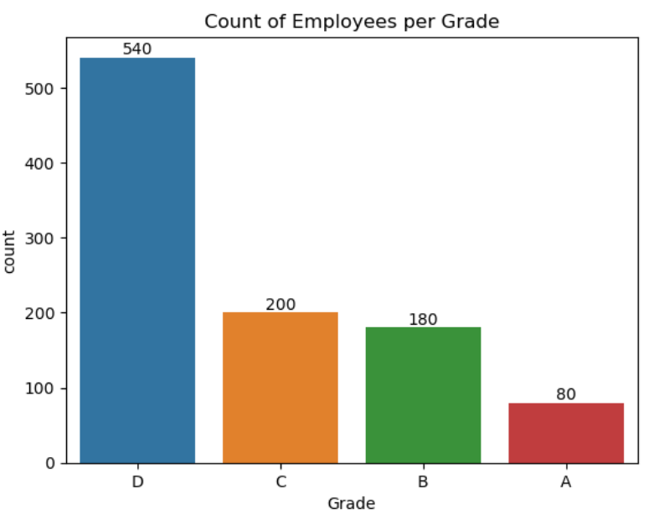
Demographic
1000 employees.
10 questions.

Slide 3
Question Score
Universal Exports does a good job of keeping me informed about important news and events. | 81%
My manager treats me fairly. | 81%
I get a sense of achievement from the work I do in my job. | 80%
I believe that Universal Exports really cares about my health and wellbeing. | 72%
I am proud to work for Universal Exports | 66%
I trust and respect the management of Universal Exports. | 63%
Universal Exports has created an environment that encourages me to perform to the best of my abilities. | 54%
I have access to opportunities to develop my career in Universal Exports. | 54%
All in all, Universal Exports is effectively managed and well-run. | 53%
I believe that Universal Exports has fair and transparent processes for promoting people into new roles. | 32%

Slide 4
Overall Engagement Score
Overall Score :- 3.62 / 5 (Slightly Positive)

Slide 5
Conclusion
Key Actions to take:-
Improve the transparency and fairness when promoting employees.
Focus on improving engagement for Grade D employees.

