Slide 1
Higher Education Students Performance Evaluation
Anand Suresh Krishnan
16/06/2023

Slide 2
Background
The data was collected from Turkish students at two faculties: Faculty of Engineering and Faculty of Educational Sciences students in 2019.
The goal is to create an ML model that can predict student performance.

Slide 3
Topics Covered
EDA
Modelling
Submitted model
Improved model
Recommendation

Slide 4
EDA
Shape : 145 students/rows, 33 columns
No missing values
Grade : Target variable
Grade | Count of Students | Percentage
AA | 17 | 11%
BA | 13 | 9%
BB | 17 | 11%
CB | 10 | 7%
CC | 21 | 14%
DC | 24 | 16%
DD | 35 | 24%
Fail | 8 | 5%

Slide 5
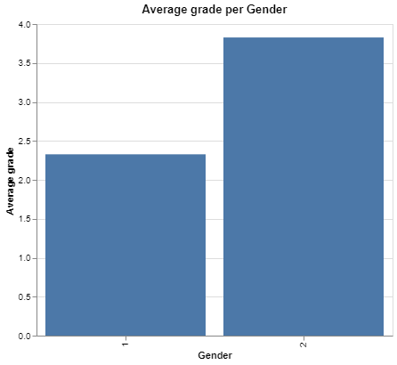
1. Gender
Gender:- 60% Male, 40% Female
Male students have much higher grades (CB) on average than female students (DC).

Slide 6
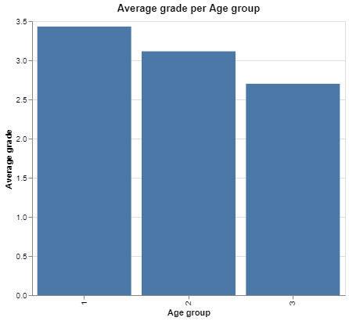
2. Age
Age:- Younger students (18-21) tend to have higher grades than older groups.
Age group | Count (Students)
1 (18-21 years) | 70
2 (22-25 years) | 65
3 (26+ years) | 10

Slide 7
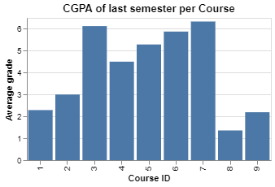
3. Course ID
9 Courses
Students studying courses 3 and 7 had the highest grades on average.
Students from courses 1, 8 and 9 had very poor grades.
Course ID | Count (Students)
1 | 66
2 | 2
3 | 8
4 | 2
5 | 7
6 | 8
7 | 15
8 | 14
9 | 21

Slide 8
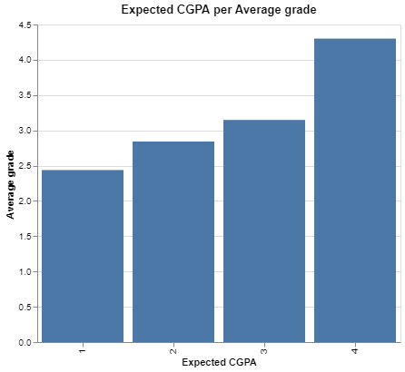
4. Expected CGPA
Higher the expected grade, higher the grade obtained.
Expected CGPA | Count (Students)
1 (<2.00) | 16
2 (2-2.49) | 38
3 (2.50-2.99) | 61
4 (3.00-3.49) | 30
5 (>3.49) | 0

Slide 9
Modelling – Submitted Model
Multiclass classification not possible – Not enough data.
Binary classification –
Grade AA and BA – High Performing Students (30 students – 21%)
Grade BB-Fail – Non-high Performing Students (115 students – 79%)
Student ID dropped.

Slide 10
Train-test Split
Train-test split will be done first to prevent information leakage.
70% Training set 30% Testing set
Training data distribution:-
High Performing Students (19 students – 19%)
Non-high Performing Students (82 students – 81%)

Slide 11
Balancing Dataset
SMOTE (Synthetic Minority Oversampling Technique) used.
Interpolating of minority classes and its neighbors.
Prevents overfitting by not creating exact copies.
Chose number of neighbors as 2.
Training dataset after balancing:-
High Performing Students (82 students – 50%)
Non-high Performing Students (82 students – 50%)
The testing dataset will not be balanced since it should reflect the real-world distribution of data.

Slide 12
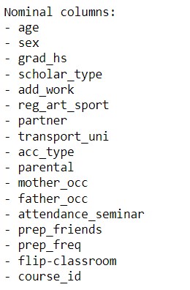
Nominal Encoding
All the features are in numerical format.
Nominal Features:- 17 columns
OneHotEncoding will be done.

Slide 13
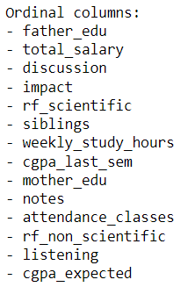
Ordinal Encoding
Ordinal features:- 15 columns
3 features re-ordered correctly:- impact, attendance_classes, prep_freq
After encoding, we have 73 columns.

Slide 14
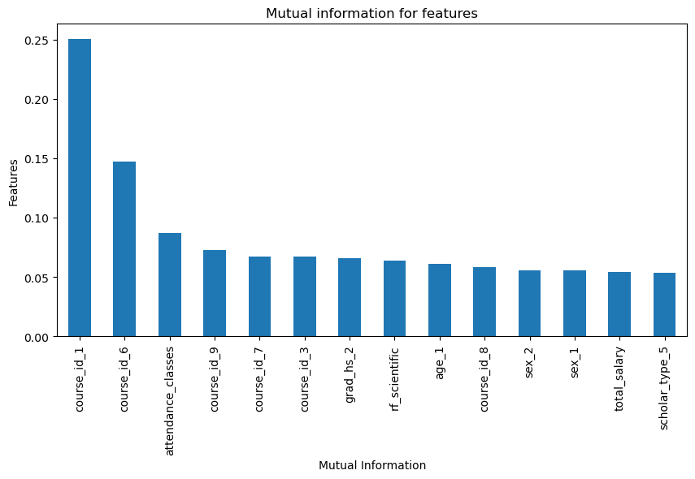
Feature Selection
Mutual information was calculated to select features.
Select 14 best features gave me the best model accuracy.

Slide 15
Performance Metric
Macro average of f1 score
Equally interested in minimizing False positives and False negatives.
Macro average chosen since the f1 score for each individual class is varying significantly.
Prevents f1 score of one class significantly biasing the average.

Slide 16
Comparing Models
Five base models were trained on the training dataset and compared without any hyperparameter tuning .
We can see that all the models had near perfect training accuracy. Linear Support Vector Classifier had the highest test accuracy and ROC-AUC score for test set.
Model | Train f1 Score | Test f1 Score | ROC-AUC Score
Linear SVC | 0.98 | 0.87 | 0.85
Random Forest | 0.98 | 0.81 | 0.79
Logistic Regression | 0.99 | 0.79 | 0.76
Decision Tree | 0.98 | 0.76 | 0.76
K-nearest Neighbor | 0.99 | 0.74 | 0.71

Slide 17
Linear Support Vector Classifier
I chose Linear SVC model for multiple reasons:-
1. Dataset Size: Linear SVC can handle small datasets reasonably well as it seeks to find a linear decision boundary that separates the classes.
2. Interpretability: Linear SVC is generally more interpretable than ensemble methods. Linear SVC provides coefficients for each feature, which can indicate their importance in the classification process.
3. Training and Inference Time: Linear SVC is generally faster to train and infer on small datasets compared to methods such as Random Forest.

Slide 18
Final model
Default hyperparameters worked best.
L2 Regularization will reduce overfitting and handle multicollinearity.
C=1
Training f1-score : 0.98
Testing f1-score : 0.87
ROC-AUC Score : 0.85
The model is overfitting significantly.
Testing f1-score of 0.87 is not reliable as I obtain different testing accuracy when taking different samples of data for training.

Slide 19
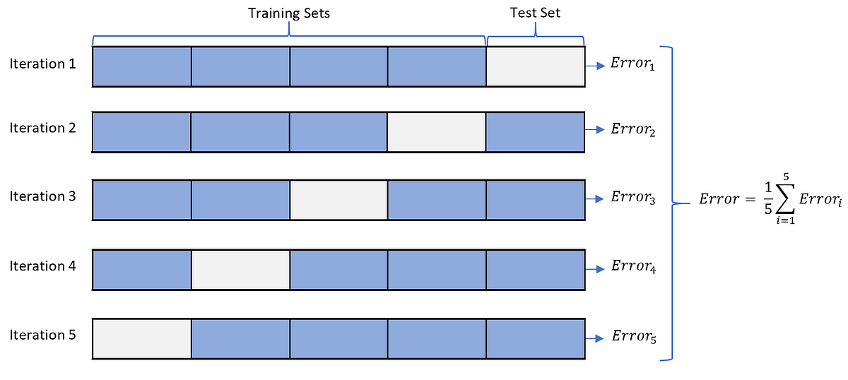
Further Steps
Cross-validation using Stratified K-fold technique will give a more reliable accuracy.
For each fold, training dataset must be balanced, and test dataset must be kept intact to preserve the original distribution.

Slide 20
Model Summary
Binary classification model significantly outperforms the multiclass classification model due to reduction in complexity.
Due to the dataset being relatively small and imbalanced, different test-train data splits leads to variations in the representation of classes or important patterns in the data. This heavily impacts the model's ability to generalize and result in varying accuracy values.
The model is significantly bottlenecked by sample size. If the sample size of training dataset was increased, we could expect to have a much more accurate and reliable model.

Slide 21
Improved Model
Use a statistical modelling approach.
Use Logistic Regression.
Select features based on domain knowledge.
Use chi-square test for feature importance.
Features used:-
Course ID
Sex
Age
Expected CGPA

Slide 22
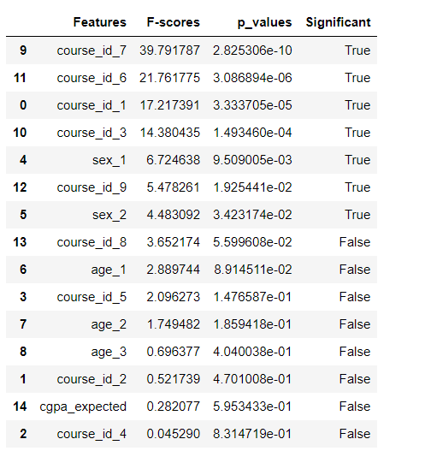
Chi-square test
Perform a chi-square hypothesis test to check if the correlation between a feature and the target variable is statistically significant.
We will be choosing a confidence interval of 95% (p-value<0.05).

Slide 23
Improved Model Performance
Improved model performance with cross validation:-
Mean Training f1-score : 0.93 (Scores:- [0.93, 0.95, 0.93, 0.93, 0.93])
Mean Testing f1-score : 0.87 (Scores:- [0.87, 0.79, 0.87 ,0.91, 0.91])
SD = 0.05
Mean ROC-AUC Score : 0.93
Much lower variation in model accuracy for different splits of data.

Slide 24
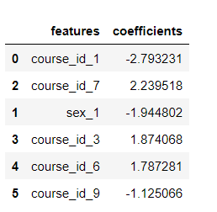
Recommendations
Best predictors of student performance:-
Course 1
Course 7
Sex - Female

Slide 25
Areas to Focus
Few of the data-driven steps we can take:-
Students studying courses having low average grades must be given top priority.
Do further research on why certain courses have students with high grades.
Start a campaign for female education to reduce the grade disparity between male and female students.

