Slide 1



Tech Engine
Increment Decrement & String Operators

Slide 2
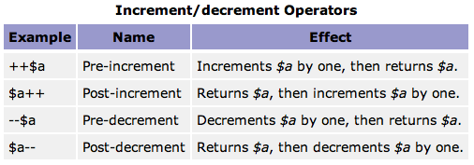
Tech Engine

Slide 3
Tech Engine
Say $a = 5;
 | Operator | 1st RUN | 2nd Run
Pre Increment | ++$a ; echo $a | 6 | 7
Post Increment | $a++ ; echo $a | 5 | 6
Pre decrement | --$a ; echo $a | 4 | 3
Post Decrement | $a-- ; echo $a | 5 | 4

Slide 4
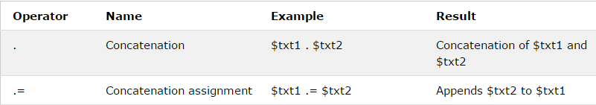
Tech Engine
String Operators in Php
Let’s say
$name = ‘Pankaj Borah’;
$profession = ‘Programmer’ ;
operator | Example | Result
. | echo $name. ‘ is a ’.$profession; | Pankaj Borah is a Programmer
.= | $name .=‘ is a ’; //pankaj borah is a $name .=’.$profession;//pankaj borah is a programmer echo $name; | Pankaj Borah is a Programmer

Slide 5

Tech Engine
Thank you and stay tuned.

