Slide 1
PV Real-Time Monitoring system Online Solar Energy Monitoring “HARNESS THE POWER OF SOLAR”
Product Documentation

Slide 2
Index
Aim
The Industry Problems
Solutions
Salient Features
Benefits
Road Ahead

Slide 3
Aim
It supports you to monitor your production in real time from all your sites stations from single centralized platform so you do not have to travel those remote sites for calibration and configuration.

Slide 4
The Industry Problems
Solar Power Plant Industry in India is yet to embrace the digitization of their day to day operations. Here are some of the common problems they face
52% solar plants are not performing to their capacity. No tool for Base lining and benchmarking.
No tool to measure net electricity, generated less used or forecast yield.
Mismanaged scheduling of O&M.
Real-time performance ratio & solar yield calculation required.
Some faults are impossible to detect without active monitoring.
Smart demand management tool required.

Slide 5
Solutions
A Software as a Service platform, that makes solar data simple to acquire, understand and act upon so that you can improve yield & profitability.

Slide 6
Monitoring
Monitoring Interface
One Click KPI Monitoring
Better way to Know Your Plant(KYP)
All data at a single place
Enhanced Performance Visualization
Monthly, Weekly Trends

Slide 7
Insights
Insights
Analytics Backbone
Technology specific
Environment Specific
Mismatch, Soiling impact on performance
Best approaches to address every issue
Insights onto lack of performance

Slide 8
Threat Mitigation
Threat Mitigation
Virtual Clone
Discover the reasons for losses
Make more hay while the sun shines
Digital Twin
Simulation of Practical Climate and Performance Comparison
Live inputs from model to address the identified issues

Slide 9
Risk Analysis
Risk Assessment
Plant Health
Rack & other physical Assets
Data based approach to predict/assess the health
Based on climatological parameters and physical inspection data
Module, Inverter, Transformer
Performance related
Day ahead/Week ahead assessment of generation
Helps in understanding risks linking to Discoms

Slide 10
Automation
Automation
Reports & Analysis
Schedule events which are automatically notified to individuals
O&M activities
Automatic alerts
Create/Design Customized reports with ease
No manual extraction of data involved
Alert ground staff for taking action

Slide 11
Salient Features
Software includes the following features
Dashboards, reports, and export functionality
Manage entire portfolio of your solar plants
Real time solar plant performance monitoring
Environmental contribution
Enterprise class user access control
Significant events information relayed in the dashboard
Generate Alerts over email and SMS
Inventory management tool for effective management of assets

Slide 12
Benefits
Software includes the following features
Forecasting Performance
Effective O&M
Real Time Insights
Maximize Performance
Yield Analysis

Slide 13
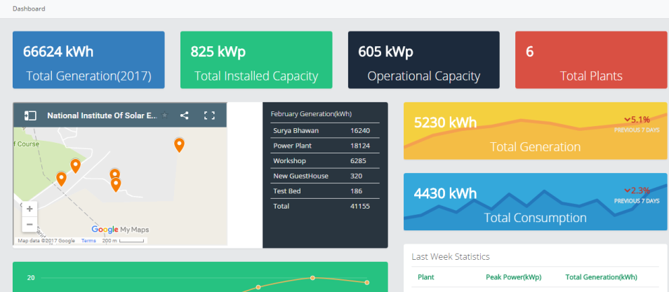
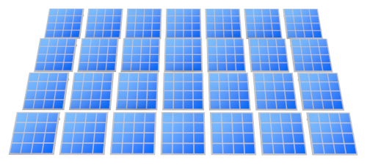

How it works
MONITORING INTERFACE
MITRA INTERFACE
MITRA HARDWARE
DC
RS485,232
Ethernet
Wi-Fi
Bluetooth
AI Powered Analytics
SCADA SYSTEM
REAL TIME INSIGHTS
WITHOUT SCADA
WITH SCADA

Slide 14
Road Ahead
Include week ahead/day ahead forecast of generation
Include tools to gather usage information
Understand how the usage information can help any other stake holders in the eco-system( Developers, Financers, Panel cleaning equipment owners, Cabling enablers etc.)
Migrate to app based platform
Identify inverter vendors without specific UI’s and bring them on MITRA’s platform
Create a plug and play module(Inverter specific configurable mechanism with Soreva’s hardware to MITRA UI)
Establish PoI(Point of Interconnections) with existing inverter softwares to MITRA UI

Slide 15
End of the beginning

