Slide 1
SEMINAR
COLLEGE ASSIGNMENT COMPUTERIZATION

Slide 2
ABSTRACT
IT HANDLES FACULTY-STUDENT INTERACTIONS EASILY AND EFFICIENTLY.
IT SERVES AS AN INTIMATE WEBSITE FOR TEACHERS TO INTERACT WITH STUDENTS WITHOUT ANY INTERRUPTIONS OR DISCOMFORT.
THE WEBSITE'S MAIN PURPOSE IS TO HANDLE SMALL ORDERED GROUPS OF STUDENTS AND FACULTIES INSTEAD OF A LARGE DISORDERED NETWORK OF MANY INDIVIDUALS.
IT SERVES TO AVOID COMPLICATIONS AND THE DISCOMFORTS OF A LARGE CLASSROOM
STUDENTS CAN INTERACT WITH THEIR PROFESSORS AND SUBMIT THEIR EXPECTED ASSIGNMENTS AND SUBMISSIONS THROUGH THIS PORTAL
THE FACULTY CAN DOWNLOAD THE PROJECTS, GRADE THEM AND ALSO CHOOSE THE BEST ONE AS A REFERENCE FOR THE OTHER STUDENTS.
THE PROJECT SIMPLIFIES THE STUDENT TEACHER INTERACTIONS AND RESTRICTS IT TO A SMALL GROUP.
THE SQL DATABASE IS ACTUALLY PERFORMED OF SQL EXPRESS AS EXPRESS IS FREE AND ENCOMPASSES ALL THE REQUIREMENTS MAKING THE PROJECT ESSENTIALLY FREE
THE PROJECT ONLY USES MICROSOFT’S SOFTWARES. THIS PROVIDES UNIFORMITY THROUGHOUT
TO RUN IN THE BROWSER WE USE JAVASCRIPT.

Slide 3
PROBLEM STATEMENT
DUE TO THE ONGOING PANDEMIC, IT IS A DAILY STRUGGLE FOR A FACULTY TO COMMUNICATE WITH HIS/HER STUDENTS. “COLLEGE ASSIGNMENT COMPUTERIZATION” SERVES AS AN INTIMATE WEBSITE FOR TEACHERS TO INTERACT WITH STUDENTS WITHOUT ANY INTERRUPTIONS OR DISCOMFORT

Slide 4
LITERATURE REVIEW
“COLLEGE ASSIGNMENT COMPUTERIZATION” IS AN INTIMATE WEBSITE THAT ENABLES INTERACTION BETWEEN FACULTY AND STUDENTS.
IN THIS PROJECT WE USE SQLITE TO STORE AND READ THE DATABASE VALUES.
THE MAJOR PROGRAMMING LANGUAGE USED TO MAKE THIS PROJECT IS “C#”.
TO DESIGN THE WEBSITE WE HAVE USED JAVASCRIPT.
WE HAVE USED ASP.NET AS A PLATFORM TO CREATE DYNAMIC WEBSITE.
WE DID NOT USE PHP BECAUSE ASP.NET IS FASTER

Slide 5
PROPOSED WORK
THIS PROJECT PROVIDES A PLATFORM WHERE TEACHERS AND STUDENT CAN INTERACT THROUGH A WEBSITE.
THIS PROJECT ALSO ENABLES STUDENTS TO UPLOAD ASSIGNMENTS ALLOTTED TO THEM BY THEIR FACULTY INCHARGE.
ALONG WITH UPLOADING AND EVALUATION, TEACHER CAN ALSO CHOOSE THE BEST PROJECT OUT OF ALL AND KEEP IT A REFERENCE FOR FUTURE USE.

Slide 6
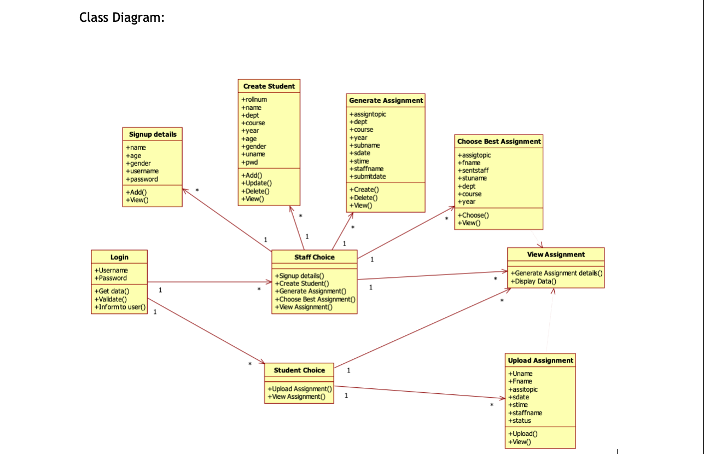
ARCHITECTURE DIAGRAM

Slide 7
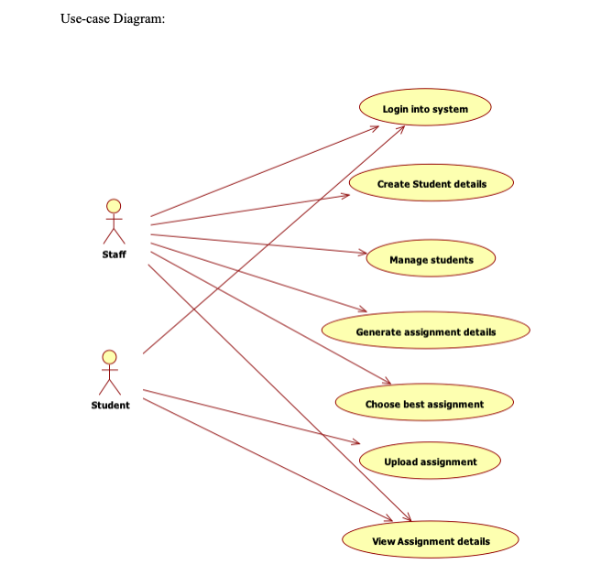

Slide 8
MODULES
STUDENT’S LOGIN
ASSIGNMENT SUBMISSION
ASSIGNMENT VALIDATION
MARKS UPDATES
BEST ASSIGNMENT AND LATE SUBMISSION

Slide 9
MODULE DESCRIPTION
STUDENT’S LOGIN
INITIAL MODULE OF THE PROJECT, STUDENT PLAYS MAIN ROLE IN PROJECT
CORRESPONDING FACULTY CAN CREATE THE STUDENT DETAILS
FACULTY IS RESPONSIBLE FOR MAINTAINING THEIR STUDENT LIST
ALL THE DETAILS WILL BE CENTRALIZED IN THE LOCAL SERVER
ONCE A STUDENT ID IS CREATED THE STUDENT WILL BE PROVIDED WITH A UNIQUE USERNAME AND PASSWORD
STUDENTS CAN LOGIN FOR FURTHER USE.

Slide 10
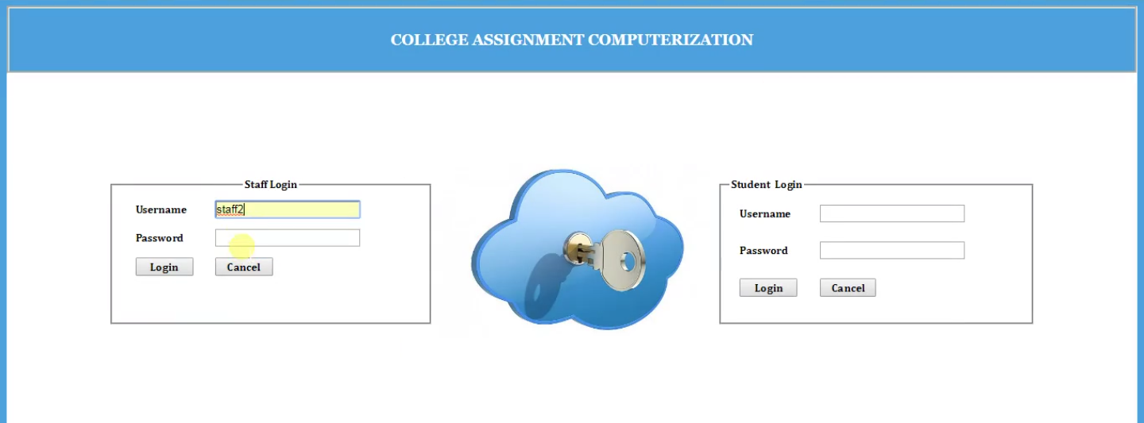

Slide 11
ASSIGNMENT SUBMISSION
STUDENTS CAN LOGIN TO THEIR ACCOUNT FOR ASSIGNMENT PROCESS.
HERE MULTIPLE USER INTERFACES CAN BE DONE.
IN STAFF SIDE, THE STAFFS NEED TO PROVIDE THE ASSIGNMENT NAME, DEPARTMENT, COURSE AND YEAR
THE PUBLISHED DETAIL WILL BE TRANSFERRED TO THE CORRESPONDING STUDENT’S LOGIN.
AFTER ASSIGNMENT PREPARATION, STUDENTS NEED TO UPLOAD THE ASSIGNMENT
THE DATABASE WILL ACCEPT VARIOUS FORMATS FOR ASSIGNMENT

Slide 12
ASSIGNMENT VALIDATION
AFTER UPLOADING THE ASSIGNMENT, ALL THE FILES WILL BE CENTRALIZED IN THE SERVER FOR VALIDATION PROCESS
CLIENT SERVER METHOD WITH LOCAL HOST HAS BEEN USED
THIS WILL SEPARATE THE ASSIGNMENT THE CONTENT AND FORWARD THE DETAILS TO THE CORRESPONDING FACULTY
THE FACULTY WILL RECEIVE THE EXACT FILE UPLOADED BY THE STUDENT
THE FILE CAN BE EITHER DOWNLOAD BY THE FACULTY OR CAN BE VIEWED ON THE BROWSER ITSELF

Slide 13
MARKS UPDATE
THIS IS THE DEPENDENCY MODULE OF THE PREVIOUS MODULE
BOTH VALIDATION AND TRANSFER PROCESS HAS BEEN USED IN THIS MODULE
STAFF PROVIDES MARKS FOR THE PROVIDED ASSIGNMENT
STUDENTS CAN VIEW THEIR MARKS IN THEIR LOGIN
BEST ASSIGNMENT AND LATE SUBMISSION
ALL DATA COMES UNDER DATA MINING PROCESS.
WHILE SUBMITTING THE ASSIGNMENT, DATE AND TIME WILL BE CALCULATED
LATE SUBMISSION DETAILS WILL BE HIGHLIGHTED IN THE GRID
IF FACULTY FINDS ANY BEST ASSIGNMENT AND PUBLISH TO THE ENTIRE CLASS ROOM.
THIS ENCOURAGES THE STUDENTS TO WRITE OR PREPARE GOOD ASSIGNMENTS.

Slide 14
CONCLUSION
USING THIS PROJECT WE HAVE PROVIDED AN INTIMATE TEACHER AND STUDENT INTERACTION PORTAL. USING THIS PORTAL A STUDENT CAN UPLOAD HIS/HER ASSIGNMENT AND CAN VIEW HIS/HER GRADES. IT ALSO MAKES IT EASY FOR THE FACULTY TO VIEW ASSIGNMENT, GRADE AND MAYBE CHOOSE ANY BEST ASSIGNMENT FOR FUTURE REFERENCE.

