Slide 1

CAPSTONE PROJECT
Secure Data Hiding In Images Using Steganography
Presented By: Anand Sanjay Swami
Student Name : Anand Sanjay Swami
College Name & Department : Shri TuljaBhavani College
of Engineering, Tuljapur. (CSE)

Slide 2
OUTLINE :-
Problem Statement
Technology used
Wow factor
End users
Result
Conclusion
Git-hub Link
Future scope

Slide 3
Problem Statement :-
In today's digital world, the need for secure communication is increasing. Traditional communication methods are vulnerable to hacking and data leaks.
This project addresses this issue by implementing image steganography, allowing users to securely hide encrypted messages within images using passwords.
The application provides a way to protect sensitive information from prying eyes, ensuring both privacy and security.

Slide 4
Technology used :-
Libraries:
Tkinter: For creating the graphical user interface (GUI).
Pillow (PIL): For image processing and manipulation.
Cryptography: For message encryption and decryption (using Fernet).
Hashlib: For password hashing (to generate a 32-byte key from a password).
Base64: For encoding the encryption key to ensure it’s URL-safe for use with Fernet.
Platform:
Python 3.x: The primary programming language used.
IDE: Any Python-supported IDE (e.g., PyCharm, Visual Studio Code).
Operating Systems: Cross-platform, works on Windows, Mac, and Linux (with required Python dependencies).

Slide 5
Wow factor :-
This project stands out for its combination of:
Enhanced Security: It allows secure encryption and hiding of messages in image files, making it difficult for unauthorized individuals to extract the hidden data.
Simplicity & Accessibility: Users can easily encode and decode messages through a simple, interactive GUI with no advanced technical knowledge required.
Password-based Encryption: It uses a password to generate a cryptographic key, enhancing security and ensuring that the encoded message can only be accessed by someone with the correct password.
Real-time Visual Feedback: The GUI displays the image being worked with, offering a more intuitive and engaging user experience.

Slide 6
End users :-
This application is designed for:
General Users: Anyone who needs to securely communicate confidential messages without using traditional communication methods.
Privacy Enthusiasts: People who are concerned about the privacy of their data and want a simple way to hide messages within images.
Professionals in Secure Communications: Individuals or organizations requiring a tool to securely transmit sensitive data in images.
Educational Purposes: A tool for learning and demonstrating steganography concepts in computer science courses.

Slide 7
Result :-
The project successfully hides messages within image files by manipulating the least significant bits of each pixel’s RGB values.
The encrypted message is then safely hidden and can only be accessed by decrypting it with the correct password.
The solution ensures the integrity of both the image and the message.
After encoding, the user gets an image that visually appears unchanged, while securely carrying hidden data inside it.

Slide 8
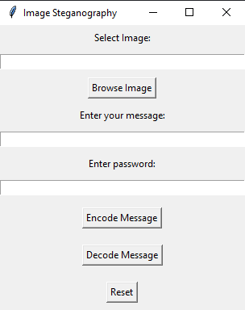
Image Steganography_GUI :-
PATH
select Image
secret message
Hidden Password
For Encode
For Decode
For Reset
Selected Image Preview

Slide 9
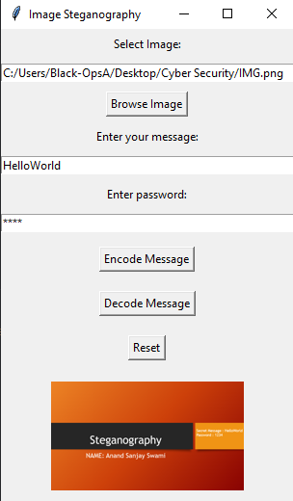
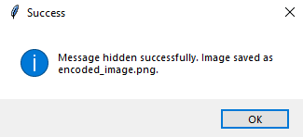
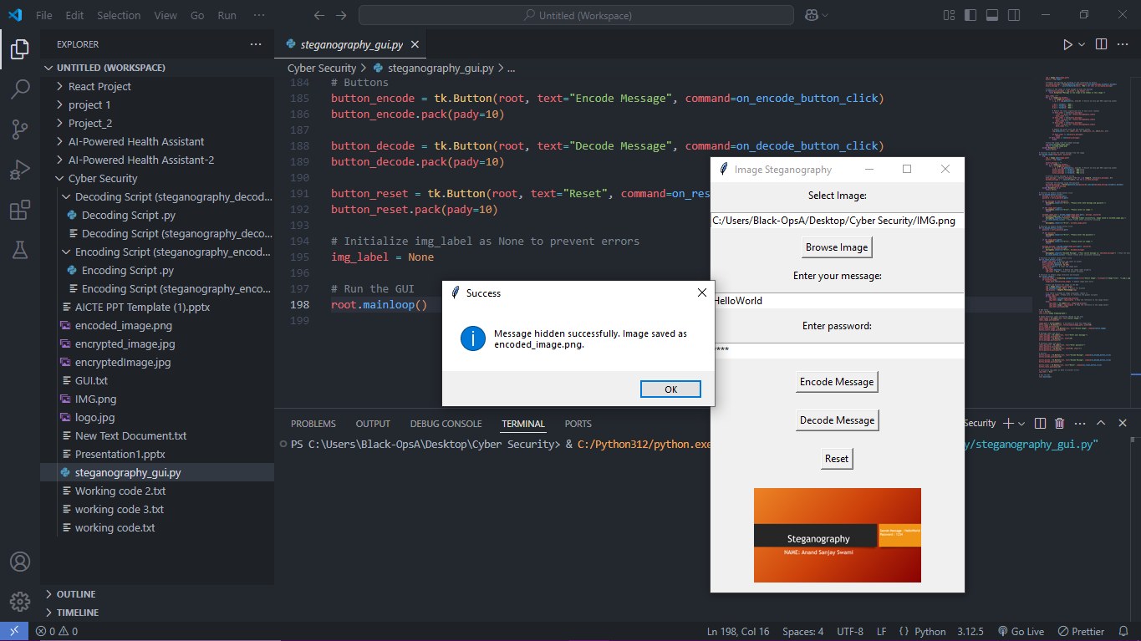
Encryption Process :-
image saved as
“encoded_image”

Slide 10
Encryption Process Step by Step :-
The encryption process starts with the user providing a password, which is hashed using SHA-256 and then base64 URL-safe encoded to create a 32-byte key.
This key is used with the Fernet encryption system to encrypt the user's secret message, turning it into unreadable data.
The encrypted message is then converted into a binary string, with each character represented as a sequence of bits.
This binary data is embedded into the image by modifying the least significant bit of the RGB values in each pixel, making the changes imperceptible to the human eye.
Finally, the modified image, which now contains the hidden encrypted message, is saved as a new image file.
The image looks the same as the original, but it secretly holds the encrypted message, which can only be decrypted with the correct password.

Slide 11
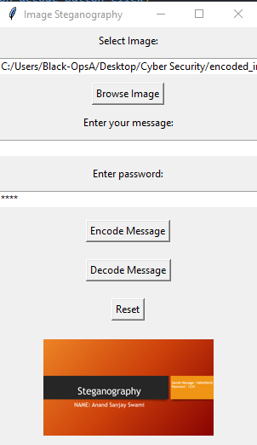
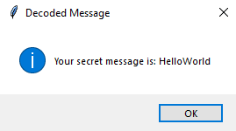

Decryption Process :-
Decoded Message is
“HelloWorld”

Slide 12
Decryption Process Step by Step :-
The decryption process begins when the user provides the password, which is used to regenerate the same 32-byte key through the same hashing and encoding steps as in the encryption process.
The user then selects the image that contains the hidden message.
The image is opened, and its pixel data is accessed to extract the binary data, which was embedded by modifying the least significant bits of the RGB values.
The binary data is then converted back into a string of characters.
Afterward, the extracted message, which is still encrypted, is decrypted using the Fernet system and the key derived from the password.
This decryption process converts the message back into its original readable form. If successful, the decrypted message is displayed to the user, revealing the hidden secret.

Slide 13
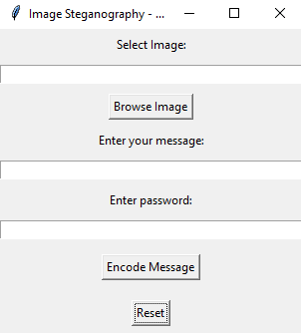
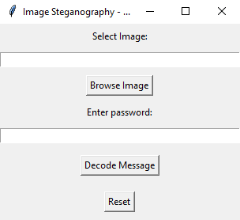
Separate Encryption and Decryption :-
Separate Encryption
Separate Decryption

Slide 14
Conclusion
This image steganography project highlights how digital images can be used to securely transmit sensitive information, integrating encryption and password-based protection.
It provides a simple, effective solution for hiding and protecting data in a visually indistinguishable way.
The project showcases both the practical application of cryptography and steganography and the power of Python libraries for secure communication.

Slide 15
GitHub Link
https://github.com/anandswami001/Steganography_with_GUI
https://github.com/anandswami001/Steganography_with_GUI
You can find the complete code and instructions to run the project in the provided GitHub repository.

Slide 16
Future Scope
Support for Multiple Image Formats: The application currently works with PNG and JPG images. Expanding support to more image formats (like BMP or TIFF) can broaden its usability.
Cloud Integration: Allow users to encode and decode messages directly from cloud storage, enabling easy sharing of steganographic images across devices.
Advanced Encryption Algorithms: Integrating stronger encryption algorithms (e.g., AES) for added security.
Graphical Visualization of Encoded Data: Provide a visual tool for users to see how the data is hidden within the image (perhaps a heatmap or pixel analysis).
Mobile Application Development: Build a mobile version of the application for iOS and Android to enhance accessibility on mobile devices.

Slide 17
THANK YOU

