Slide 1
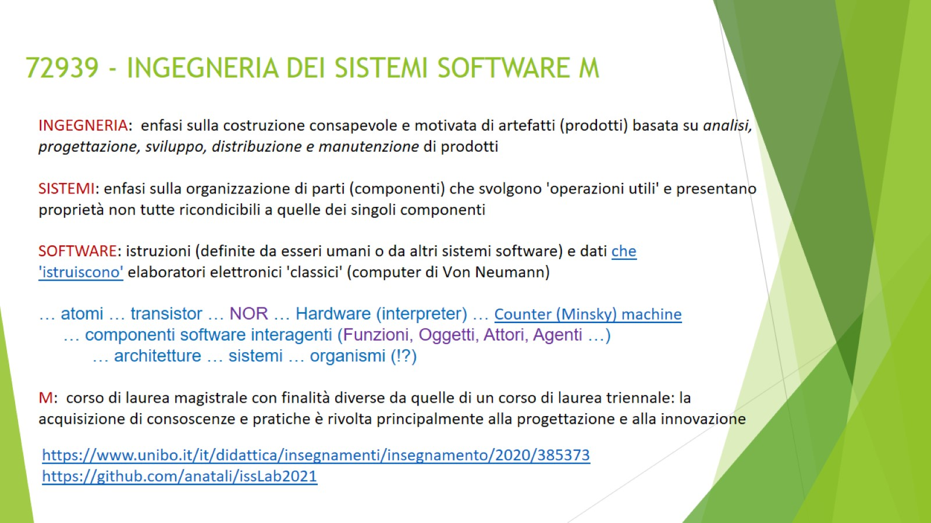
72939 - INGEGNERIA DEI SISTEMI SOFTWARE M

Slide 2
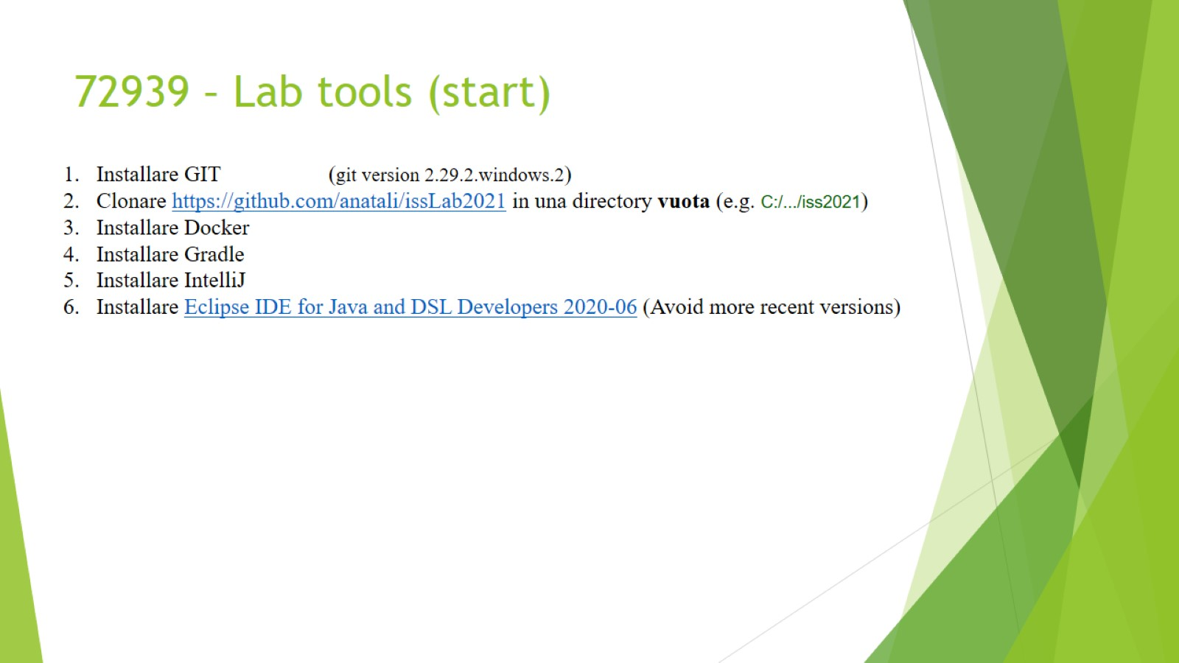
72939 – Lab tools (start)

Slide 3
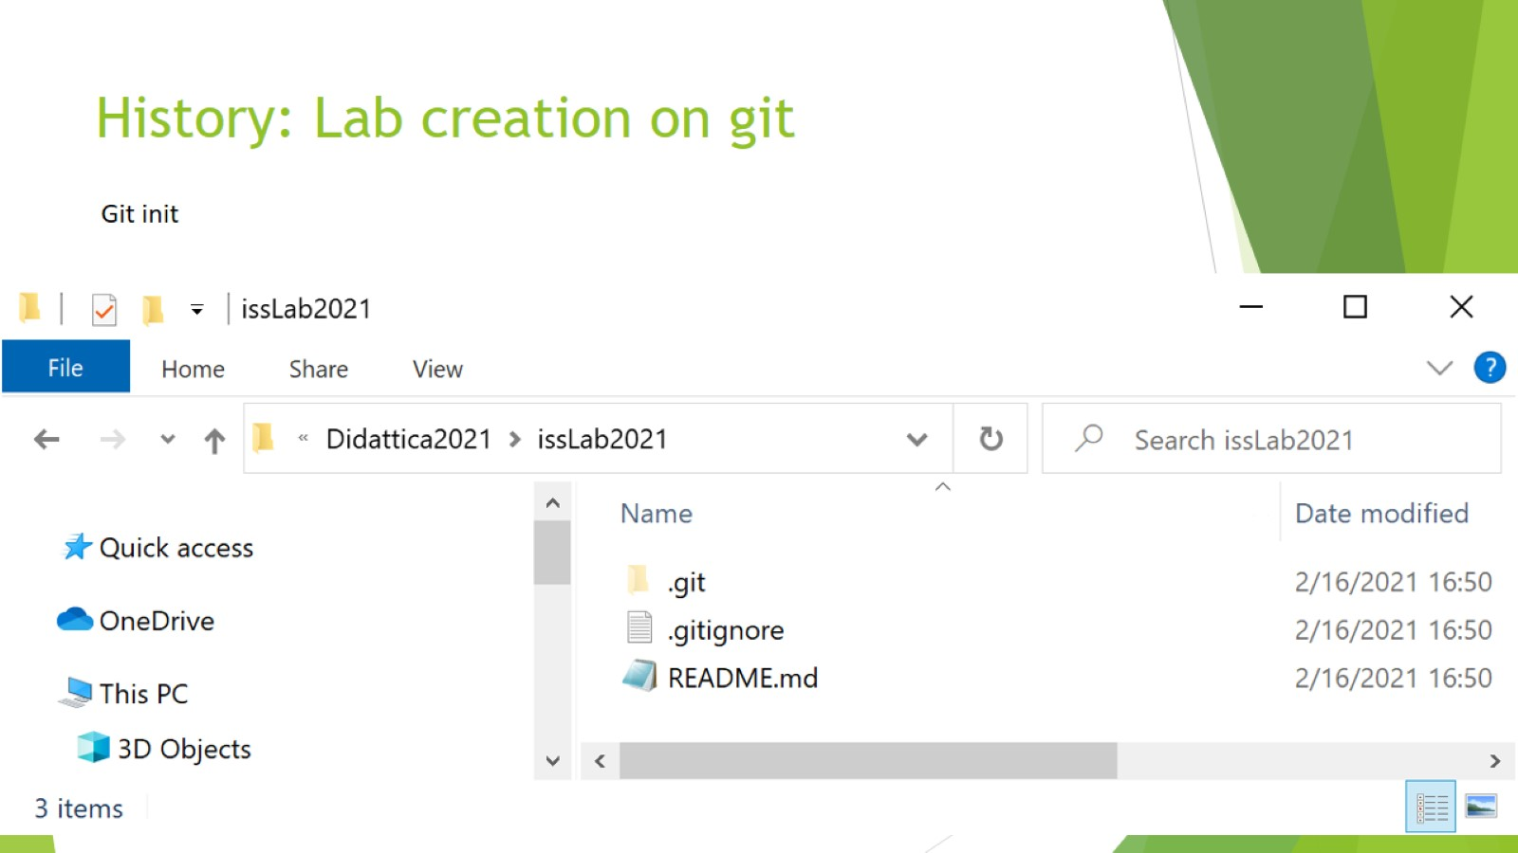
History: Lab creation on git

Slide 4
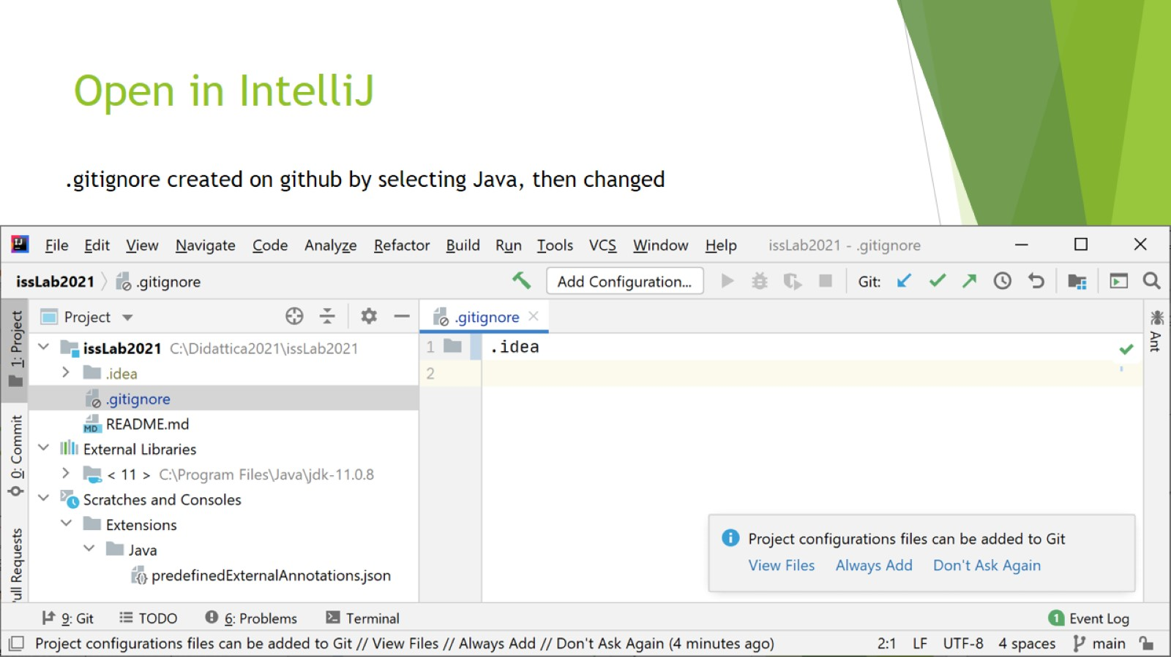
Open in IntelliJ

Slide 5
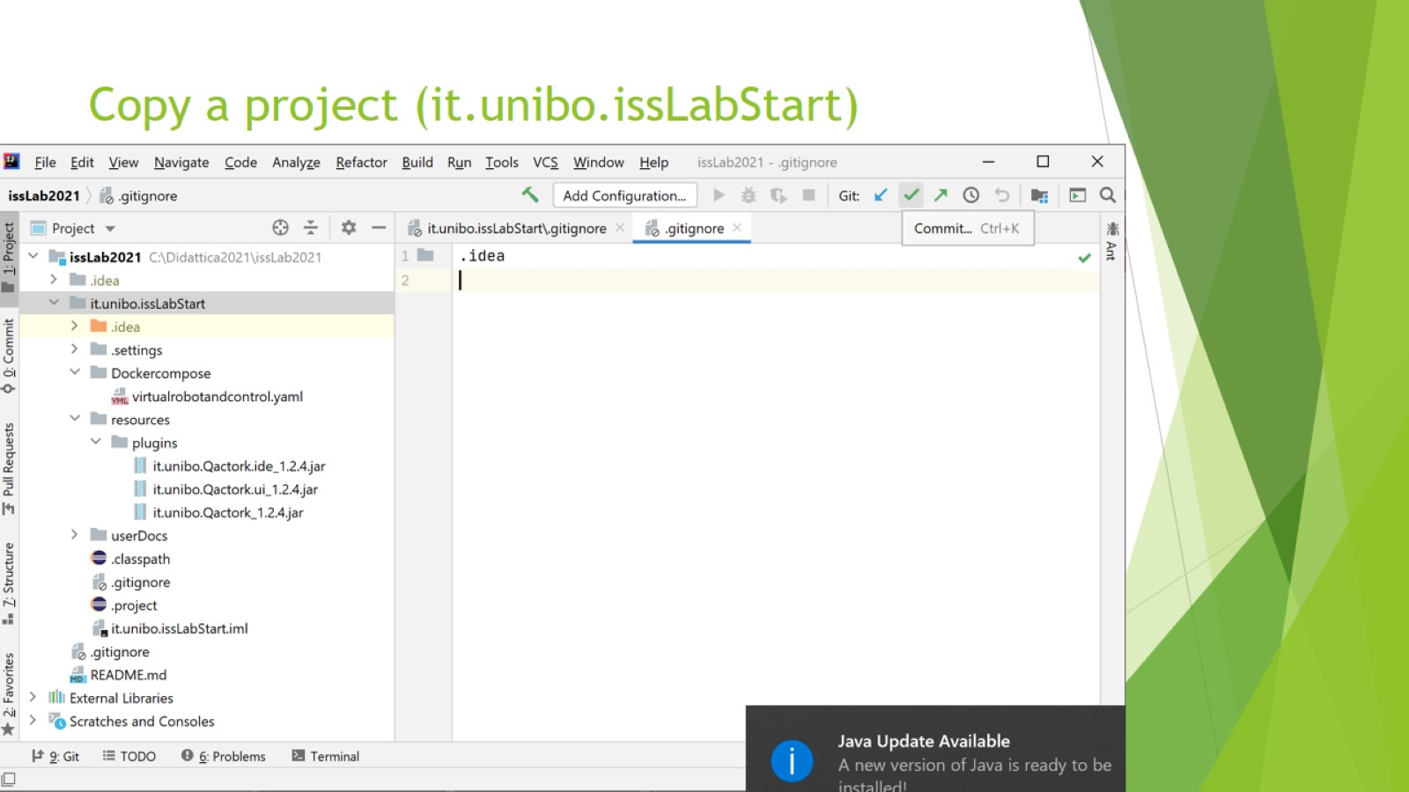
Copy a project (it.unibo.issLabStart)

Slide 6
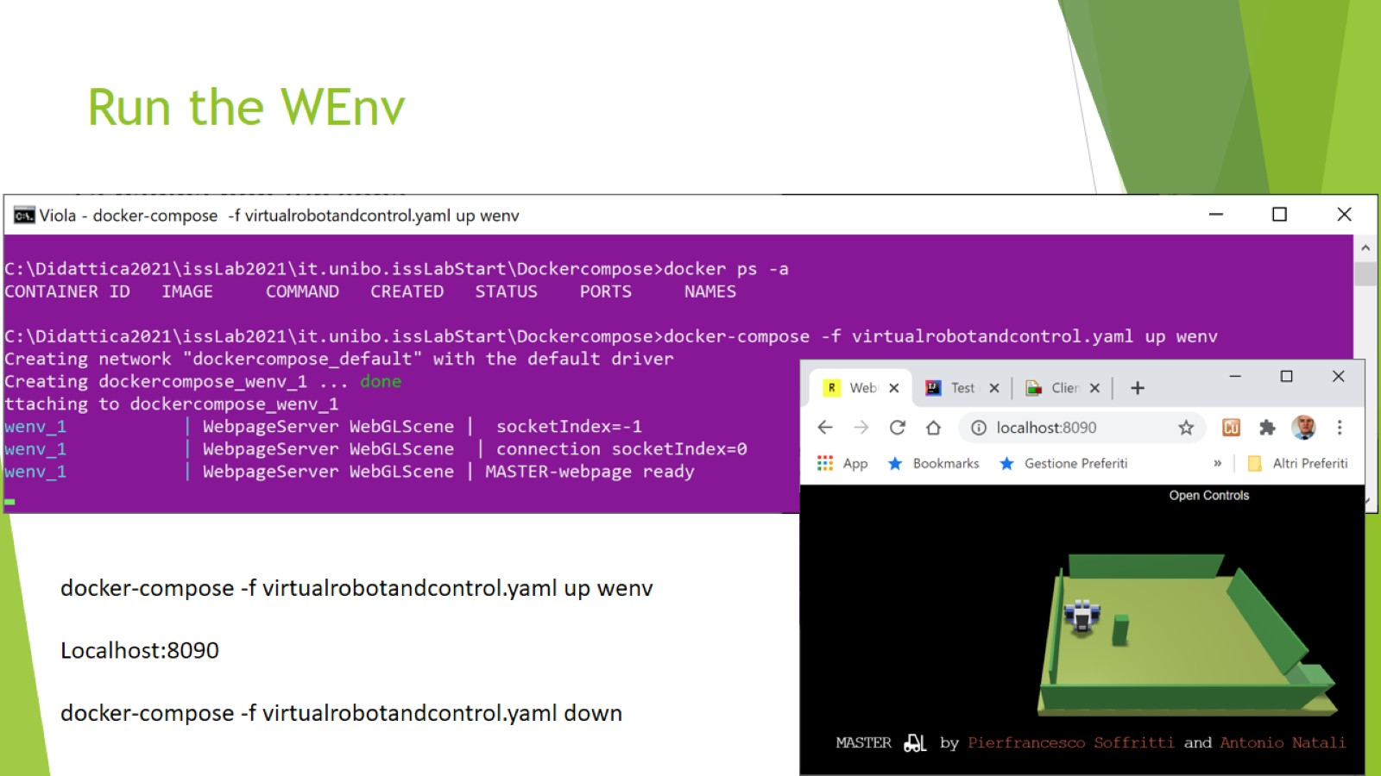
Run the WEnv

Slide 7
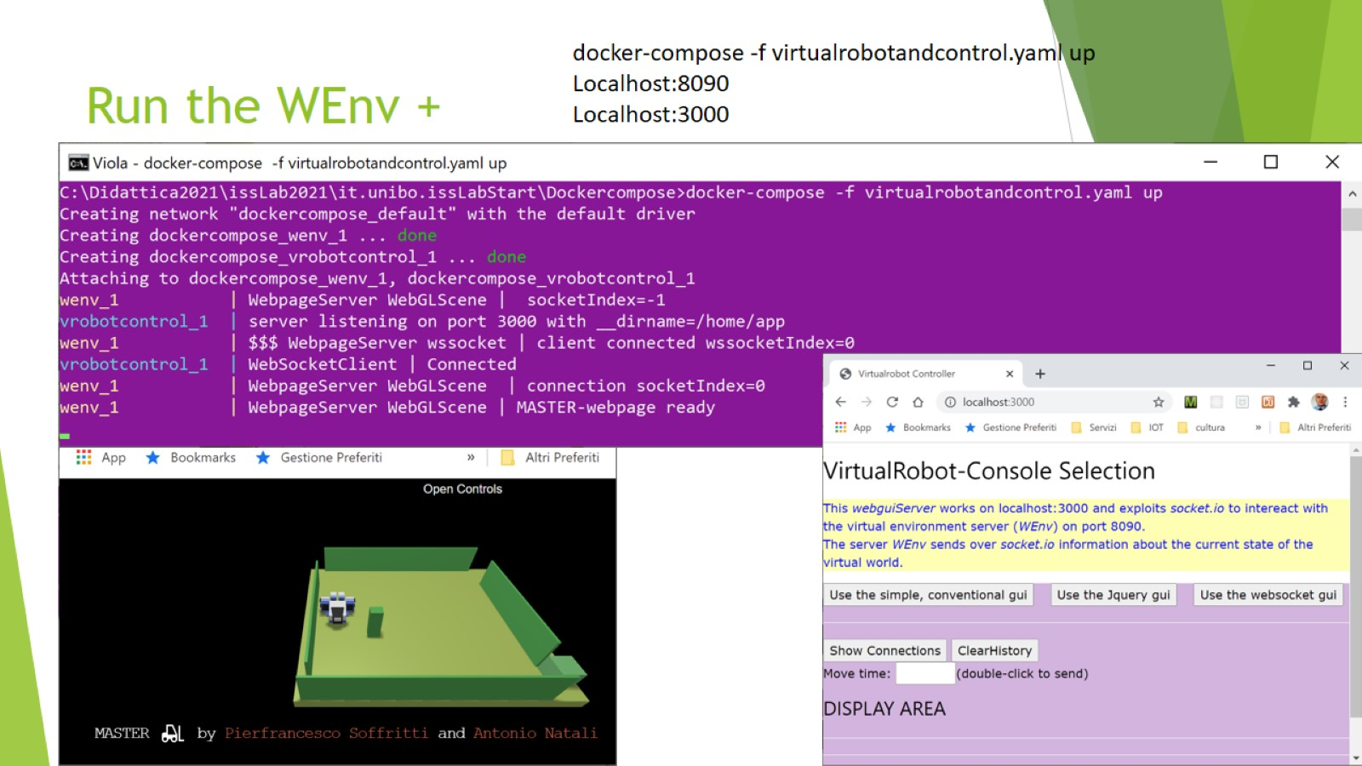
Run the WEnv +

Slide 8
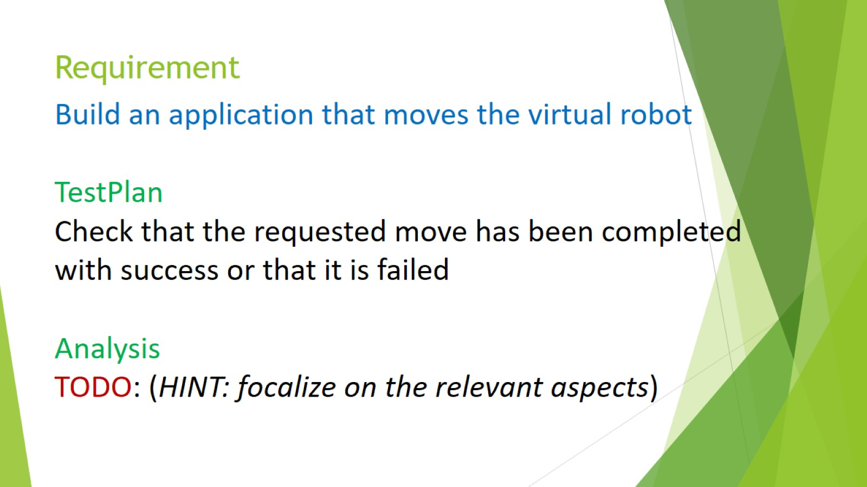
Requirement

Slide 9
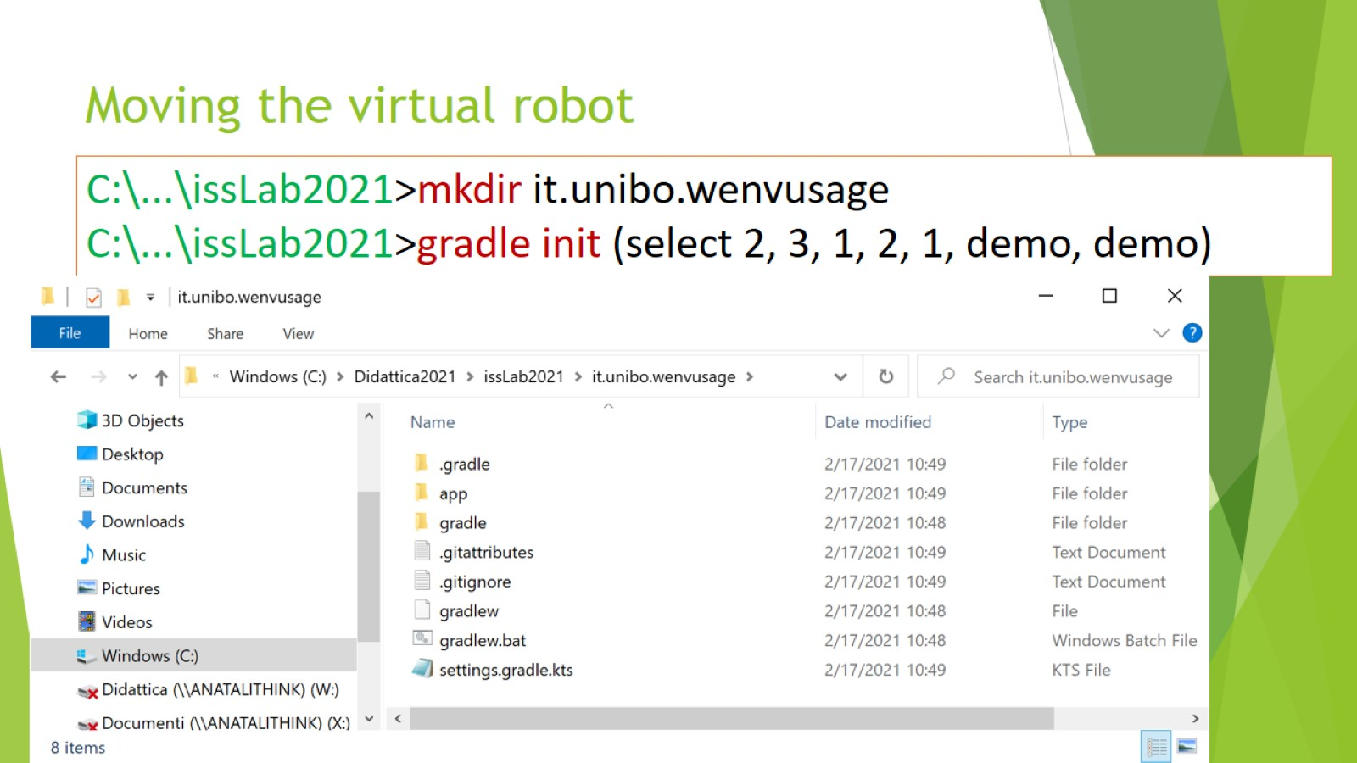
Moving the virtual robot

Slide 10
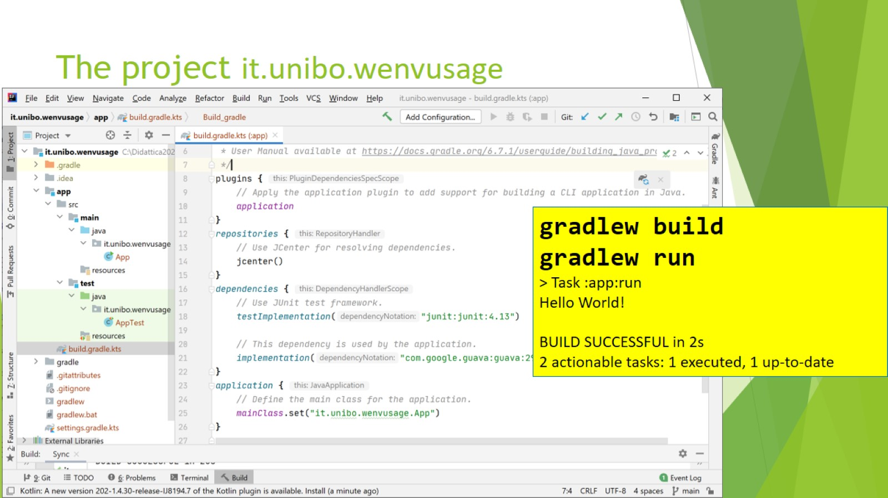
The project it.unibo.wenvusage

Slide 11
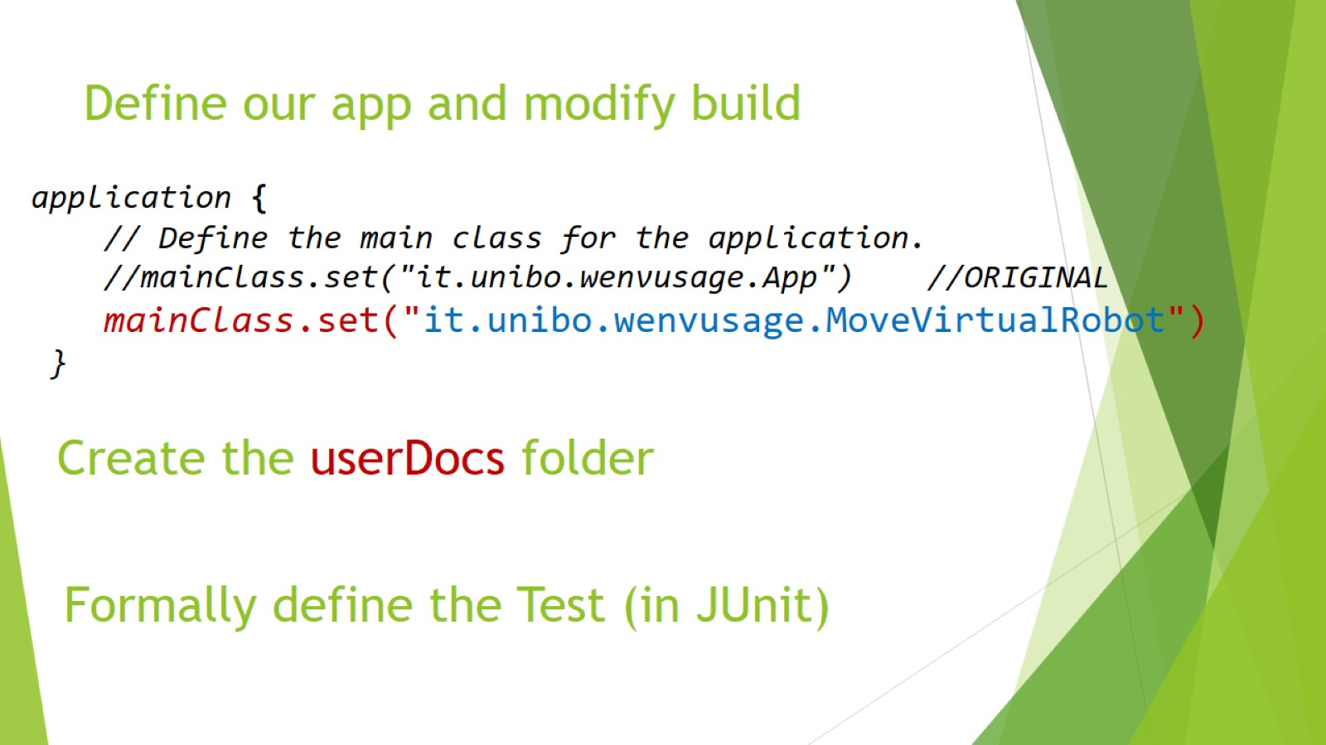
Define our app and modify build

Slide 12
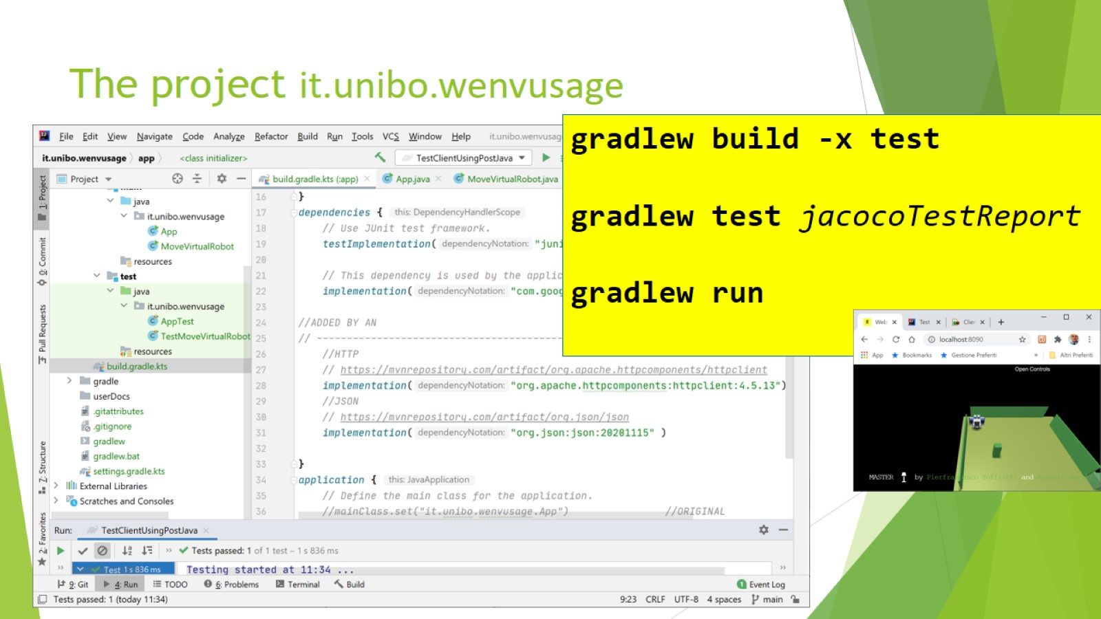
The project it.unibo.wenvusage

