Slide 1

SED – Stream Editor
Notes:
CSCI 330 - The UNIX System
NIU - Department of Computer Science

Slide 2
What is sed?
A non-interactive stream editor
Interprets sed instructions and performs actions
Use sed to:
  Automatically perform edits on file(s)
  Simplify doing the same edits on multiple files
  Write conversion programs

Slide 3
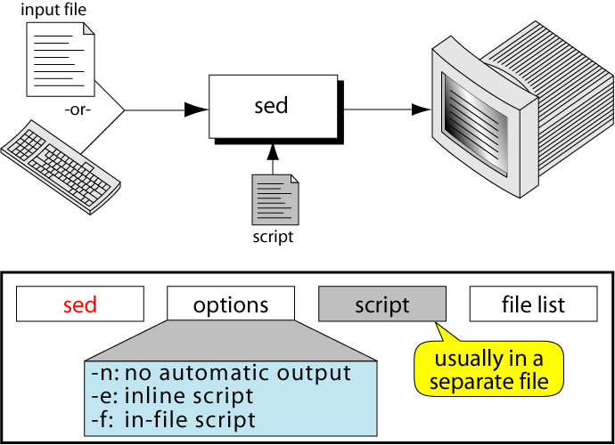
The sed command

Slide 4
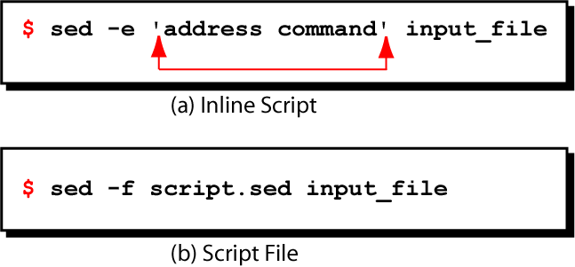
sed command syntax

Slide 5
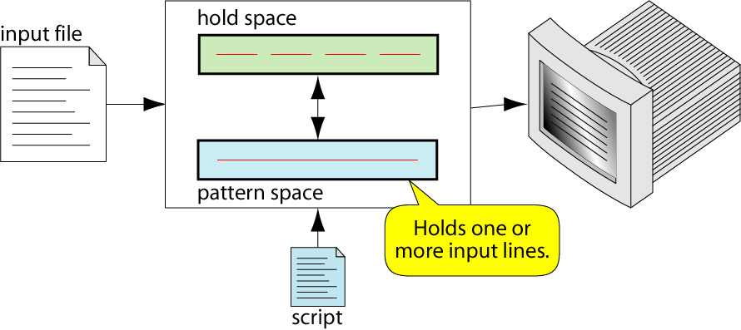
sed Operation

Slide 6
How Does sed Work?
sed reads line of input
  line of input is copied into a temporary buffer called pattern space
  editing commands are applied
    subsequent commands are applied to line in the pattern space, not the original input line
    once finished, line is sent to output
    (unless –n option was used)
  line is removed from pattern space
sed reads next line of input, until end of file
Note: input file is unchanged

Slide 7
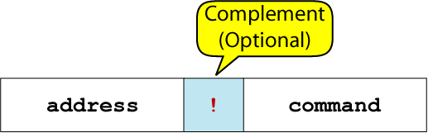
sed instruction format
address determines which lines in the input file are to be processed by the command(s)
  if no address is specified, then the command is applied to each input line
address types:
  Single-Line address
  Set-of-Lines address
  Range address
  Nested address

Slide 8
Single-Line Address
Specifies only one line in the input file
  special: dollar sign ($) denotes last line of input file
Examples:
  show only line 3
  sed -n -e '3 p' input-file
  show only last line
  sed -n -e '$ p' input-file
  substitute “endif” with “fi” on line 10
  sed -e '10 s/endif/fi/' input-file

Slide 9
Set-of-Lines Address
use regular expression to match lines
  written between two slashes
  process only lines that match
  may match several lines
  lines may or may not be consecutive
Examples:
  sed -e ‘/key/ s/more/other/’ input-file

Slide 10
Range Address
Defines a set of consecutive lines
Format:
start-addr,end-addr (inclusive)
Examples:
  10,50 line-number,line-number
  10,/R.E/ line-number,/RegExp/
  /R.E./,10 /RegExp/,line-number
  /R.E./,/R.E/ /RegExp/,/RegExp/

Slide 11
Example: Range Address
% sed -n -e ‘/^BEGIN$/,/^END$/p’ input-file
Print lines between BEGIN and END, inclusive
      BEGIN
      Line 1 of input
      Line 2 of input
      Line3 of input
      END
      Line 4 of input
      Line 5 of input
addr1
addr2
These lines are printed

Slide 12
Address with !
address with an exclamation point (!):
instruction will be applied to all lines that do not match the address
Example:
print lines that do not contain “obsolete”
sed -e ‘/obsolete/!p’ input-file

Slide 13
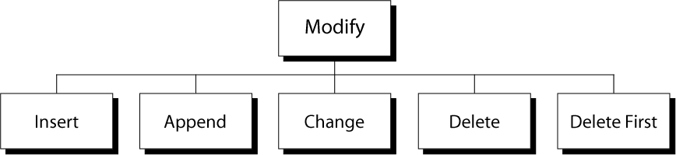
modify commands
Substitute

Slide 14
Insert Command: i
adds one or more lines directly to the output before the address:
  inserted “text” never appears in sed’s pattern space
  cannot be used with a range address; can only be used with the single-line and set-of-lines address types
Syntax:
  [address] i\
  text

Slide 15
Example: Insert Command (i)
% cat tuition.insert.sed
1 i\
Tuition List\
% cat tuition.data
Part-time 1003.99
Two-thirds-time 1506.49
Full-time 2012.29
% sed -f tuition.insert.sed tuition.data
Tuition List
Part-time 1003.99
Two-thirds-time 1506.49
Full-time 2012.29
Sed script to insert “Tuition List” as report title before line 1
Input data
Output after applying
the insert command

Slide 16
Append Command: a
adds one or more lines directly to the output after the address:
  Similar to the insert command (i), append cannot be used with a range address.
  Appended “text” does not appear in sed’s pattern space.
Syntax:
  [address] a\
  text

Slide 17
Example: Append Command (a)
% cat tuition.append.sed
a \
--------------------------
% cat tuition.data
Part-time 1003.99
Two-thirds-time 1506.49
Full-time 2012.29
% sed -f tuition.append.sed tuition.data
Part-time 1003.99
--------------------------
Two-thirds-time 1506.49
--------------------------
Full-time 2012.29
--------------------------
Sed script to append
dashed line after
each input line
Input data
Output after applying
the append command

Slide 18
Change Command: c
replaces an entire matched line with new text
accepts four address types:
  single-line, set-of-line, range, and nested addresses.
Syntax:
  [address1[,address2]] c\
  text

Slide 19
Example: Change Command (c)
% cat tuition.change.sed
1 c\
Part-time 1100.00
% cat tuition.data
Part-time 1003.99
Two-thirds-time 1506.49
Full-time 2012.29
% sed -f tuition.change.sed tuition.data
Part-time 1100.00
Two-thirds-time 1506.49
Full-time 2012.29
Sed script to change
tuition cost from
1003.99 to 1100.00
Input data
Output after applying
the change command

Slide 20
Delete Command: d
deletes the entire pattern space
  commands following the delete command are ignored since the deleted text is no longer in the pattern space
Syntax:
  [address1[,address2]] d

Slide 21
Example: Delete Command (d)
Remove part-time data from “tuition.data” file
% cat tuition.data
Part-time 1003.99
Two-thirds-time 1506.49
Full-time 2012.29
% sed –e '/^Part-time/d' tuition.data
Two-thirds-time 1506.49
Full-time 2012.29
Input data
Output after applying delete command

