Slide 1
kraftOfi
Ecommerce website connecting people to traditional handcrafted products
By anand tharad

Slide 2
What is it?
The project, kraftOfi, is an Ecommerce Website on which various products are listed.
People can add and view products, add them to their carts, add and view reviews.
Hosted on Heroku. Can Visit on https://kraftofi.herokuapp.com

Slide 3
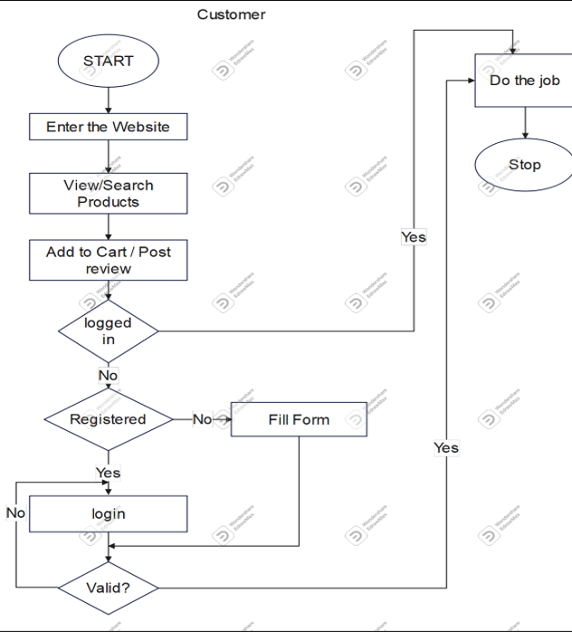
Flowchart Representing Customer’s Flow On Kraftofi

Slide 4
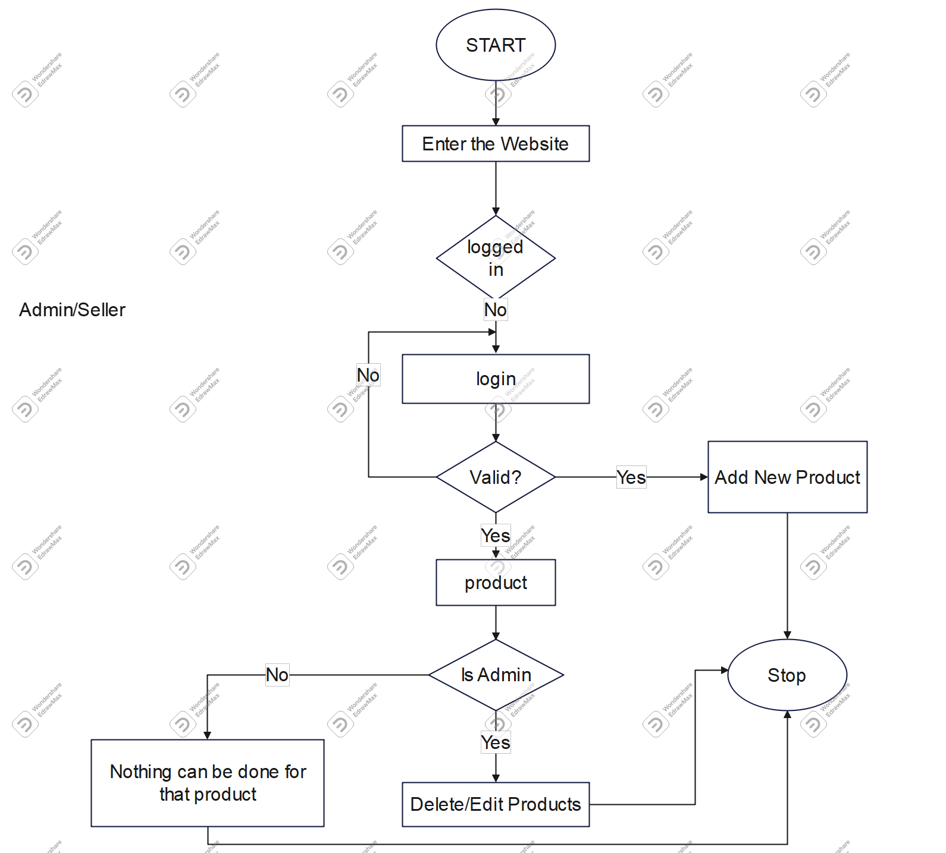
Flowchart Representing Admin / Seller’s Flow On Kraftofi

Slide 5




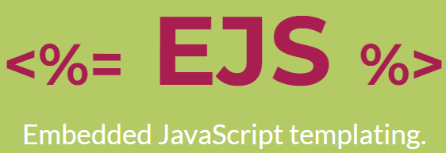






Tech-Stack and Libraries Used

Slide 6
THANK YOU

