Slide 1
Wildfire burned area mapping
LITERATURE REVIEW
By Anandu N R
Summer Internship
Under the supervision of Prof. Saeid Homayouni, INRS Quebec

Slide 2
Contents
Index | Project | Page No.
1 | Contribution of SAR/Sentinel-1 images in the detection of burnt areas in the natural vegetation of the Brazilian Pantanal biome | 3
2 | BADI: a novel burned area detection index for sentinel-2 imagery using google earth engine platform | 6
3 | A deep convolutional neural network for burn progression mapping using Sentinel-1 SAR timeseries | 9
4 | A novel deep Siamese framework for burned area mapping Leveraging mixture of experts | 12
5 | Burnt-Net: Wildfire burned area mapping with single post-fire Sentinel-2 data and deep learning morphological neural network | 15
6 | Single-Temporal Sentinel-2 for Analyzing Burned Area Detection Methods: A Study of 14 Cases in Republic of Korea Considering Land Cover | 18
7 | An Unsupervised Saliency-Guided Deep Convolutional Neural Network for Accurate Burn Mapping from Sentinel-1 SAR Data | 21
8 | Automatic Mapping of Burned Areas Using Landsat 8 Time-Series Images in Google Earth Engine: A Case Study from Iran | 24

Slide 3
Contribution of SAR/Sentinel-1 images in the detection of burnt areas in the natural vegetation of the brazilian Pantanal biome
The purpose of this study was to map burnt areas in the EASP conservation unit, Mato-Grosso, Brazil in the dry season of 2020.
The focus of this study was on fire events that took place between June 20 and November 22, 2020.
Data Used:
Sentinel-2 Optical Data(Used as ground truth): Acquired on June 20 (Pre fire) and November 22 (Post fire)
Sentinel-1 SAR Data: Pre- (June 15)and post-fire (November 24) images were selected.

Slide 4
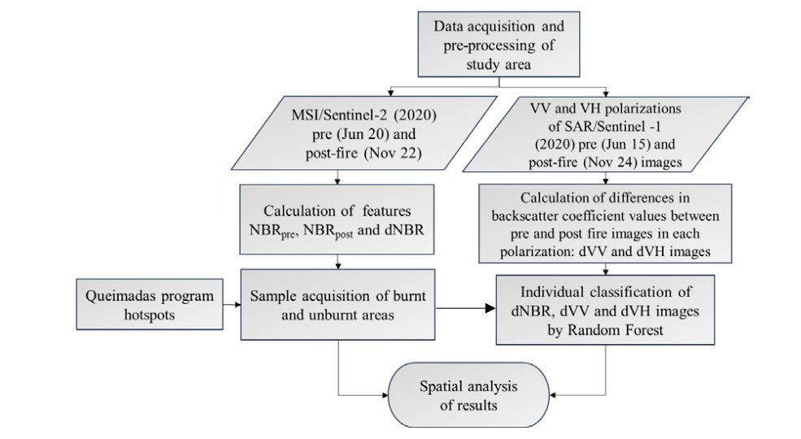
Methodology:
Acquisition of optical and SAR data.
Calculation of NBR and dNBR.
Calculation of difference in backscatter coeficient in dVV and dVH images
Random Forest classification of dNBR, dVV, and dVH(Two output classes: burnt areas and unburnt areas.)
Data pre-processing, both optical and SAR images, was performed using the Sentinel Application Platform 8.0 (SNAP) software, developed by the ESA.

Slide 5
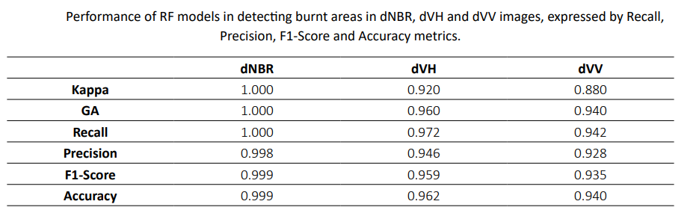
Results
Calculated the Recall, Precision, F1-Score, and accuracy metrics from the validation data.
Strong correlation between SAR and optical data.
The results showed that the dVH and dVV products identified more burnt areas compared to dNBR, 21% and 18%, respectively.
The dVH and dVV products were able to differentiate water bodies, not associating them with burnt areas, as occurred with dNBR.

Slide 6
2. BADI: a novel burned area detection index for sentinel-2 imagery using google earth engine platform
The fire event considered in this research occurred from 3 to 13 May 2020 in southwestern Iran and southwestern Fars province .
Cloud-free optical satellite images obtained by the Sentinel-2 satellite were used.
The Sentinel-2 data was acquired and pre-processed in the GEE environment.

Slide 7
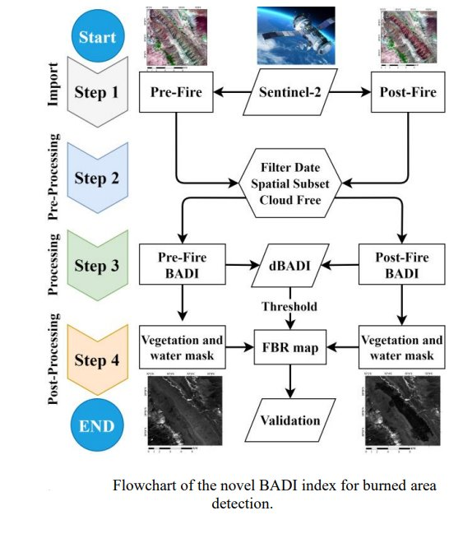
Methodology:
The BA map was extracted using the BADI spectral index and the automatic Otsu thresholding method.
In the next step, water(NDWI index) and vegetation(NDVI index) classes were removed from the PBR map to create the FBR map.
An evaluation of the proposed BADI index was conducted based on the Copernicus EMS reference map.

Slide 8
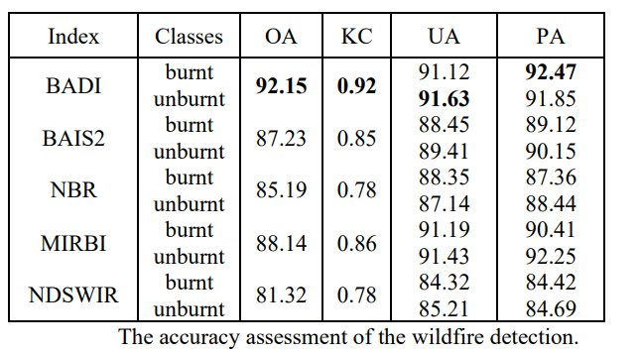
Results:
Four measures of accuracy were used to evaluate the outcomes: producer accuracy (PA %), user accuracy (UA%), overall accuracy (OA%), and kappa coefficient (KC).
To compare the BADI index with the reference spectral indicators used for mapping the BA, BAIS2, NBR, normalized difference SWIR (NDSWIR), and mid-infrared bispectral index (MIRBI) were calculated.
Results showed reduction in false positives.

Slide 9
3. A deep convolutional neural network for burn progression mapping using Sentinel-1 SAR timeseries
Study Areas:
Derazno, Iran: A fire incident on 23 September 2021 burned around 200 hectares of Caspian Hyrcanian mixed forest.
Rossomanno-Grottascura-Bellia, Italy: A large wildfire on 6 August 2017 affected approximately 3,851 hectares in Sicily, Italy.
Data used:
Sentinel-1 SAR data was used, acquired from Google Earth Engine (GEE).
Reference Data: Sentinel-2 multispectral images and the normalized burn ratio (NBR) were used for validation.

Slide 10
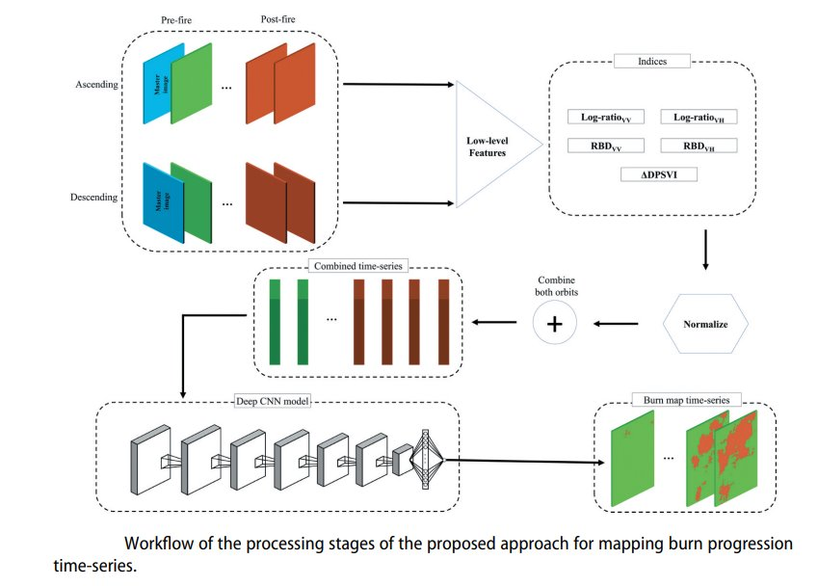
Methodology:
SAR indices, including log-ratio, RBD, and ΔDPSVI, are extracted.
This process is performed by considering both ascending (ASC) and descending (DES) images separately, so for each orbit (ASC and DES).
One of the pre-fire images is regarded as a master to calculate five channels for the remaining SAR images.
the SAR indices are concatenated to construct a five channel time-series for each orbit.
Then, the two series (ASC and DES) of SAR channels are combined to construct a united time series.
the training samples of the combined time-series are fed to the proposed CNN for training the deep model

Slide 11
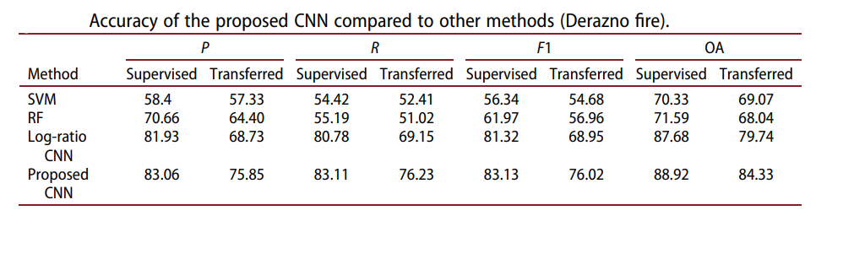
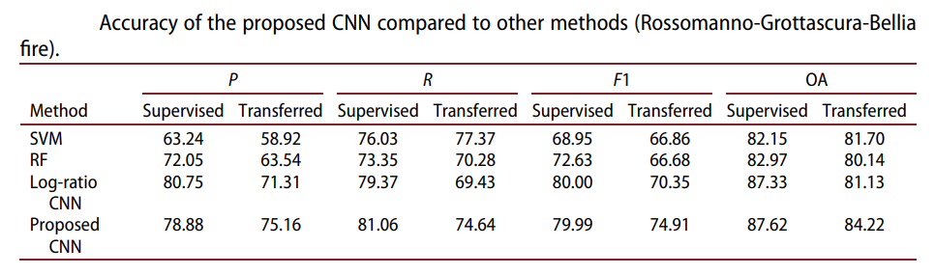
In burn mapping studies, the ground truth data might not be available due to the presence of clouds and smoke.
To overcome this problem, we analyze its transferability for mapping burned areas on unseen dates.
Each of the case studies includes four post-fire images, of which two are considered for supervised training.
The remaining images (i.e. pre-fire, during burn progression and the other two postfire images) are used to assess the effectiveness of the transferred models.

Slide 12
4. A novel deep Siamese framework for burned area mapping Leveraging mixture of experts
The study areas are located in different countries (Spain, Italy, and Portugal).
In this study, the Sentinel-2 dataset with spatial resolutions of 10 and 20 (m) was used.
Three real bi-temporal Sentinel-2 datasets were selected to evaluate the performance of the SMoE model.
Three reference datasets were used in this study, the ground truth of which is available at [https://emergency. copernicus.eu/].

Slide 13
Methodology
(1) Data preparation
(2) Model training, the model parameters are tuned by an iterative manner based on learning using the training dataset and evaluating the model by loss function on the validation dataset.
(3) Prediction, the dataset is fed to the predictive model to generate the final burned map, also, the performance model is evaluated based on the test dataset by quantitative measurement indices and visual analysis.
Results
To evaluate the performance of the SMoE model, implemented six other deep learning and advanced machine learning models.
These models include extreme gradient boosting (XGBoost), light gradient boosting machine (LGBM), 2D-Siamse convolutional neural network (2D-SCNN), 3DSiamse convolutional neural network (3D-SCNN), multi-layer perceptron mixer (MLP-Mixer), and Hierarchical Vision Transformer using Shifted Windows (Swin-T).

Slide 14
Advantages:
(1) High accuracy in BAM
(2) Low miss detection and false alarm rates
(3) Doesn’t require additional processing such as feature extraction
(4) High generalization for the unseen dataset
(5) Adaptive with mono-temporal and bitemporal datasets for BAM.

Slide 15
5. Burnt-Net: Wildfire burned area mapping with single post-fire Sentinel-2 data and deep learning morphological neural network
The study areas are located in different countries, which are included: Cyprus, Turkey, Greece, France, Portugal, and Spain.
This study proposed a novel End-to-End framework based on deep learning and post-fire Sentinel-2 imagery.
The proposed framework known as Burnt-Net combines quadratic morphological operators and standard convolution layers.
The reference data were obtained based on visual analysis and the interpretation of the results of burned area mapping results in some papers.
It utilized only post-fire dataset and and required no pre-processing.

Slide 16
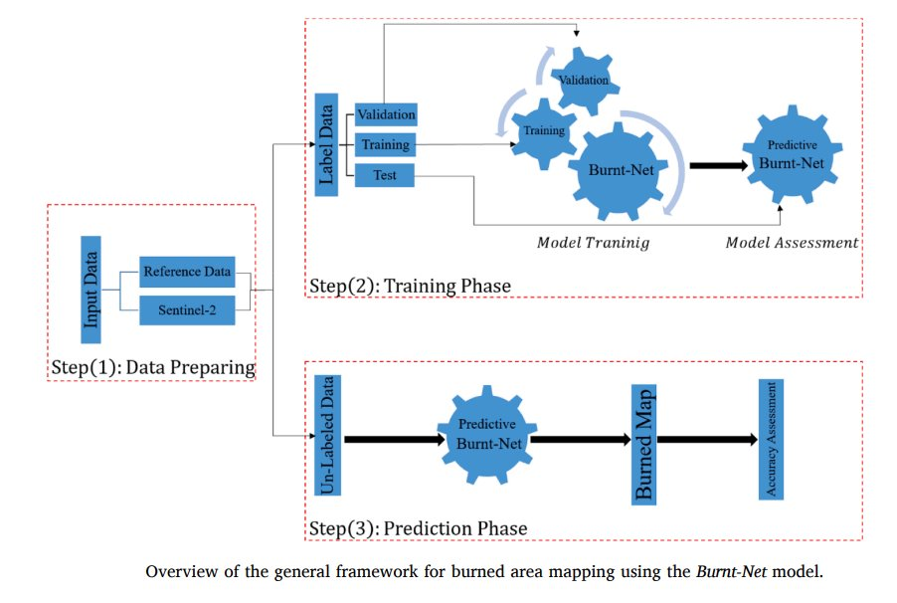
Methodology
(1) Data preparing:The data preparation included preprocessing the Sentinel-2 dataset and patch-generation.
(2) Burnt-Net model training:the labeled datasets are fed for the training Burnt-Net model. In this step, the dataset is split into three main parts such as training, validation, and testing datasets.
(3) Prediction based on Burnt-Net:After tuning model parameters, the model applies for mapping burned areas and then the result of burned area mapping is assessed by reference datasets.
A hybrid loss function has been employed combines the weighted cross-entropy (WCE) loss and intersection-over union (IOU) loss.

Slide 17
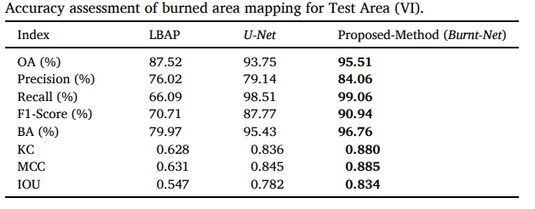
Results
Used Overall accuracy (OA), Recall, Precision, Balance Accuracy (BC), F1-score, Jaccard index/ Intersection over Union (IoU), kappa coefficient (KC), and Matthews correlation coefficient (MCC).
For comparing the performance of the proposed method, U-Net and the Landsat burned area product (LBAP) has been selected.
The deep learning-based frameworks have a high-efficiency comparison with LBAP.
The BurntNet has provided considerable results in the detection of both burned and unburned pixels.

Slide 18
6. Single-Temporal Sentinel-2 for Analyzing Burned Area Detection Methods: A Study of 14 Cases in Republic of Korea Considering Land Cover
The study focused on 14 significant forest fire incidents that occurred in the Republic of Korea between 2019 and 2023
Data used - Sentinel-2 images
Methodology
(1) Data Preparation – Sentinel 2 Image processing
(2) Generation of ground truth (GT) data: Using Labkit tool within ImageJ Fiji Java 8
(3) Creation of method-specific datasets: tailor datasets for different detection methods (DL, ML, and SI) by extracting relevant features and integrating GT data.
(4) Evaluation of detection results: assess algorithm performance using accuracy assessment techniques and compare with GT data.

Slide 19
Deep Learning Analysis:
U-Net Model and HRNetV2+OCR Model
Plans:
Plan 1: Three combinations of individual spectral bands.
Plan 2: Additional SI (NDVI, NBR).
Utilized ArcGIS Pro v2.9.0 and PyCaret in Python.
Machine learning Analysis: AutoML Model
Spectral Indices-Based Approaches: NDVI and NBR for burned area detection.
Accuracy Evaluation Metrics: Accuracy, Precision, Recall, F1-score, IoU.

Slide 20
Results:
U-Net:
Effectively handled imbalanced datasets, beneficial for complex terrains.
Misclassified agricultural lands as forest areas.
HRNet:
Highest accuracy in both qualitative and quantitative analyses.
Stability across various terrains and conditions.
Conclusion:
DL models (especially HRNet) are highly effective for detecting forest fire damage using single-temporal Sentinel-2 imagery.
False-color RGB images (B4, B8, B3) were found to be the most effective for detecting forest fire damage.

Slide 21
7. An Unsupervised Saliency-Guided Deep Convolutional Neural Network for Accurate Burn Mapping from Sentinel-1 SAR Data
Study Area:
Wildfire on 6 August 2017 in Rossomanno-Grottascura-Bellia, Sicily, Italy.
Data used:
Sentinel-1 data
The reference ground truth map was generated using the ∆NBR (normalized burn ratio) index, calculated from Sentinel-2 multispectral images.
Preprocessing: (Used GEE)
Terrain correction and refined Lee filter for noise reduction.
Averaged pre- and post-fire Sentinel-1 SAR images.
Log-ratio of VV and VH polarization computed for pre- and post-fire images.
Generation of saliency rate images and binary masks to remove non-salient regions.

Slide 22
Methodology:
Saliency-Guided Technique:
Detected salient regions with a high probability of containing burned areas.
Produced saliency maps using pre- and post-fire difference images for VV and VH polarizations.
Aggregate saliency maps to utilize full Sentinel-1 backscatter data potential.
Initial Clustering and Supervised Learning:
Fuzzy C-Means (FCM) to segment data into burned, intermediate, and unburned regions.
DCNN to classify intermediate regions using clustered data.
Evaluation Parameters:
Precision, Recall, F1-score, Overall Accuracy (OA).

Slide 23
Results:
Cross-polarization (VH) proved dominant in mapping burned areas.
Combined VV and VH polarizations outperformed single polarization.
Discussion:
Unsupervised saliency-guided DCNN model effectively detected burned areas using Sentinel-1 SAR images.
Saliency maps and difference images enhanced the segmentation and classification process.
The proposed model, utilizing both polarizations, achieves high precision and can be implemented unsupervised, suitable for diverse conditions without reliable ground truth data.

Slide 24
8. Automatic Mapping of Burned Areas Using Landsat 8 Time-Series Images in Google Earth Engine: A Case Study from Iran
The study was conducted in Iran, covering an area of 1.7 million km²
Utilized surface reflectance time-series images from Landsat 8, accessed through GEE.
Data Preparation:
Landsat 8 Image Collection:
9 bands (B1–B7, B10–B11) from 1 January 2019 to 30 December 2020 and 1 January 2021 to 30 September 2021.
13 spectral indices generated and added to 9 bands, resulting in 22 bands.
Repeated for 1 January 2021 to 30 September 2021.
Reference Data:
Coordinates and dates of wildfires from the Iranian Space Agency (ISA).
Non-burned reference polygons created using FIRMS products.
MODIS (MCD64A1) products for model comparison and evaluation.

Slide 25
Methodology:
Training Data Creation:
Burned area polygons using ISA data and Sentinel-2 images.
Unburned area polygons using FIRMS fire products. Landsat 8 images with 22 features sampled at 30 m spatial scale.
Feature Selection and Model Training:
Combined GA and NN algorithm for optimal feature selection and model training. 19 optimal features selected.
NN and RF algorithms used for burned area detection.

Slide 26
Discussion:
Model Performance:
Both NN and RF models demonstrated effective burned area detection. Accuracy influenced by quality and dynamics of reference data.
GEE platform enabled efficient handling and analysis of large datasets.
Conclusion:
Automatic burned area mapping using Landsat 8 and GEE is effective and efficient. Optimal feature selection and robust model architecture crucial for accurate detection.
Study highlights importance of high-quality reference data and temporal analysis for reliable burned area mapping.

