Slide 1

MCA PROJECT REPORT • CLOUD COMPUTING SPECIALIZATION
Implementation of Cloud Computing
in Business Operations
A Study Focused on the Retail Sector
Anandumon Prasad Thuruthel
Enrollment No: O24MCA110149
Mentor: Ms. Vasanthi Chandran | Qollabb / Plag Pro, Noida
Centre for Distance & Online Education, Chandigarh University
2026

Slide 2
AGENDA
What's Inside This Deck
01
Problem & Objectives
02
Research Approach
Why retail needs a structured way to think about cloud adoption
Reading around the topic, talking to IT professionals, and looking at real cases
03
System Analysis & Design
04
Key Findings
Architecture, UML diagrams, and the database schema behind it
What the interviews and case patterns showed, plus a provider comparison
05
Results & Best Practices
06
Conclusion & Future Scope
What actually improved, and a framework you can follow
Where this could go next for retail
Implementation of Cloud Computing in Business Operations
2

Slide 3


THE PROBLEM
What Cloud Promises vs. What Retail Experiences
Most retail businesses already know cloud computing is supposed to bring scalability, lower costs, and resilience — the hard part is actually making that happen in practice.
RESEARCH QUESTION
Where to start
How can a retail business implement cloud computing well, while managing the risk, cost, and organizational change that comes with it?
It's not always obvious which systems to migrate first, or in what order
Security worries
Concerns about data protection often slow everything down
Generic advice, specific problem
Most frameworks don't account for retail's seasonal demand swings
Focus sector: Retail
Implementation of Cloud Computing in Business Operations
3

Slide 4




PROJECT OBJECTIVES
Four Objectives, One Goal
Evaluate
Analyze
Assess
Explore
The benefits and challenges of adopting cloud computing in a business setting
What cloud computing actually does to operational efficiency in retail
The security and privacy questions that come with moving data to the cloud
Best practices and strategies for getting implementation right
01
02
03
04
Implementation of Cloud Computing in Business Operations
4

Slide 5




RESEARCH APPROACH
Combining Multiple Sources of Evidence
Literature Review
Practitioner Interviews
Case Patterns
System Analysis & Design
Cloud service and deployment models, how retail has approached adoption, and Agile vs. Waterfall migration thinking
3 short structured interviews with IT professionals in retail and enterprise roles
Two illustrative retail migration patterns, looked at for their operational outcomes
DFDs, UML diagrams, and an ER model turning the findings into a conceptual architecture
Findings were checked against each other across all three sources before being treated as solid.
Implementation of Cloud Computing in Business Operations
5

Slide 6


SYSTEM ANALYSIS
From On-Premises to Cloud-Native
EXISTING SYSTEM
PROPOSED SYSTEM
On-Premises Infrastructure
Hybrid Cloud Architecture
Heavy upfront spend on hardware
Pay-as-you-go pricing keeps upfront investment low
Scaling is manual — new capacity can take weeks to provision
Auto-scaling absorbs demand spikes within minutes
Each store is its own single point of failure
Redundancy and backups are built in and managed by the provider
Software updates roll out slowly, store by store
Updates roll out centrally, to every store at once
Limited visibility into stock across stores
Inventory stays in sync across stores in real time
Implementation of Cloud Computing in Business Operations
6

Slide 7
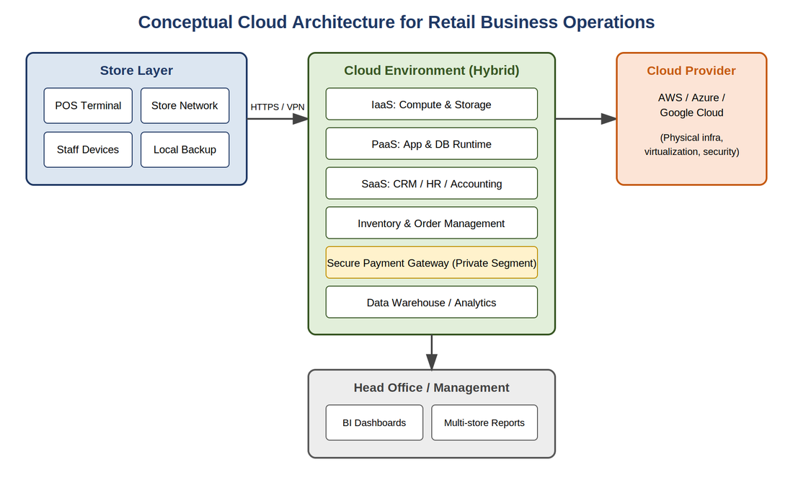
SYSTEM DESIGN
Conceptual Cloud Architecture
Store-level POS terminals connect securely into a hybrid cloud environment. General business services (IaaS/PaaS/SaaS) sit apart from a tightly controlled payment-processing segment.
Implementation of Cloud Computing in Business Operations
7

Slide 8
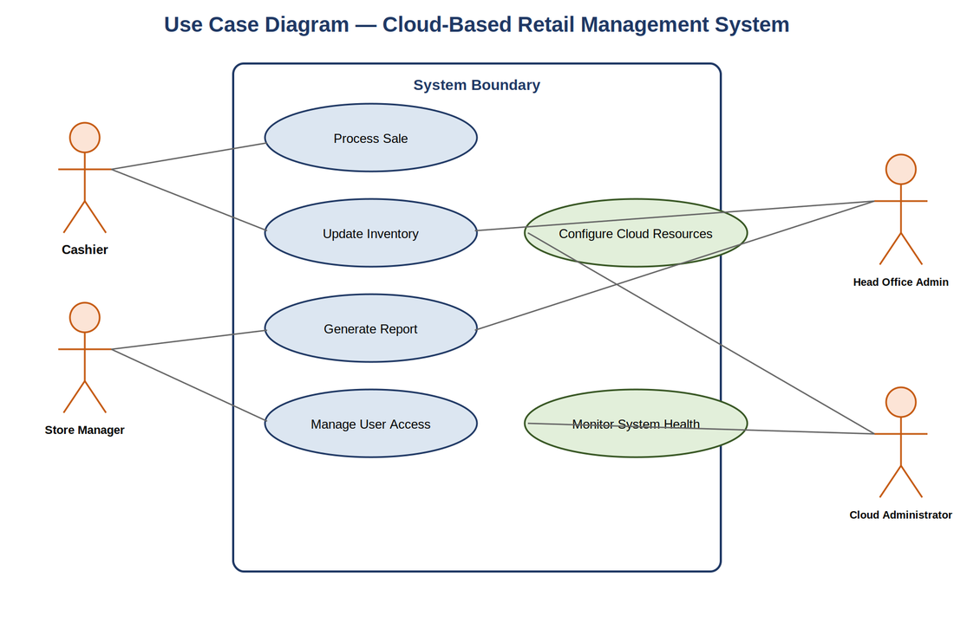
SYSTEM DESIGN
Who Uses the System, and How
Cashier
Processes sales and updates stock in real time
Store Manager
Keeps an eye on store performance and manages staff access
Head Office Admin
Sees consolidated reporting across every store
Cloud Administrator
Configures cloud resources and monitors system health
Implementation of Cloud Computing in Business Operations
8

Slide 9
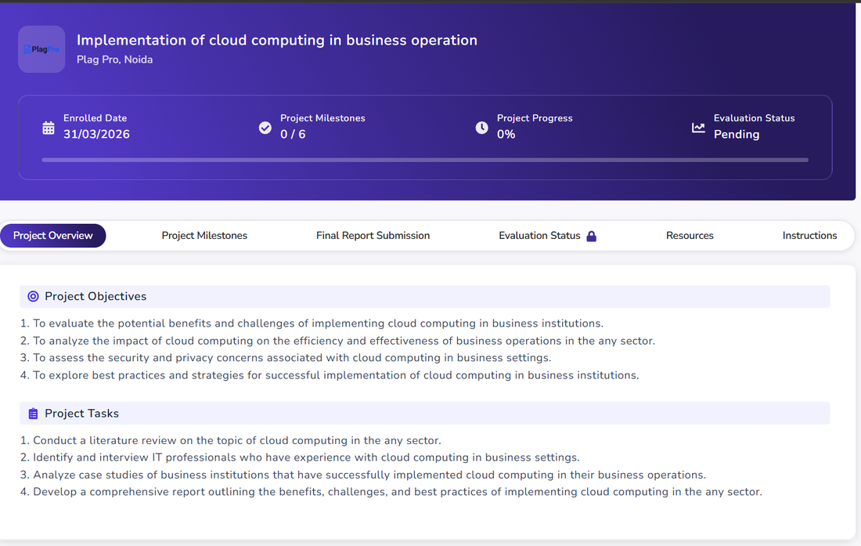
PROJECT EXECUTION
Run Through the Qollabb Platform
This project was enrolled, mentored, and tracked from start to finish on the Qollabb industry-project platform, with milestone tracking and mentor feedback along the way.
PROJECT
Implementation of Cloud Computing in Business Operations
MENTOR
Ms. Vasanthi Chandran
ENROLLED
31/03/2026
MILESTONES
6 — Literature Review → Final Report
Implementation of Cloud Computing in Business Operations
9

Slide 10
KEY FINDINGS
What the Interviews Turned Up
IT Support Specialist, Retail (5+ yrs)
Cloud-hosted POS noticeably cut downtime during peak sales, but staff needed proper retraining to adjust.
1
Systems Administrator, Enterprise IT (7+ yrs)
Migration was phased over 18 months; security and IAM planning ended up taking longer than budgeted.
2
Cloud Support Engineer (4+ yrs)
Cost overruns happened without centralized governance — tagging and budget alerts turned out to be essential.
3
Across all three: the technical side was manageable — organizational readiness was the real hurdle.
Implementation of Cloud Computing in Business Operations
10

Slide 11

KEY FINDINGS
Two Patterns Seen in Retail
PATTERN A
PATTERN B
Large Retail Chain
Mid-Sized Retailer
POS and inventory moved to the cloud in phases, piloted at a few stores before the full rollout.
Went SaaS-first — accounting and POS software first, with CRM layered in later.
Better uptime during peak periods
An easier entry point, with no deep cloud expertise needed
Software updates reach every store at once
Gets cloud benefits without a major infrastructure investment
Fewer stockouts thanks to shared inventory visibility
Adoption pace matched to the business's existing IT capacity
Implementation of Cloud Computing in Business Operations
11

Slide 12
COMPARATIVE ANALYSIS
Choosing a Cloud Provider for Retail
Criterion
AWS
Microsoft Azure
Google Cloud
Retail-specific tooling
Extensive
Strong (MS ecosystem)
Strong in AI/analytics
ERP / SAP integration
Well-documented
Native MS integration
Fewer pre-built connectors
Pricing transparency
Granular, complex
Granular, complex
Comparatively simpler
SMB / mid-retail fit
High
High
Moderate–High
Implementation of Cloud Computing in Business Operations
12

Slide 13

SECURITY & GOVERNANCE
Security Built In, Not Bolted On
Encryption
Role-Based Access
Multi-Factor Auth
Shared Responsibility
TLS/HTTPS in transit, plus encryption at rest for anything sensitive
4 distinct roles, each limited to the functions they actually need
Required for every administrative and head-office account
The provider secures the infrastructure; the organization secures its apps and access
PCI DSS concerns are handled by routing card data through certified third-party payment gateways rather than touching it directly.
Implementation of Cloud Computing in Business Operations
13

Slide 14


RESULTS
What Actually Improved
Lower
Centralized & simultaneous
Real-time
Low to moderate
Downtime during peak periods
Speed of software rollouts
Visibility into inventory across stores
Upfront capital investment
One gap worth naming honestly: the API design here doesn't yet spell out detailed connector logic for deep legacy SAP/ERP integration — flagged as future work rather than glossed over.
Implementation of Cloud Computing in Business Operations
14

Slide 15
RECOMMENDATIONS
A Framework Worth Following
Start with a phased, pilot-first migration — prove it works at a few stores before scaling up
1
Set up centralized cost governance — tagging, budget alerts — before provisioning at scale
2
Match the entry point (IaaS / PaaS / SaaS) to what your IT team can actually handle
3
Invest in staff training early — organizational readiness matters more than technical complexity
4
Build security and IAM planning into the timeline from day one, not as an afterthought
5
Implementation of Cloud Computing in Business Operations
15

Slide 16

FUTURE SCOPE
Where This Could Go Next
Deeper ERP Integration
AI-Driven Forecasting
Edge Computing
Beyond Retail
A detailed, connector-level design for syncing with legacy SAP systems
ML-based demand prediction, replacing today's static reorder thresholds
Local in-store processing to stay resilient when connectivity drops
Testing whether this framework holds up outside retail — healthcare, finance
Implementation of Cloud Computing in Business Operations
16

Slide 17

CONCLUSION
Cloud Computing Isn't Optional Anymore
Cloud computing has gone from a nice-to-have to something close to a basic requirement for competitive retail. Pulling together the literature, the interviews, the case patterns, and the system design in this project shows both the real benefits and the genuine challenges retail organizations have to work through to get there.
WHAT I TOOK AWAY
Applying structured systems analysis to a real business problem, getting hands-on with UML modeling for cloud-native design, comparing cloud platforms on practical criteria, and combining primary research with a literature review.
All 4 project objectives were substantively addressed
A complete conceptual system design package was delivered
Real practitioner evidence, not just literature
Implementation of Cloud Computing in Business Operations
17

Slide 18
Thank You
Questions & Discussion
Anandumon Prasad Thuruthel
Enrollment No: O24MCA110149
Mentor: Ms. Vasanthi Chandran | Qollabb / Plag Pro, Noida
Centre for Distance & Online Education, Chandigarh University

