Slide 1
Routing protocols in Ad hoc network Routing when a data packets has multiple paths to reach a destination .It always selects one path by preferring it over others. This selection process is termed as routing. Routing is done by special network devices called routers

Slide 2
Primary goal of Routing protocol in Ad hoc Network The correct and efficent route establishment and maintance between a pair of nodes.so that message may be delivered reliable and a timely manner

Slide 3
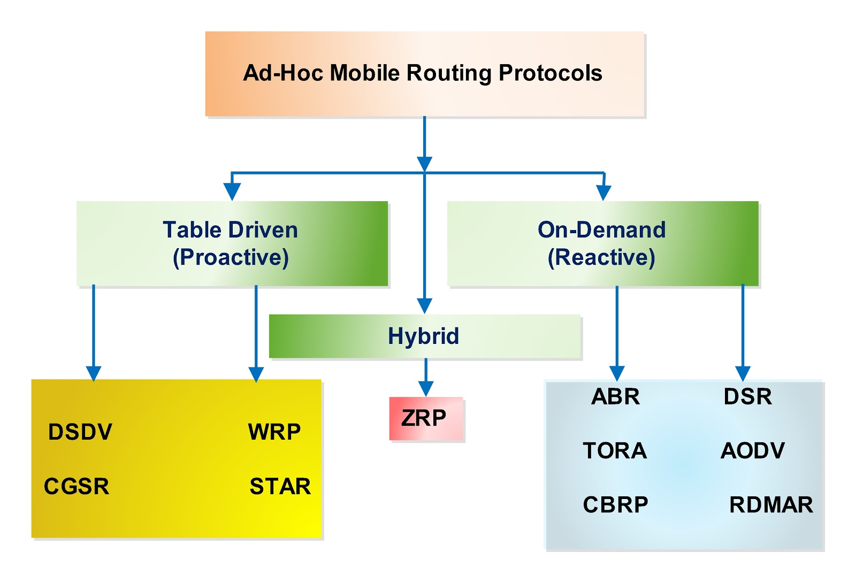
Clasification of Routhing protocol

Slide 4
Table-driven (proactive) routing This type of protocols maintance fresh lists of destinations and their routes by periodically distributhing routing tables thoughout the network. On-demand (reactive) routing This type of protocol finds route on demand by flooding the network with route request packets. Hybried (both proactive and reactive) routing This type of protocol combines the advantages of proactive and reactive routing .The routing is initially established with some proactively prospected routes and serves the demandfrom additionally activated nodes through reactive flooding.

