Slide 1
IBM SKILLSBUILD DATA ANALYTICS WITH AI INTERNSHIP PROJECT
Household Energy Pattern Segmentation and Consumption Prediction Using Machine Learning
Vishwesh Anand · 2024PECML219
Artificial Intelligence and Machine Learning · Panimalar Engineering College

Slide 2



01 — THE SIGNAL
Energy data can reveal recurring household-use states
Historical rhythm
Recurring patterns
Appliance energy consumption changes with time, day, and seasonal conditions.
Machine learning can discover recurring patterns from historical energy data.
Two analytical views
Time, day, and seasonal conditions leave a recognizable structure in appliance energy consumption.
Unsupervised pattern discovery plus supervised next-10-minute prediction.
1
2
3
4
Energy Data
Pattern Discovery
Prediction
Analytical Insights
Household Energy Pattern Segmentation and Consumption Prediction Using Machine Learning
2

Slide 3
02 — THE CHALLENGE
The challenge is to understand and anticipate changing consumption
Consumption varies
Patterns to identify
Across time of day, weekdays and weekends, months and seasons, and environmental conditions.
Identify recurring energy-consumption patterns and understand the characteristics of different consumption states.
Prediction target
Predict appliance consumption for the following 10-minute interval.
Compare models using standard metrics and generate data-driven observations.
Household Energy Pattern Segmentation and Consumption Prediction Using Machine Learning
3

Slide 4
03 — THE WORKFLOW
The project follows an end-to-end machine-learning workflow
Load and explore the dataset.
Check quality, preprocess, and engineer features.
Apply K-Means, evaluate cluster counts, and visualize with PCA.
Build regression models for next-10-minute prediction.
Evaluate, interpret, and summarize energy patterns.
Household Energy Pattern Segmentation and Consumption Prediction Using Machine Learning
4

Slide 5
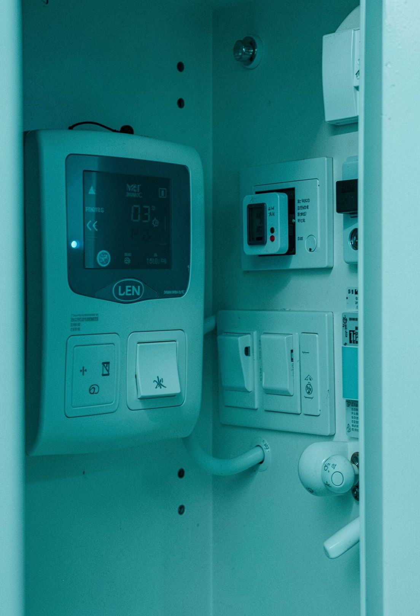
04 — THE DATA
The UCI dataset captures appliance energy every 10 minutes
Source: UCI Machine Learning Repository
Field | What it carries
19,735 observations | Multivariate time series
Time column | date
Target variable | Appliances
Context | Lighting, indoor conditions, and outdoor weather
Variables include lights, T1–T9, RH_1–RH_9, T_out, Press_mm_hg, RH_out, Windspeed, Visibility, Tdewpoint, rv1, and rv2.
Household Energy Pattern Segmentation and Consumption Prediction Using Machine Learning
5

Slide 6
05 — THE STACK
The stack covers the full analytics workflow
Python
pandas
NumPy
Project language.
Data loading and cleaning.
Numerical operations.
Matplotlib and Seaborn
Scikit-learn
Jupyter Notebook / Google Colab
Visual analysis.
Preprocessing, clustering, PCA, regression, and evaluation.
Development and execution environment.
Household Energy Pattern Segmentation and Consumption Prediction Using Machine Learning
6

Slide 7
From raw observations to interpretable energy insights
Data Loading
Data Quality Check
01
02
Cleaning and Preprocessing
Exploratory Data Analysis
03
04
Feature Engineering
Feature Scaling
05
06
K-Means Clustering
Elbow and Silhouette Evaluation
07
08
PCA Visualization
Next-10-Minute Prediction
09
10
Regression Models
Model Evaluation
11
12
Cluster Interpretation
Energy Insights
13
14
Household Energy Pattern Segmentation and Consumption Prediction Using Machine Learning
7

Slide 8
07 — FEATURE ENGINEERING
Time, rolling, and lag features make the data ML-ready
Transformation: Raw Data → Cleaning → Feature Engineering → ML-ready Data.
Cleaning
Feature Engineering
Removed duplicate observations, checked missing values, validated the target, converted date to datetime, and sorted chronologically. Applied IQR-based target outlier filtering.
Created Hour, DayOfWeek, Month, Year, IsWeekend, Quarter, TimeOfDay, and Season. Added Rolling_Mean_24, Rolling_Std_24, Lag_1, and Lag_24.
Household Energy Pattern Segmentation and Consumption Prediction Using Machine Learning
8

Slide 9
08 — EXPLORATORY DATA ANALYSIS
EDA frames the patterns before modeling
Distribution
Time-of-day profile
Calendar and environment
Inspect the distribution of appliance energy consumption.
Compare energy consumption across hours.
Examine weekday versus weekend behavior.
Review monthly and seasonal patterns.
Study relationships with environmental variables through correlation analysis.
Qualitative view · shape and spread
Qualitative view · hourly rhythm
Qualitative view · context and relationships
Use notebook charts if available; otherwise show qualitative chart panels without invented numerical values.
Household Energy Pattern Segmentation and Consumption Prediction Using Machine Learning
9

Slide 10

09 — CLUSTERING
K-Means segments recurring time-based consumption patterns
Select Features
Standardize Data
Evaluate k
Cluster & Interpret
These clusters represent recurring time-based energy-consumption patterns, not ten physically separate households.
FINAL CONFIGURATION · K = 10
Household Energy Pattern Segmentation and Consumption Prediction Using Machine Learning
10

