Slide 1
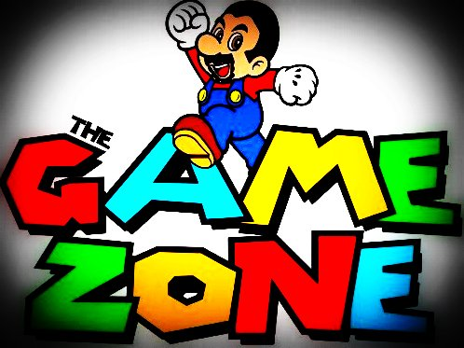
GAME ZONE
BY :-
CyberPunks
Kritika Sharma
Heena Odedra
Milan Pokharna
Priyansha Jain

Slide 2
DATA STRUCTURES USED
HASH SETS
HASH MAPS
ARRAY LISTS

Slide 3
ARRAY LISTS
ArrayList is not synchronized.
ArrayList supports dynamic array which can grow as needed.
Size of ArrayList can be dynamically increased or decreased.
ArrayLists are created with initial size.
In Java, standard arrays are of fixed length. After arrays are
created, they cannot grow or shrink means you must know
in advance how many elements an array will hold.
ArrayList can contain duplicate elements.
ArrayList maintains insertion order of the elements.
Retrieval is random access because array works at index basis.

Slide 4
HASH SETS
The important points about Java HashSet class are:
HashSet stores the elements by using a mechanism called hashing.
HashSet contains unique elements only.
Difference between List and Set
List can contain duplicate elements whereas Set contains unique elements only.

Slide 5
HASH MAPS
The important points about Java HashMap class are:
A HashMap contains values based on the key.
It contains only unique elements.
It may have one null key and multiple null values.
It maintains no order.

Slide 6
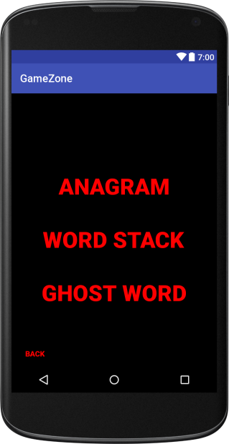
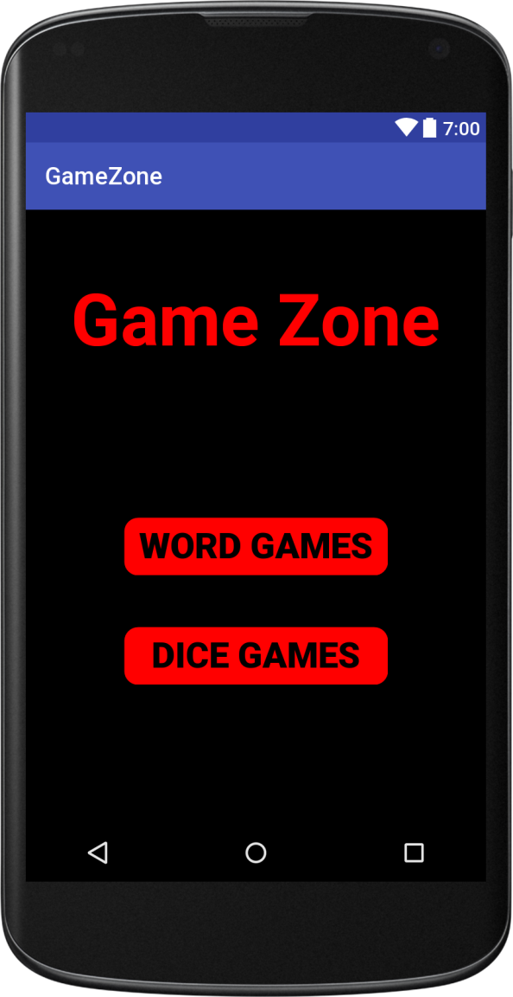
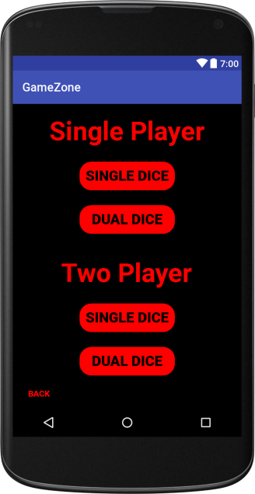
ABOUT APP
This app is a Combination of all the apps that we’ve learnt in Applied CS with Android Workshop.
WORD GAMES
DICE GAMES

Slide 7
WORD GAMES
ANAGRAM
WORD STACK
GHOST WORD

Slide 8
ANAGRAM
An anagram is a word formed by rearranging the letters of another word.
For example, cinema is an anagram of iceman.
MECHANICS OF THE GAME
The game provides the user with a word from the dictionary.
The user tries to create as many words as possible that contain all the letters of the given word plus one additional letter. Note that adding the extra letter at the beginning or the end without reordering the other letters is not valid. For example, if the game picks the word 'ore' as a starter, the user might guess 'rose' or 'zero' but not 'sore'.
3. The user can give up and see the words that they did not guess.

Slide 9
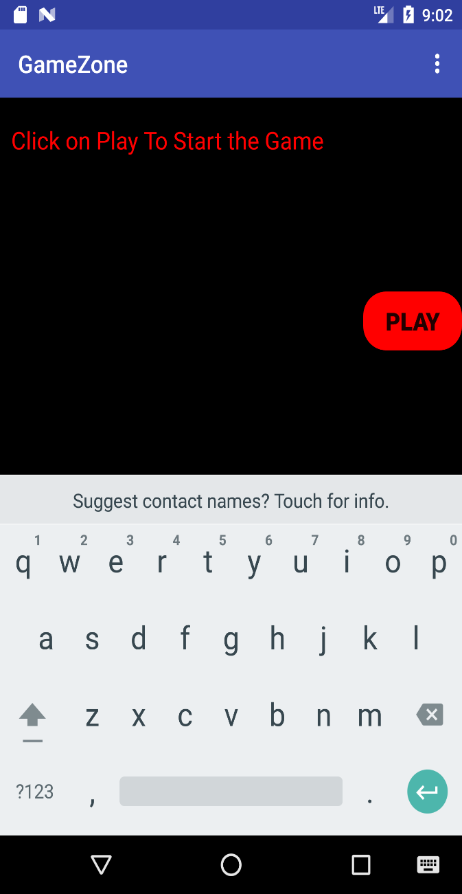
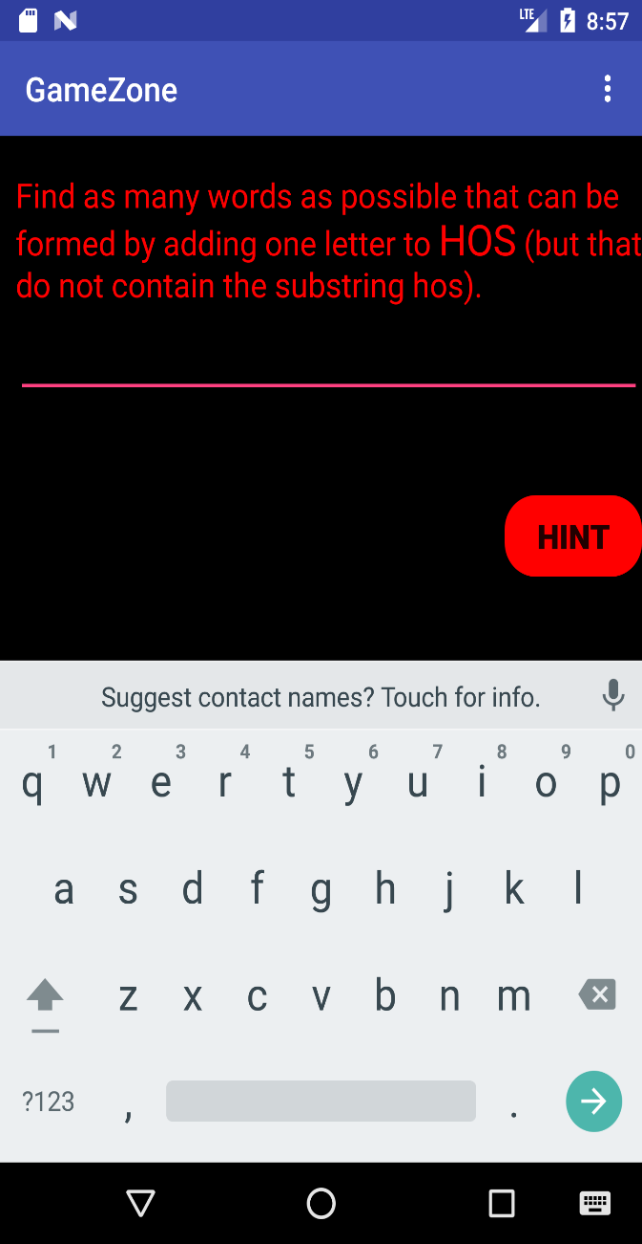
THE GAME LOOKS AS :

Slide 10
WORD STACK
The idea of the game is to try to separate out two words of the same length whose letters have been scrambled .
(But the order of the letters has been preserved).
MECHANICS OF THE GAME
The Game provides the user a jumbled word of 6 Letters.
There are 2 White boxes, where User tries to reform the Words by dragging and dropping the letter tiles .
When user places all the tiles , Computer shows the correct two words.

Slide 11
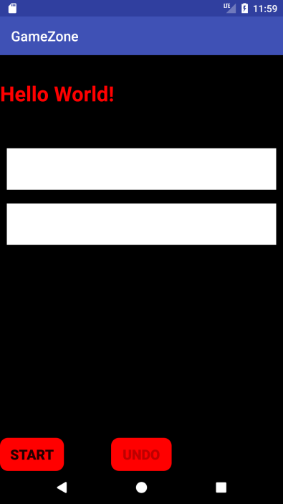
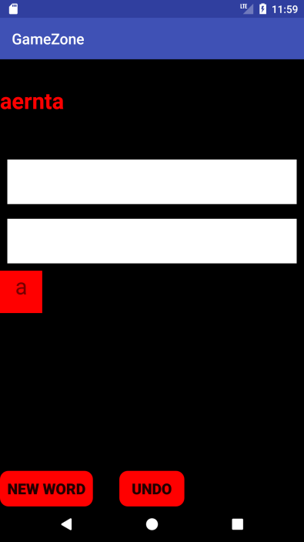
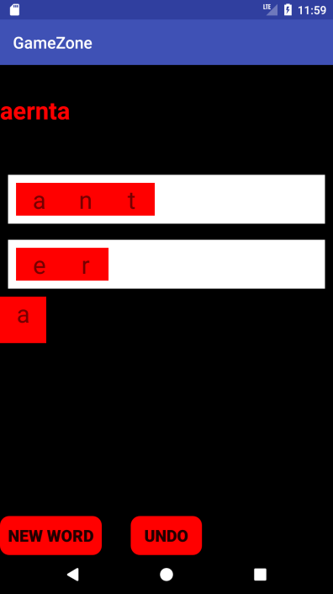
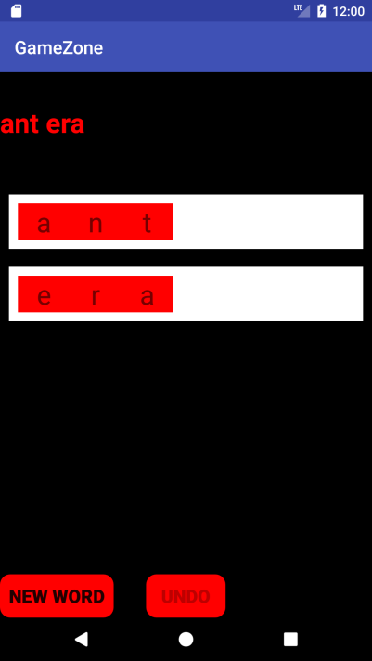
THE GAME LOOKS AS :
On clicking “NEW WORD” , it again throws a New Jumbled Word .

Slide 12
GHOST GAME
Ghost is a word game in which players take turns adding individual letters to a growing word fragment, trying not to be the one to complete a valid word. The player who completes a word or creates a fragment that is not the prefix of a word loses the round.
MECHANICS OF THE GAME
On player 1’s Chance… Player 1 can :
Challenge player 2's word if they think player 2 has formed a valid word of at least 4 letters. If the fragment is a word, then player 1 wins; if the fragment is not a word, then player 2 wins.
Challenge player 2's word if they think that no word can be formed with the current fragment. Then, player 2 must provide a valid word starting with the current fragment or lose.
Add a letter to move the fragment towards a valid word.
Attempt to bluff player 2 by adding a letter that doesn't move the fragment towards a valid word.

Slide 13
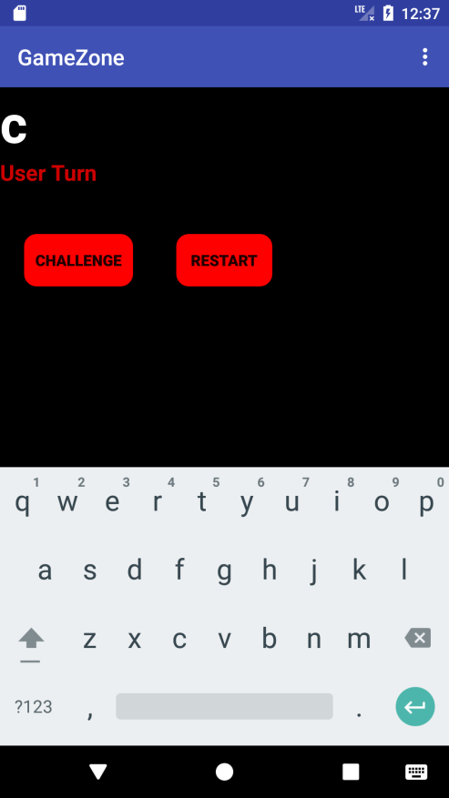
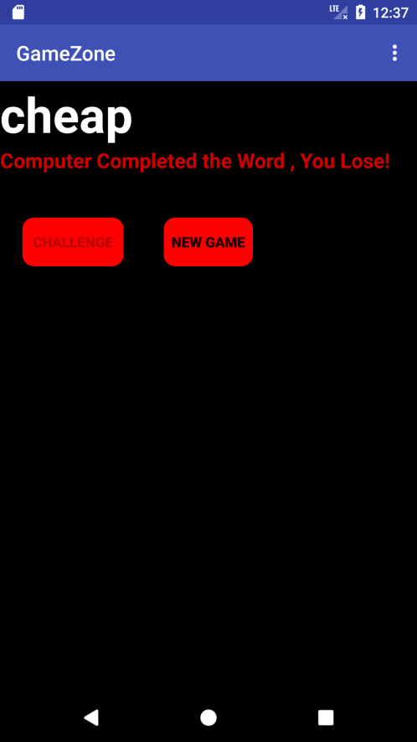
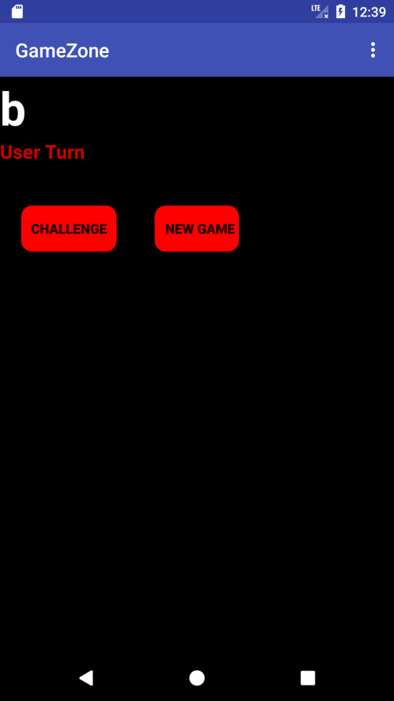
THE GAME LOOKS AS :
NEW GAME

Slide 14
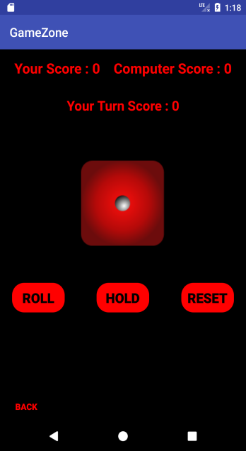
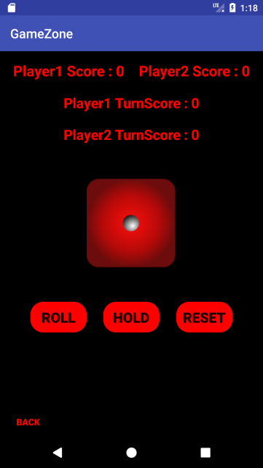

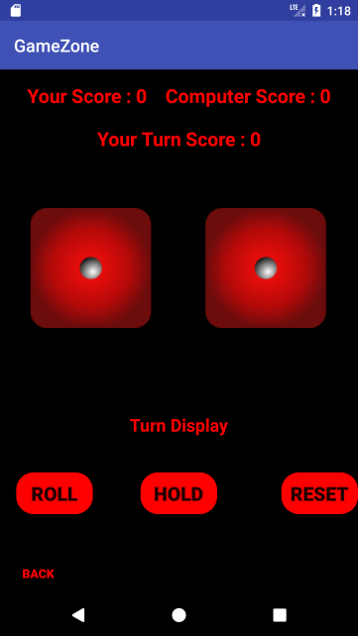
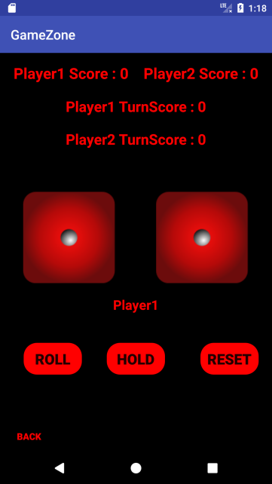
DICE GAMES
SINGLE DICE
SINGLE PLAYER
DUAL PLAYER
DUAL DICE

Slide 15
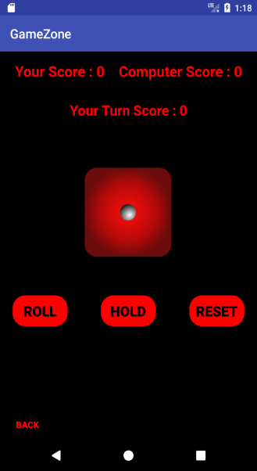

SINGLE SCARNE’S DICE
MECHANICS OF THE GAME
Scarne’s Dice is a turn-based dice game where players score points by rolling a die and then:
If they roll a 1, score no points and lose their turn
If they roll a 2 to 6:
add the rolled value to their points
choose to either reroll or keep their score and end their turn
The winner is the first player that reaches (or exceeds) 100 points.

Slide 16
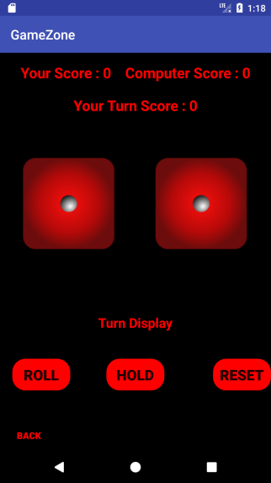

DUAL SCARNE’S DICE
MECHANICS OF THE GAME
In this version, two standard dice are rolled:
If neither shows a 1, their sum is added to the turn total
If a single 1 is rolled, the player scores nothing and the turn ends
If two 1s are rolled, the player’s entire score is lost, and the turn ends
If a double is rolled, the point total is added to the turn total as with any roll but the player is obligated to roll again.
The winner is the first player that reaches (or exceeds) 100 points.

Slide 17
THANK YOU ☺

