Slide 1
Parallelizing Class Imbalance Problem Using SMOTE
CLIP: Class Imbalance Problem Parallelization
Avik Dhupar (ad3910)
Angad Nandwani (an3077)
EECS E4750 Hybrid Computing for Signal and Data Processing, Fall 2021

Slide 2
Summary
In Classification Problems using Machine Learning, a dataset may have multiple classes but their sizes could be in different ratio.
For example, let’s assume a dataset where we are trying to classify a student into 3 categories:
“Good”,
“Better”
“Best”
If the training set has many rows for the categories “Good” and “Better” but only few rows which belong to category “Best”, then this problem becomes a class imbalance problem in machine learning
A model trained on this imbalanced dataset will only be able to learn “Good” and “Better” classes perfectly but will lack learning the class “Best” significantly.
Hence, the predictions also will only belong to classes “Good” and “Better” and will not have “Best” Category. To solve this, we use SMOTE: Synthetic Minority Oversampling TEchnique
SMOTE - It is a technique to create more data samples for the minority classes which is in this case “BEST” class. It will synthesize more data points in the dataset which belongs to the minority class making sure that the dataset have rows which have equal proportion of the classes

Slide 3
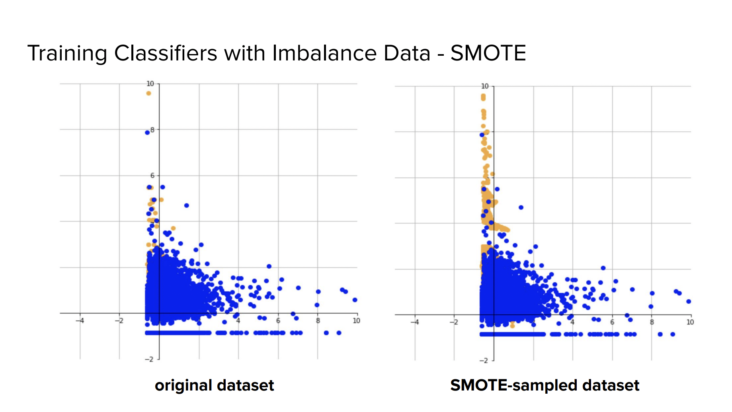
Courtesy: Prof. Vijay Pappu - Applied Machine Learning

Slide 4
Parallelization Aspects of the Problem
SMOTE - Synthetic Minority Oversampling Technique
Uses k-nearest neighbor & Vector Distance algorithm to compute synthetic samples which belong to the minority class.
For this project, we will be parallelizing the following algorithms using GPU
k-Nearest Neighbor is a technique in machine learning to associate a category to a datapoint based on it’s k-nearest neighbors
Vector Distance is a technique to impute distance between 2 points in n-dimension space (We will use Euclidean distance metric for calculating distance between 2 points)

Slide 5
Key Prior Art, References
SMOTE-GPU: Big Data preprocessing on commodity hardware for imbalanced classification [1]
[1] Gutiérrez, P.D., Lastra, M., Benítez, J.M. et al. SMOTE-GPU: Big Data preprocessing on commodity hardware for imbalanced classification. Prog Artif Intell 6, 347–354 (2017)
[2] N. V. Chawla et al, "SMOTE: Synthetic Minority Over-sampling Technique," The Journal of Artificial Intelligence Research, vol. 16, pp. 321-357, 2002
Keywords: Smote + Gpu | Cuda | Parallel processing

Slide 6
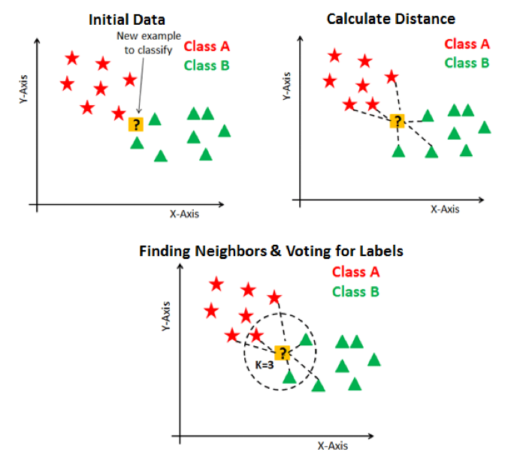
Smote Technique - Core Algorithms
K-Nearest Neighbor & Vector Distance
Here in this problem we have 2 classes, and we need to find the class for the unknown point.
We started this problem by finding the vector distance between the unknown points with all the samples in the dataset.
Now we have all the distances measured between this unknown point and all other points in the sample. So, for K=3 (randomly selected), we picked 3 nearest points to this unknown point. We noticed that 2 out of 3 points belong to class B and hence by majority vote, the unknown point was classified as Class B.

Slide 7
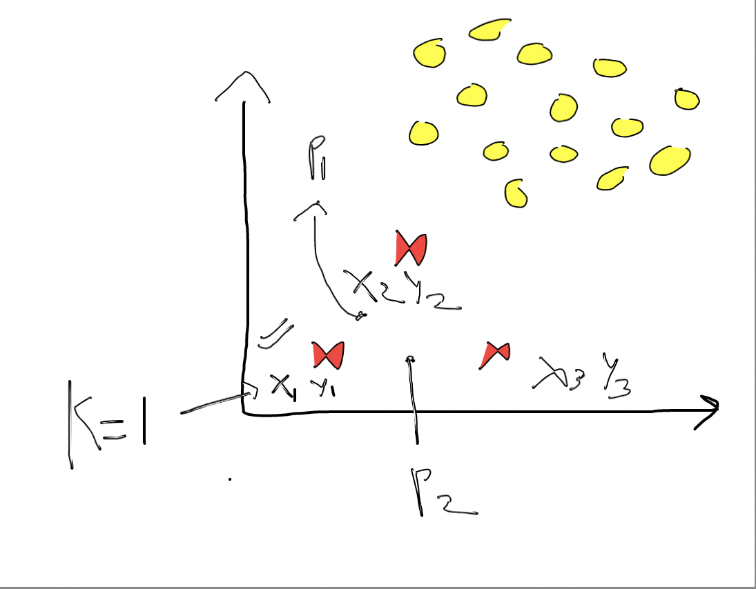
Smote Technique
The minority classes in the dataset are synthesized based on KNN and Vector Distance Algorithm.
Example:
Assume we have 100 million data points which are segregated into 2 classes “Yes” and “No”
90 million data points in class “NO”
10 million data points in class “YES”
We can use SMOTE (which internally uses k-Nearest Neighbor and Vector Distance) to synthesize 40 million more samples for the data points which belong to class “YES”

Slide 8
Detailed Description - Why
For solving this class imbalance problem, we are using vector distance as the metric, to impute distance of one point with all the other points in the sample. Calculating distance of one point with all the other points and repeating the same for all data points in the sample, makes it of the order of N^2 which is very very slow computation.
Also, once we have the distance, based on the value of “K”, we have to synthesize new data points from each data point. This process is also time taking if done serially as there can be large number of samples which we want to synthesize.
Hence parallelizing both K-NN and Vector Distance will be very efficient in solving the class imbalance problem.

Slide 9
Detailed Description - How
Calculating distance between all the minority samples - 5 minority samples
 | X1 | X2 | X3 | X4 | X5 | Class
1 | 1 | 3 | 4 | 5 | 4 | Yes
2 | 4 | 3 | 2 | 5 | 7 | Yes
3 | 5 | 9 | 2 | 8 | 6 | Yes
4 | 1 | 2 | 4 | 6 | 7 | Yes
5 | 6 | 5 | 6 | 7 | 2 | Yes
 | 1 | 2 | 3 | 4 | 5
1 | D11 | D12 | D13 | D14 | D15
2 | D21 | D22 | D23 | D24 | D25
3 | D31 | D32 | D33 | D34 | D35
4 | D41 | D42 | D43 | D44 | D45
5 | D51 | D52 | D53 | D54 | D55
Dij - Distance between ith and jth point

Slide 10
Detailed Description - How
Thread 1,2,3...25
Calculating distance between all the minority samples
 | X1 | X2 | X3 | X4 | X5 | Class
1 | 1 | 3 | 4 | 5 | 4 | Yes
2 | 4 | 3 | 2 | 5 | 7 | Yes
3 | 5 | 9 | 2 | 8 | 6 | Yes
4 | 1 | 2 | 4 | 6 | 7 | Yes
5 | 6 | 5 | 6 | 7 | 2 | Yes
 | 1 | 2 | 3 | 4 | 5
1 | D11 | D12 | D13 | D14 | D15
2 | D21 | D22 | D23 | D24 | D25
3 | D31 | D32 | D33 | D34 | D35
4 | D41 | D42 | D43 | D44 | D45
5 | D51 | D52 | D53 | D54 | D55
Input Matrix
Vector Distance Matrix
Dij - Distance between ith and jth point

Slide 11
Detailed Description - How
Now we have the Distances between the Samples. Now we want to find various points based on varying “K”
 | 1 | 2 | 3 | 4 | 5
1 | D11 | D12 | D13 | D14 | D15
2 | D21 | D22 | D23 | D24 | D25
3 | D31 | D32 | D33 | D34 | D35
4 | D41 | D42 | D43 | D44 | D45
5 | D51 | D52 | D53 | D54 | D55

Slide 12
Detailed Description - How
Now we have the Distances between the Samples. Now we want to find various points based on varying “K”
K=1
So, for k=1, let’s assume following nearest neighbor based on distance
For point 1, nearest neighbor is 3
For point 2, nearest neighbor is 5
For point 3, nearest neighbor is 2
For point 4, nearest neighbor is 1
For point 5, nearest neighbor is 2
 | 1 | 2 | 3 | 4 | 5
1 | D11 | D12 | D13 | D14 | D15
2 | D21 | D22 | D23 | D24 | D25
3 | D31 | D32 | D33 | D34 | D35
4 | D41 | D42 | D43 | D44 | D45
5 | D51 | D52 | D53 | D54 | D55

Slide 13
Detailed Description - How
Now we have the Distances between the Samples. Now we want to find various points based on varying “K”
K=1
So, for k=1, let’s assume following nearest neighbor based on distance
For point 1, nearest neighbor is 3
For point 2, nearest neighbor is 5
For point 3, nearest neighbor is 2
For point 4, nearest neighbor is 1
For point 5, nearest neighbor is 2
 | 1 | 2 | 3 | 4 | 5
1 | D11 | D12 | D13 | D14 | D15
2 | D21 | D22 | D23 | D24 | D25
3 | D31 | D32 | D33 | D34 | D35
4 | D41 | D42 | D43 | D44 | D45
5 | D51 | D52 | D53 | D54 | D55
Point 6
Point 7
Point 8
Point 9
Point 10
Point 6 = Avg of Features for Point 1 & Point 6

Slide 14
Detailed Description - How
Now we have the Distances between the Samples. Now we want to find various points based on varying “K”
Thread 1
 | X1 | X2 | X3 | X4 | X5 | Class
1 | 1 | 3 | 4 | 5 | 4 | Yes
3 | 5 | 9 | 2 | 8 | 6 | Yes
 | 1 | 2 | 3 | 4 | 5
1 | D11 | D12 | D13 | D14 | D15
2 | D21 | D22 | D23 | D24 | D25
3 | D31 | D32 | D33 | D34 | D35
4 | D41 | D42 | D43 | D44 | D45
5 | D51 | D52 | D53 | D54 | D55
Point 6
Shared Memory
Result
 | X1 | X2 | X3 | X4 | X5 | Class
6 | ? | ? | ? | ? | ? | Yes
Point 6 = Avg of Features for Point 1 & Point 6

Slide 15
Detailed Description - How
Now we have the Distances between the Samples. Now we want to find various points based on varying “K”
K=2
So, for k=2, let’s assume following nearest neighbor based on distance
For point 1, nearest neighbor is 3 and 5
For point 2, nearest neighbor is 5 and 1
For point 3, nearest neighbor is 2 and 4
For point 4, nearest neighbor is 1 and 5
For point 5, nearest neighbor is 2 and 4
 | 1 | 2 | 3 | 4 | 5
1 | D11 | D12 | D13 | D14 | D15
2 | D21 | D22 | D23 | D24 | D25
3 | D31 | D32 | D33 | D34 | D35
4 | D41 | D42 | D43 | D44 | D45
5 | D51 | D52 | D53 | D54 | D55
Point 11
Point 12
Point 13
Point 14
Point 15

Slide 16
Example for Input Size: 5
Vector Distance Output:
[[0. 4.61 .30 3.31 6.40 ]
[4.61 0. 6.85 3.87 7.28 ]
[.30 6.85 0. 8.60 7.08 ]
[3.31 3.87 8.60 0. 8. ]
[6.40 7.28 7.08 8. 0. ]]
Input Matrix
[[1. 3. 4. 5. 4.]
[4. 3. 2. 5. 7.]
[5. 9. 2. 8. 6.]
[1. 2. 4. 6. 7.]
[6. 5. 6. 7. 2.]]
Shape of Input Matrix= (5, 5)
K=2
New Points For the Matrix Through KNN Algorithm
[[1. 2.5 4. 5.5 5.5]
[2.5 2.5 3. 5.5 7. ]
[4.5 6. 2. 6.5 6.5]
[1. 2.5 4. 5.5 5.5]
[3.5 4. 5. 6. 3. ]
[2.5 3. 3. 5. 5.5]
[2.5 3. 3. 5. 5.5]
[5.5 7. 4. 7.5 4. ]
[2.5 2.5 3. 5.5 7. ]
[5.5 7. 4. 7.5 4. ]]
Shape of Output Matrix = (10, 5)

Slide 17
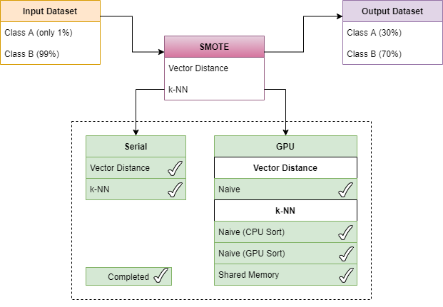
Current Implementation Status

Slide 18
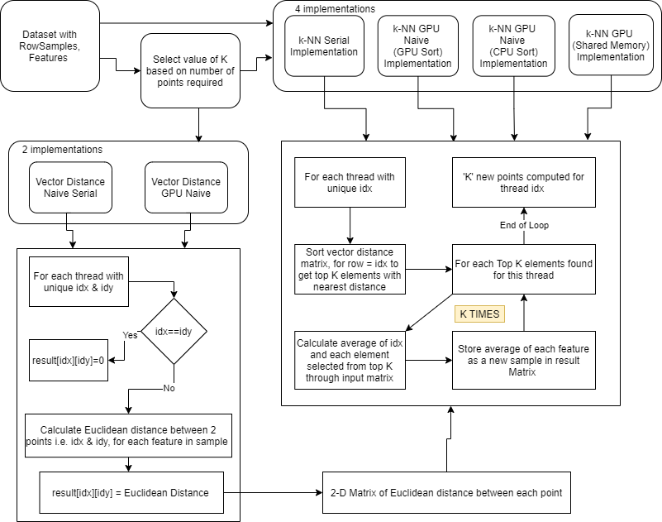
Flowchart

Slide 19
Pseudo-code for Kernel - Vector Distance
Invocation of Kernel
If rowsCount * rowsCount <=1024
Invoke threads in both X & Y with blockSize_X = blockSize_Y=rowsCount and GridSize_X = Grid_Size_Y= 1
Else
Invoke threads in both X & Y with blockSize_X = blockSize_Y=32 and GridSize_X = Grid_Size_Y= math.ceil(rowsCount/32)
Algorithm
For each thread with unique idx & idy
If(idx & idy <=rowsCount && idx!=idy)
With this particular thread, we need to impute distance between Row Indices - “idx” and “idy”
For each feature in the sample, calculate the euclidean distance. Example - D12 , represented by idx=1 and idy=2 with 5 features will be imputed as follows :-
Store the euclidean distance in result matrix at the position - “idx*rowsCount+idy”
Else if(idx==idy)
Store 0.0 to result at the position - “idx*rowsCount+idx”

Slide 20
Pseudo-code for Kernel - knn
Invocation of Kernel
If rowsCount <=1024
Invoke threads in X with blockSize_X =rowsCount and GridSize_X = 1
Else
Invoke threads in X with blockSize_X = 1024 and GridSize_X= math.ceil(rowsCount/1024)
Algorithm
For each thread with unique idx, if it is less than rowsCount
First step will be to impute k-nearest neighbor for this sample
For this, we have first sorted the entire row of features for this sample, and picked “first K” from the result. We have tried sorting in both CPU and GPU and hence we have 2 variants for the Naive Version of Knn
For each point in the top K selected Points
Calculate the average of each features between the samples selected i.e. idx and Kth Point.
Store the average obtained for each feature as the new Sample in the result matrix.
On Completion, K new points will be generated for a given idx and stored in the result matrix.

Slide 21
Results
Number of Rows | Vector Distance CPU Naive (ms) | Vector Distance GPU Naive (ms) | k-NN CPU Naive (ms) | k-NN GPU Naive (ms) | k-NN GPU (CPU Sort) (ms) | Knn Gpu Shared (ms)
64 | 28.07 | 2.086 | 8.192 | 3.922 | 3.567 | 1.025
256 | 441.469 | 2.915 | 68.781 | 24.115 | 48.985 | 24.047
1024 | 7306.5 | 31.242 | 964.638 | 465.625 | 859.034 | 371.749
2048 | 28304.937 | 124.387 | 3850.55 | 1926.440 | 3532.538 | 1911.049
4096 | 113108.70 | 461.8450 | 15462.044 | 8273.1103 | 14616.88 | 8273.375
8192 | 463131.68 | 1413.88 | 63622.26 | 39773.44 | 61138.83 | 39557.10

Slide 22
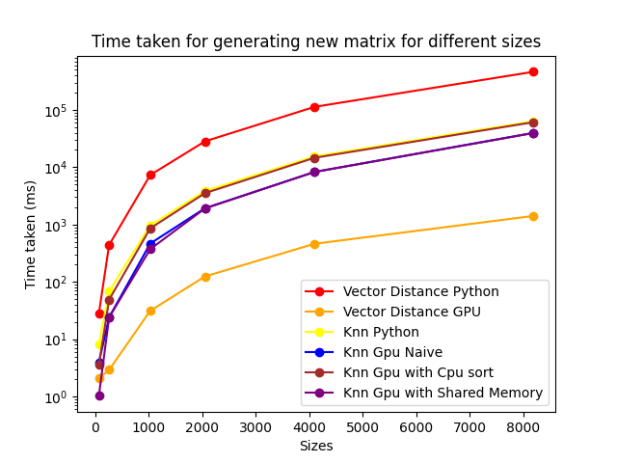
Results

Slide 23
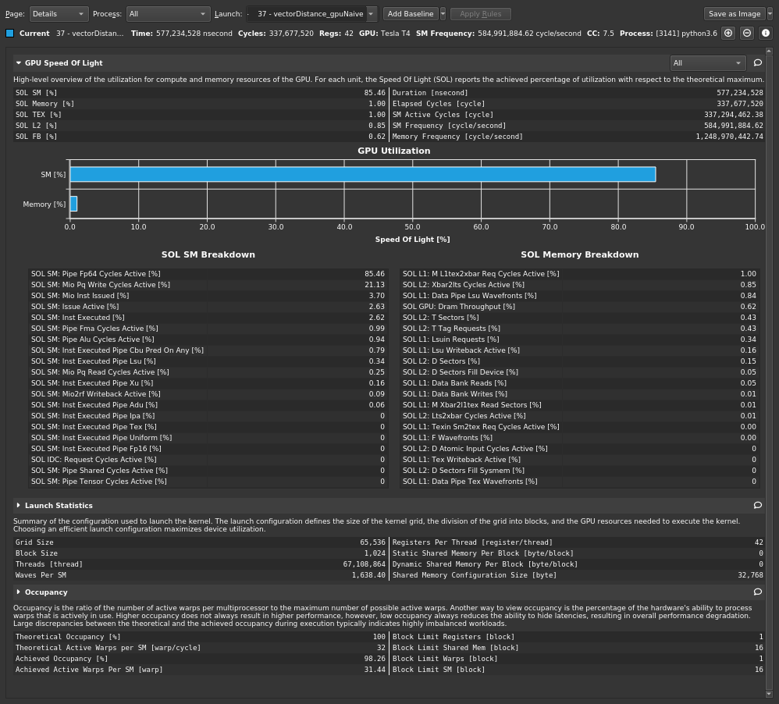
Profiling Results - Vector Distance Naive GPU

Slide 24
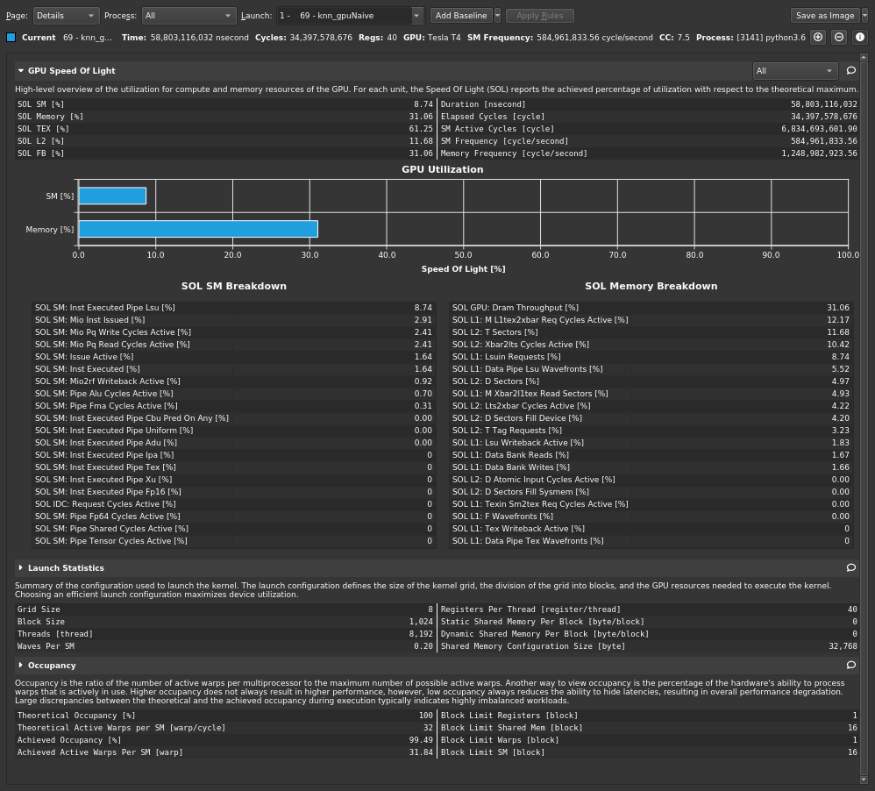
Profiling Results - K-NN Naive GPU

Slide 25
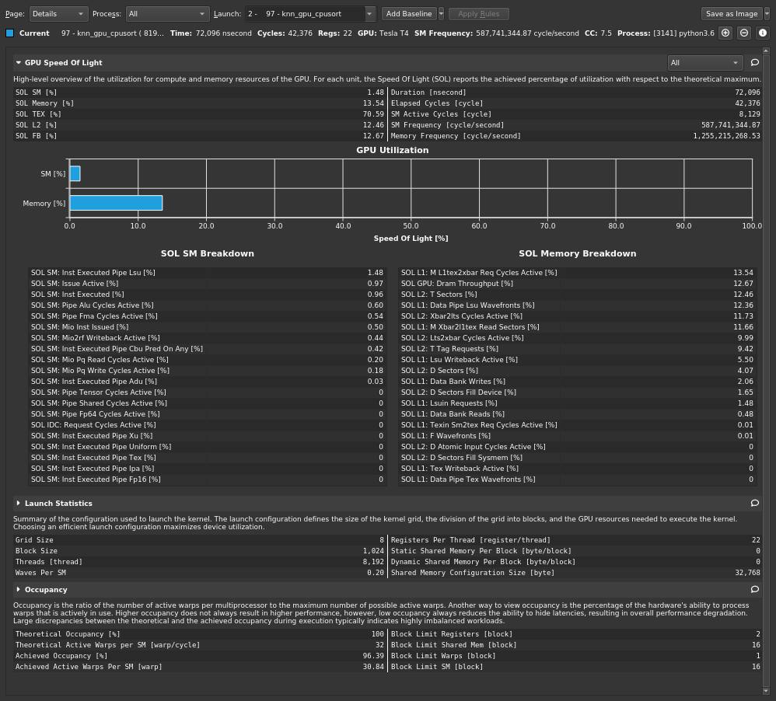
K-NN GPU - CPU SORT

Slide 26

K-NN GPU Shared

Slide 27
Potential Future Work
Implement Vector Distance variant for the shared memory
For k-nn shared memory implementation, we can write a logic to calculate the points with maximum hit, which we can store as part of shared memory elements, rather than randomly storing points in the shared memory.
Observe the functionality of SMOTE for a dataset in Machine Learning Pipeline.

Slide 28
References
https://www.datacamp.com/community/tutorials/k-nearest-neighbor-classification-scikit-learn
SMOTE-GPU: Big Data preprocessing on commodity hardware for imbalanced classification | SpringerLink
k-nearest neighbors algorithm - Wikipedia
Linear regression - Wikipedia
ML Studio (classic): SMOTE - Azure | Microsoft Docs
AI, C.X., 2005. GPU Gems 3
Kirk, D. and Wen-Mei, W.H., 2016. Programming massively parallel processors: a hands-on approach. Morgan kaufmann

