Slide 1
Data Issues
Data issues identified fall into below categories
Data issue description
Features like card_present_flag, merchant_id, merchant_suburb, merchant_state, merchant_long_lat have 36% missing values. For transaction types: Salary credit & interbank transfers. This makes sense as merchant/POS is not involved here.
Features like bpay_biller_code, merchant_code have 93% missing values.
Presence of outliers: Example, ~2.7% data points beyond mean +/- 3 sigma limit for average amount spent per day.
Multi-level categorical variables like ‘txn_description’ need to be encoded into categorical variables with just 2 levels, 0 or 1.
Average frequency, amount of transactions has very high variability at individual customer & merchant level. Some customers would be outliers based on their economic status, transaction behavior and might need to be normalised for generic trend predictions.
Daily amount spent data has spikes in mid Oct’18 which exactly coincides with visit of British Prince & Wife, probably a significant event.
The seasonality in data means we should be careful while sampling data for training and testing. If any of the training/testing/validation set is captured from a specific season/trend-bucket, it will not represent the population appropriately and will undermine performance of any model built using it.
Only 3 month data will not be able to capture long range trend in remaining months of the year & across years.
Missing values
Multi-level categorical variables need binning
Seasonality
High variability
Outliers

Slide 2
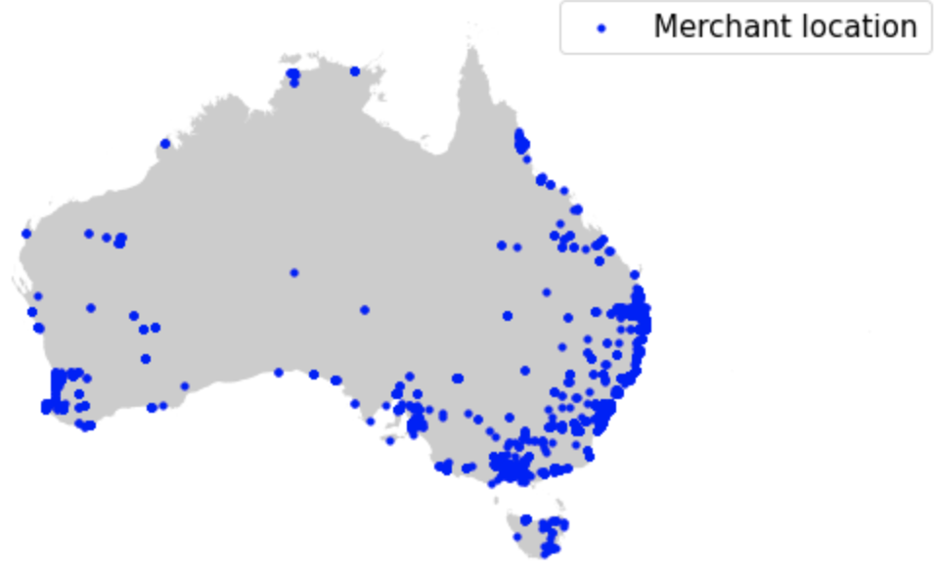
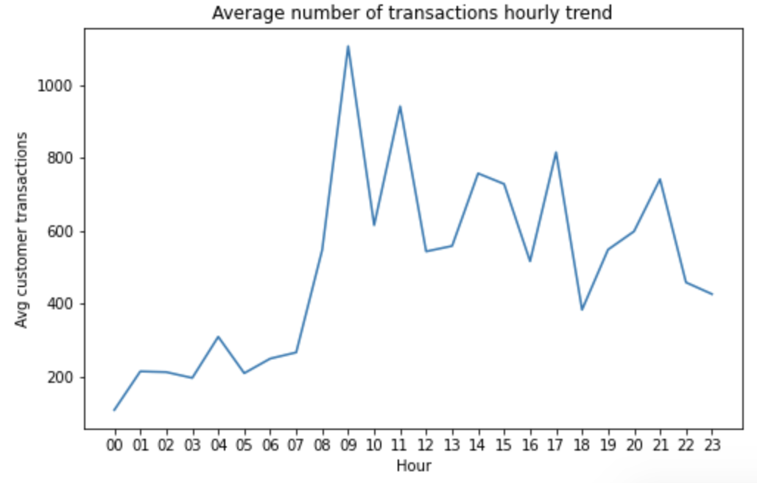
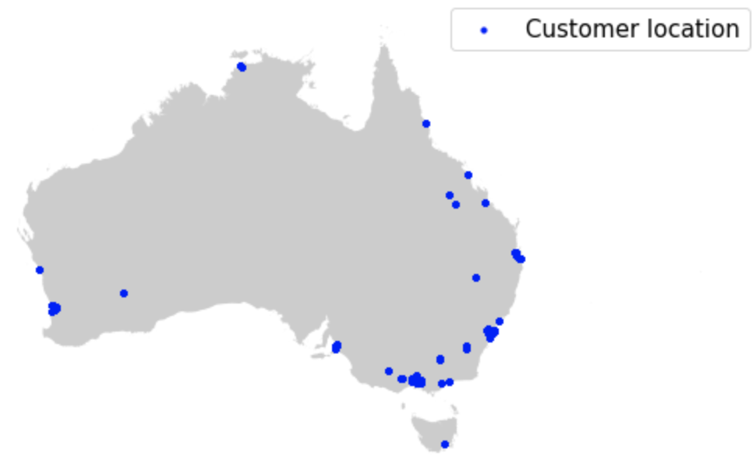
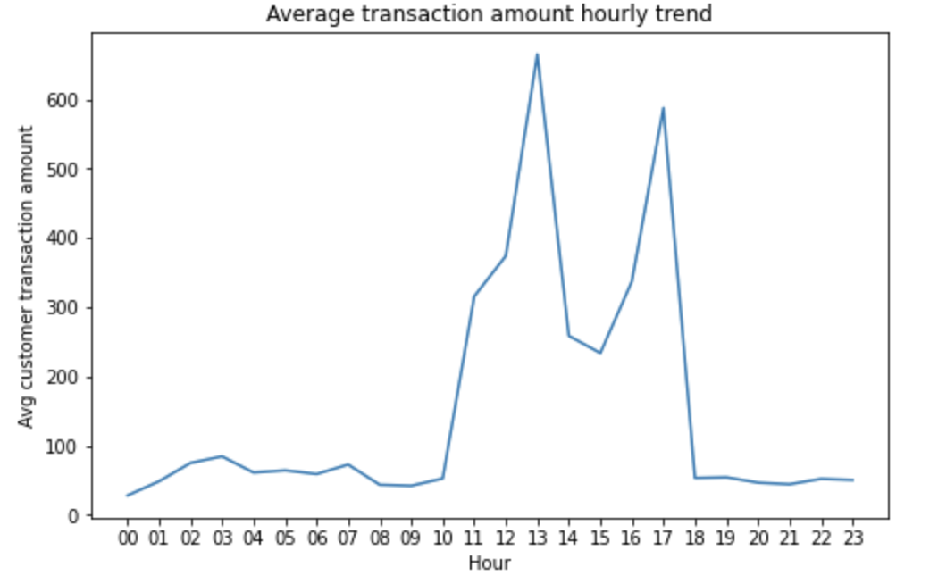
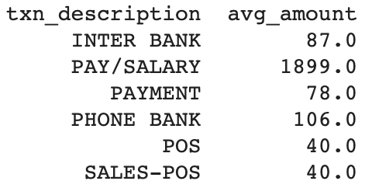
Insights - Generic, Geo-spatial data & intraday transaction trend
Generic Insights
Insights from Geo-spatial data
Intraday customer behavior trend
Average amount spent by Men is $206 vs $169 by Women. Average transaction amount is $188.
Average transactions per customer per month: 40
Average number of transactions per customer per month across transaction types
Inter bank | 2
Pay/Salary | 3
Payment | 9
Phone Bank | 0
PoS | 13
Sales-PoS | 13
Most of merchants are located on east & south-west coast.
Number of transactions spikes in morning (8-10am) with a gradually tapering trend.[Useful for: server load balancing]
Average transaction amount across different transactions
Most of ANZ’s customer are located on south - east coast.
Customer & Merchant geo-locations provide us with locations for marketing campaign targeting & integration/selling efforts.
Median distance between customer and merchants is 16 Kms versus mean distance at 1050 Kms, this means bulk of transactions by customer are done under 16 km radius of customer location (from local merchants), however, online transactions are preferred over long distances (driving mean higher).
Customers do their highest amount transactions in afternoon/lunch-time. [Useful for: Offers & promotions.]
$ = Australian Dollar (AUD)

Slide 3
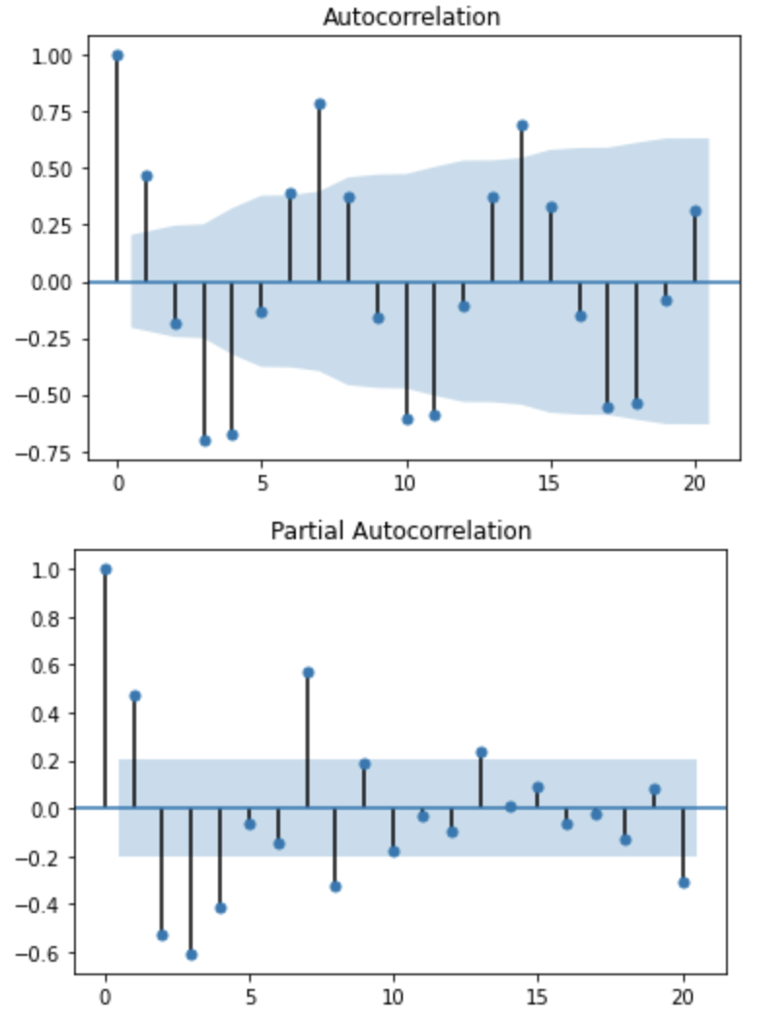
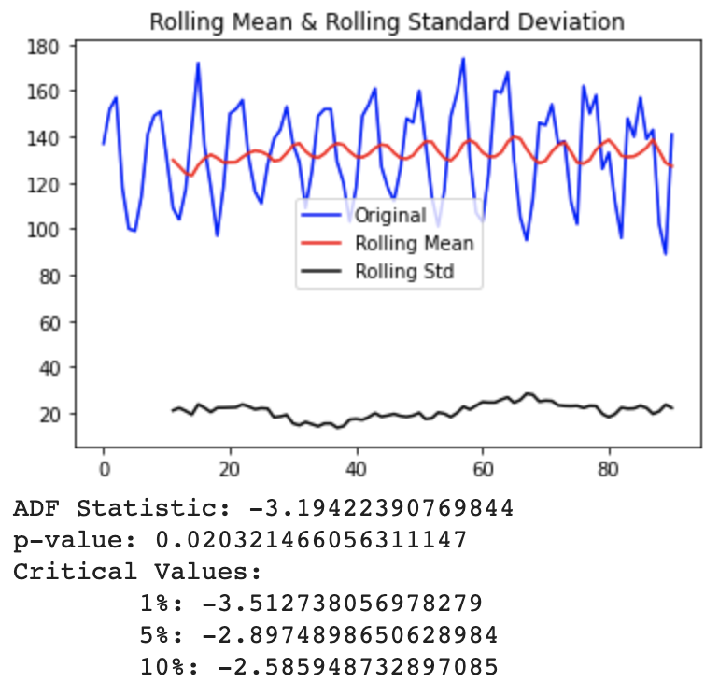
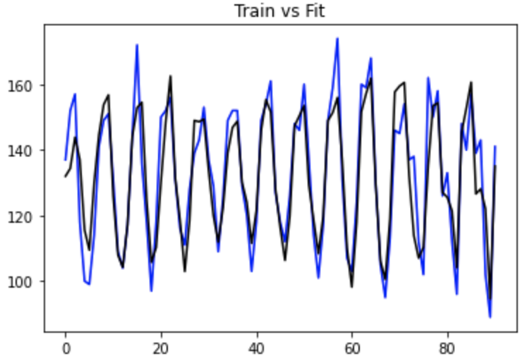
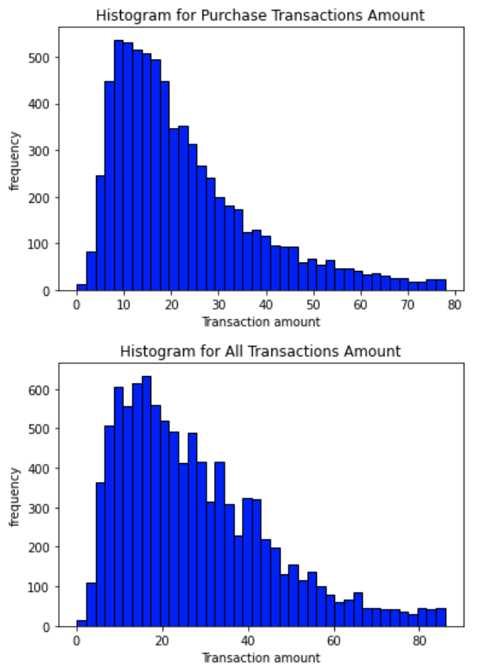
Insights - Customer’s Daily Transaction Volume Trend [Customers have fixed, predictable number of expenses daily]
Given strong auto-correlation & stationarity of the customer daily transaction volume,transaction behavior of customer is highly predictable over short range.
The plot for number of transactions on any given day and it’s rolling average mean are stationary** in nature. That is, there mean doesn’t change over time, which indicates that customer’s transaction volumes are predictable and oscillates (due to weekly seasonality) around a stable rolling mean.
**ADF of -3.2 < Critical value @ 5%. P value is also less than 0.05.
Highest number of transactions are done on Fridays & lowest on Mondays.
Number of transactions on any given day has autocorrelation at 7 days interval. That is, customers tends to do repetitive number of transactions on particular days of the week. Owing to repetitive services/utility bill cycles, food replenishment due to fixed consumption pattern.

Slide 4
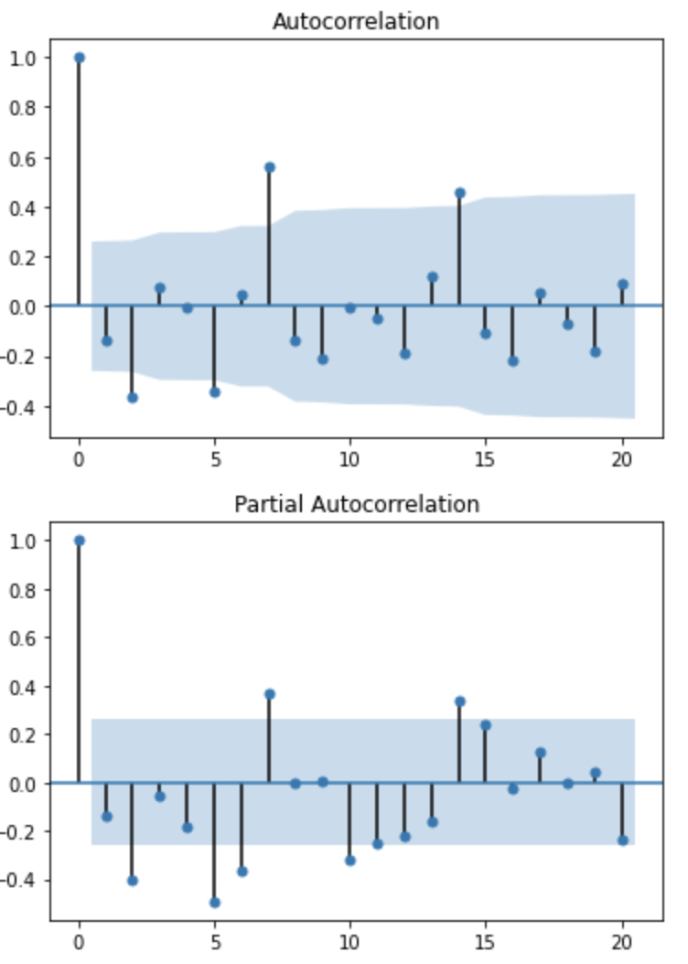
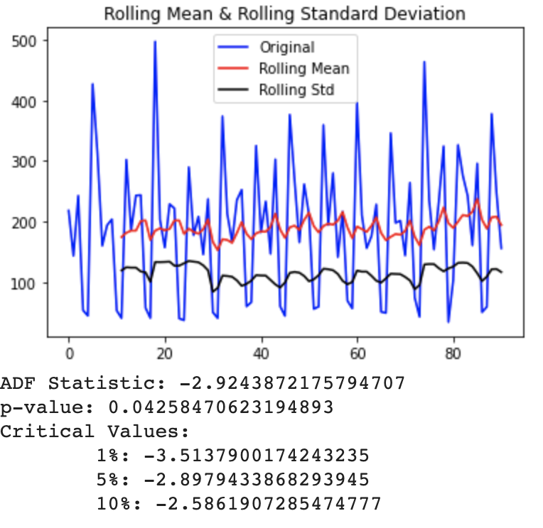
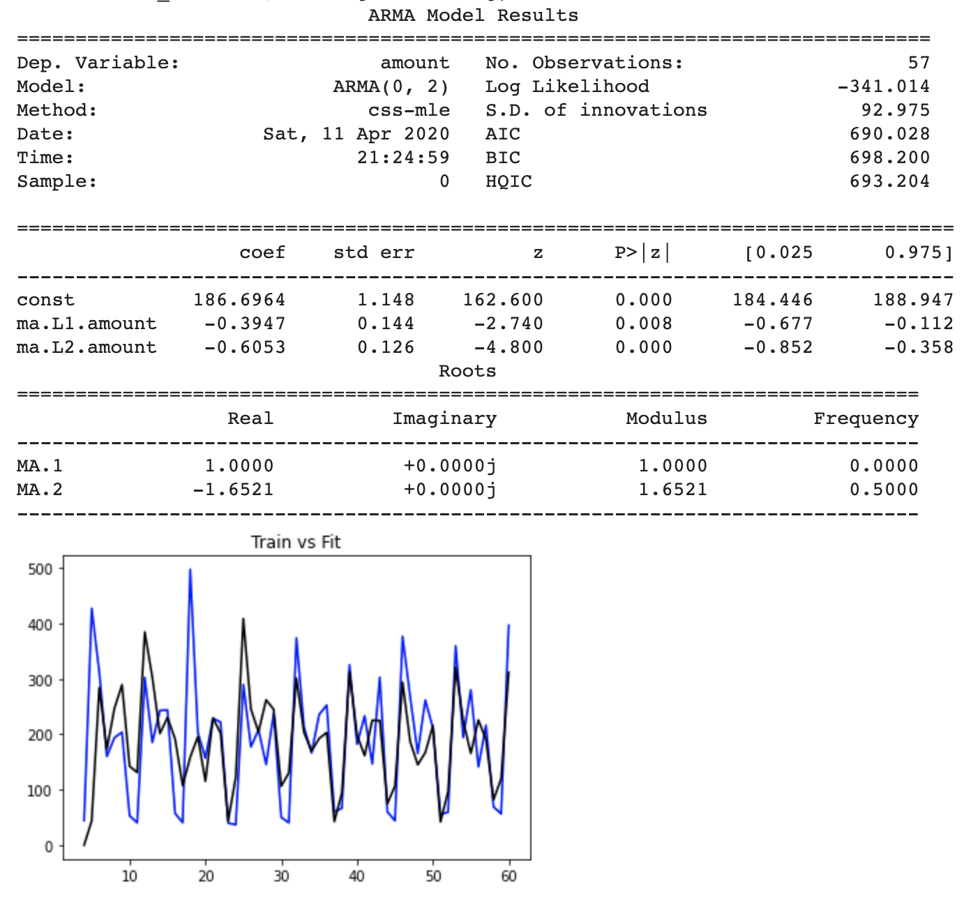
Insights - Customer Transaction Amount Spent daily Trend [Customers have fixed, predictable daily expenses]
outlier/event
The average daily spent plot and rolling average mean for customer’s spent are stationary** in nature. That is, there mean doesn’t change over time, which indicates that customer’s spent are predictable and oscillates (due to weekly seasonality) around a stable rolling mean.
**ADF of -2.9 < Critical value @ 5%. P value is also less than 0.05.
The lowest spent amount is on Sundays & highest spent on Mondays.
Average transaction amount has autocorrelation at 7 days interval. That is, the spent on coming Sunday is correlated to what customer spent on last Sunday, similar trend is observed for other days of the week.
Given strong auto-correlation & stationarity of the customer spent, the transaction behavior of customer is highly predictable over short range.

