Slide 1
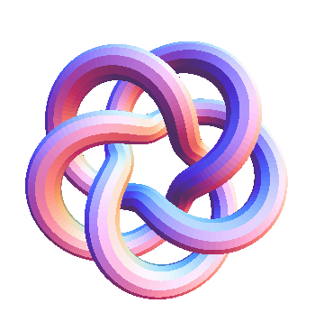
An Untangled Introduction to Knot Theory
Ana Nora Evans
University of Virginia Mathematics
12 February 2010

Slide 2
Why study knots?
Used in
Biology
Chemistry
Physics
Graph Theory
…..
Rule Asia
Notes:
Pause at the end.

Slide 3
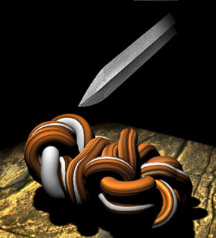
Gordian Knot
“… Seeing Gordius, therefore, the people made him king. In gratitude, Gordius dedicated his ox cart to Zeus, tying it up with a highly intricate knot - - the Gordian knot. Another oracle -- or maybe the same one, the legend is not specific, but oracles are plentiful in Greek mythology -- foretold that the person who untied the knot would rule all of Asia.”
From “Untying the Gordian Knot” by Keith Devlin
(www.maa.org/devlin/devlin_9_01.html)

Slide 4
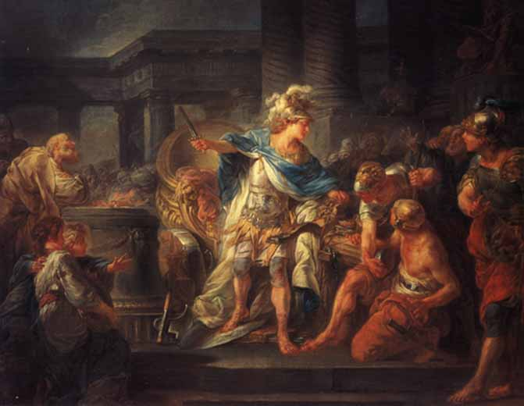
Problem Solved!!!
Alexander cuts the Gordian Knot, by Jean-Simon Berthélemy
Notes:
The problem has been solved by Alexander the Great by non-knot theoretical means. He cut it with a sword.

Slide 5
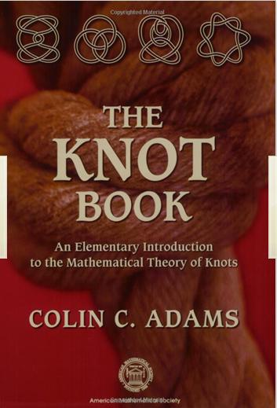
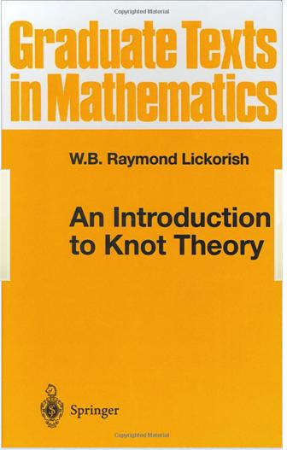
More importantly
It’s fun
Interesting
Hot area of research
The Knot Book by Colin C. Adams
An Introduction to Knot Theory
by W.B. Raymond Lickorish

Slide 6
Knot Definition
A knot is an embedding of S¹ in R³.
Take a piece a string.
Tie a knot in it.
Now glue the ends of the string together to form a knotted loop.
(see Colin Adams – The Knot Book)
Notes:
Smooth embedding = topological embedding + immersion (differential is injective)

Slide 7
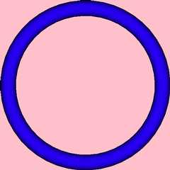
Unknot

Slide 8
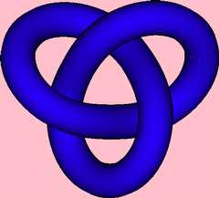
Trefoil
Notes:
Tricoloration of knots
A knot is tricolorable if: Rule 1: At every crossing, either all three strands are of a different color, or the same color. Rule 2: All three colors are used in coloring the knot.

Slide 9
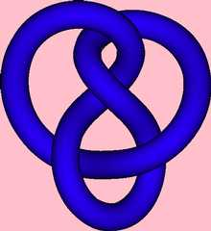
Figure 8
Notes:
Not tricolorable

Slide 10
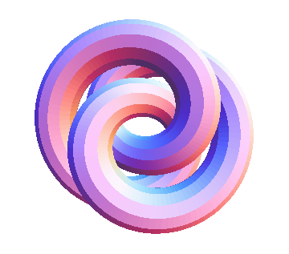
Which knot is this?
Notes:
We have here another pretty picture of a knot. Can you tell which of the three knots it is?
How many vote for the unknot?
How many vote for the trefoil?
How many vote for the figure 8 knot?
In the next few slides I will introduce concepts that will help us answer this question.

Slide 11
Planar Diagrams
Notes:
We start by defining a two dimensional representation of the knot.
A planar diagram is simply a projection of the knot on a plane carefully chosen.
When we project the knot it is possible that curves that were disjoint to intersect or even overlap.
We choose the projection plane such that no curves overlap.
[draw a bad projection of the unknot]
However, it may not be possible to avoid intersection.
What we can avoid is intersection of more than to curves at any given point.
[draw a bad projection of the trefoil]
The intersection of two curves in the projection is called a crossing.
Of these two curves we draw the one closest to the projection plane with an interrupted line and we call it underpass. The other curve is called the overpass.
[draw them]

Slide 12
Examples
Notes:
My drawing talents are not so good so I draw most of the knots ahead of time.
[[ explain the diagram of the trefoil ]]
I cheated a little when I asked you to identify a knot because I have not told you yet what it means for two knots to be the same.

Slide 13
Knot equivalence
Two knots are equivalent if there exists an isotopy of R³ taking one knot to the other.
Two knots are equivalent if you can get one from the other by deforming the string without cutting it.
Notes:
You can stretch or contract the rope, but you can not contract parts of it all the way to a point and make crossings disappear.
I will present next a set of legal changes you can make to a knot diagram that are sufficient to get you from a diagram of one knot to another diagram of the same knot.
f,g : N -> M
Isotopy = smooth map Mx[0,1] -> M st for each t the map M->M is a diffeomorphism, and F1 f = g

Slide 14
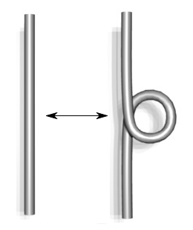
Reidemeister Move 1 (R1)
Notes:
All these changes, that we call Reidemeister moves are local changes. The picture shows you the change on a small part of the diagram. You should imagine ropes continue, do some knotty things and eventually they are connected to a loop.
R1 – elimination/introduction of a twist

Slide 15
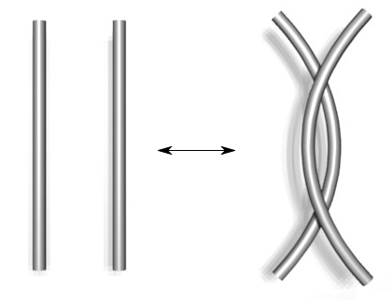
Reidemeister Move 2 (R2)
Notes:
The R2 move allows you to slide a piece of rope sitting on top of another off it.

Slide 16
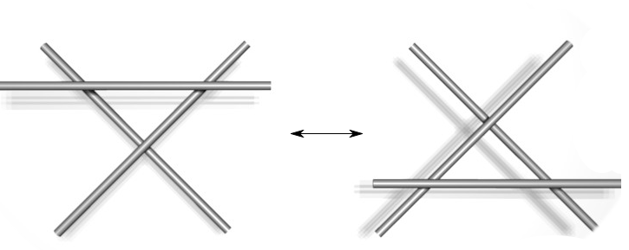
Reidemeister Move 3 (R3)
Notes:
R3 allows you to slide a piece of rope sitting on top of two pieces that cross each other, over the crossing.

Slide 17


Are these three moves enough?
Notes:
I said earlier that I will present a set of changes that allow you to tell if you can change a diagram into another. The question is if only these three simple moves are enough for that.
Well, they are, but I will not prove it. I will just show you an example.
[[Show with a cable R1]]
What if we bring the lower part up? This is a different kink.
I will show you next a sequence of Reidemeister moves that take the second type of king to a straight line.
Explain the sequence

Slide 18
More Moves

Slide 19
Which knot is this?
Notes:
[[explain pictures]]
By this point I hope I convinced you that by using the Reidemeister moves it is not easy to tell if two knots are the same or not.
Also, these moves are useful to prove that two knots the same. To show that two knots are not the same you need to show there is no sequence of RM taking one diagram to another. This is very hard to impossible in most of the cases.

Slide 20
Knot Invariants
A knot invariant is a mathematical object associated to a knot
two equivalent knots have the same invariant
Examples
Crossing number
Unknotting number
Notes:
That’s why we define knot invariants.
A knot invariant is a mathematical object associated to a knot, for example a number, or a polynomial.
We need that two equivalent knots to have the same invariant. We do not require, however, that two knots with the same invariant to be equivalent.
Invariants are really good at deciding when two knots are not the same.
The crossing number is the minimal number of crossings of any diagram of the knot.
The Unknotting Number is the smallest number of times a knot must be passed through itself to untie it.
These are nice enough invariants to understand, but not so easy to calculate since they involve taking a minimum over an infinite set.

Slide 21
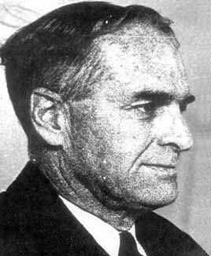
James Waddell Alexander II
“Topological invariants of knots and links”
In Transactions of the American Mathematical Society (1928)
Notes:
One invariant that has an algorithm to calculate it has been introduced in 1928 by Alexander. No relationship with Alexander the Great.
This invariant has been called the Alexander polynomial in his honor.
Mathematicians created tables of knots believed to be the same. The Alexander polynomial was used to prove that the knots with up to 9 crossings in those tables were actually different.

Slide 22
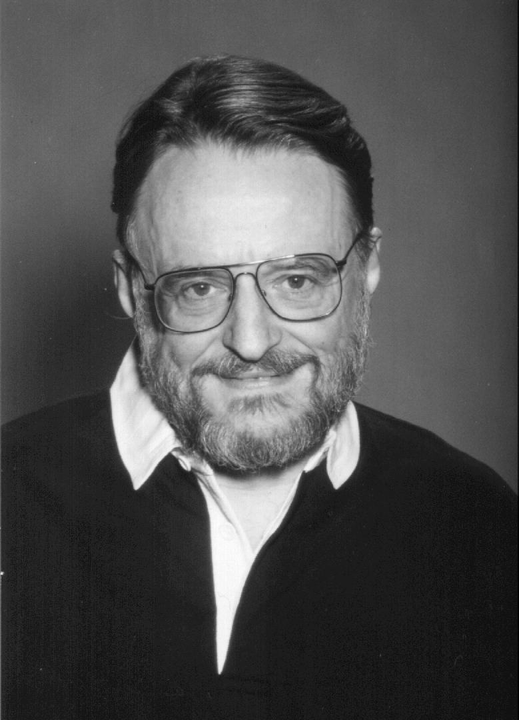
John Conway
“An enumeration of knots and links, and some of their algebraic properties”
In Computational Problems in Abstract Algebra, 1967
Notes:
Conway come up with a better way of defining the Alexander polynomial in 1967. And this is how I will present the Alexander polynomial.
This invariant is defined for oriented knots.

Slide 23
Oriented Knots
Positive crossing
Negative crossing
Notes:
To orient a knot means essentially choosing a direction.
Now we identify two types of crossings: a positive and a negative one.
To determine the type of a crossing, imagine you walk on the overpass in the direction given by the arrow. Imagine that on the underpass there are cars going also in the direction of the arrow, for the underpass. Now, the crossing is positive if the cars come from the right, and it is negative if the cars come from the left.

Slide 24
Conway’s Skein Relation
Notes:
The first rule states that the Alexander polynomial of the unknot is 1.
Rule 2 gives a relation between the Alexander polynomial of three different knots, but they differ only at one crossing.
We choose one crossing in an oriented knot. Let’s assume this crossing is positive, then this is the L+ knot.
To obtain the L- knot we interchange the role of the overpass and underpass. Essentially, we make the rope go trough itself.
The knot L0 is the knot that is completely missing the crossing we consider. Because the knot is oriented there is only one way to eliminate the crossing.
[[ Read the rule 2]]
Conway discovered this relation in highschool, but he proved it rigorously much later in his career.
And something similar was present in Alexander’s original paper, in an addendum.

Slide 25
Example - Trefoil
Notes:
It looks like we have a problem: two disjoint circles.

Slide 26
Example – Hopf Link

Slide 27
Example – Unlink
Notes:
We start with the picture from the previous slide.
If we want to make some progress we better choose a different crossing.
It looks we’re back where we started.

Slide 28
Example – Unlink
Notes:
The way to make progress is to represent the two unlinked circles as the L0 knot.

Slide 29
Back to Trefoil
Notes:
The Alexander polynomial can be calculated, but it is not straightforward, some attention is required. Another disadvantage, that is not clear at all from what I presented so far it can not tell if a knot is or not the unknot. By rule 1, the unknot has Alexander polynomial 1. There are knots that are not the unknot with Alexander polynomial 1.

Slide 30
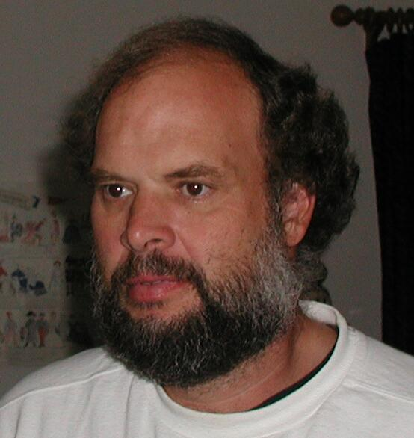
Vaughan Jones
Fields Medal in 1990
“A polynomial invariant for knots via von Neumann algebras.”
In Bull. Amer. Math. Soc. (N.S.) Volume 12, Number 1 (1985),
Notes:
The Jones polynomial is an invariant of oriented links. But to define it we first need to introduce the Kauffman bracket.

Slide 31
Kauffman Bracket
Notes:
The Kauffman bracket is defined for unoriented diagrams. It is a polynomial, denoted by angular brackets.
The Kauffman bracket of a empty diagram is 1.
[click]
If we have a diagram with a disjoint circle then we can eliminate it, but we have to multiply by a factor of ….
Observe that the KB of k disjoint circles is …..
[click]
This rule allows us to eliminate a crossing. Since the diagram is unoriented there are two ways we can do it, connecting horizontally and vertically. We call this smootings.
Now it is clear, that by applying rule 3 we get something simpler, with fewer crossings.
[click]
We can add a new rule, that is only a rotation by 90 degrees of the previous one, but it will make our lives easier.

Slide 32
Kauffman Bracket - example

Slide 33
Jones Polynomial
Notes:
J hat is the un-normalized Jones polynomial and …. Read the formula
We define the normalized Jones polynomial to be …..
This is done to ensure that the Jones polynomial for the unknot is 1.
Now, we apply these formulas to the knot

Slide 34
Kauffman Bracket – R2

Slide 35
Jones Polynomial – R2

Slide 36
Trefoil

Slide 37
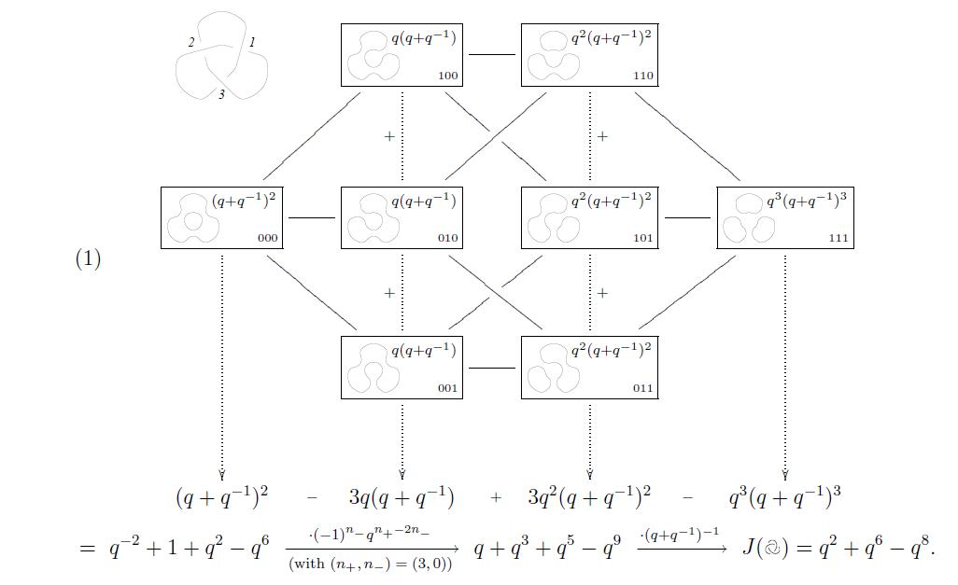
From: “On Khovanov's Categorification of the Jones Polynomial “, Dror Bar-Natan,
Algebraic and Geometric Topology 2-16 (2002) 337-370

Slide 38
Open Question
Is there a nontrivial knot with Jones polynomial equal to that of the unknot?
It is known that there are nontrivial links with Jones polynomial equal to that of the corresponding unlinks by the work of Morwen Thistlethwaite.

Slide 39
Thank you!
The talk is available at:
http://www.cs.virginia.edu/nora

