Slide 1
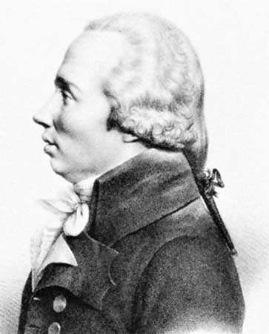
Topologically Trivial Legendrian Knots
I don’t even know what a knot is!
Y. Eliashberg, M. Fraser
arXiv:0801.2553v2 [math.GT]
Presented by Ana Nora Evans
University of Virginia
April 28, 2011
TexPoint fonts used in EMF.
Read the TexPoint manual before you delete this box.: AAA

Slide 2
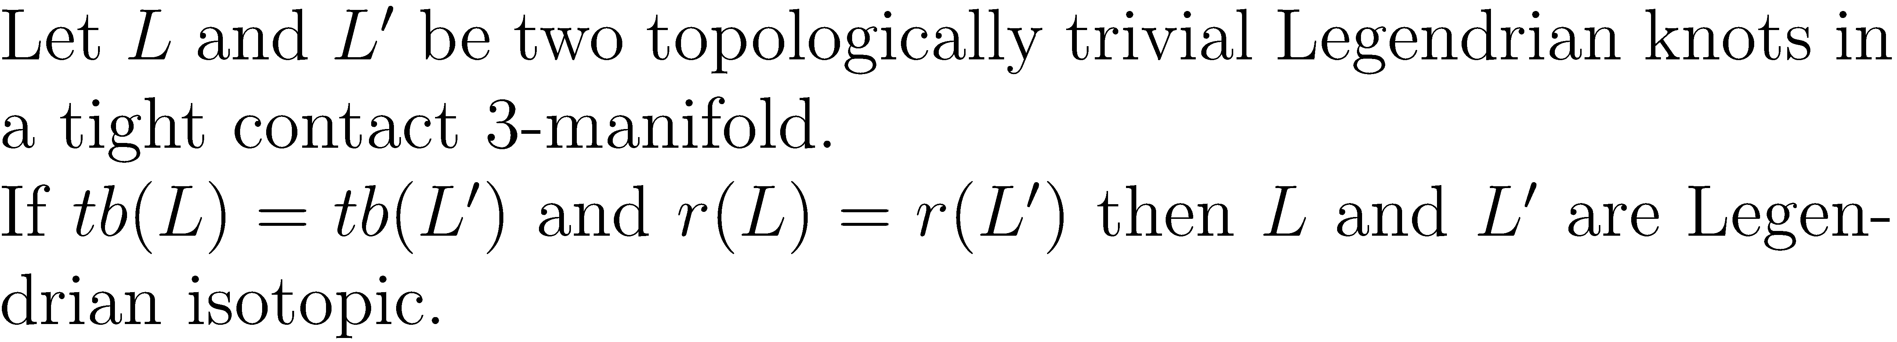
Main Theorem

Slide 3
Proof Strategy
Let L be a Legendrian knot bounding an embedded disk D.
Perturb the foliation
Build a tree
Define a front projection and a foliation
Modify the tree

Slide 4
Catalog of Wavefronts
r=-s < 0, tb = -(2t+1+s)

Slide 5
Catalog of Wavefronts
r=s > 0, tb = -(2t+1+s)
Reverse orientations in the previous slide
r=0, tb = -(2t+1)

Slide 6
Step1: Perturb the foliation
Goal: Given a spanning disk D of L, perform a C⁰-small perturbation of D to obtain a spanning disk D’ of L with foliation in elliptic form.
Just h+ and e- on boundary
Just h+ and e- on boundary and just e+ and h- on interior
Mostly h+ and h- on boundary, just e+ and e- on interior

Slide 7
Elliptic Foliation
Signs of boundary singularities alternate
Boundary singularities connect only with their direct neighbors on the boundary and interior singularities
All interior singularities are elliptic
Interior singularities connect to at least two boundary hyperbolic singularities

Slide 8
Elliptic Foliation

Slide 9
Just h+ and e- on boundary
If tb(L)=t then there is a C⁰-small perturbation of D such that there are exactly 2t singularities on the boundary and they have alternating signs.
Elliptic-hyperbolic conversion

Slide 10
Just h- and e+ on interior
Destroy hyperbolic-hyperbolic connections
Eliminate negative elliptic singularities
Eliminate positive hyperbolic singularities

Slide 11
Just e- and e+ on interior (1)

Slide 12
Just e- and e+ on interior (2)

Slide 13
Just e- and e+ on interior (3)

Slide 14
Just e- and e+ on interior (4)

Slide 15
Step 2: Build a Tree
Skeleton of the foliation
Vertices - interior elliptic points
Edges – representative arcs
Extended skeleton of the foliation
New vertices – elliptic boundary points
New edges – representative arcs
Signed trees
Have an acceptable planar embedding

Slide 16
Extended Skeleton

Slide 17
Build an wavefront
Choose disjoint neighborhoods of vertices
Leftmost vertex
End vertex
Otherwise – replace the subtree to the right by a reflection of it in the horizontal axis

Slide 18
Recap
Start with Legendrian knot L spanned by the embedded disk D
Perturb D to have an elliptic foliation
Get an embedded Legendrian tree T (extended skeleton)
Given a planar embedding of T build a front projection W_{T}
Claim: The lift of W_{T} bounds an embedded disk whose foliation is elliptic and diffeomorphic to the elliptic foliation of D.

Slide 19
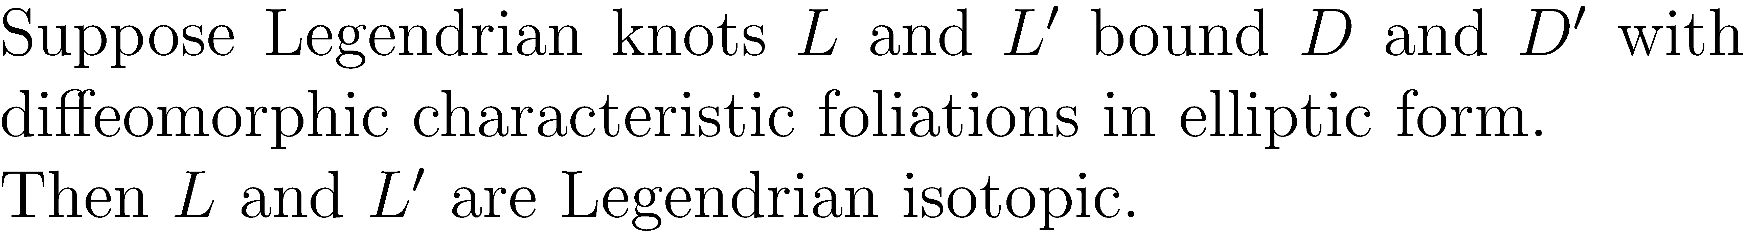
Forget about L (1)
Convert the elliptic form spanning disk to exceptional form spanning disk

Slide 20
Forget about L (2)
Isotopy supported in the complement of small neighborhood of end vertices.

Slide 21
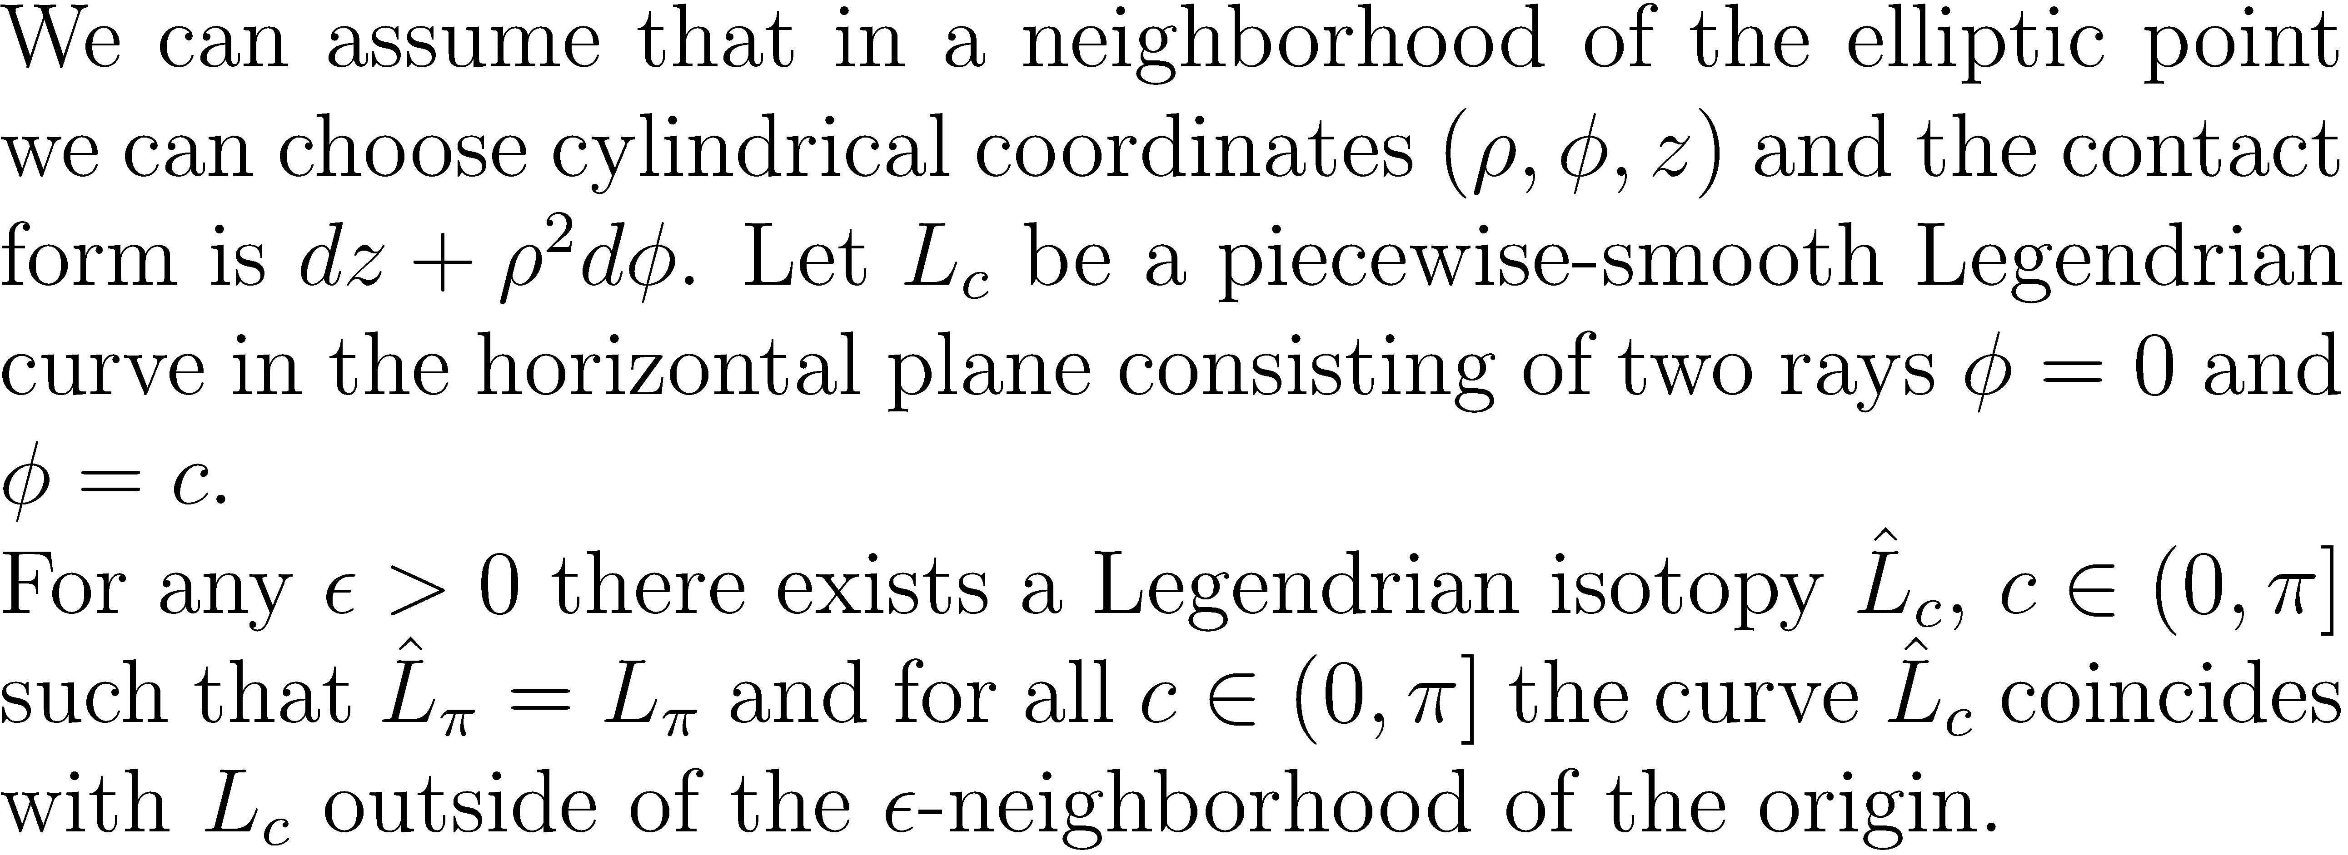
Forget about L (3)
Use Elliptic Pivot Lemma to extend the isotopy to the entire disk.

Slide 22
Step 4: Modify the Tree

Slide 23
Step 4: Modify the Tree

