Slide 1
The Effectiveness of Instruction Set Randomization
Where's the FEEB?: The Effectiveness of Instruction Set Randomization. Nora Sovarel, David Evans, Nate Paul. To appear at USENIX Security, August 2005
Nora Sovarel
http://www.cs.virginia.edu/nora
University of Virginia
Computer Science
2005 IEEE Symposium on Security and Privacy

Slide 2
Instruction Set Randomization
Encryption Key
Decryption Key
Compile
Load
In memory
Execution

Slide 3
Jump Attack: jmp -2
2-byte instruction
Correct: infinite loop
Wrong:
  Usually crashes
  Sometimes false positive
False positives
  Conditional jumps
  Used to reduce the number of attempts (average 24 per byte)
eb
eb
fe
fe
cd
0xbfffe990
0xbfffe991

Slide 4
Requirements
Multiple guess attempts on same key
  Server forks process
  No rerandomization
Remotely observable behavior
Injection at known address
Simple encryption scheme
  Byte-wise
  Learn key from one plain/cipher pair

Slide 5
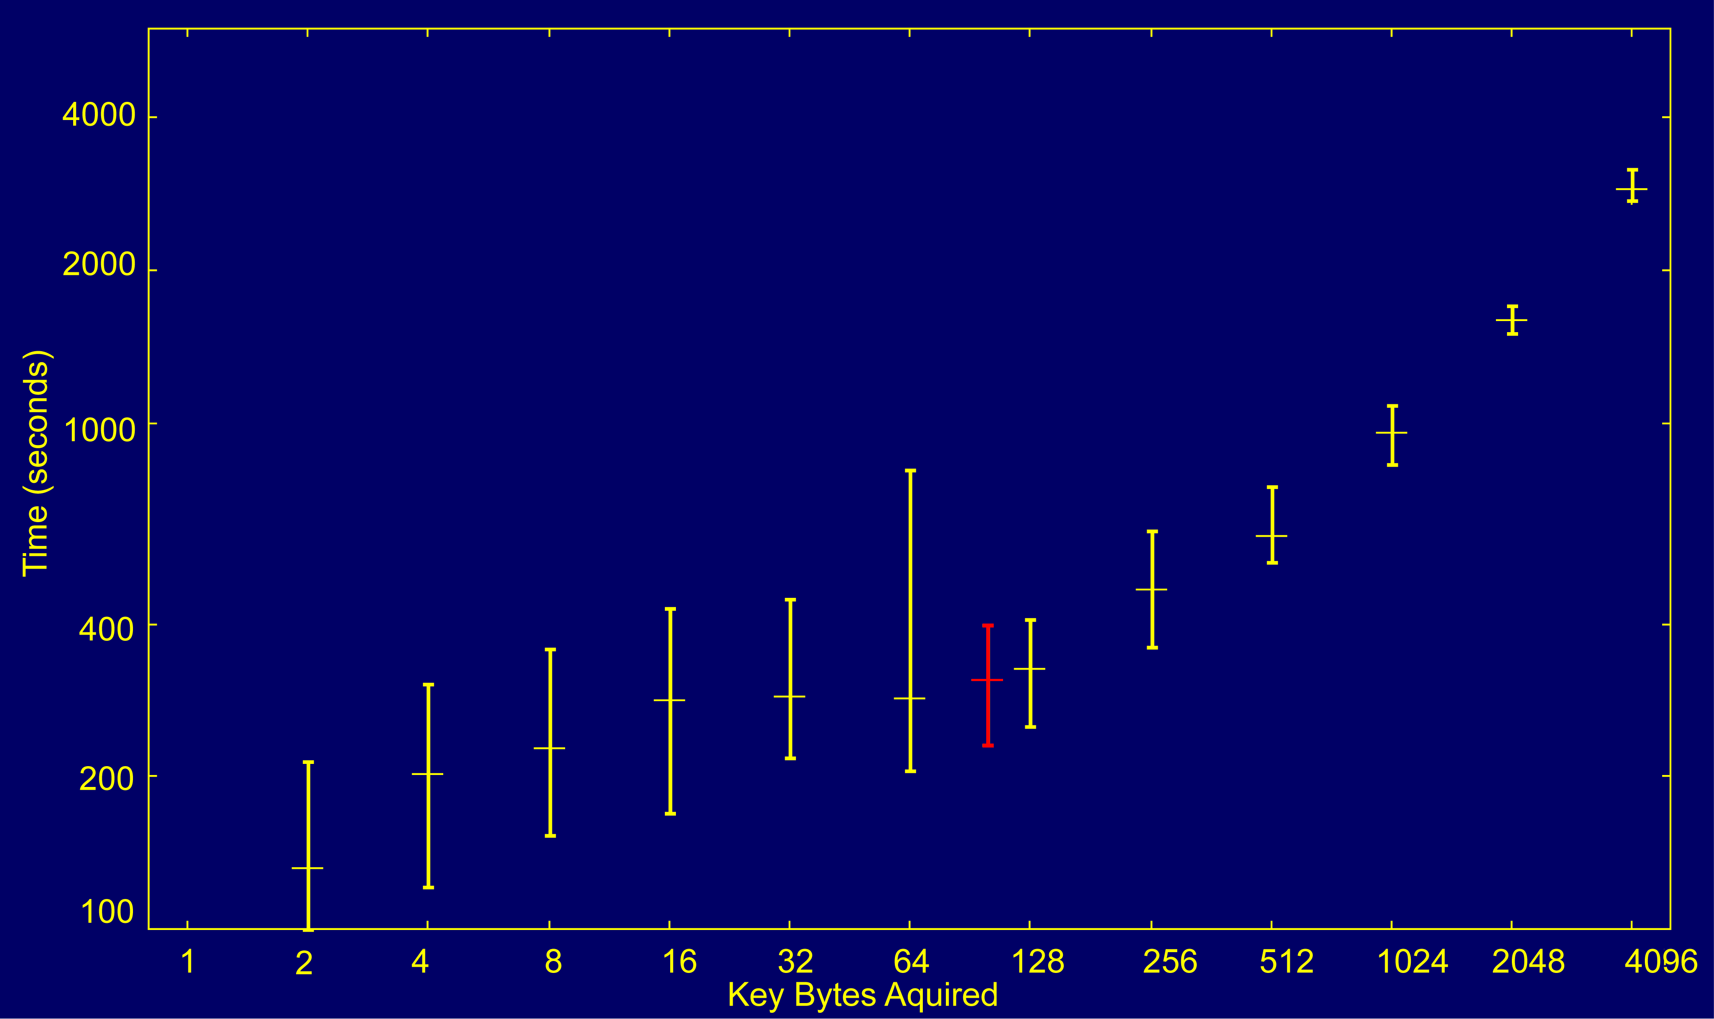

Slide 6
Conclusion
It sometimes works
Possible countermeasures
  Rerandomize periodically
  Stronger encryption
http://www.cs.virginia.edu/nora
Where's the FEEB?: The Effectiveness of Instruction Set Randomization. Nora Sovarel, David Evans, Nate Paul. To appear at USENIX Security 2005

