Slide 1

Where’s the FEEB?:
Effectiveness of Instruction Set Randomization
Nora Sovarel, David Evans, Nate Paul
University of Virginia
Computer Science
USENIX Security 2005
4 August 2005
Baltimore, MD
Notes:
I’m Nora Sovarel from University of Virginia.
I’ll present the work I’ve done with David Evans and Nate Paul on evaluating the security provided by Instruction Set Randomization.

Slide 2
Security Through Diversity
Monoculture
  Windows, x86 ISA, Cisco, Apache
Diversity
  Address Space Layout Randomization - PaX, Exec Shield
    Brute force attack [Shacham+, CCS 04]
  Instruction Set Randomization
    [Barrantes+, CCS 03] [Kc+, CCS 03]
Notes:
Today’s computing infrastructure suffers from being a monoculture.
An attacker has to write one malicious program and it will run on millions computers.
One defense proposed is diversity.
The systems are altered automatically such that they appear to be different to an attacker.
For example, Address Space Layout Randomization changes the start address of program’s segments, breaking the attacks that rely knowing the location of a particular object.
It is already incorporated in the latest linux kernels.
There is a paper from Stanford in the last CCS on a brute force guessing attack that breaks ASLR.
Another diversity defense is Instruction Set Randomization.
It breaks any code injection attacks and works by altering the instruction set.

Slide 3
Instruction Set Randomization
[Barrantes+, CCS 03] [Kc+, CCS 03]
Encryption Key
Decryption Key
Compile
Load
In memory
Execution
Notes:
Here is how ISR works.
The text segment is encrypted at compile, install, or load time.
The decryption is done on the processor or emulator just before execution or emulation.
[[Pause]]
While it is in memory the binary is encrypted.
When an attacker injects its malicious code in the main memory.
The subsequent decryption will transform it into essentially random instructions and the attack will fail.
Usually, the application will crash, and the attack will not behave as attacker intended.
[[Pause]]

Slide 4
ISR Effectiveness
Can an attacker determine the randomization key remotely?
  Next: incremental guessing technique
Can an attacker spread a worm on network of ISR-protected servers?
  Later this talk: MicroVM technique
Notes:
In this paper we investigate the security provided by ISR.
The questions we will answer are:
“Can an attacker determine the randomization key remotely?” and
“Can a worm spread on a network of ISR protected servers?”
We identified an attack which incrementally determines the randomization key remotely.
This allows us to inject code encrypted with the correct key.
I’ll present this next.
We designed and implemented a micro virtual machine that executes the attack code.
It reduces significantly the number of key bytes we need to guess.
I’ll present this towards the end of the talk.
[[Pause]]

Slide 5
Incremental Guessing
Key space too large (2^{4K}) for brute force guessing
Need to guess key bytes incrementally: XOR encryption allows this
Attacker needs to find a short instruction sequence that produces remotely observable behavior
Notes:
Key size varies with the ISR implementation from 4 bytes to entire program length.
Such a key space prohibits a brute force approach. So, we need to guess key bytes incrementally.
The XOR encryption used by current ISR designs allows this since each key bit affects only one ciphertext bit.
In order for this attack to work, it is critical that we find a short instruction sequence that reveals if a guessed key is correct.
This means we need to be able to remotely observe different behavior of the server depending on whether the guessed key is correct or incorrect.

Slide 6
Remotely Observable Behavior
TCP sockets
Wrong guess - application crash, the socket is closed immediately
Correct guess – the socket stays open / application sends the expected result
False positives
  Wrong guess which looks like a good one
Notes:
With TCP sockets, the remote attacker can observe when the server crashes.
We assume the attacker connects using a TCP socket. Furthermore, the normal flow of communication should keep the socket open until the injected code is executed.
This enables us to distinguish between a correct and a wrong guess.
On a good guess the behavior is the socket stays open and on a wrong guess the socket is immediately closed.
Sometimes, it happens that a wrong guess looks like a correct one. We call this a false positive.

Slide 7
Guessed Instructions
Short control flow instructions
Return instruction (0xc3)
  One-byte instruction
  Changes control flow noticeably
  Problem: mangles stack, server will usually crash soon after correct guess
Jump instruction (0xebfe)
  Two-byte instruction
  jmp -2 produces an infinite loop
Notes:
The key insight is the usage of control instructions which change the execution flow noticeably.
We devised two attacks.
One is based on one byte return instruction. In this attack an extra return instruction is executed and it pops an extra element from the stack.
Due to the stack inconsistency, the application will crash shortly even if the guess is correct.
The vulnerability should be placed on a location where the noticeably behavior is observed before the application crash.
In this talk I won’t present the return attack. For details, please see the paper.
[[Pause]]
The attack I’ll present today is based on a two byte jump instruction.
A correct guess will produce an infinite loop on the server.

Slide 8
Jump – first two bytes
Infinite loop – jmp -2
False positives
  Small negative offset
    jmp -4
  Conditional jumps
    jnz -2
  Others (see paper)
eb
fe
Overwritten Return Address
Notes:
Here is how the jump attack works.
We exploit a buffer overflow vulnerability, but any vulnerability which allows us to inject code should work.
There is a shortcoming in attacking an ISR protected server.
The common technique of creating a landing zone of noops doesn’t work since we don’t know the randomization key for those positions.
[[pause]]
The attack consists in injecting a jump negative two encrypted with the current guess for the randomization key.
When the guess is correct, the injected code spins on a jump to itself producing an infinite loop.
There are other possibilities, however, that could produce an infinite loop.
The false positives have two major causes.
A small negative offset combined with harmless instructions between the jump target and the jump will cause and infinite loop too.
This is a problem only when guessing the first two bytes.
[[pause]]
Another source of false negatives are conditional jumps.
When the condition is true, they behave like an unconditional jump.
The good news are that the conditional jumps helped us to devise an algorithm which performs much better than brute force.
Other possibilities occur infrequently and they are described in the paper .

Slide 9
Conditional Jumps
16 conditional jumps (0x70−0x7f)
Opposite conditions differ by last bit
  JZ (0x74), JNZ (0x75)
At most 32 attempts to find first infinite loop
  0x00,0x10,…,0xf0, 0x01,0x11,…,0xf1
Average number of attempts
  15.75 to find first infinite loop
  23.5 to guess the key
Notes:
Conditional jump instructions in x86 are very conveniently arranged.
There are sixteen conditional jumps and their opcodes share the first 4 bits.
Furthermore, conditional jumps with opposite conditions, from which one is always taken and one is always not taken differ only by the last bit.
From a jump with an even opcode and a jump with the consecutive opcode, exactly one is taken producing an infinite loop, and always the other one is not taken crashing the server.
[[pause]]
With at most 32 attempts we will find an infinite loop.
Next we will check the next two consecutive opcodes to verify whether this infinite loop was caused by a conditional or unconditional jump.
The average number of attempts to guess one key byte is under 24.
For the first two bytes this number will be multiplied by 256 as we need to guess the offset too.

Slide 10
Next bytes
eb
eb
fe
fe
cd
0xbfffe991
0xbfffe990
Notes:
Once we have determined the first two bytes, we can use them to guess additional bytes more efficiently.
To guess the next byte, we place the injected instruction up one byte on the stack.
We encrypt the offset with the key already guessed.
We will guess the encryption key for the memory location where the opcode is placed.
For each byte we guess we create an average of 3 infinite loops.
If we continue with this approach the load on the server will increase considerably soon.
This is likely to be noticed by system administrator and it slows down subsequent guesses.

Slide 11
Extended attack
eb
Use a combination of short (0xeb) and near jump (0xe9)
Reduce false positives by using interrupt instruction (0xcd)
06
cd
cd
cd
cd
cd
cd
e9
32 bit
offset
Overwritten Return Address
Notes:
To minimize the number of infinite loops after we guessed enough keys we change the attack.
We use a jump with offset 6 where a near jump is placed.
The near jump has a 32 bit offset and it will move the execution flow back in the text segment where the application would normally return.
Between the two jumps we place value 0xcd encrypted with the key already guessed for that memory location.
0xcd is the opcode of interrupt instruction.
It is a two byte instruction, but the only legal value for the second byte in user mode is 0x80.
If the guess is wrong but decrypts to a harmless instruction the application will crash with extremely high probability.
The expected behavior is observed only when the injected instruction decrypts to a unconditional or conditional jump, and otherwise the server crashes.

Slide 12
Attack Requirements
Multiple guess attempts on same key
  Server forks process
  No rerandomization
Remotely observable behavior
Vulnerability that allows injection at known address
Simple encryption scheme
  Byte-wise
  Learn key from one plain/cipher pair
Notes:
The incremental property of our attack forces the requirement of being able to execute multiple attempts on the same randomization key. If the randomization key changes for the already guessed positions we have to start from the beginning.
The vulnerability must be in a position that allows us to remotely distinguish between a correct and an incorrect guess.
As I mentioned before, the noop padding technique is not applicable in our attack since we don’t know the randomization keys. We must inject code to known location.
The encryption scheme must allow us guessing the key incrementally.

Slide 13
Experiment
Simple echo server with a buffer overflow vulnerability
Forks a process for each request
New Mexico RISE [Barrantes+, CCS 03]
Modified RISE to initialize the encryption keys before fork
Turned off Fedora address space layout randomization
Notes:
To evaluate our attack we conducted experiments using a simple echo server with a contrived buffer overflow vulnerability.
We used RISE implementation of ISR. Unfortunately, we had to modify it as one of the necessary conditions for our attack was not satisfied. Due to the way fork is implemented in Valgrind and a lazy key initialization performed by RISE, each attempt was using a different key.
Another hurdle was caused by ASLR as it breaks our requirement of injecting code to a known memory location.

Slide 14
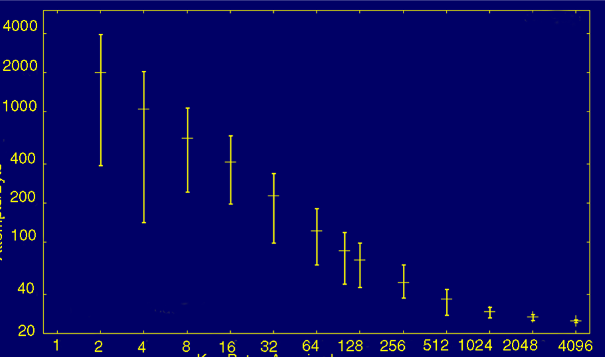
Attempts per Byte
1991
Attempts/Byte
24.99
Key Bytes Acquired

Slide 15
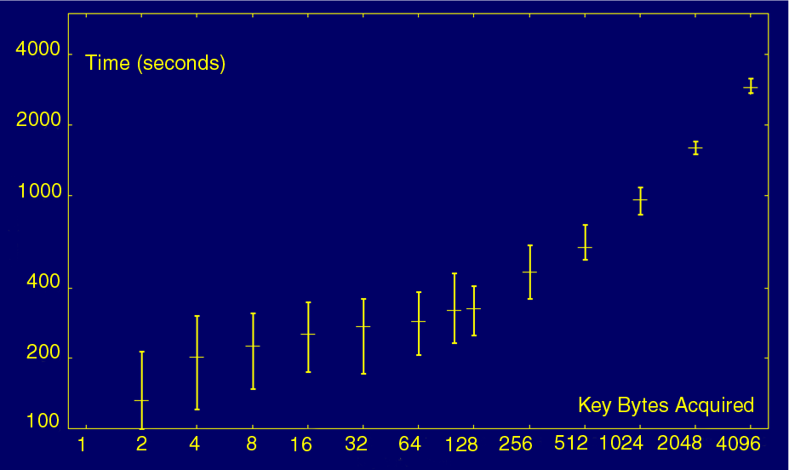
Time
2884
132

Slide 16
Is attack practical?
Attack one server
  Inject malicious code
  Sapphire: 376 bytes (under 10 minutes)
Spread a worm
  Need to add guessing code: 34,723 bytes
  Need to crash server ~ 800k times
Can we do better ?
Notes:
If we want to attack one server we need to guess the randomization keys for the malicious payload.
For example, the Sapphire worm is only 376 bytes long.
We can guess a key of this size in under 10 minutes.
[[pause]]
A worm able to spread a on a network of ISR protected servers must contain the code for guessing the randomization key.
As you can see we need to crash the server so many times that is hard to go unnoticed by the administrator.
So, can we do better?

Slide 17
MicroVM
save worm address in ebp
move stack frame pointer
WormIP ← 0
copy worm code into buffer
update WormIP
save MicroVM registers
load worm registers
22-byte worm execution buffer
save worm registers
load MicroVM registers
jmp to read next block
saved registers
worm code
host key masks
guessed (target) masks
other worm data
Learned Key Bytes
Loop:
  Load block into execution buffer
  Execute block
76 bytes of code
+ 22 bytes for execution
+ 2 bytes to avoid NULL
= 100 bytes is enough
> 99% of the time
Notes:
Yes, we can do better.
We can run any length of malicious code with only 100 key bytes.
The idea is to execute the worm code in small block at the same location.
We propose a 100 bytes micro VM with 76 bytes for VM code, and 22 bytes used as execution buffer for the worm code.
The micro VM consists of an initialization code and the execution loop.
The execution loop reads a 22 byte block of worm code, and executes it.
The worm code is a lot bigger than 100 bytes, but it executes only in the 22 byte execution buffer.

Slide 18
Micro VM – 100 bytes
push dword ebp mov ebp, WORM_ADDRESS + WORM_REG_OFFSET
pop dword [ebp + WORM_DATA_OFFSET]
xor eax, eax ; WormIP = 0 (load from ebp + eax)
read_more_worm: ; read NUM_BYTES at a time until worm is done
cld xor ecx, ecx mov byte cl, NUM_BYTES
mov dword esi, WORM_ADDRESS ; get saved WormIP
add dword esi, eax mov edi, begin_worm_exec
rep movsb ; copies next Worm block into execution buffer
add eax, NUM_BYTES ; change WormIP
pushad ; save register vals
mov edi, dword [ebp] ; restore worm registers
mov esi, dword [ebp + ESI_OFFSET] mov ebx, dword [ebp + EBX_OFFSET]
mov edx, dword [ebp + EDX_OFFSET] mov ecx, dword [ebp + ECX_OFFSET]
mov eax, dword [ebp + EAX_OFFSET]
begin_worm_exec: ; this is the worm execution buffer
nop nop nop nop nop nop nop nop nop nop nop nop
nop nop nop nop nop nop nop nop nop nop nop nop
mov [ebp], edi ; save worm registers
mov [ebp + ESI_OFFSET], esi mov [ebp + EBX_OFFSET], ebx
mov [ebp + EDX_OFFSET], edx mov [ebp + ECX_OFFSET], ecx
mov [ebp + EAX_OFFSET], eax
popad jmp read_more_worm ; restore microVM register vals and read more
Notes:
Here is the micro VM code.
[[point noops]]

Slide 19
Deploying a Worm
Learn 100 key bytes to inject MicroVM
  Median 8694 attempts
  Fast enough for a worm to spread effectively
Inject pre-encrypted worm code
  XORed with the known key at location
Inject key bytes
  needed to propagate
Notes:
To deploy a worm, we need to guess enough key bytes to inject the Micro VM, and we have to construct worm code that will run in the VM.
A worm will execute the following steps:
Run the attack code to guess 100 key bytes. This takes about 5 minutes and crash the server around 8000 times on average.
Re-encrypt the worm code for the new location
Inject the microVM, worm code and, key bytes

Slide 20
Worm code
Worm code split into 22 byte basic blocks (noop padding)
Jumps
  Within a block - short relative jump is fine
  Between worm blocks
    Update the WormIP stored on the stack
    Code conditional jump, JZ target in worm as:
JNZ +5 ; if opposite condition, skip
MOV [ebp + WORMIP_OFFSET] target
Notes:
To keep the VM small we have to format the executable. It must be split in basic blocs of 22 byte length. We use noop padding to ensure this property.
The 22 byte blocks can contain jumps with the target in the same block.
If the jump target is in another block we instead update the internal instruction pointer of micro VM, called WormIP.
Conditional jumps require special handling. We replace the conditional jump with the sequence shown on the slide.
First there is the conditional jump with the opposite condition to skip the next instruction when the jump would not be taken.
The second instruction updates the instruction pointer when the jump would be taken.

Slide 21
Countermeasures
Eliminate all vulnerabilities
  Attacker can not inject anymore
Fixed known address
  Combine ISR with ASLR
Rerandomize periodically
  Monitor the process crashes
Stronger encryption
  Use a stronger cipher like AES
Notes:
How our attack can be prevented …
Eliminate all vulnerabilities, not quite possible
Turn on ASLR
Rerandomize after a number of crashes
Use stronger encryption which does not allow learning the key from a single plaintext ciphertext pair.

Slide 22
Summary
ISR promising and effective
But, vulnerable when
  attacker can send multiple guess attempts against the same key
  simple encryption is used

Slide 23

Done ☺
http://www.cs.virginia.edu/feeb

