Slide 1
DOCUMENTATION ON PHARMACY MANAGEMENT SYSTEM

Slide 2
Problem Statement
The pharmacy management system has recently been digitized by keeping track of very large pharmacy records. As a result, the old habit where paper records were kept in filing cabinets has been abolished. This project will focus on managing such complex records by employing a manager, salesperson, and pharmacist. An application will be used to provide quick access to the records and check vital reviews about the pharmacy business to monitor growth stages.

Slide 3
Requirement
The software is mainly to perform the following tasks:
The Admin can add new and delete new managers, pharmacists, and salespersons. This is to enable close supervision of the work performed by the various stakeholders.
The pharmacist, manager, and salesperson log in their details only after the admin adds them to the database. This thereby provides easy accessibility to the pharmacist, manager, and salesperson records.

Slide 4
Software Process
Agile methodology is an interactive technique that will be implemented in our project. Agile promotes teamwork among the developers and clients to discuss the cycle of the project leading to frequent interactions among them improving error debugging. Also, there will be no increase in cost in case of pharmacy plan changes since it requires less expensive reworks.

Slide 5
Software Modeling
The methodology used in the implementation of the software is the Incremental Model of System Development Life Cycle, which allows room for scalability as time goes on. Creating an Online Pharmaceutical Management System would help in pharmaceutical practices for all parties involved. It is eminent that the system provides a safe, secure, and verified platform for all parties which help to bridge the communication gap and provide legitimate drugs. Therefore, if all recommendations are strictly adhered to, there will be strict monitoring and regulation of how drugs are circulated and a decrease in the speed of fake drugs.

Slide 6
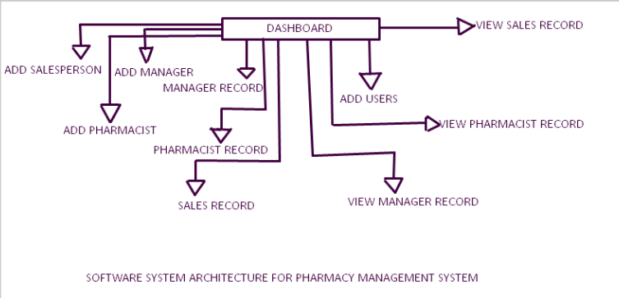
Software System Architecture

Slide 7
Design and Implementation
The customer asks for the product he/she wants to purchase. The salesperson checks if the medicine is available. If the product is available it is recorded in the sales made database but if not, no record is kept. The salesperson cannot delete, or update any of the items in the database because he/she has no authority to do so. The salesperson can only view the sales dashboard to see which items got sold at some time. The sales reports are kept daily, weekly, and monthly, which will be checked and monitored by the manager. The sales reports will help update and inform the admin if there is a shortage of a particular drug and the growth of the business.

Slide 8
Testing
There should be the removal of bugs before the pharmacy management system is implemented into operation. This phase is essential to reach a successful project. Once the system’s codification is done, a test plan should be developed and run on a given set of test data. The test run’s performance should match the expected results. After the first test is done, the primary test follows where actual data is used and executed. The execution is analyzed, and, in case of any errors, the errors will be identified and fixed and further tested for the expected output.

Slide 9
Software Project Planning
The analysts are required to check what is really happening in the business. Problems, opportunities, and objectives are identified through this planning process. Together with other team members, developers and analysts find out the problems. The objective of the system is also needed to know the purpose of the business. The analysts and developers check whether the information gathered can aid in solving specific problems or opportunities.

Slide 10
Software Project Costing
Making an economic analysis is essential in the field of software making for solving problems. The first to ask the developer is how much does the pharmacy manager software cost? With the clients having their budgets in mind, this question cannot be answered straightforwardly as the client may expect. A lot such as app platform (Android, IOS Web application); and UI design development (front-end, back-end) all affect the cost of the price of the software. For instance, considering a customer wants his/her app to work on both IOS and android platforms, the fees charged will be more than just one of the platforms. The reason is that both platforms have different SDKs and converting an Android app into an IOS app is impossible. This literally means the developer needs to create the app for each of the platforms individually increasing the price.

Slide 11
Software Scheduling
The time scheduled for the app was an intense everyday coding to fully complete this pharmacy management project.

