Slide 1
Design pattern
Design Patterns:
Singleton, Flyweight

Slide 2
Outline
Singleton pattern
Serializable interface and persistent objects
Flyweight pattern

Slide 3
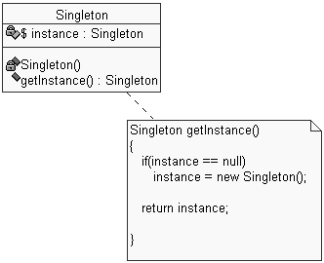
Pattern: Singleton
a class that has only one instance

Slide 4
Restricting object creation
problem: sometimes we will really only ever need one instance of a particular class
  examples: keyboard reader, bank data collection
  we'd like to make it illegal to have more than one, just for safety's sake
why we care:
  creating lots of objects can take a lot of time
  extra objects take up memory
  it is a pain to deal with different objects floating around if they are essentially the same

Slide 5
Singleton pattern
singleton: an object that is the only object of its type
  ensures that a class has at most one instance
  provides a global access point to that instance
  takes responsibility of managing that instance away from the programmer (illegal to construct more instances)
  provide accessor method that allows users to see the (one and only) instance
  possibly the most known / popular design pattern! (this should tell you something)

Slide 6
Restricting objects, continued
One way to avoid creating objects:
use static methods instead
  Math, System, JOptionPane
  is this a good alternative choice? Why or why not?
Problem: lacks flexibility
  Example: static methods can't be passed as an argument to a method, nor returned
Problem: cannot be extended
  Example: static methods can't be subclassed and overridden like a singleton's could be

Slide 7
Implementing Singleton
make constructor(s) private so that they can not be called from outside
declare a single static private instance of the class
write a public getInstance() or similar method that allows access to the single instance
  possibly protect / synchronize this method to ensure that it will work in a multi-threaded program

Slide 8
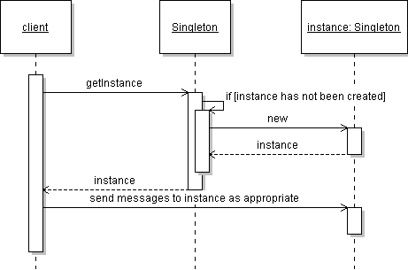
Singleton sequence diagram

Slide 9
Singleton example
consider a singleton class RandomGenerator that generates random numbers
public class RandomGenerator {
private static RandomGenerator gen = new RandomGenerator();
public static RandomGenerator getInstance() {
return gen;
}
private RandomGenerator() {}
public double nextNumber() {
return Math.random();
}
}
possible problem: always creates the instance, even if it isn't used

Slide 10
Singleton example 2
variation: don't create the instance until needed
// Generates random numbers.
public class RandomGenerator {
private static RandomGenerator gen = null;
public static RandomGenerator getInstance() {
if (gen == null)
gen = new RandomGenerator();
return gen;
}
}
What could go wrong with this version?

Slide 11
Singleton example 3
variation: solve concurrency issue by locking
// Generates random numbers.
public class RandomGenerator {
private static RandomGenerator gen = null;
public static synchronized
RandomGenerator getInstance() {
if (gen == null)
gen = new RandomGenerator();
return gen;
}
}
Is anything wrong with this version?

Slide 12
Singleton example 4
variation: solve concurrency issue without unnecessary locking
// Generates random numbers.
public class RandomGenerator {
private static RandomGenerator gen = null;
public static RandomGenerator getInstance() {
if (gen == null) {
synchronized (RandomGenerator.class) {
// must test again -- can you see why?
if (gen == null)
gen = new RandomGenerator();
}
}
return gen;
}
}

Slide 13
Singleton example
consider a class RandomGenerator that generates random numbers
public class RandomGenerator {
private static RandomGenerator gen;
public static RandomGenerator getInstance() {
return gen;
}
private RandomGenerator() {}
public double nextNumber() {
return Math.random();
}
}

Slide 14
Singleton exercise
Let's make our game model a singleton. What other classes can be singletons in this system?
Open issue: What happens if we want a saveable game, where the game state can be stored onto the disk?
  Will there be any issues with this that are unique to a singleton class?
Notes:
other singletons: consider SoundPlayer object

Slide 15
Let's make our (singleton) game model serializable
What can happen if a singleton is saved and loaded?
  Is it possible to have more than one instance of the singleton's type in our system?
  Does this violate the Singleton pattern? Will it break our code? If so, how can we fix it?

Slide 16
Singleton example 5
variation: has strict checks to make sure that we have not saved a stale reference to the singleton object
// Generates random numbers.
public class RandomGenerator {
private static RandomGenerator gen = null;
...
public double nextNumber() {
// put code like this in methods that use/modify it
if (this != gen)
throw new IllegalStateException("not singleton");
return Math.random();
}
}

Slide 17
Pattern: Flyweight
a class that has only one instance for each unique state

Slide 18
Problem of redundant objects
problem: existence of redundant objects can bog down system
  many objects have same state
  intrinsic vs. extrinsic state
  example: File objects that represent the same file on disk
    new File("mobydick.txt")
    new File("mobydick.txt")
    new File("mobydick.txt")
    ...
    new File("notes.txt")
    new File("notes.txt")

Slide 19
Flyweight pattern
flyweight: an assurance that no more than one instance of a class will have identical state
  achieved by caching identical instances of objects to reduce object construction
  similar to singleton, but has many instances, one for each unique-state object
  useful for cases when there are many instances of a type but many are the same
  can be used in conjunction with Factory pattern to create a very efficient object-builder
  examples in Java: String, Image / Toolkit, Formatter

Slide 20
Flyweight and Strings
Flyweighted strings
  Java Strings are flyweighted by the compiler wherever possible
  can be flyweighted at runtime with the intern method
public class StringTest {
public static void main(String[] args) {
String fly = "fly", weight = "weight";
String fly2 = "fly", weight2 = "weight";
System.out.println(fly == fly2); // true
System.out.println(weight == weight2); // true
String distinctString = fly + weight;
System.out.println(distinctString == "flyweight"); // false
String flyweight = (fly + weight).intern();
System.out.println(flyweight == "flyweight"); // true
}
}

Slide 21
Implementing a Flyweight
flyweighting works best on immutable objects
  immutable: cannot be changed once constructed
class pseudo-code sketch:
public class Flyweighted {
  static map or table of instances
  private constructor
  static method to get an instance
    if we have created this type of instance before, get it from map and return it
    otherwise, make the new instance, store and return it
}

Slide 22
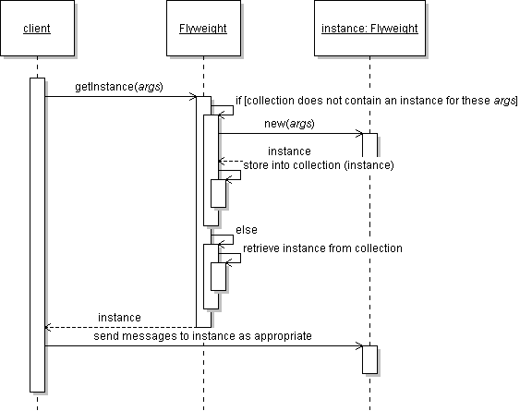
Flyweight sequence diagram

Slide 23
Implementing a Flyweight
public class Flyweighted {
Map or table of instances
private Flyweighted() {}
public static synchronized Flyweighted getInstance(Object key) {
if (!myInstances.contains(key)) {
Flyweighted fw = new Flyweighted(key);
myInstances.put(key, fw);
return fw;
} else
return (Flyweighted)myInstances.get(key);
}
}

Slide 24
Class before flyweighting
A class to be flyweighted
public class Point {
private int x, y;
public Point(int x, int y) {
this.x = x; this.y = y;
}
public int getX() { return this.x; }
public int getY() { return this.y; }
public String toString() {
return "(" + this.x + ", " + this.y + ")";
}
}

Slide 25
Class after flyweighting
A class that has been flyweighted!
public class Point {
private static Map instances = new HashMap();
public static Point getInstance(int x, int y) {
String key = x + ", " + y;
if (instances.containsKey(key)) // re-use existing pt
return (Point)instances.get(key);
Point p = new Point(x, y);
instances.put(key, p);
return p;
}
private final int x, y; // immutable
private Point(int x, int y) {
...

Slide 26
References
The Java Tutorial: I/O
  http://java.sun.com/docs/books/tutorial/essential/io/
Java API pages
  http://java.sun.com/j2se/1.4.2/docs/api/java/io/ObjectInputStream.html
  http://java.sun.com/j2se/1.4.2/docs/api/java/io/ObjectOutputStream.html
  http://java.sun.com/j2se/1.4.2/docs/api/java/awt/FileInputStream.html
  http://java.sun.com/j2se/1.4.2/docs/api/java/awt/FileOutputStream.html
Cunningham & Cunningham OO Consultancy, Inc.
  http://c2.com/cgi/wiki?SingletonPattern
  http://c2.com/cgi/wiki?MementoPattern
  http://c2.com/cgi/wiki?FlyweightPattern
Design Patterns Java Companion
  http://www.patterndepot.com/put/8/JavaPatterns.htm

