Slide 1
Project Management
Aura S. Ali - 011182143
Sumaiya Akhter - 011201069
K. M Shahriar Alam Adib - 011201073
Sanjida Jannat Anannaya - 011201440

Slide 2
Content
Waterfall
Incremental
Spiral
RUP (Rational Unified Process)
Scrum
Extreme Programming

Slide 3

WATERFALL METHODOLOGY
Waterfall methodology, also known as the waterfall model, is a traditional project management approach which follows a linear and sequential process, where each phase is completed before moving on to the next.

Slide 4
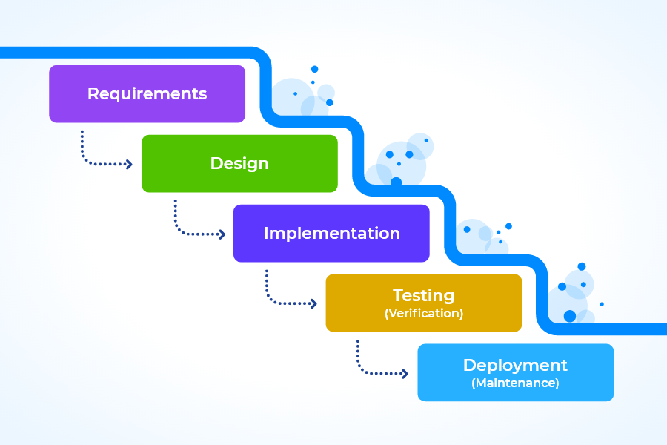
WATERFALL METHODOLOGY PHASES
REQUIREMENTS
All customer requirements are gathered at the beginning of the project, allowing every other phase to be planned without further customer correspondence until the product is complete.
DESIGN
Involves creating a detailed technical design that outlines the architecture, software components, and overall system structure.
IMPLEMENTATION
-Focuses on developing and coding the software based on the design specifications. -Involves a dedicated team of developers
TESTING
-Ensure the product has no errors. -All of the requirements have been completed
-Ensuring a good user experience with the software.
DEPLOYMENT
-Software is deployed to the production environment or delivered to the client.
-Maintenance is done to fix issues occured in the customer environment.

Slide 5
PROS & CONS OF WATERFALL
PROS
Clear and Well-Defined Requirements
Easy to Understand and Manage
Clearly Defined Milestones
Documentation Focus
Suitable for Stable Requirements
Customers aren’t always adding new requirements to the project, delaying production.
CONS
Limited Flexibility
Late Feedback and Risk Mitigation
Long Delivery Time
Limited Client Involvement
Limited Adaptability to Changing Requirements

Slide 6
BEST USE OF WATERFALL METHODOLOGY
Projects which are well-defined and has stable requirements.
The waterfall methodology works well when the project can be divided into distinct phases that follow a sequential and linear flow.
Projects with predictable outcomes and low levels of complexity and risk.

Slide 7
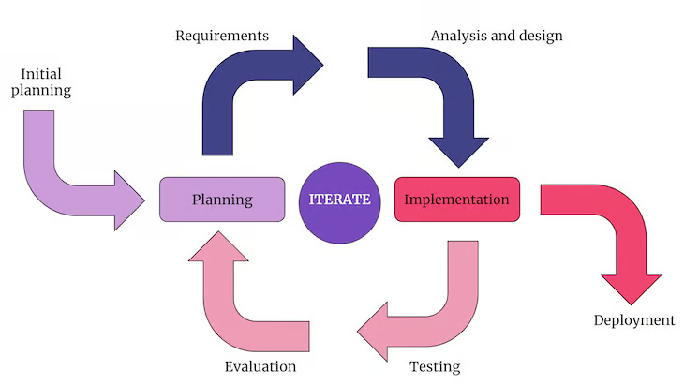
INCREMENTAL METHODOLOGY
Incremental methodology, also known as iterative or agile methodology, is an approach to software development that breaks down a project into smaller increments or iterations.

Slide 8
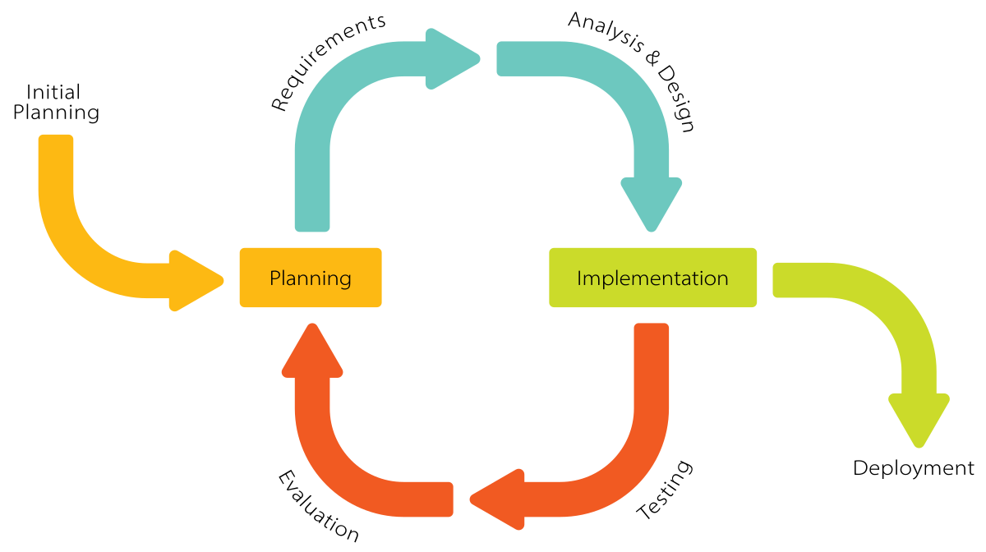
HOW INCREMENTAL METHODOLOGY WORKS?
Incremental methodology works by dividing the software development process into smaller iterations or increments, each delivering a functional piece of the software.
Initial Planning- The overall goals, requirements, and priorities of the project are defined.
Requirements
Analysis & design
Implementation
Testing
Deployment

Slide 9
PROS & CONS OF INCREMENTAL METHODOLOGY
PROS
Reduces the overall project risk
Flexibility and Adaptability
Improved efficiency
Feedback is possible
Easier to test and debug
CONS
Scope Management
The iteration stages are rigorous, and they don’t overlap.
If team is not focused, the project will become uncoordinated.
Rectifying a problem in one unit requires correction in all the units and consumes a lot of time

Slide 10
WHEN TO USE INCREMENTAL METHODOLOGY?
The project which are not fully known or likely to change over time , though some details can evolve at each increment over time.
Incremental methodology is well-suited for complex projects that carry significant risks.
In situations where time-to-market or time-sensitive delivery is crucial, incremental methodology can be advantageous.
If there is a high likelihood of receiving change requests during the development process, incremental methodology provides the flexibility to accommodate these changes effectively.

Slide 11
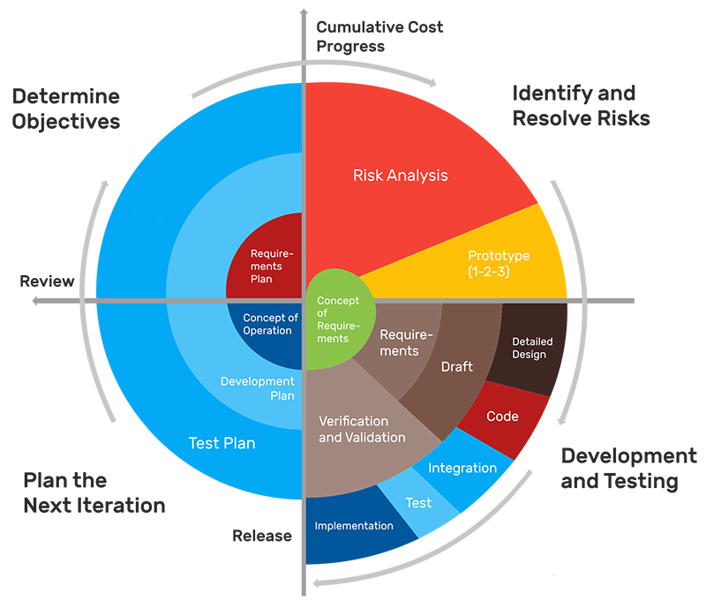
Boehm’s Spiral
Methodology
A software development approach that uses iterative cycles to focus on managing risks and adapting to changes

Slide 12
What is Boehm’s Spiral Methodology?
Boehm's Spiral Methodology, also known as the Spiral Model, is a software development process model that combines elements of both waterfall and incremental development methodologies. It is characterized by a series of iterative cycles, with each cycle representing a phase of the software development process. These phases typically include requirements gathering, design, development, testing, and deployment. However, unlike the traditional waterfall model, the Spiral Model acknowledges the iterative nature of software development and allows for feedback and changes at each phase.

Slide 13
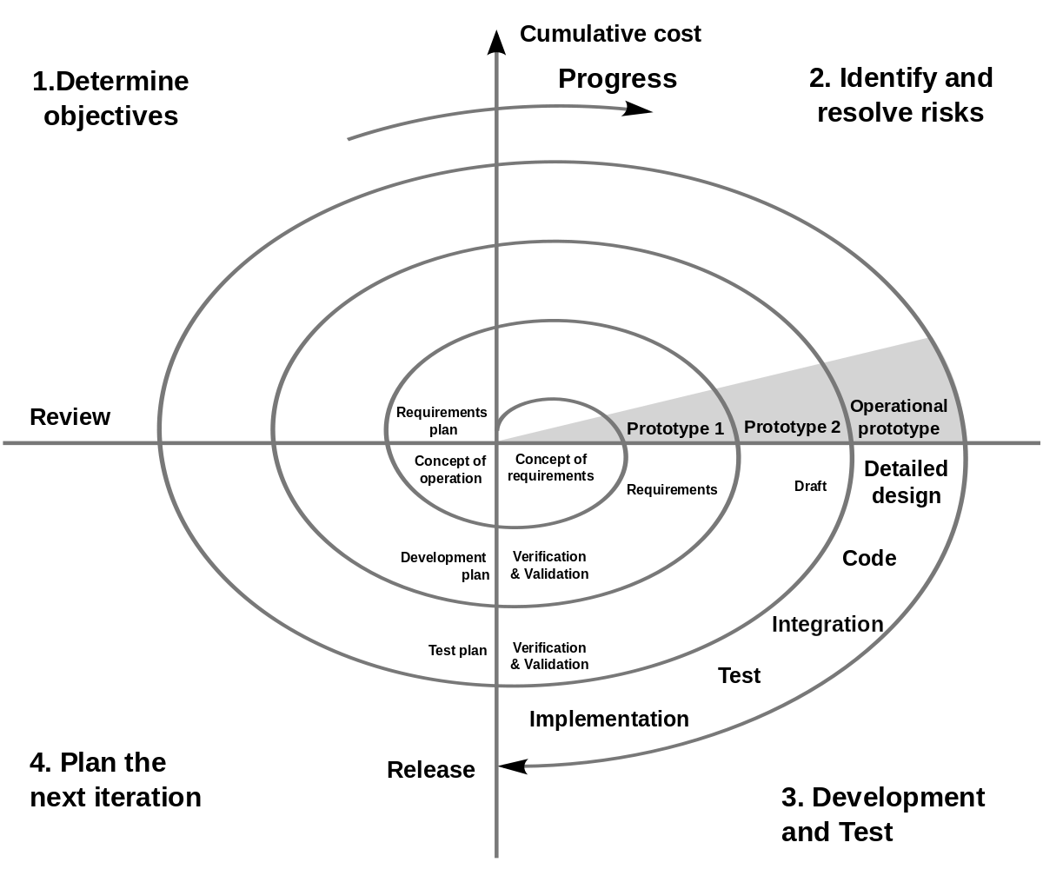
Boehm’s Spiral Methodology - How it works
Determine Objectives The development team defines the specific objectives and requirements for the iteration.
Identify and resolve risks Potential risks and uncertainties are identified and analyzed. This step involves evaluating technical, schedule, and cost risks associated with the project.
Development and Tests The software is designed, developed, and tested according to the objectives and requirements defined in the previous steps.
Determine the next cycle Based on the evaluation results and risk analysis, the next iteration's objectives, requirements, and plans are defined.

Slide 14
Pros and Cons of the Spiral Model
Pros | Cons
Risk Management in large amounts | A costly model
Useful for large and mission-critical projects | Risk analysis needed highly particular expertise
Flexible | Not suitable for smaller projects

Slide 15
When the Spiral Model is used
The spiral model is used during these scenarios:
Frequent Updates Required
Large and Complex Projects
When Project Requirements are complex and ambiguous
Frequent changes and uncertain/evolving requirements
High Budget Projects

Slide 16
Rational Unified Process (RUP)
An approach for software engineering for delegating activities and responsibilities inside a software development organization

Slide 17
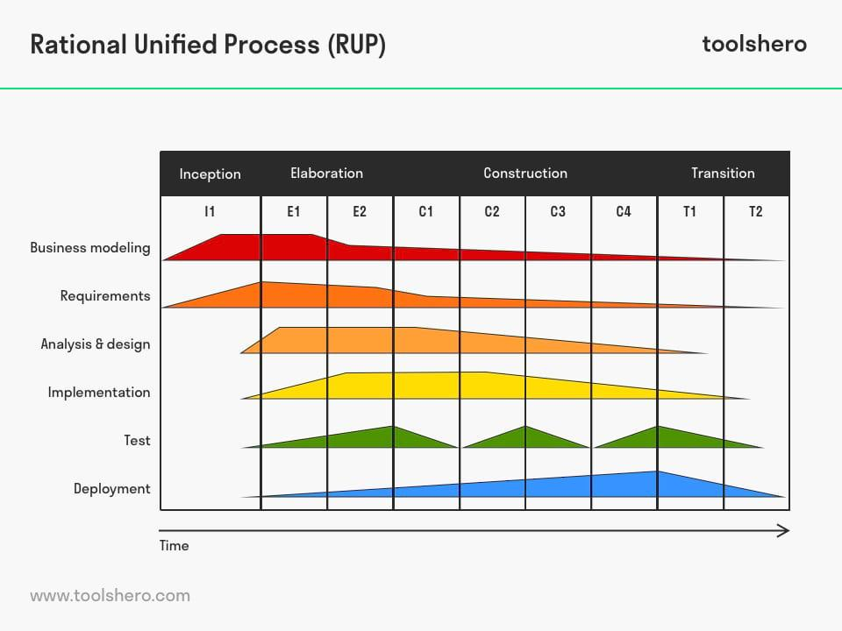
What is Rational Unified Process?
Rational unified process (RUP) is a software engineering and development process focused on using the unified modeling language (UML) to design and build software. It allows to operate business analysis, design, testing and implementation throughout the software development process and its unique stages, help to create a customized product.

Slide 18
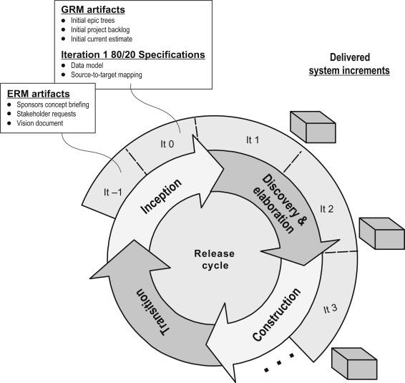
Phases of RUP
There are five phases of RUP that can help to decrease development costs, wasted resources and total project management time.They are :
Inception phase:
Communication and planning
Identifies the scope of the project
Project plan,goal,use case model and description
Prototype development
2. Elaboration phase:
a) Planning and modeling
b) Detailed evaluation and development plan
and diminishes the risks
c) Executable architecture baseline

Slide 19
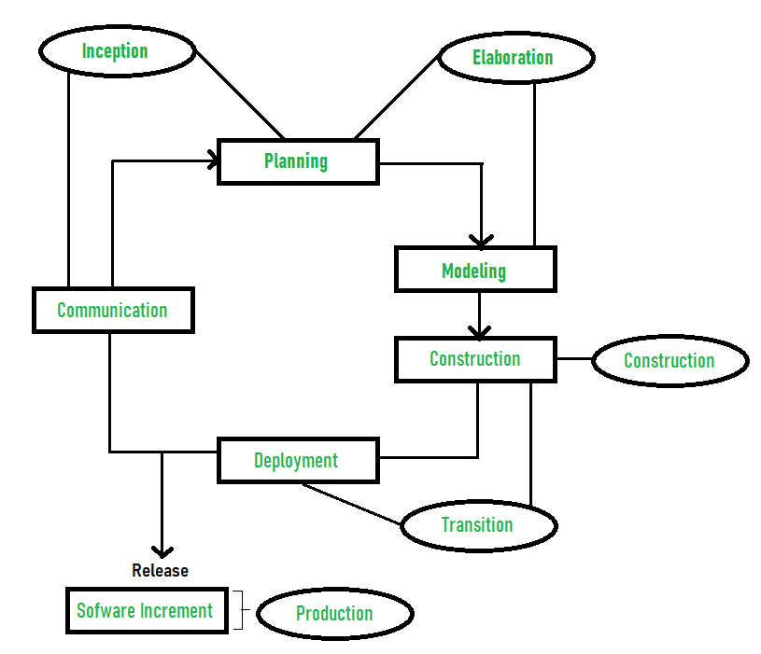
Phases of RUP
3. Construction phase:
a) Project development and completion
b) System or source code create and complete testing
4. Transition phase:
a) Final project released and analysis
b) Beta testing
c) Collection of user feedback
5. Production phase:
a) Project maintenance and update accordingly
b) Final phase of the model
c) User help and assistance platform availability

Slide 20
Pros and cons of RUP
Pros | Cons
Provides good documentation | Complexity of process
Provides risk management support | Cost and time
Reduce total project time | Hard to integrate again and again
Giving regular feedback to stakeholders | Complex and not properly organized process

Slide 21
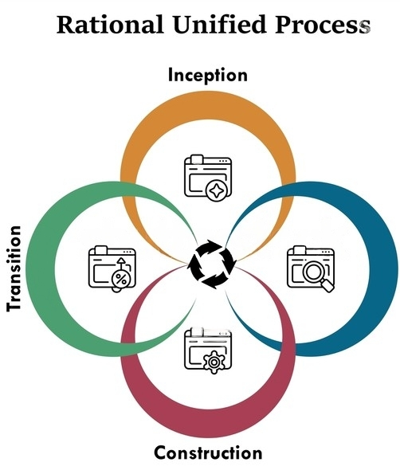
Best practices for using RUP
RUP is well-suited for large-scale and complex software development projects. It places significant emphasis on requirements management and analysis. The iterative nature makes it adaptable to changing requirements. RUP encourages collaboration among team members, stakeholders, and customers. It incorporates various quality-focused practices such as continuous verification and validation, risk management, and architectural reviews.RUP supports long-term projects where technology choices may evolve over time.
Elaboration

Slide 22
Scrum
A lightweight framework for project management and software development.
An iterative and incremental approach, where the team works in short sprints to deliver working software.

Slide 23
Scrum’s Core Values
1
2
Individuals and interactions over processes and tools
Working software over comprehensive documentation.
4
3
Customer collaboration over contract negotiation
Responding to change over following a plan

Slide 24
Major features of Scrum
4
1
Self-organizing teams
Iterative and incremental development
3
2
Transparency
Continuous improvement

Slide 25
Increased collaboration and communication
Pros of Scrum:
Increased transparency
Requires a skilled team
Increased flexibility
Requires a skilled team
Improved quality
Can be difficult to scale
Cons of Scrum:
Motivation to finish sprint
Can be time-consuming
Can be difficult to get buy-in from stakeholders

Slide 26
XP(extreme programming)
A comprehensive agile methodology that emphasizes:
Technical Excellence,
Continuous Improvement, and
Customer Satisfaction.

Slide 27
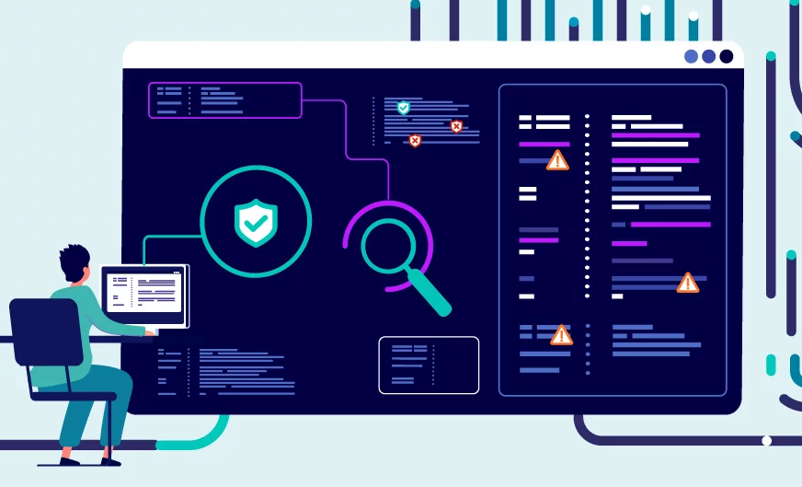

Core Values of XP
in agile project management
Simplicity
01
03
Discipline
Doesn’t overburden the developers with an invasive process.
Includes practices that we to follow.
Key point of the XP method.
Centred on people, developers and consumers.
02
04
Software Development
Humanistic

Slide 28
Principles of XP
Feedback
Simplicity
Courage
COMMUNICATION
: The team should communicate effectively with each other and with the customer.
get feedback from the customer early and often.
The team should strive to keep the code simple and easy to understand.
team should have the courage to make changes, even if they are difficult.

Slide 29
Major Features of XP
Simple Design
Test-Driven
Development
Pair Programming
On-Site Customer
2
4
6
8
1
3
5
7
Incremental
Planning
Small
Releases
Refactoring
Continuous
Integration

Slide 30
Agile project management infographics
Pro’s of XP
High Quality Software
Unclear Estimates
Faster Development
Collocated Team Only
Customer Satisfaction
Code over Design
Fast MVP Delivery
Con’s of XP
Less Documentation
High Visibility
Pair Programming takes Longer

Slide 31
A comparison of the different agile methods:
Method | Pros | Cons
Scrum | Flexible and adaptable | Can be difficult to get started with
XP | Focuses on quality | Can be time-consuming
Waterfall | Well-defined process | Not flexible or adaptable
RUP | Comprehensive framework | Can be complex and difficult to implement
Spiral | Involves risk analysis | Can be time-consuming
Incremental | Delivers working software early and often | Can be difficult to manage

Slide 32


