Slide 1
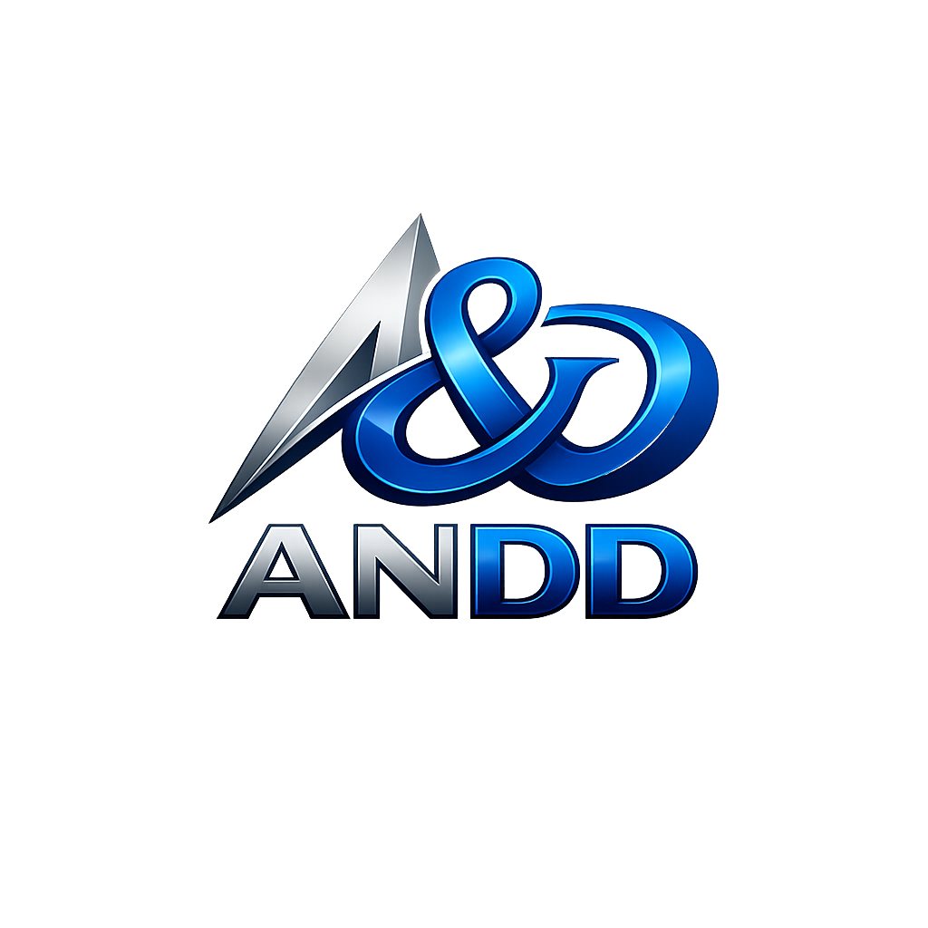
AI Native Distributed
Datacenter Network
A commercially scalable network of inference-specific micro datacenters
delivering AI models, agents, and on-demand token capacity at the edge
$162B
<2MW
AI Native
DC Projects Blocked
Per Site Footprint
Autonomous Operations
Business Overview — April 2026
CONFIDENTIAL — DO NOT DISTRIBUTE

Slide 2
THE PROBLEM
The Datacenter Industry Has Hit a Wall
Massive datacenter projects face unprecedented opposition while AI inference demand explodes. The industry needs a fundamentally different approach.
$162B
70%
300MW
of datacenter projects
blocked by state & local pushback
of East Coast internet traffic
routed through Northern Virginia alone
per hyperscale campus —
equivalent to a small power plant
Why States Are Pushing Back
What This Concentration Means
▸ Hyperscale campuses overwhelm local power grids
▸ Massive water consumption for cooling (millions of gallons/day)
▸ Communities see burden without proportional economic benefit
▸ Environmental impact reviews blocking permits
▸ Political pressure from residents and local government
▸ Critical internet functions have no geographic redundancy
▸ No data sovereignty — governments have zero control over where data lives
▸ AI inference requires low latency that centralized facilities cannot serve at the edge
▸ A single regional disaster could degrade federal, financial, and defense systems simultaneously

Slide 3
MARKET OPPORTUNITY
$162B in Blocked Projects. The Market Needs an Alternative.
The demand for compute capacity hasn't gone away — the deployment model is what's broken.
The Blocked Pipeline
Why Distributed Solves This
▸ $162B of announced datacenter projects facing delays or cancellation
▸ States including VA, GA, IN, SC imposing moratoriums
▸ Environmental impact reviews adding 12-24+ months to timelines
▸ Grid interconnection queues extending 3-5+ years
▸ Community opposition escalating to state legislation
▸ Power: <2MW per site works within existing grid — no new generation needed
▸ Permitting: Small footprints within cell tower sites bypass permitting battles
▸ Water: Direct liquid cooling eliminates evaporative cooling towers
▸ Community: Creates local jobs and tax revenue without environmental burden
Environmental Concerns Are Real
Data Sovereignty Requires Local
▸ Single hyperscale campus uses 1-5M gallons of water/day
▸ Concentrated power demand drives new fossil generation
▸ IEA projects DC electricity at 945-1,300 TWh by 2030
States are increasingly mandating that government data remain within their borders. Municipalities need local compute for 911, traffic, and utility SCADA. Data sovereignty can only be addressed by local operation — no cloud policy can substitute for physical proximity.

Slide 4
OUR APPROACH
Micro Datacenters at Cellular Tower Sites
Highly dispersed, inference-specific micro datacenters (<2MW each) deployed at existing cellular tower infrastructure — eliminating the permitting, power, and community opposition problems.
<2MW
60-90 days
Zero
40,000+
Per site power draw
To deploy (prefab)
New permitting required
Crown Castle tower sites
Crown Castle Agreement: Active discussions to co-locate ANDD micro datacenters at their 40,000+ tower sites across the US. Existing power, connectivity, and site access provide an immediate deployment pipeline.
Existing Power & Connectivity
Tower sites already have utility power feeds and fiber/microwave backhaul. We scale to the grid capacity that's already there.
Permitting Risk Eliminated
By staying inside the existing site footprint, we operate under the tower's existing land use permits. No new environmental reviews.
Geographic Distribution Built-In
Cell towers are sited for population coverage. We inherit a deployment map optimized for proximity to end users.
AI Native = Lower Operating Cost
AI handles provisioning, monitoring, billing, and maintenance. 1 human operator per 20-50 sites, not 5-10 humans per site.

Slide 5
WHAT'S NOVEL
An Inference Network, Not Just Datacenters
ANDD is building a commercially scalable network of inference-specific resources that makes AI capacity available like a utility.
AI Model Marketplace
Elastic Token Capacity
Edge-Native Inference
Customers access a wide catalog of AI models, LLMs, and agents hosted across the network. Consume inference as a service — no GPU provisioning needed.
Customers purchase AI token capacity on-demand. The network routes to available GPUs across the mesh automatically — no capacity planning.
Sub-10ms latency for real-time applications: autonomous vehicles, medical devices, industrial control, fraud detection.
Five Things That Make ANDD Different
The Business Moat
1. Cell tower co-location — 40,000+ sites, existing permits, existing power
2. <2MW per site — fits within current grid, no new generation needed
3. AI-native operations — 95%+ of ops automated, 60-75% lower staffing costs
4. Inference-specific hardware — optimized for the 60-70% of AI compute that is inference
5. Network mesh fabric — nodes cooperate, workloads route to optimal location automatically
Every new site makes the network more valuable.
▸ More locations = lower latency for more customers
▸ More coverage = more addressable market
▸ More data = better AI capacity planning
▸ More nodes = higher network-wide utilization
This is a network effect business, not a real estate business.

Slide 6
CUSTOMERS
Who Buys Edge AI Inference Capacity
AI / ML Companies
Government (Fed/State/Local)
Healthcare & Telemedicine
Companies deploying AI models needing low-latency inference close to end users. LLM providers, computer vision, NLP, AI agents.
Data sovereignty, FedRAMP workloads, NG911, FirstNet, CJIS, defense-adjacent processing.
HIPAA-compliant edge compute for medical imaging AI, remote diagnostics, patient data processing.
Buy token capacity and GPU hours.
Multi-year contracts, premium pricing.
Data must stay local, latency is life-critical.
Financial Services
Autonomous Systems
Web3 / DePIN Projects
Fraud detection (sub-50ms), payment processing, data residency. Regional banks and fintech.
V2X for autonomous vehicles, drone coordination, industrial robotics. Sub-10ms inference required.
Enterprise-grade infra for decentralized networks. Validator hosting, compute marketplace, settlement.
High-value, SLA-sensitive.
Growing rapidly, no alternative to edge.
Pay-per-use via crypto micro-transactions.
$500B+
60-70%
$25B+
Edge computing TAM by 2030
Of all AI compute is inference
DePIN infrastructure market

Slide 7
EXECUTION
Keys to Success & Risk Mitigation
Keys to Success
Key Risks & Mitigations
Speed to Scale
Crown Castle Partnership
MEDIUM
Prefab modular units deploy in 60-90 days vs. 18-24 months. Cell tower sites provide 40,000+ pre-validated locations. Target: 3-5 sites Year 1, 50 by Year 2, 300 by Year 4.
Agreement may not materialize. Mitigation: Cell towers are one channel — can co-locate at industrial parks, substations, ISP POPs. Multiple site strategies in parallel.
Cost Management
Utilization / Fill Rate
MEDIUM
AI-native operations cut staffing from $400K+/yr to $80-150K/yr per site. Power scales to existing grid — no infrastructure buildout premiums.
Sites may not reach target utilization fast enough. Mitigation: AI demand modeling drives site selection. Government anchor tenants provide base load.
Compute Fill at Premium Rates
Technology Execution
LOW
Inference-specific positioning commands premium pricing. AI capacity planning ensures utilization by routing workloads across the mesh to fill available capacity.
AI management layer may not achieve target autonomy. Mitigation: Each component is proven tech. Innovation is integration. Graduated rollout with human fallback.
Offtake Customers
Competition
LOW
Government contracts (3-5 yr, premium rates) provide base revenue. AI companies and healthcare provide volume. Multi-rail revenue diversifies concentration risk.
Hyperscalers could replicate. Mitigation: Sub-2MW is structurally unattractive for them. Previous edge attempts failed on economics that AI ops now solve.

Slide 8
UNIT ECONOMICS
What It Costs: Per-Site Economics
Capital Expenditure (Per 200kW Edge Node)
Annual Operating Expenses (Per Node)
Modular enclosure + site prep $300K-$500K
Compute & GPU hardware (4-8 racks) $600K-$1.0M
Networking (switches, backhaul) $100K-$200K
Power (UPS, PDU, switchgear) $150K-$250K
Cooling (DLC + ambient) $100K-$150K
Security, fire suppression, misc $50K-$100K
Total CapEx per node $1.5M - $2.5M
Category
Traditional
ANDD AI-Native
Staffing / operations
$400K+
$80K-$150K
Power (@ $0.08/kWh)
$140K
$140K
Connectivity
$100K
$60K-$120K
Site lease / co-lo fee
$50K-$100K
$50K-$100K
Insurance, maintenance
$50K
$30K-$50K
Total Annual OpEx
$740K+
$360K-$560K
CapEx Offsets
The AI Operations Advantage
▸ On-site solar (100kW): ~$150K installed
▸ Battery storage (500kWh): ~$200K installed
▸ IRA ITC credit (30-50%): -$105K to -$175K savings
▸ OZ tax benefits: Significant additional reduction
Traditional model: sub-2MW sites are margin-negative. Staffing costs alone consume most revenue.
ANDD model: AI automation cuts operating costs by 40-55%, making 200kW sites margin-positive for the first time in the industry.

Slide 9
FINANCIAL RETURNS
Return on Investment
Per-Node Revenue Model (200kW, at target utilization)
Investment Returns Summary
AI inference (GPU hours, token capacity) $350K-$600K
Compute & colocation (enterprise, gov) $100K-$250K
Storage & CDN services $30K-$80K
DePIN / Web3 hosting $20K-$70K
Grid services (BESS demand response) $50K-$150K
Total Annual Revenue $550K - $1.15M
30-45%
2.5-4 yr
Gross Margin
(at target util.)
CapEx Payback
(per node)
18-30%
0%
Unlevered IRR
(10-yr hold)
Federal Cap Gains
(10-yr OZ hold)
Opportunity Zone Tax Stack
Ramp Assumptions
▸ Deferral: Capital gains reinvested into QOF defer tax obligation
▸ Step-up: 10% basis step-up at 5 years (up to 30% for rural OZ)
▸ Exclusion: Zero capital gains tax on all appreciation after 10 years
▸ IRA credits: 30-50% ITC on solar/BESS further reduces effective cost
Year 1: 30-40% utilization → Covers OpEx + partial CapEx service
Year 2: 50-65% utilization → Cash-flow positive
Year 3+: 70-85% utilization → Full margin realization
Network Scale: Unit economics improve with scale — shared AI ops amortized across nodes, bandwidth purchasing power improves, mesh routing enables higher network-wide utilization.

Slide 10
SCALE PLAN
Path to Scale: Network Buildout
Phase 1 — Prove
Phase 2 — Validate
Phase 3 — Scale
Phase 4 — Dominate
Months 1-12
Months 12-24
Months 24-48
Months 48-72
▸ 3-5 pilot sites at Crown Castle
▸ AI ops platform v1 operational
▸ Beta customers (gov, AI, health)
▸ SOC 2 Type I certification
▸ QOF structure established
▸ 20-50 nodes in regional clusters
▸ 2-3 regional hubs deployed
▸ First government contracts
▸ AI handles >90% of ops
▸ FedRAMP Moderate authorization
▸ 100-300 nodes, 10+ hubs
▸ Full mesh fabric operational
▸ Federal government customers
▸ AI model marketplace live
▸ Cash-flow positive (network)
▸ 500-1,000+ nodes nationwide
▸ Revenue funds growth
▸ International expansion
▸ Critical national infrastructure
▸ VPP grid services at scale
$8-15M
$40-100M
$200-600M
Self-Funding
Capital Required
Capital Required
Capital Required
Revenue-Funded
$2.5M
60-90 days
40,000+
Avg CapEx per node
Deploy time (prefab)
Available tower sites

Slide 11
TEAM
The Team Building This
What the Team Must Excel At
Founding Team
Deals & Partnerships
Building ANDD requires expertise across datacenter infrastructure, AI/ML systems, telecommunications, real estate development, federal compliance, and financial structuring.
Crown Castle agreement. Utility interconnections. Government contract vehicles. OZ fund structure. Execution-dependent relationships requiring experienced operators.
CEO / Visionary
Strategy, investor relations, partnerships
AI Operations Engineering
CTO
AI ops platform, infrastructure architecture
The AI management layer is the core differentiator. Deep ML/AI engineering to build the autonomous ops platform that makes the economics work.
VP Infrastructure
Site buildout, hardware, power systems
VP Sales / BD
Government contracts, enterprise customers
Datacenter Operations
CFO
QOF structure, capital markets, financial ops
Prefab deployment, power systems, cooling, physical security, compliance certifications. Proven operators who have built and run facilities.
Government & Compliance
FedRAMP, SOC 2, HIPAA, CJIS, ITAR. Government procurement, security clearances, and patience for federal sales cycles.

Slide 12
THE OPPORTUNITY
The Compute Market Needs a New Model.
This Is It.
$162B in blocked datacenter projects. Exploding AI inference demand. States pushing back on hyperscale.
ANDD delivers the compute capacity the market needs — without the problems.
<2MW
AI Native
40K+ Sites
0% Tax
Fits existing grid
No pushback
60-75% lower ops cost
Margin-positive at 200kW
Crown Castle pipeline
Pre-permitted locations
On appreciation
10-year OZ hold
Revenue from Year 1
Network Appreciation
National Impact
Infrastructure services generate income immediately upon deployment
Each new node increases the value of every existing node in the mesh
Sovereign infrastructure, local jobs, and AI capacity for underserved communities
Email
contact@andd.network
Web
andd.network
CONFIDENTIAL — DO NOT DISTRIBUTE

