Slide 1


∀NDD
/
AI-NATIVE DISTRIBUTED DATACENTERS
// BUSINESS OVERVIEW · APRIL 2026
The fabric beneath the next internet.
CONFIDENTIAL — DO NOT DISTRIBUTE
A commercially scalable network of inference-specific micro datacenters — delivering AI models, agents, and on-demand token capacity at the edge.
BLOCKED DATACENTER PROJECTS
PER-SITE FOOTPRINT
OPERATIONS
CROWN CASTLE PIPELINE
$162 B
<2 MW
AI Native
40 K+
Industry's deployment wall — our opening
Fits within existing grid; no new generation
1 operator per 20–50 sites
Pre-permitted tower locations
// 01 / 13 · TITLE

Slide 2
∀NDD
01 · THE OPPORTUNITY
// THE OPPORTUNITY
The compute market needs a new model. This is it.
$162B in blocked datacenter projects. Exploding AI inference demand. States pushing back on hyperscale. ANDD delivers the capacity — without the problems.
CONFIDENTIAL — DO NOT DISTRIBUTE
◆ <2MW FITS EXISTING GRID
◆ 40K+ TOWER SITES
◆ AI-NATIVE OPERATIONS
◆ 0% CAPITAL GAINS
No grid strain
Pre-permitted
60–75% lower opex
10-yr OZ hold
Low power, no pushback, no new generation needed.
Crown Castle pipeline. Fabric link + scale compute.
Margin-positive at 350kW. Opex minimized.
Appreciation tax-free on qualified sites.
/ REVENUE FROM YEAR 1
/ NETWORK APPRECIATION
/ NATIONAL IMPACT
Infrastructure services generate income immediately on deployment.
Every new node increases the value of every existing node in the mesh.
Sovereign infrastructure, local jobs, AI capacity for underserved communities.
// 02 / 13 · OPPORTUNITY
CONTACT@ANDD.AI · ANDD.AI

Slide 3
∀NDD
02 · THE PROBLEM
// THE PROBLEM
The datacenter industry has hit a wall.
Massive campuses face unprecedented opposition while AI inference demand explodes. The industry needs a fundamentally different approach.
BLOCKED
CONCENTRATED
HEAVY
$162B
70%
300MW
CONFIDENTIAL — DO NOT DISTRIBUTE
Of datacenter projects halted by state & local pushback.
Of East Coast internet traffic routed through Northern Virginia alone.
Per hyperscale campus — equivalent to a small power plant.
/ WHY STATES ARE PUSHING BACK
/ WHAT THE CONCENTRATION MEANS
Hyperscale campuses overwhelm local power grids
Millions of gallons/day of water for evaporative cooling
Burden without proportional economic benefit
Environmental reviews blocking permits, noise, blight
Political pressure from residents & local gov
No geographic redundancy for critical internet
No data sovereignty — gov has no control of where data lives
AI inference needs latency centralized facilities can't serve
A single regional event degrades federal + financial + defense
// 03 / 13 · PROBLEM
SOURCES: INDUSTRY TRACKERS, Q1 2026

Slide 4
∀NDD
03 · MARKET OPPORTUNITY
// MARKET OPPORTUNITY
$162B in blocked projects. The demand didn't go away.
The deployment model is what's broken. Distributed, sub-2MW edge sites clear every obstacle the hyperscale model tripped over.
◆ THE BLOCKED PIPELINE
◆ ENVIRONMENTAL CONCERNS ARE REAL
$162B of announced datacenter projects facing delays or cancellation
VA, GA, IN, SC imposing moratoriums
EIRs adding 12–24+ months to timelines
Grid interconnect queues 3–5+ yr (7+ in N. Virginia)
Community opposition → state legislation
Single hyperscale campus uses 1–5M gallons of water/day
Concentrated demand drives new fossil generation
IEA projects DC electricity at 945–1,300 TWh by 2030
CONFIDENTIAL — DO NOT DISTRIBUTE
→ FORCING A NEW DEPLOYMENT PRIMITIVE
◆ WHY DISTRIBUTED SOLVES THIS
◆ SOVEREIGNTY REQUIRES PRESENCE
Power: <2MW works within existing grid — no new generation
States increasingly mandate government data stay within their borders. Municipalities need local compute for 911, traffic, and utility SCADA. No cloud policy substitutes for physical proximity.
Permitting: small footprints within tower sites bypass battles
Water: DLC eliminates evaporative towers
Community: local jobs & tax revenue, zero burden — won't know it's there
// 04 / 13 · MARKET OPPORTUNITY
TAM · EDGE COMPUTE $500B+ BY 2030

Slide 5
∀NDD
04 · OUR APPROACH
// OUR APPROACH
Micro datacenters at cellular tower sites.
Highly dispersed, inference-specific micro datacenters (<2MW each) deployed at existing cellular tower infrastructure — eliminating permitting, power, and community opposition.
PER-SITE POWER DRAW
DEPLOY TIME (PREFAB)
NEW PERMITTING REQUIRED
CROWN CASTLE TOWER SITES
<2 MW
90–180 d
Zero
40,000 +
CONFIDENTIAL — DO NOT DISTRIBUTE
◆ CROWN CASTLE AGREEMENT
◆ EXISTING POWER & FIBER
◆ PERMITTING RISK ELIMINATED
Active discussions to co-locate ANDD micro datacenters at 40,000+ tower sites . Available power, connectivity, and site access provide an immediate deployment pipeline.
Utility feeds + fiber/microwave backhaul already on-site. We scale to the grid capacity that's already there.
Inside the existing tower footprint; operates under the tower's land-use permits. No new EIRs.
◆ DISTRIBUTION BUILT-IN
◆ AI-NATIVE = LOWER OPEX
Tower siting tracks population. We inherit a deployment map optimized for user proximity.
1 operator per 20–50 sites (not 5–10 per site). AI handles provisioning, monitoring, billing.
// 05 / 13 · APPROACH
DEPLOY PATTERN · PREFAB + TOWER CO-LO

Slide 6
∀NDD
05 · WHAT'S NOVEL
// WHAT'S NOVEL
An inference network, not just datacenters.
ANDD makes AI capacity available like a utility — elastic, priced, routed.
01 / AI MODEL MARKETPLACE
02 / ELASTIC TOKEN CAPACITY
03 / EDGE-NATIVE INFERENCE
Inference as a service
Buy tokens on demand
Sub-10ms latency
CONFIDENTIAL — DO NOT DISTRIBUTE
Wide catalog of LLMs, agents, vision models hosted across the network. No GPU provisioning needed.
The network routes to available GPUs across the mesh automatically — no capacity planning, no dedicated hardware.
Real-time applications: autonomous vehicles, medical devices, industrial control, fraud detection.
/ FIVE THINGS THAT MAKE ANDD DIFFERENT
◆ THE BUSINESS MOAT
01 Cell tower co-location — 40,000+ sites, existing permits & power
Every new site makes the network more valuable.
02 <2MW per site — fits current grid, no new generation
More locations → lower latency, higher reliability
More coverage → more addressable market
More data → better capacity planning
More nodes → higher network-wide utilization
03 AI-native ops — 95%+ automated, 60–75% lower staffing
04 Inference-specific hardware — optimized for 60–70% of AI compute
05 Network mesh fabric — workloads route to optimal location
THIS IS A NETWORK-EFFECT BUSINESS, NOT A REAL ESTATE BUSINESS.
// 06 / 13 · NOVEL
POSITIONING · INFRA PRODUCT, NOT LANDLORD

Slide 7
∀NDD
06 · CUSTOMERS
// CUSTOMERS
Who buys edge AI inference capacity?
01 / AI & ML
02 / GOVERNMENT
03 / HEALTHCARE
Model & agent providers
Fed / state / local
Telemedicine & imaging
LLM, CV, NLP, AI agents — low-latency inference close to users. Buy token capacity & GPU hours.
Data sovereignty, FedRAMP, NG911, FirstNet, CJIS, defense-adjacent. Multi-year contracts at premium pricing.
HIPAA-compliant edge for medical imaging AI, remote diagnostics. Data stays local, latency is life-critical.
CONFIDENTIAL — DO NOT DISTRIBUTE
04 / FINANCIAL SERVICES
05 / AUTONOMOUS SYSTEMS
06 / WEB3 & DEPIN
Fraud, payments, residency
V2X, drones, robotics
Enterprise-grade backbone
Sub-50ms fraud detection, payment processing, data residency. High-value, SLA-sensitive.
Sub-10ms inference required. Growing rapidly — no alternative to edge.
Validator hosting, compute marketplaces, settlement. Pay-per-use via crypto micro-transactions.
EDGE COMPUTING TAM · 2030
SHARE OF AI COMPUTE IN INFERENCE
DEPIN INFRASTRUCTURE MARKET
$500 B+
60–70 %
$25 B+
// 07 / 13 · CUSTOMERS
SIX DEMAND RAILS, DIVERSIFIED

Slide 8
∀NDD
07 · EXECUTION
// EXECUTION
Keys to success & risk mitigation.
/ KEYS TO SUCCESS
/ KEY RISKS & MITIGATIONS
Speed to scale
Crown Castle partnership
MEDIUM
Prefab units in 60–90d vs. 18–24mo. 40K+ pre-validated locations.
Target: 3–5 sites Y1, 50 Y2, 300 Y4.
Agreement may not materialize. Mitigation: towers are one channel — industrial parks, substations, ISP POPs, other towercos in parallel.
Cost management
Utilization / fill rate
CONFIDENTIAL — DO NOT DISTRIBUTE
MEDIUM
AI ops cuts staffing $400K+ → $80–150K/yr/site. Power scales to existing grid — no buildout premiums.
Sites may not hit target utilization fast enough. Mitigation: AI demand modeling drives site selection; gov anchor tenants = base load.
Premium compute fill
Technology execution
LOW
Inference-specific commands premium pricing. Mesh routing fills available capacity across the network.
AI mgmt layer may not hit target autonomy. Mitigation: components are proven; innovation is integration. Graduated rollout with human fallback.
Offtake customers
Competition
LOW
Gov contracts (3–5 yr, premium) provide base load. AI & healthcare provide volume. Multi-rail revenue diversifies concentration.
Hyperscalers could replicate. Mitigation: sub-2MW is structurally unattractive; prior edge attempts failed on economics AI ops now solve.
// 08 / 13 · EXECUTION
RISK POSTURE · CONSERVATIVE ON CONTRACTS, AGGRESSIVE ON OPS

Slide 9
∀NDD
08 · UNIT ECONOMICS
// UNIT ECONOMICS
What it costs: per-site economics.
◆ CAPEX — PER 320KW EDGE SITE
◆ ANNUAL OPEX — TRADITIONAL VS ANDD
Modular enclosure + site prep
$250K
CATEGORY
TRADITIONAL
ANDD AI-NATIVE
Compute (5 racks, 160 GB200s)
$9M
Staffing
$400K+
$80–150K
Networking (switches, backhaul)
$250K
Power (@ $0.10/kWh)
$280K
$280K
Power (UPS, PDU, switchgear)
$500K
Connectivity
$100K
$60–95K
CONFIDENTIAL — DO NOT DISTRIBUTE
Cooling (DLC + ambient)
$250K
Site lease / co-lo
$50–100K
$50–100K
Security, construction, other
$750K
Insurance, maintenance
$150–200K
$150–175K
Total CapEx per site
$11M
Total annual OpEx
$980K+
$620–800K
◆ SUMMARY — SITE UNIT ECONOMICS / YEAR
REVENUE
DIRECT COSTS
EBITDA
$4.2–5.1M
$620–800K
$3.6–4.3M
Each site generates ≈ $2.9M excess cash after equity, debt service and residual. 3-year time-frame to secure.
// 09 / 13 · UNIT ECONOMICS
ILLUSTRATIVE · 320KW EDGE SITE, TARGET UTILIZATION

Slide 10
∀NDD
09 · FINANCIAL RETURNS
// FINANCIAL RETURNS
Return on investment.
◆ PER-SITE REVENUE MODEL — 320KW, TARGET UTIL.
GROSS MARGIN
CAPEX PAYBACK
85 %
2.5–3 yr
AI inference (GPU hours, token capacity)
$4M – 4.5M
At target utilization
Per site
Compute & colo (enterprise, gov)
$100–250K
LEVERAGED PROJECT IRR
FEDERAL CAP GAINS
70–80 %
0 %
Storage & CDN services
$30–80K
50% debt · 10% int · 3Y term
10-yr OZ hold
CONFIDENTIAL — DO NOT DISTRIBUTE
DePIN / Web3 hosting
$20–70K
Grid services (BESS, demand response)
$50–150K
◆ OPPORTUNITY ZONE TAX STACK
Deferral: capital gains reinvested into QOF defer tax obligation
Total annual revenue
$4.2 – 5.1M
Step-up: 10% basis step-up at 5 years (up to 30% for rural OZ)
Exclusion: zero capital gains tax on all appreciation after 10 years
IRA credits: 30–50% ITC on solar/BESS further reduces effective cost
→ NETWORK SCALE: UNIT ECONOMICS IMPROVE WITH SCALE — SHARED AI OPS AMORTIZED ACROSS NODES, PURCHASING POWER IMPROVES, MESH ROUTING LIFTS NETWORK-WIDE UTILIZATION.
// 10 / 13 · FINANCIAL RETURNS
ILLUSTRATIVE IRR · SENSITIVITY MODELED

Slide 11
∀NDD
10 · SCALE PLAN
// SCALE PLAN
Path to scale: network buildout.
PHASE 1 / DEMONSTRATE
PHASE 2 / SCALE
PHASE 4 / DOMINATE
2026 & 2027
2028 & 2029
2030+
6 pilot sites + 75 operational sites in top PEAs
AI ops platform v1 operational
Beta customers (gov, AI, health)
Purchase commitments and/or down payments
SOC 2 Type I certification
QOF structure established
430 additional sites in top PEAs
Government contracts
AI handles >90% of ops
Full mesh fabric operational
FedRAMP Moderate authorization
EBITDA positive (2027/2028 – driven by scale)
500–1,000+ nodes nationwide – fill in PEA Demand
Cash flow funds growth
International expansion
Critical national infrastructure
VPP grid services at scale
CONFIDENTIAL — DO NOT DISTRIBUTE
EQUITY REQUIRED
EQUITY REQUIRED
FUNDING
$600M
$1.8B
EBITDA-funded
AVG CAPEX PER SITE
DEPLOY TIME · PREFAB
AVAILABLE TOWER SITES
$11 M
90–180 d
40,000 +
// 11 / 13 · SCALE PLAN
CAPITAL STACK · EQUITY → DEBT → SELF-FUNDED

Slide 12
∀NDD
11 · CUSTOMER TRACTION
// CUSTOMER TRACTION
Pipeline, not speculation.
ANDD has line of sight to demand for the first fifty 500kW datacenters, a DoW program ( FreedomNet) covering majority of Florida, and T-Mobile as an additional pipeline opportunity.
◆ IMMEDIATE
◆ NEAR TERM
◆ FUTURE
Kardeshev
US DoT · FreedomNet
T-Mobile
CONFIDENTIAL — DO NOT DISTRIBUTE
First 50 × 500kW datacenters. Line-of-sight demand, near-term contracting.
Program requires ANDD to build out majority of Florida with datacenters — sovereign national deployment.
Additional carrier-pipeline opportunity. Overlays neatly on the tower-site co-location model.
● ACTIVE
● ENGAGED
● EXPLORING
/ CATEGORY INTEREST
Conversations in market with hyperscalers
Google · Amazon · Meta — all exploring edge inference capacity as their own hyperscale pipelines face the same blocks.
// 12 / 13 · TRACTION
PIPELINE SNAPSHOT · Q2 2026

Slide 13
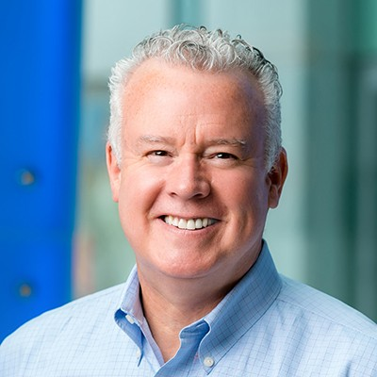
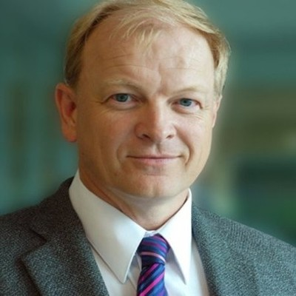
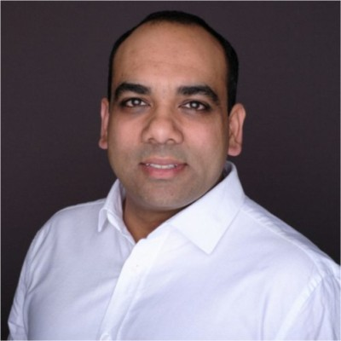
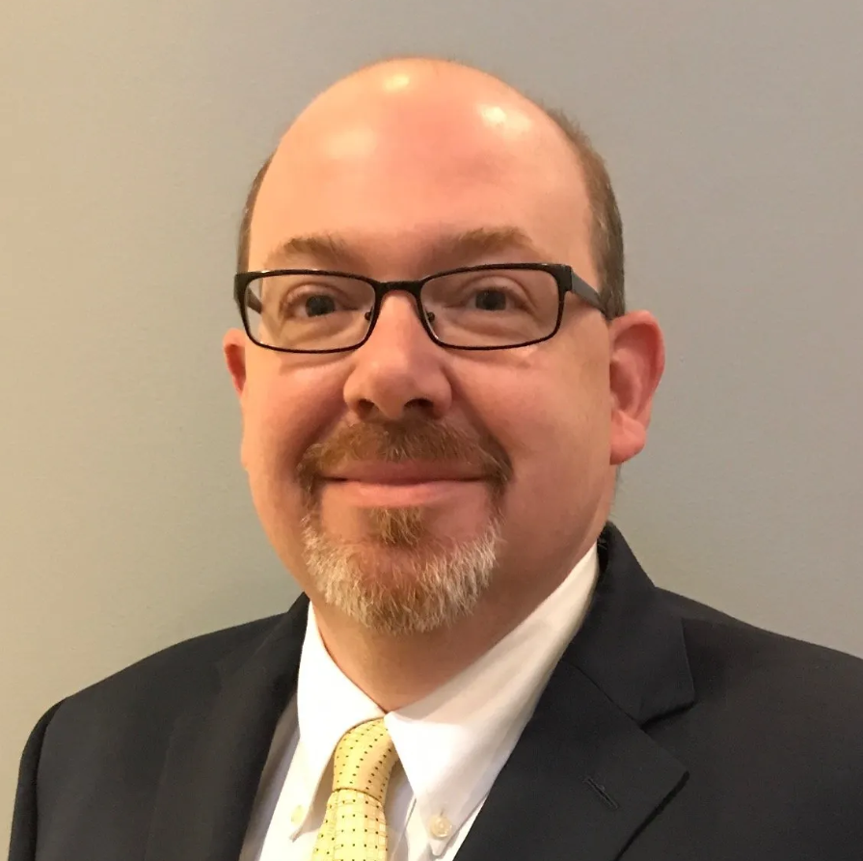
∀NDD
12 · TEAM
// TEAM
The team building this.
Building ANDD requires expertise across datacenter infrastructure, AI/ML systems, telecommunications, real estate, federal compliance, and financial structuring.
CEO
PRESIDENT
CTO
William Tolpegin
Chris Stark
Anoop Nannra
35+ yrs executive experience. Former CEO of C-Band Alliance — the Intelsat/SES/Eutelsat/Telesat consortium that reallocated U.S. mid-band spectrum for 5G. Former CEO of OTA Broadcasting; co-founder of AURA Networks (deterministic wireless for drone C2).
35+ yrs across Fortune 1000 and technology ventures with deep expertise in telecom, spectrum, and large-scale infrastructure deployment. Chairman and co-founder CBRS alliance, long-time operator of complex multi-stakeholder programs.
CEO/Co-Founder of Trugard Labs. Previously led blockchain and cloud initiatives at AWS and Cisco, co-founded & chaired the Trusted IoT Alliance. Hands-on background in distributed systems, photonics, chip design, video infrastructure and cybersecurity.
CONFIDENTIAL — DO NOT DISTRIBUTE
To Be Hired
EVP OPERATIONS
CLO
Head of Deployment & Operations
Brian Hendricks
◆ GET IN TOUCH
contact@andd.ai andd.ai
Seeking a 20+ yr operator from hyperscale or towerco — Equinix / Digital Realty / Crown Castle / American Tower . Must own multi-site prefab rollout at 50+ sites/yr, utility interconnect & DLC commissioning, NOC automation, SOC 2 / FedRAMP compliance, and 24/7 field ops across distributed footprints.
Chief Public Policy & Government Affairs Officer at Nokia (13+ yrs). Former General Counsel & Staff Director , U.S. Senate Committee on Commerce, Science & Transportation; FCC Enforcement Bureau attorney; AT&T policy. J.D./MPP, William & Mary.
// 13 / 13 · TEAM

