Slide 1
IBM University Engagement Project Submission
“Exploring the Power of Agentic AI with IBM Granite and LangFlow”

Slide 2

Project Title – AI Agent for Digital Financial Literacy
Domain of Project – Finance / Education / Digital Literacy
Student Name | Recent Passport Photo | Email ID | Mobile number [WhatsApp]
Anannya Bhowmik |  | anannyabh2002@gmail.com | 7439835582

Slide 3
Problem Statement –
Problem Statement : AI Agent for Digital Financial Literacy
The Challenge
Millions of Indians are entering the digital financial ecosystem for the first time, yet lack the knowledge to use it safely and effectively. People struggle to understand UPI payments, fall victim to online scams and phishing, cannot interpret loan interest rates, and have no framework for budgeting or personal finance management. Reliable, personalized financial guidance is scattered across complex government portals, banking websites, and educational platforms — inaccessible to those who need it most, especially in regional languages.
The Objective
Build an AI-powered Digital Financial Literacy Agent using RAG and IBM Granite that delivers personalized, accurate, and multilingual financial guidance to Indian users. The solution should:
• UPI Guidance – Step-by-step help on using UPI apps (GPay, PhonePe, Paytm) safely, transaction limits, and PIN security.
• Scam Detection & Awareness – Real-time fraud signal detection on every message; alerts users to phishing, fake KYC requests, and lottery scams with cybercrime.gov.in reporting guidance.
• Budget & EMI Calculator – 50/30/20 budget planning tool and standard EMI calculator with amortization summary and personalized savings tips.
• Interest Rate Explainer – Simple vs compound interest comparison, RBI-informed safe rate ranges for home, personal, education, car and gold loans.
• Multilingual Support – Supports English, Hindi, Bengali, Tamil, Telugu, Marathi, and Gujarati via auto language detection and translation.
• RAG Knowledge Base – Curated India-specific documents embedded in ChromaDB for accurate retrieval.
• Session Memory – Keeps last 5 conversation turns per user session for contextual continuity.
• Web Chat UI – Responsive single-page application with sidebar quick actions, language selector, fraud warning banner, and interactive Budget/EMI calculator modals.

Slide 4
Proposed Solution -
Proposed Solution: The proposed solution is FinLit AI — an AI-powered Digital Financial Literacy Agent built using FastAPI, IBM watsonx.ai, IBM Granite, LangChain, and ChromaDB. It provides personalized, multilingual financial guidance to Indian users through a RAG pipeline grounded in a curated knowledge base.
At its core, the solution uses a RAG pipeline built with LangChain and ChromaDB. Five India-specific knowledge base documents (UPI guide, scam awareness, interest rates, budgeting, and personal finance) are chunked, embedded using sentence-transformers (all-MiniLM-L6-v2), and stored in ChromaDB for fast semantic retrieval.
The system consists of five core modules:
RAG Pipeline (rag_pipeline.py) retrieves the top-4 most relevant knowledge base chunks for every user query using ChromaDB semantic search.
IBM Granite LLM (granite_llm.py) builds a structured prompt with system instructions, RAG context, and conversation history, then calls ibm/granite-13b-chat-v2 via ibm-watsonx-ai SDK.
Fraud Detector (fraud_detector.py) scans every user message for 50+ scam keywords and regex patterns, returning severity level, warning message, and actionable safety tips.
Translator (translator.py) uses langdetect for auto language detection and deep-translator for bidirectional translation supporting 7 Indian languages.
The frontend (HTML/CSS/JavaScript) provides a modern chat interface with a sidebar language selector, 8 quick-action buttons, fraud warning banner, Budget Calculator (50/30/20 animated bars), and EMI Calculator — all connecting to the FastAPI backend at localhost:8000.
LangChain orchestrates the RAG workflow, while IBM watsonx.ai ensures scalable, governed model deployment. IBM Granite (ibm/granite-13b-chat-v2) powers natural language understanding, contextual reasoning, and multilingual response generation.
Overall, FinLit AI delivers an end-to-end intelligent financial literacy assistant that empowers Indian users with knowledge, protects them from fraud, builds confidence in digital finance, and makes financial literacy accessible, personalized, and culturally inclusive.

Slide 5
Technology Used
FastAPI (Python) – High-performance REST API backend serving 7 endpoints: /chat, /budget, /emi, /interest, /health, /session, /rebuild-index
IBM Granite Model – ibm/granite-13b-chat-v2 via ibm-watsonx-ai SDK for natural language understanding, contextual reasoning, and financial Q&A generation
IBM Cloud (Lite Plan) – Provides the infrastructure for IBM watsonx.ai model hosting; API key and Project ID used for secure, governed model access at no cost.
LangChain + RAG – Orchestrates the retrieval-augmented generation pipeline: document loading, chunking (RecursiveCharacterTextSplitter), embedding, and context injection into prompts.
IBM watsonx.ai – Production model deployment platform providing the ModelInference API, AI governance, and scalable Granite model serving.
ChromaDB + sentence-transformers – Vector store persisted on disk using all-MiniLM-L6-v2 embeddings; enables fast top-4 semantic retrieval from the financial knowledge base.

Slide 6
Key Components Used -
1) Chat UI (index.html / app.js) – Single-page web application where users type queries in any of 7 languages and receive responses with fraud warnings and quick actions.
2) FastAPI Backend (main.py) – REST API with CORS, Pydantic validation, session memory (defaultdict), and startup pre-loading of the vector store.
3) IBM Granite Model – ibm/granite-13b-chat-v2 via ModelInference API; max_new_tokens=512, temperature=0.7, top_p=0.9, with repetition_penalty for quality responses.
4) RAG Pipeline (rag_pipeline.py) – LangChain TextLoader + RecursiveCharacterTextSplitter (chunk_size=500, overlap=50) + HuggingFace embeddings + ChromaDB persistent vector store.
5) Fraud Detector (fraud_detector.py) – 50+ scam keywords + 10 high-severity regex patterns (OTP sharing, KYC fraud, lottery, fake UPI collect, job scams); severity levels: low/high.
6) Translator (translator.py) – deep-translator (GoogleTranslator) + langdetect; supports auto-detection of language and bidirectional translation for 7 Indian languages.

Slide 7
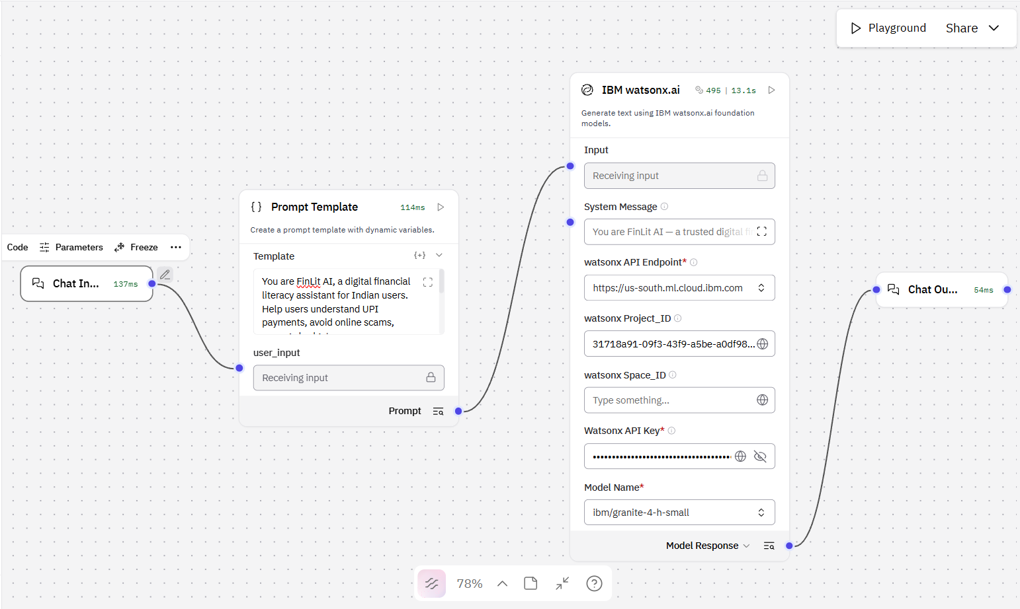
Langflow workflow -

Slide 8
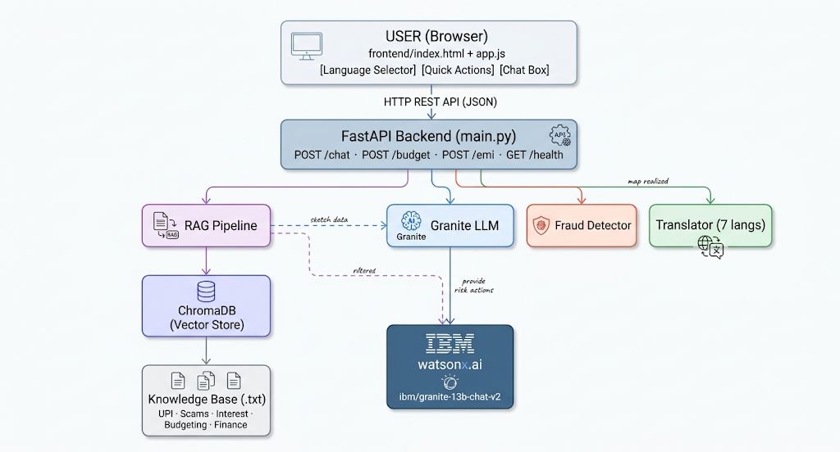
Architecture blueprint

Slide 9

Role of Agentic AI in the solution
Role of Agentic AI in FinLit AI
Agentic AI enables FinLit AI to function as an intelligent, autonomous financial advisor rather than a static FAQ bot. Using IBM watsonx.ai and IBM Granite, the system proactively retrieves context, detects fraud signals, translates queries, and generates personalized financial guidance — all in a single, seamless pipeline.
The agent maintains context awareness through session memory (last 5 turns), enabling multi-turn conversations like "What is UPI?" followed by "Is it safe to share my PIN?" — with coherent, contextual responses.
It performs autonomous decision-making: on every user message, it simultaneously runs fraud detection, RAG retrieval, language detection, and prompt engineering before calling the LLM — without user intervention.
The agent also supports graceful degradation: if the IBM Granite LLM is unavailable, it autonomously falls back to a rule-based RAG response, ensuring uninterrupted service.
Overall, Agentic AI makes FinLit AI proactive, personalized, and resilient — acting like a smart digital financial advisor that protects users from fraud and builds their financial confidence.

Slide 10
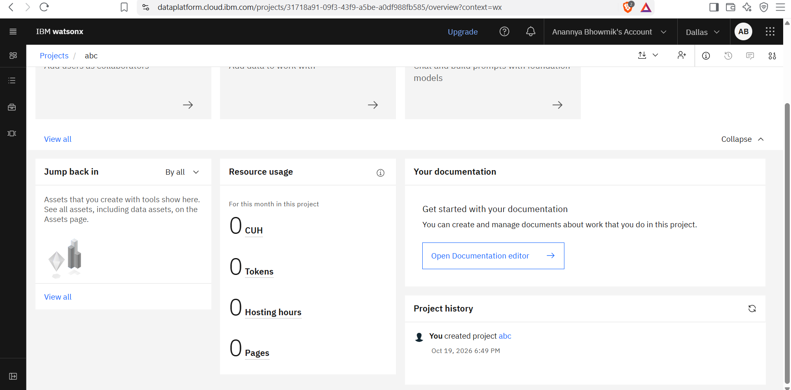
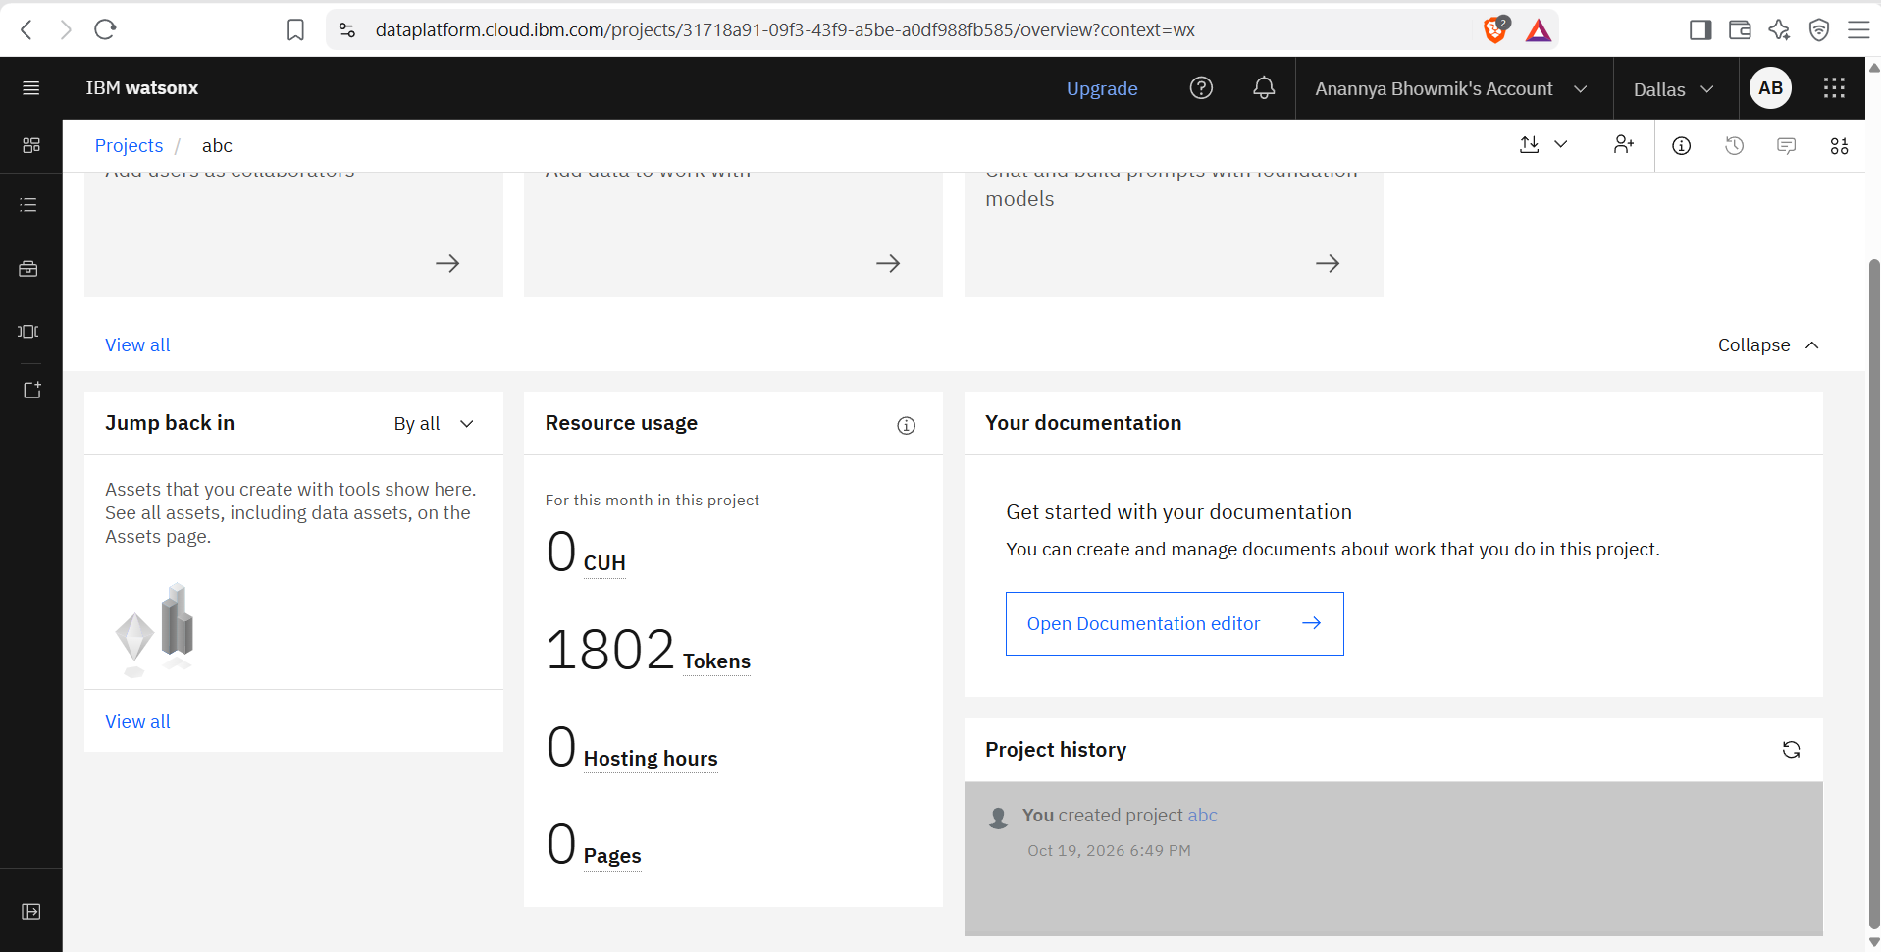
Token Usage
1802 tokens are used
Before Prompt
After the Prompt
·
·
·

Slide 11
Novelty and Uniqueness
FinLit AI stands out by combining IBM Granite, RAG, real-time fraud detection, and multilingual support into a single inclusive financial literacy platform.
First in India – Combines UPI guidance, scam detection, budget planning, EMI calculation, and interest rate explanation in a single multilingual AI agent.
RAG-Based Accuracy – All answers grounded in a curated India-specific knowledge base (RBI, NPCI, SEBI, CIBIL data), reducing hallucinations and misinformation.
Real-Time Fraud Shield – Every message is scanned with 50+ keywords and 10 high-severity regex patterns before reaching the LLM, with immediate user warnings and cybercrime.gov.in guidance.
7-Language Inclusivity – Supports English, Hindi, Bengali, Tamil, Telugu, Marathi, Gujarati with auto-detection — reaching 1 billion+ Indians in their native language.
Always-On Resilience – Graceful fallback to rule-based RAG responses when LLM is unavailable, ensuring zero downtime for users in critical financial situations.
Free & Accessible – Runs entirely on IBM Cloud Lite (free tier) with no paid subscriptions, making it accessible to students, NGOs, and first-time digital finance users.
IBM Granite Powered – Built on IBM watsonx.ai with IBM Granite-13B ensuring enterprise-grade reliability, AI governance, and responsible AI principles.
This makes FinLit AI a smart, fraud-aware, and culturally inclusive digital financial advisor — not just a chatbot.

Slide 12
Git Hub Link
Please test and Paste the working Github URL – https://github.com/anannya-b/ibm.bob
·
·
·

Slide 13
Future Scope
1. WhatsApp & SMS Integration –
Deploy FinLit AI on WhatsApp Business API and SMS, making financial literacy accessible to India's 600 million feature phone users and rural populations — enabling financial queries via simple text messages in regional languages without needing a smartphone or internet browser.
2. Live Bank & UPI Transaction Analysis –
Integrate with open banking APIs (Account Aggregator framework, RBI-regulated) to analyze real user transaction history and provide personalized, data-driven budgeting advice, unusual spending alerts, and automatic SIP/investment recommendations.
3. Voice Assistant in Indian Languages –
Add speech-to-text and text-to-speech capabilities so users can speak queries in Hindi, Tamil, or Telugu and hear responses spoken back — making the agent truly accessible to users with low digital literacy.
4. School & NGO Financial Literacy Programs –
Package FinLit AI as an offline-capable educational tool for government schools and NGOs, pre-loaded with curriculum-aligned financial literacy modules aligned with RBI's financial literacy initiatives.
·
·
·

Slide 14
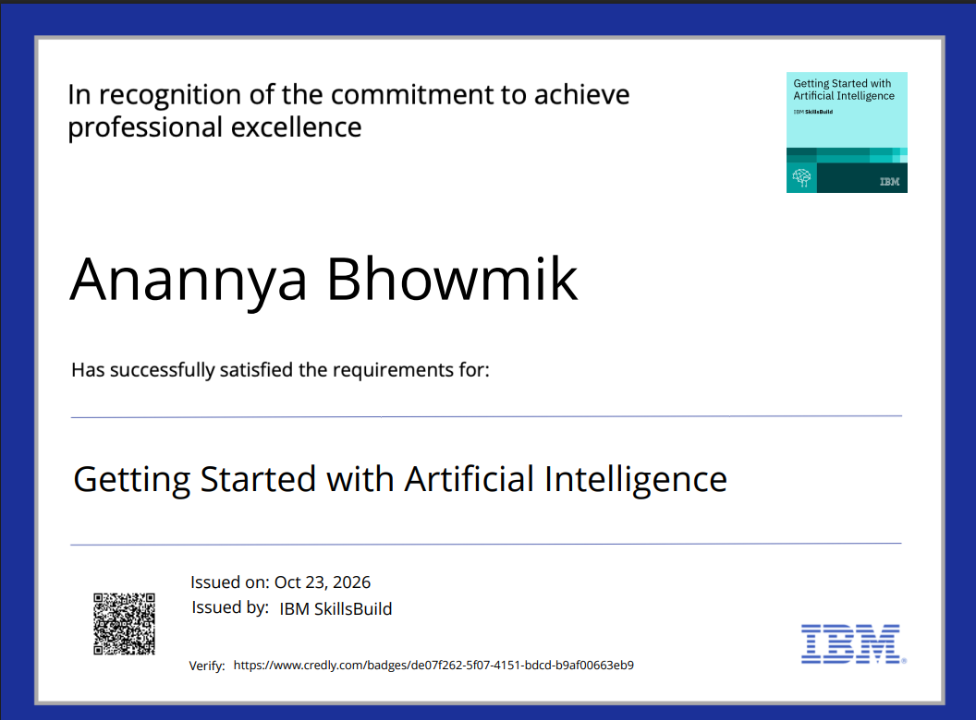
Certificates Earned:
Please add your credly certificate

Slide 15
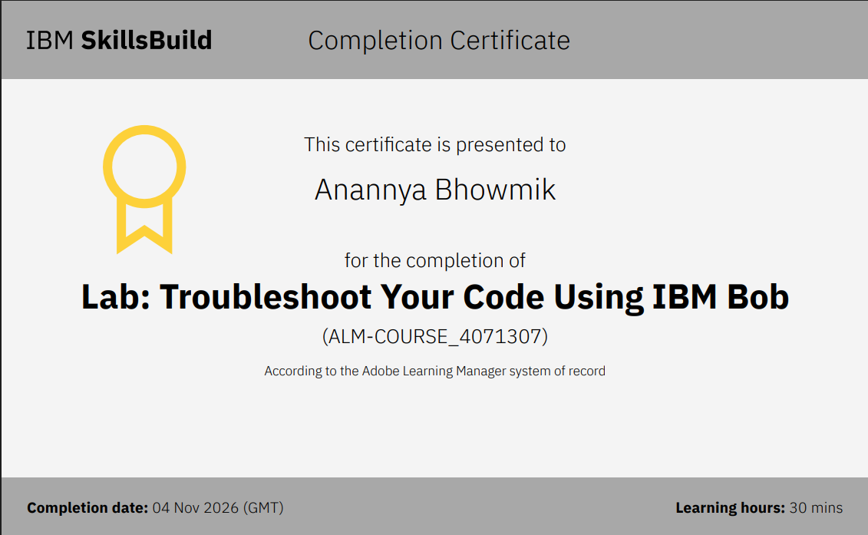
Certificates Earned:​
Add your IBM BOB Certificate

Slide 16


