Slide 1

Multiple Linear Regression Analysis
On
High school Graduation Performance
By
Anannya Chatterjee
University of North Texas

Slide 2
Theory about the data
The technology revolution and digitization of 21st century has brought in new challenges for the teachers, parents and mentors to understand and quantify multiple factors that influence a student’s conduct in various subjects which becomes a deciding factor for their grades/marks in the final year of graduation. Creating data models to follow students throughout their high school to unlock key issues that lead to success or failure of post-middle school education have the potential to not only help the national discussion regarding post-middle school success, but in this age of spiraling college tuition costs, may assist families in making more thoughtful decisions about how best to prepare their children for productive and successful educational experiences after high school graduation.

Slide 3
What to do next?
Focusing on the ways of mathematically sorting out:
Which of the factors do indeed have an impact on the student performance at high school graduation ?
Which factors matter the most?
Which all we can ignore?

Slide 4
DataSET Details
As part of this project, I have introspected the “HighSchool_GraduationPerformance.xlsx “dataset for determining the factors that possibly influence the performance of a student . There were all total 9 variables (Gender, Race, Parental_Education, TestPrep_Course, Special_Coaching, Attendance, DailyStudy_Hours and Result) and 298 observations. Result is considered as the dependent variable and all others are considered independent variables.

Slide 5
ACTIVITIES
Data preparation and Cleansing.
Running preliminary regression model and removing the variables that are either statistically or practically insignificant…
Taking the help of histograms and scatter plots to find out the correct functional form of the reduced variables.
Created 3 different models based on the above information.

Slide 6
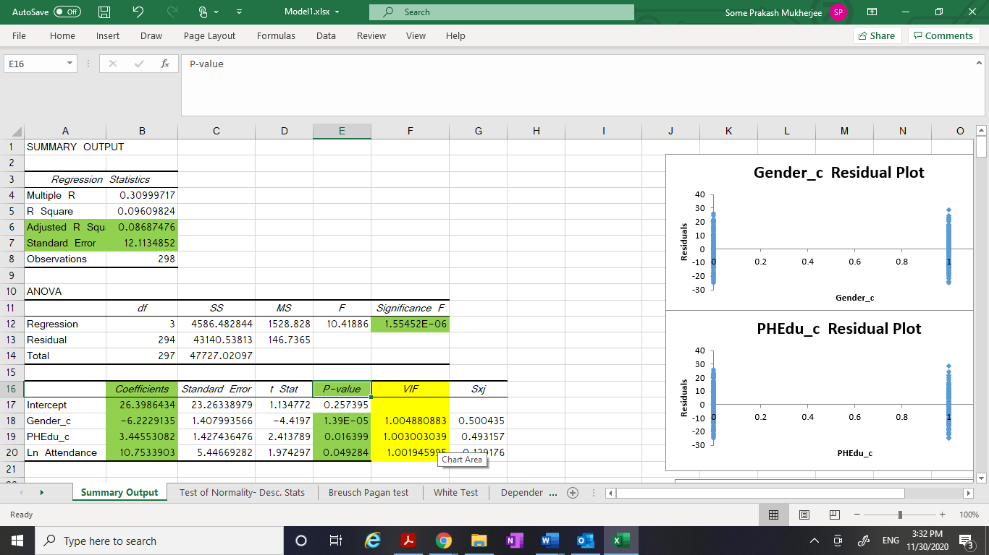
First Model
Here I have considered Gender_c, PHEdu_c, Ln_Attendance as the independent variables and Result as the dependent variable and ran the Regression in the Excel.

Slide 7
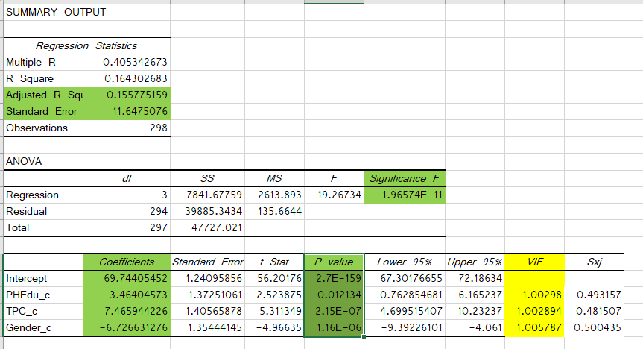
Second Model
Here I have considered PHEdu_c, TPC_c and Gender_c as the independent variables and Result as the dependent variable and ran the Regression in the Excel.

Slide 8
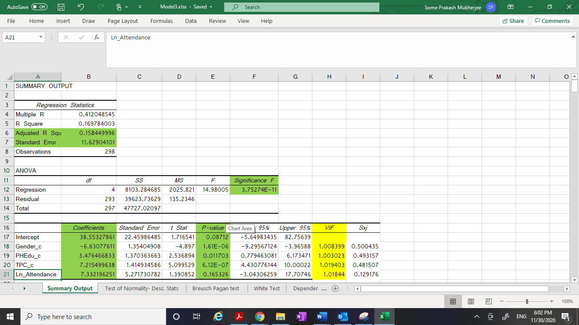
Third Model
Here I have considered Gender_c, PHEdu_c, TPC_c and Ln_Attendance as the independent variables and Result as the dependent variable and ran the Regression in the Excel.

Slide 9
SELECTING the best model
I have compared the values of “Adjusted R Square “and “Standard Error” among all the three different models. Adjusted R-squared increases only when independent variable is significant and affects dependent variable. Since the “Adjusted R Square” is highest in Model 3 (compared to model 1 and 2) and “Standard Error” is least in “Model 3” compared to Model 1 and 2, so I predict that Model 3 is the best among all the three models.
 | Adjusted R Square | Standard Error
Model 1 | 0.086874755 | 12.11348522
Model 2 | 0.155775159 | 11.6475076
Model 3 | 0.158449996 | 11.62904101

Slide 10
Findings from model 3
From the Model# 3, I can state that H0 is rejected and Model# 3 is better than H0. Hence, we have proved that there is a relationship between the variables that is explained by Model 3.
The model#3 states the relationship among the variables as follows:
Result(hat) = 38.553 - 6.630*Gender_c + 3.476*PHEdu_c + 7.215*TPC_c + 7.332*Ln_Attendance
Where ‘Result’ denotes the Graduation Result Percentage, ‘Gender_c’ says the gender, ‘PHEdu_c’ denotes whether parent is highly educated or not, ‘TPC_c’ denotes whether Test Preparation Course was completed or not and ‘Attendance’ denotes the percentage of attendance.

Slide 11
Interpretation of the results
As compared to Female student, the Graduation Result percentage decreases by 6.63 for Male student, while everything else is constant.
As compared to the student whose parents are not highly qualified, the Graduation Result percentage increases by 3.476 for the students whose parents are highly qualified, while everything else is constant.
As compared to the students who did not complete Test preparation courses, the Graduation Result percentage increases by 7.215 for the students who completed Test preparation courses, while everything else is constant.
This Model #3 is a semi log model as we have one logarithmic form of independent variable (Attendance) and our dependent variable is not in logarithmic form. As we know that whenever we are using Logarithmic form for any of the variable in the regression model, the coefficient (B value) tells the percentage change for that variable. That is the increase or decrease is measured as B%. Here Attendance variable had been logged and we had Ln(Attendance) in our Model.
So, the model speaks the below statement about the Attendance variable
For 1 percent increase in Attendance percentage, Graduation Result percentage increases by 0.07332 (i.e 7.332/100), while everything else is constant.

Slide 12
social implications of the findings
Based on the data analysis, it is quite imperative that teen-ager female students remain more focused on studies compared to male counterparts who get easily distracted on a wide array of things ranging from sports, outdoor activities, gaming, music and other extra-curricular activities. The thread which ties together the attention in students easily loosens up in male student compared to female and hence we see a drop in their performance during graduation.
Similarly, parents who are highly educated and earned higher degrees have the natural tendency to pass on the value of education to their off springs. Additionally, highly qualified parents tend to provide their kids with an atmosphere to learn and grow and they set it all by example which makes it easy for kids to interpret.
Also, the test preparatory courses provide an edge in the success of the students through giving them a look and feel of the actual exam pattern and environment. Students who complete those get equipped with the techniques required to set themselves apart from rest of the students in high school graduation exam
Last but not the least, attending class sessions helps students to stay on track, understand expectations, foster important peer social interactions and generally promote a sense of connectedness. Increasingly, attendance is being understood as a precursor and leading indicator for student success. Attendance improves performance.

Slide 13
Forecast future values:
The estimated equation could be better understood by using that in forecasting a future value of the Result variable. In this case, the estimated equation is:
Result(hat) = 38.553 - 6.630*Gender_c + 3.476*PHEdu_c + 7.215*TPC_c + 7.332*Ln_Attendance
Suppose high schooler Tom who maintains a 90% attendance record has reasons to believe that Test preparation Courses hardly impacts his performance. His highly educated parents are really worried about his graduation results.
The regression equation can be used to predict the result percentage of Tom in both the scenarios (with and without completing Test preparation Courses).
Case 1: Tom considers NOT to complete Test Preparation Courses.
Plugging in the values of Gender_c = 1, PHEdu_c = 1, TPC_c = 0 and Attendance = 90 in the above equation, I get:
Result = 38.553 – 6.630*1 + 3.476*1 + 7.215*0 + 7.332*ln(90)
= 68.33
Case 2: Tom considers completing Test Preparation Courses.
Plugging in the values of Gender_c = 1, PHEdu_c = 1, TPC_c = 1 and Attendance = 90 in the above equation, I get:
Result = 38.553 – 6.630*1 + 3.476*1 + 7.215*1 + 7.332*ln(90)
= 75.55
So, the regression equation could really help in estimating the result of students that is impacted by multiple variables.

Slide 14
Impact of Social desirability biasness on the regression analysis
Social-desirability bias is a type of response bias that is the tendency of survey respondents to answer questions in a manner that will be viewed favorably by others. It can take the form of over-reporting "good behavior" or undesirable behavior. The dataset that I worked on to determine validity of relationships between the Student Performance and its various deciding factors (using Regression Analysis ) is social desirability biased as respondents often hide their true attitudes - in order to impress the researcher or interviewer or to preserve one’s self-esteem. That’s why the coefficient of variation (also known as R2) that is used to determine how closely a regression model “fits” or explains the relationship between all the independent variables (Parent higher education, Gender, Test preparation course and Attendance) and the dependent variable (student Performance) has emerged low. Moreover, some other factors like inherent talent, genetic aptitude also determine the performance of a student that are very unlikely determined by any mathematical or statistical models.
As part of future research, I would like to examine potential influence of SDB in other type of student self-report data and performance levels associated with it.

Slide 15
Any Questions?

Slide 16
Thank You

