Slide 1

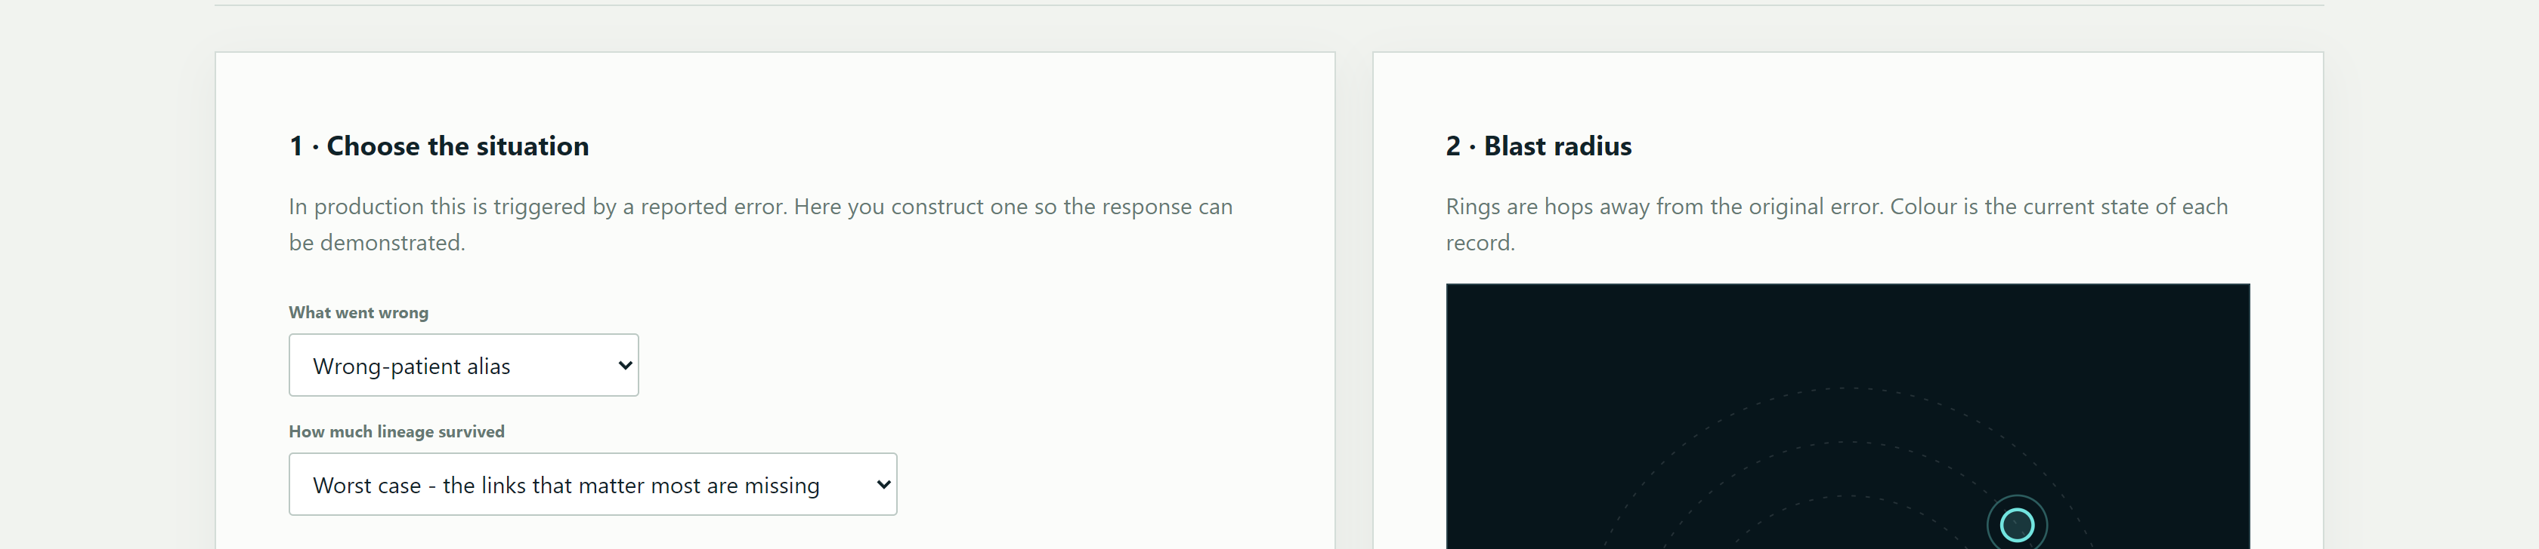
AEGIS·CARE
RESEARCH POSTER · SYSTEMS & VALIDATION
POST-INCIDENT RECOVERY FOR PERSISTENT CLINICAL AI MEMORY
Synthetic evidence only · not clinical validation
Privacy-bounded recovery for persistent clinical AI memory
CORE CLAIM
Delete the bad memory—
not everything it touched.
A control plane that identifies affected derived state, rebuilds only what is necessary, and verifies that unsafe influence cannot survive the repair.
1
ABSTRACT · INTRODUCTION · MOTIVATION
3
OBJECTIVES
4
METHODS · THE CARE LOOP
Clinical AI systems can retain long-lived memory, summaries, caches and derived artifacts. When one source is later corrected or withdrawn, naïve recovery either leaves contaminated state behind or destroys too much legitimate work. AEGIS-Care treats recovery as a bounded systems problem: find the affected closure, prove causal support, recompile from clean inputs, then enforce deletion so the incident cannot reappear.
01
BOUND
Discover the smallest affected subgraph.
C
CANDIDATE
A
ATTRIBUTION
Find affected closure
Prove causal support
02
EXPLAIN
CARE
Require lineage and causal support.
bounded repair
MOTIVATION
03
REBUILD
A corrected chart entry should not force a full reset—yet no downstream note, cache or assistant answer may preserve its influence.
Recompute from clean source state.
E
ENFORCE
R
REBUILD
Make deletion stick
Rebuild clean state
2
LITERATURE REVIEW · BACKGROUND
04
PROVE
Paired evaluation matrix
incident conditions × repair policies × evidence gates
Measure safety, utility and retention.
Prior work establishes evaluation for medical agents (MedAgentBench), staged reporting for clinical AI (DECIDE-AI), lifecycle governance (FUTURE-AI), risk controls (NIST AI 600-1), and interoperable audit/provenance semantics (HL7 FHIR). Synthea supplies realistic synthetic records. The remaining systems gap is selective, measurable post-incident recovery across persistent AI state.
5
PROTOTYPE · CURRENT PROGRESS
RUNNABLE PROTOTYPE
RESEARCH QUESTION
Clinician-facing assurance console
Can recovery simultaneously minimize residual harm, preserve clean utility and produce auditable evidence?
Role-aware views · held-record review · deterministic local answers · synthetic FHIR evidence
LAKSHIT SACHDEVA · TRAYEE NAYAMPALLI · ANANNYA SAMUDRA · SOHUM SAWANT
SVKM's NMIMS · MPSTME · Project mentor: To Be Confirmed

Slide 2
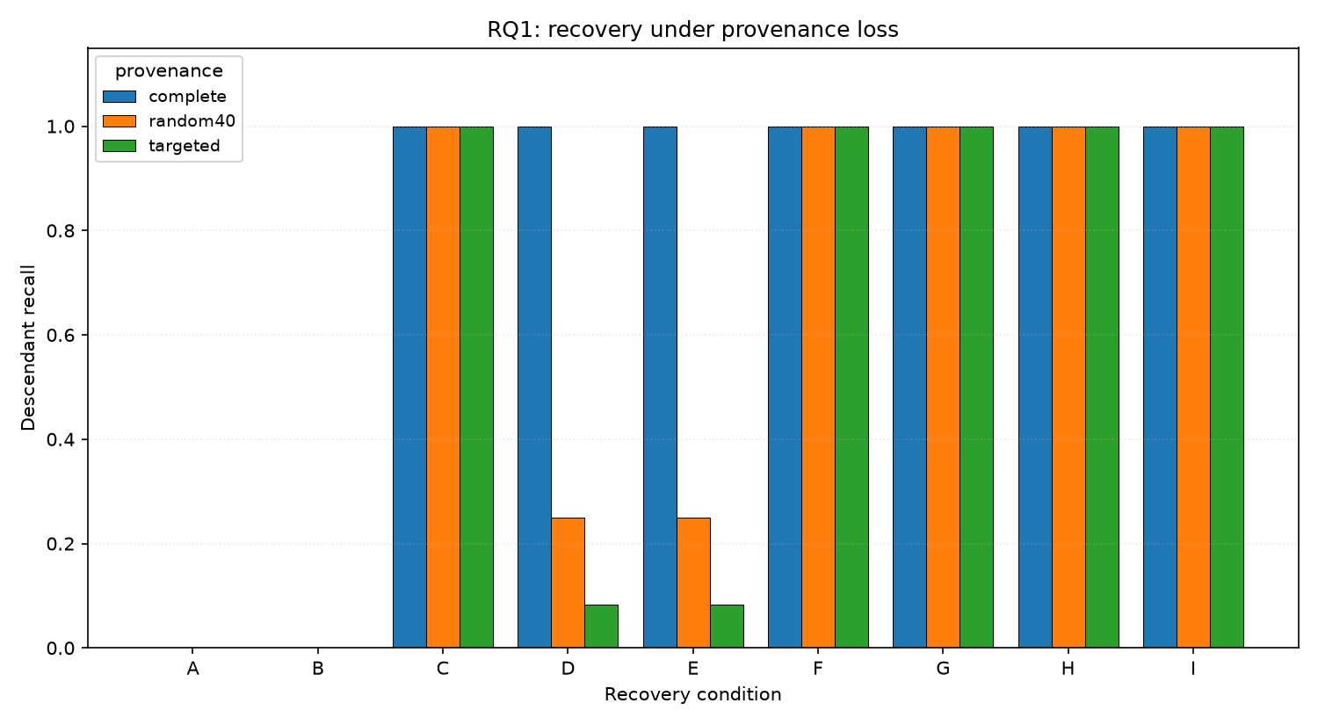
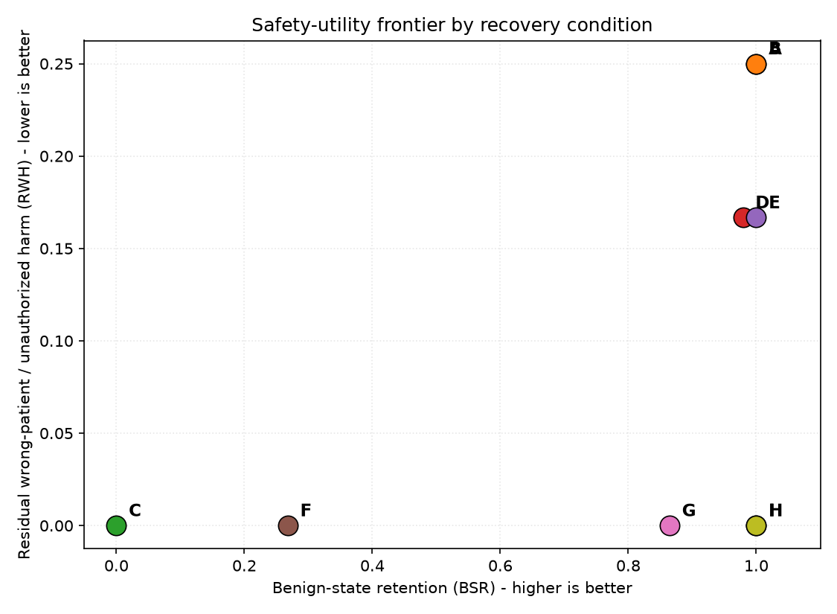
EVIDENCE, INTERPRETATION & LIMITS
AEGIS·CARE · PAGE 2 / 2
0.000
1.000
1.000
3,623
7,003
108
RESIDUAL WRONG-ANSWER HARM
INCIDENT RECALL & PRECISION
BENIGN STATE RETAINED
FHIR RESOURCES VALIDATED
NATIVE REFERENCES REWRITTEN
EXTERNAL CONDITION RUNS
6
RESULTS
7
DISCUSSION
WHAT THE EVIDENCE SUPPORTS
The mechanism can contain tested incidents without indiscriminate deletion, preserve clean state, and emit auditable evidence across a realistic synthetic FHIR corpus.
Ablations matter
Lineage-only recall = 0.4444 · sketch-only BSR = 0.2679
LIMITS / SAFETY BOUNDARY
Synthetic mechanism validation only. No diagnosis, treatment recommendation, medication execution or patient-benefit claim. Membership-inference advantage (+0.286) remains measurable and motivates stronger privacy controls.
Provenance sensitivity
Lineage-only recovery misses affected state.
Safety–utility frontier
Full CARE reaches the safe corner.
RESULT
NEXT
Prospective workflow study · adversarial incident library · privacy-hardening · standards-aligned evidence exchange.
Full CARE achieved zero residual wrong-answer harm with perfect recall, precision, benign-state retention and repair-target specificity in the external-format evaluation.
8
EXTERNAL VALIDATION
9
REFERENCES · ACKNOWLEDGEMENTS
10 public Synthea patient bundles · 12 incidents · 108 condition runs · 3,623 supported resources · 7,003 rewritten references · 0 unresolved references · 0 loader validation errors.
[1] Wang et al., MedAgentBench, NEJM AI. [2] FUTURE-AI, BMJ 388:e081554, 2025. [3] DECIDE-AI, BMJ 377:e070904, 2022.
[4] NIST AI 600-1, Generative AI Profile, 2024. [5] HL7 FHIR R4 AuditEvent & Provenance. [6] Walonoski et al., Synthea, JAMIA 25(3), 2018.
[7] AEGIS-Care v5 evidence manifest and external-validation report. Acknowledgements: SVKM's NMIMS / MPSTME; open standards and synthetic-data communities.
Evidence manifest verified: 8 artifacts.
Privacy-bounded recovery is a control-plane problem—not a prompt-engineering patch.
AEGIS·CARE · research prototype

