Slide 1
Developer Technology Trends: What Developers Use Today and Want Next
Prepared by Anandu Priyakumar
October 18, 2026

Slide 2
Table of Contents
Executive Summary
3
Introduction
4
Methodology
5
Results
6
Visualisation: Charts
7
Dashboard
13
Discussion
17
Findings & Implications
18
Conclusion
19
Appendix
20

Slide 3
Executive Summary
Purpose: Analysed Stack Overflow Developer Survey data to see which technologies developers use today and want next
Approach: Cleaned the data, explored it with SQL and Python, and built a Cognos Analytics dashboard
Key findings: JavaScript and SQL lead languages, PostgreSQL leads databases and AWS leads platforms
Future interest: Rust and Go enter the top 10 wanted languages and PostgreSQL grows as the most wanted database
Recommendation: Prioritise JavaScript/TypeScript, SQL, Python, PostgreSQL and AWS; watch Rust, Go, Supabase and FastAPI
14,943
JavaScript: most used language
11,514
PostgreSQL: most used database
12,193
PostgreSQL: most wanted database

Slide 4
Introduction
Background
Data source
Technology changes fast, so developers and organisations need to know which tools are in use and which are gaining interest
The Stack Overflow Developer Survey, with responses from developers around the world
Objective
Key questions
Identify current and future technology trends and understand who the respondents are
Which languages, databases, platforms and web frameworks are used today and wanted next?
Who are the respondents?

Slide 5
Methodology
1 Data
2 Preparation
Notebooks use the full survey (65,437 responses); the dashboard uses a course extract of 18,845
Cleaned with Python (Pandas): removed duplicates and handled missing values
3 Analysis
4 Visualisation
SQL and Python in Jupyter Notebooks to explore and count technology use
Cognos Analytics dashboard with three tabs: current use, future trends, demographics

Slide 6
Results
Current usage
Future interest
Demographics
JavaScript (14,943), SQL (12,602) and HTML/CSS (12,410) are the most used languages
PostgreSQL (11,514) leads databases; AWS (10,871) leads platforms
JavaScript, SQL, TypeScript and HTML/CSS are the most wanted languages
PostgreSQL rises to 12,193; Rust and Go enter the top 10
41.3% are aged 25-34 and 27.3% are 35-44
Most common education: bachelor's degree (8,629)
Most respondents: USA (3,441), Germany, India

Slide 7
Job Postings by Location
Washington DC has the most postings (5,316); Austin and San Francisco have the fewest. Source: jobs dataset provided with the course.

Slide 8
Average Annual Salary by Language
Swift pays the most ($130,801). Source: static web page provided with the course, scraped with BeautifulSoup, so figures are illustrative.

Slide 9
Programming Language Trends

Slide 10
Language Trends: Findings & Implications
Findings
Implications
JavaScript (14,943), SQL (12,602) and HTML/CSS (12,410) are the most used; JavaScript is also the most wanted (11,541)
TypeScript (10,709 to 10,437) and Python (9,590 to 8,919) keep most of their interest
Rust (2,284 to 5,597) and Go (3,305 to 5,661) rise; Java falls from 5,982 to 4,048
JavaScript, SQL and HTML/CSS remain the safest core skills to build on
TypeScript and Python are strong additions to that core
Rust and Go are worth watching, and lower interest in Java suggests it may be cooling

Slide 11
Database Trends

Slide 12
Database Trends: Findings & Implications
Findings
Implications
PostgreSQL is both the most used (11,514) and the most wanted (12,193) database
MySQL is second most used (8,556), but interest falls to 6,204
Redis rises from 5,814 to 6,384; Supabase enters the wanted list (1,623) while Oracle drops out
PostgreSQL is the strongest database skill to learn or adopt
MySQL is still widely used, but interest may be shifting toward PostgreSQL
Redis and Supabase are worth watching as growing options

Slide 13
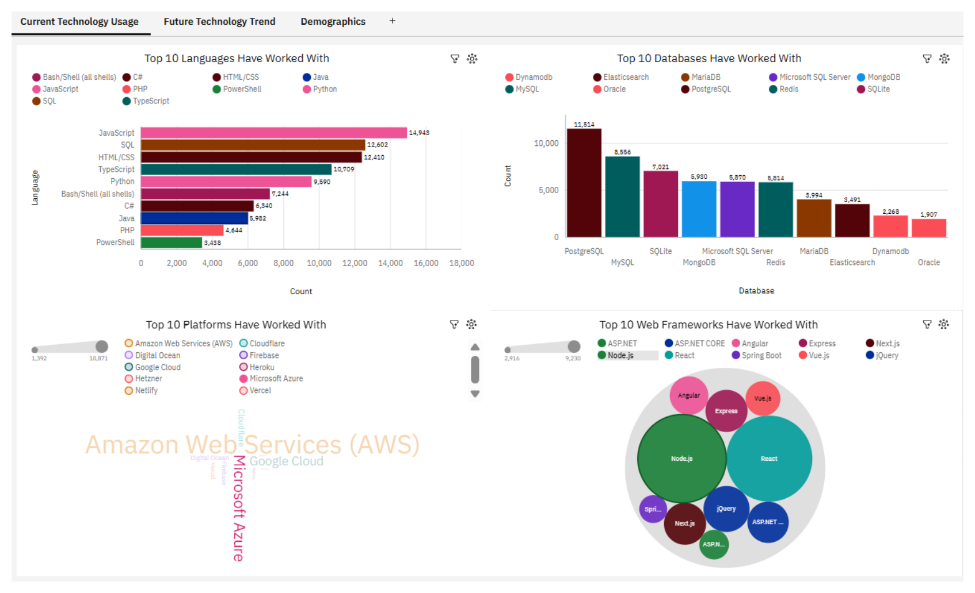
Dashboard
Interactive Cognos Analytics dashboard with three tabs
Tab 1: Current technology usage
Tab 2: Future technology trend
Tab 3: Demographics
View the survey dashboard (PDF)

Slide 14
Dashboard Tab 1: Current Technology Usage

Slide 15
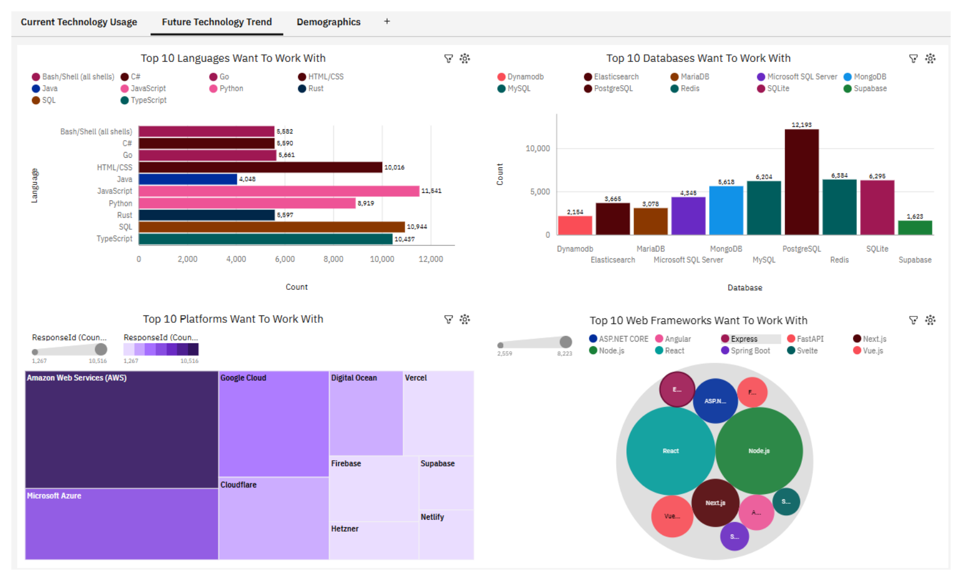
Dashboard Tab 2: Future Technology Trend

Slide 16
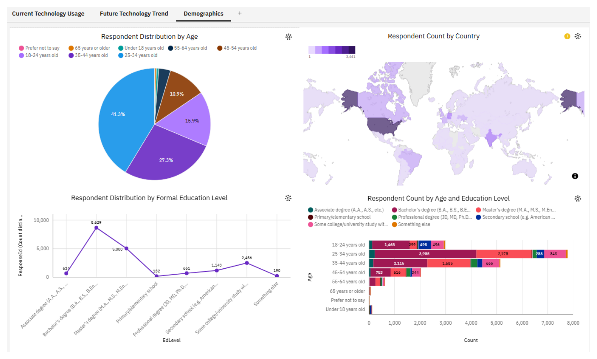
Dashboard Tab 3: Demographics

Slide 17
Discussion
1
Stable core: JavaScript and SQL lead both current use and future interest, with HTML/CSS and TypeScript close behind
2
Database shift: PostgreSQL is the most wanted database (12,193), while interest in MySQL falls from 8,556 to 6,204
3
Emerging tools: Rust, Go, Supabase and FastAPI show growing interest, though they are still smaller than the established tools
4
Cloud: AWS leads current (10,871) and future (10,516) platforms, with Azure and Google Cloud next
5
Limitation: 68.6% of respondents are aged 25-44 and most are professional developers, so findings may not describe all developers

Slide 18
Overall Findings & Implications
Findings
Implications
JavaScript and SQL lead both current use and future interest
PostgreSQL, AWS, Node.js and React lead their categories today and for the future
Rust, Go, Supabase and FastAPI are rising; 25-34 year olds are the largest group (41.3%)
Web and SQL skills are the safest foundation to build on
PostgreSQL, AWS and the Node.js/React stack are strong choices to learn or adopt
Emerging tools are worth watching, and findings mainly reflect younger developers

Slide 19
Conclusion
1
Core skills: JavaScript and SQL lead both current use and future interest
2
Leading tools: PostgreSQL, AWS, Node.js and React lead their categories today and for the future
3
Emerging trends: Rust, Go, Supabase and FastAPI show growing interest and are worth watching
4
Next steps: Track trends across multiple survey years and add job posting data to confirm employer demand

Slide 20
Appendix
Dashboard: github.com/ananpkumar/ibm-data-analyst-capstone (dashboard folder)
Data source: Stack Overflow Developer Survey. Notebooks use the full survey; the dashboard uses a course-provided extract of 18,845 responses
Tools used: SQL, Python (Jupyter Notebooks), IBM Cognos Analytics
Code and notebooks: github.com/ananpkumar/ibm-data-analyst-capstone

